Slide 1

11 December 2022
RAID56 in BTRFS
New challenges for old tricks
Qu Wenruo <wqu@suse.com>

Slide 2

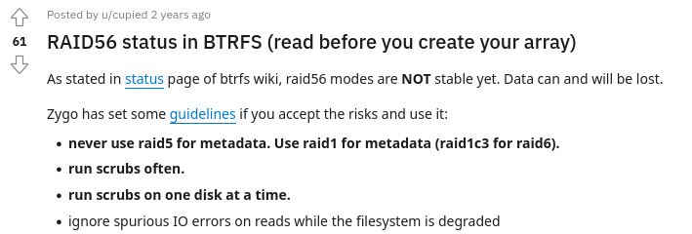
Introduction
Btrfs provides its own RAID56 profiles.
But has a bad reputation.
This talk will cover:
What’s RAID56
What’s wrong with Btrfs RAID56
New challenges for RAID56
How can we improve Btrfs RAID56

Slide 3
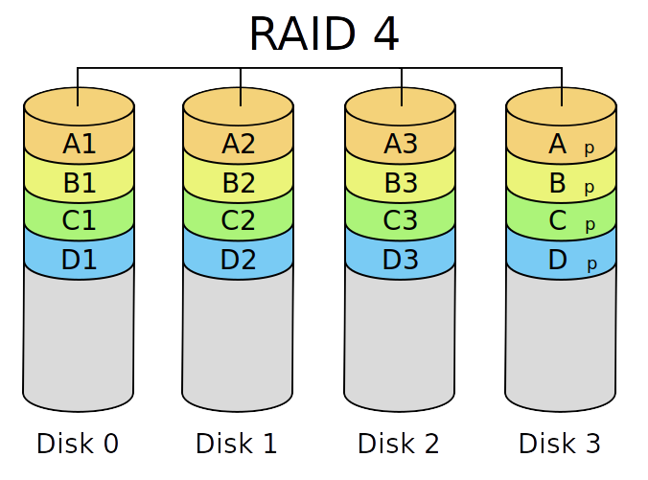
What’s RAID56
RAID4
RAID0 + dedicated parity disk
Parity = XOR(All data)
Tolerant 1 missing disk
Parity in the same disk
Lower random write performance due to frequent Parity update

Slide 4
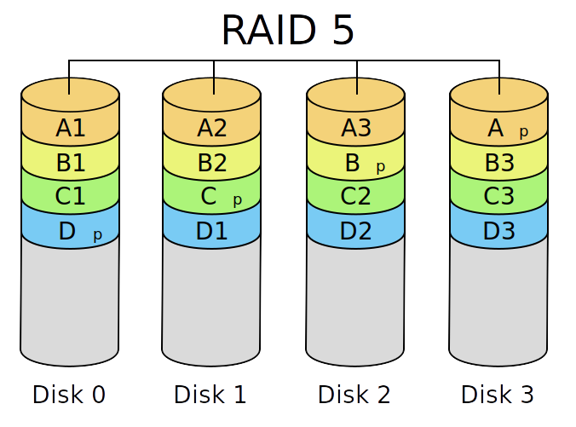
What’s RAID56
RAID5
RAID4 with rotation
Parity update is better load balanced

Slide 5
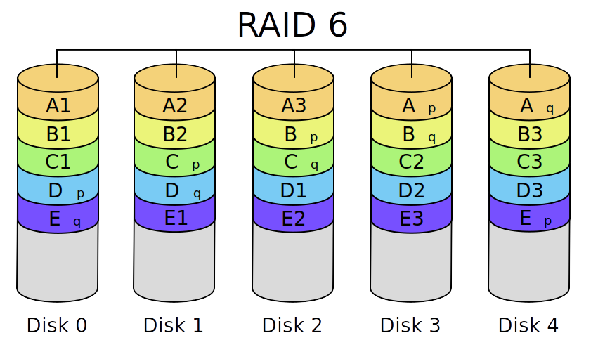
What’s RAID56
RAID6
RAID5 with extra Parity(Q)
Q calculation is more complex
Can tolerant 2 disks

Slide 6
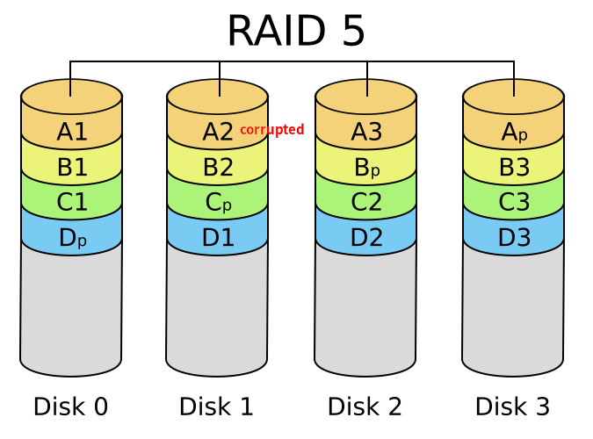
What’s RAID56
Hidden pitfalls for RAID56:
Multi-device synchronization
E.g. powerloss when doing writes
Rotten bit detection
Destructive read-modify-write (RMW) cycle

Slide 7
RAID56 in btrfs
How btrfs supports its RAID profiles
Multiple profiles can co-exist
Dynamically allocated
Mapped into a linear btrfs logical address space
Btrfs Logical address space
Type: RAID1 Metadata
Devid: 1 Physical Y1
Devid: 2 Physical Y2
0~1G
1~2G
2~3G
3~4G
Type: RAID5 Data
Stripe length: 64K
Devid: 1 Physical Y3
Devid: 2 Physical Y4
Devid: 3 Physical Y5
4G~Infi

Slide 8
RAID56 in btrfs
Current Btrfs RAID56 bug list
Write-hole (multi-device synchronization)
Have proposals, final solution TBD
Lack of subpage support
Support added in v5.19.
Over-updated Parity
Fixed in v6.0.
Destructive RMW
WIP, related to above write-hole bug.

Slide 9
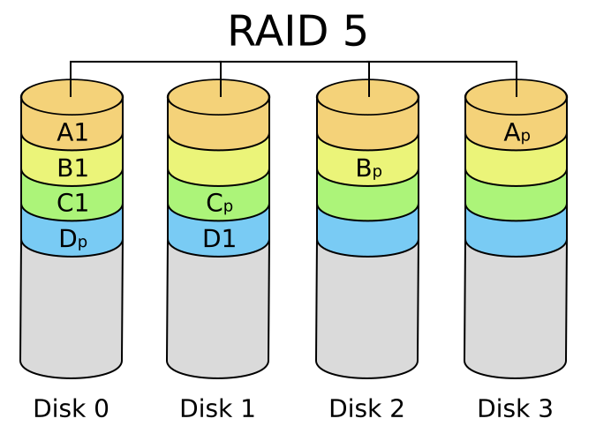
RAID56 in btrfs
For the write-hole, existing proposals are
Journal/write-intent bitmaps
Tried and true. But some performance penalty.
Avoid sub-stripe write at all
Extra ENOSPC possibility. (Worse than RAID1 space efficiency)

Slide 10
RAID56 in btrfs
For the Destructive RMW problem
Read full stripe and verify before write
Btrfs checksum comes to save us.
Will cause some performance penalty.
Possible deadlock?
Working in progress
Can partially reduce write-hole

Slide 11
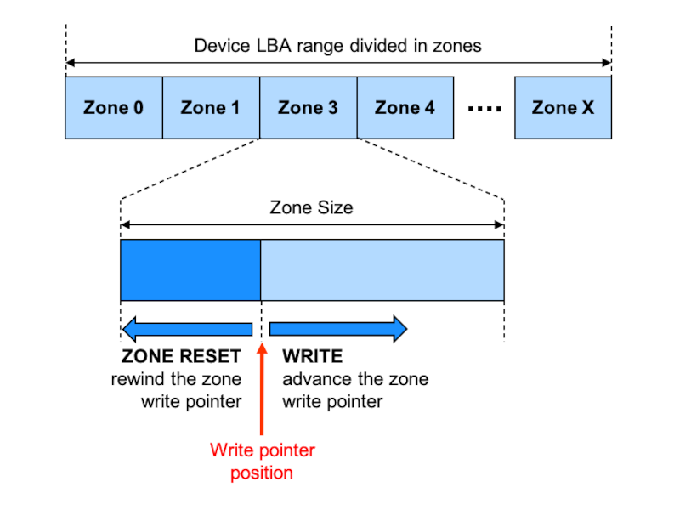
New chanlleges for RAID56
Zoned device
Multiple zones in one disk
Tape-like (-lite) behavior in sequential zones
No support for over-write.
No more guarantee the write will land where we specify

Slide 12
New chanlleges for RAID56
RAID56 and zoned device
How to support RAID56 with zoned device
Copy-on-write (COW) is definitely needed, and extra mapping for RAID56 stripes.
Dilemma for parity updates and space efficiency
Disk 1
Free
Free
Disk 1
Data 1
Free
Disk 1
Data 1
Free
Disk 2
Free
Free
Disk 2
Free
Free
Disk 2
Data 2
Free
Disk 3
Free
Free
Disk 3
Parity
Free
Disk 3
Parity1
Parity 1+2

Slide 13
TL;DR
We’re improving Btrfs RAID56 support
Existing fixes
Less parity update, subpage support, better recovery etc.
Destructive RMW problem
Can pay the performance cost, already WIP.
How to handle zoned devices
Different solutions for different devices, or go a unified “silver bullet”?

Slide 14
Q&A

Slide 15

Thank You
For more information, contact SUSE at:
+1 800 796 3700 (U.S./Canada)

