Slide 1
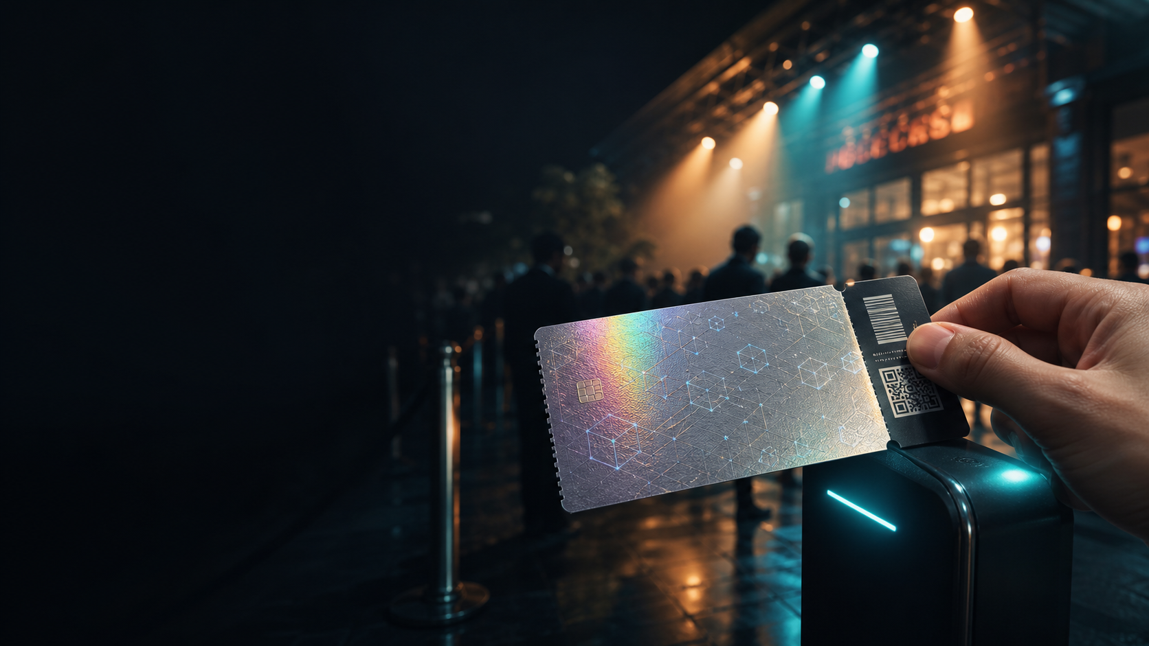



BTS · FINTECH SUMMER SCHOOL
TicketChain
Authentic concert tickets, verified on-chain.
Concert tickets you can't copy, can't overprice on resale, and can't use twice.
Sepolia testnet
Live MVP
Live demo
Live landing page on Sepolia
Practical project · A working blockchain application — built, validated, presented live.
Notes:
Hook (~30s). Say the name and the one-line value prop. Don't dive into tech yet. 6 speakers — split the sections. 15 min total, keep the live demo at the centre.

Slide 2






01 · PROBLEM & PERSONA
The problem
Fake tickets & duplicates
The same ticket can be sold to several people; buyers can't check authenticity before paying.
Two victims, one gap
The organizer
Uncontrolled resale
Loses resale revenue and sees its reputation hurt by fraud and scams.
Vinted, Facebook groups, bots: prices spike and the organizer earns nothing on that resale.
The fan
No proof at the door
Risks buying a fake, already-used, or multiply-sold ticket — with no guarantee.
A screenshot is enough to get in: entry control doesn't prove the person really owns the ticket.
Notes:
~2 min for Problem + Persona. Start with the pain, not the tech. Key line: the fan suffers the scam, but the organizer loses the revenue AND can act — hence our B2B buyer.

Slide 3
01 · PROBLEM & PERSONA
Who we serve
PRIMARY PERSONA · THE BUYER
SECONDARY PERSONA · THE BENEFICIARY
Karim, 38 — product lead at an
independent ticketing operator
Léa, 24 — student, buys and
resells second-hand
Goal cut fraud and capture a share of resale instead of letting it slip away.
Goal go to concerts without getting scammed; resell without losing money or being blamed.
Pain #1 the black market pockets all the speculation; he gets none of it. [TO VALIDATE]
Pain #1 fear of a ticket that's already used, fake, or sold to several people. [TO VALIDATE]
Today classic ticketing (Eventbrite) with no cap and no independent verification.
Her role her pain proves the problem is real — but she is not the one who signs.
Notes:
B2B2C model: Karim is the economic buyer (pays / adopts / monetizes), Léa is the beneficiary whose pain justifies it all. [TO VALIDATE] = quotes to replace with real interview verbatims before the pitch.

Slide 4

02 · MARKET
Market & why now
Competitive matrix
Solution | Resale cap | Authenticity | Independent check
Eventbrite / classic ticketing | No | Partial | No
Ticketmaster (SafeTix) | Partial | Yes | No
Wild resale (Vinted, FB, bots) | No | No | No
TicketChain | Yes | Yes | Yes
Why now?
NFT standards (ERC-721) are mature and battle-tested.
L2 networks make the per-transaction cost negligible.
Secondary-market fraud keeps growing.
Public, independent verification is finally feasible.
The gap we fill: a resale cap and an authenticity proof no one offers openly.
Notes:
~2 min. Read the matrix left to right: nobody ticks all three columns openly. Answer 'why now' crisply. Stay on OUR segment, don't drown the jury in the whole sector.

Slide 5



03 · DESIGN
Why blockchain?
The test: does it really need one? Yes — a classic database would not do this.
Verifiable by anyone
Tamper-proof ownership
Rules enforced in code
Anyone checks authenticity on Etherscan — no trusted, closed middleman required.
Every ticket is a unique NFT: impossible to copy or to sell twice.
The resale cap and the 'used' status are enforced by the contract, not by a promise.
ON-CHAIN ticket ownership · resale cap · 'used' status · concert cancellation
OFF-CHAIN holder proof via wallet signature (EIP-191) · interface display
Notes:
Crisp answer to the 'why blockchain' the jury will ask. Key point: independent verification and a cap enforced in code are impossible with a centralized database you must take on trust.

Slide 6


04 · VALIDATION
The tech holds up — 17/17 on-chain
Primary purchase (buyTicket)
17/17
Resale at the capped price
Holder proof EIP-191 (signer = on-chain owner)
lifecycle steps validated on-chain
Mark as used at the gate
Real Sepolia transactions, real gas, publicly visible on Etherscan.
Double-use rejected
Cancellation + transfer / resale rejected
script: validate-live-deployment.ts
Demo contract: 0xcf91…4259 · sepolia.etherscan.io
Notes:
~1.5 min. This is REAL execution proof we already have. Show one transaction on Etherscan on screen. Be clear what it proves (the contract) — demand validation (next slide) is separate.

Slide 7




04 · VALIDATION
Proving demand — the evidence file
Short survey
User interviews
Google Forms / Typeform, posted on Reddit & Discord.
5 to 10 conversations with real fans / organizers.
N = [ • ] responses
[ • ] real quotes
Communities
Fake door / waitlist
Reddit / Discord threads of fans in the target segment.
A landing page to measure real interest.
[ • ] links captured
[ • ] sign-ups
Brief's advice: ask about past behavior (not “would you use it?”), talk to strangers, screenshot everything.
Notes:
IMPORTANT — this slide is a TEMPLATE. Replace every [ • ] with your REAL numbers (survey N, interviews, links, sign-ups) before presenting. Never invent numbers: the brief says 'a number without a link is just a guess'. ~1.5 min.

Slide 8



05 · MVP
The app — one full journey that works
1
2
3
Create a concert
Buy → NFT
Resell (capped)
The organizer opens the event and its on-chain inventory.
The fan receives a unique NFT ticket in their wallet.
Resale is allowed, but never above the set cap.
4
5
6
Verify
Gate entry
Mark used
Anyone checks the ticket's authenticity on Etherscan.
The holder proves ownership by signing with their wallet.
The ticket flips to 'used': a second scan is refused.
Stack
Solidity · ERC-721 (OpenZeppelin)
Hardhat
Next.js
MetaMask
Sepolia
Notes:
Present the core journey BEFORE switching to the live demo. Key line: one full journey that works beats five half-built ones. Then go straight into the demo.

Slide 9

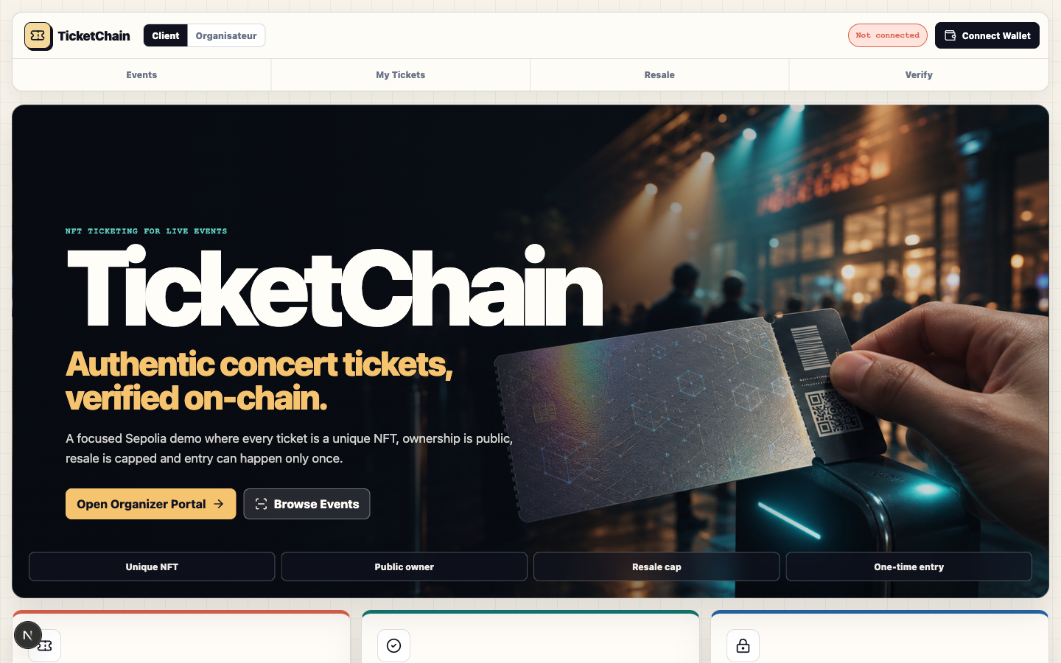
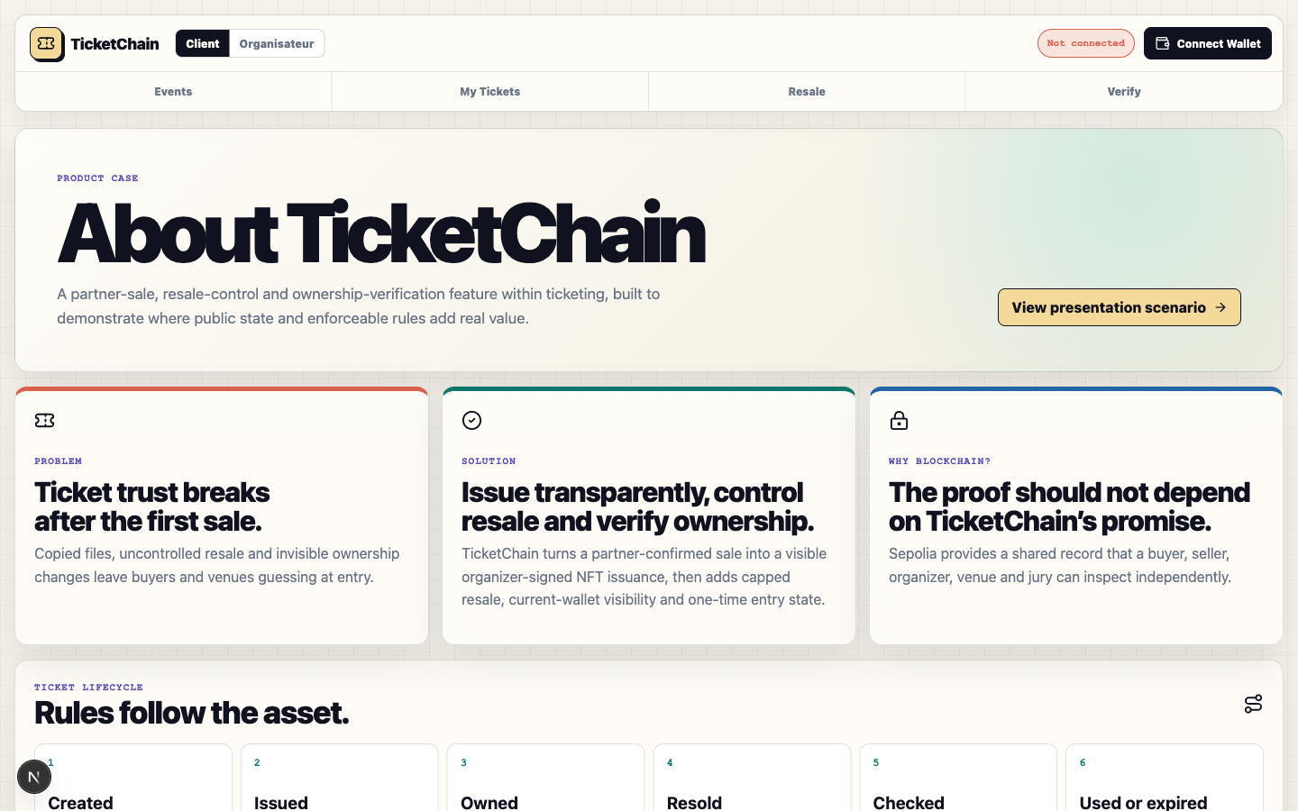
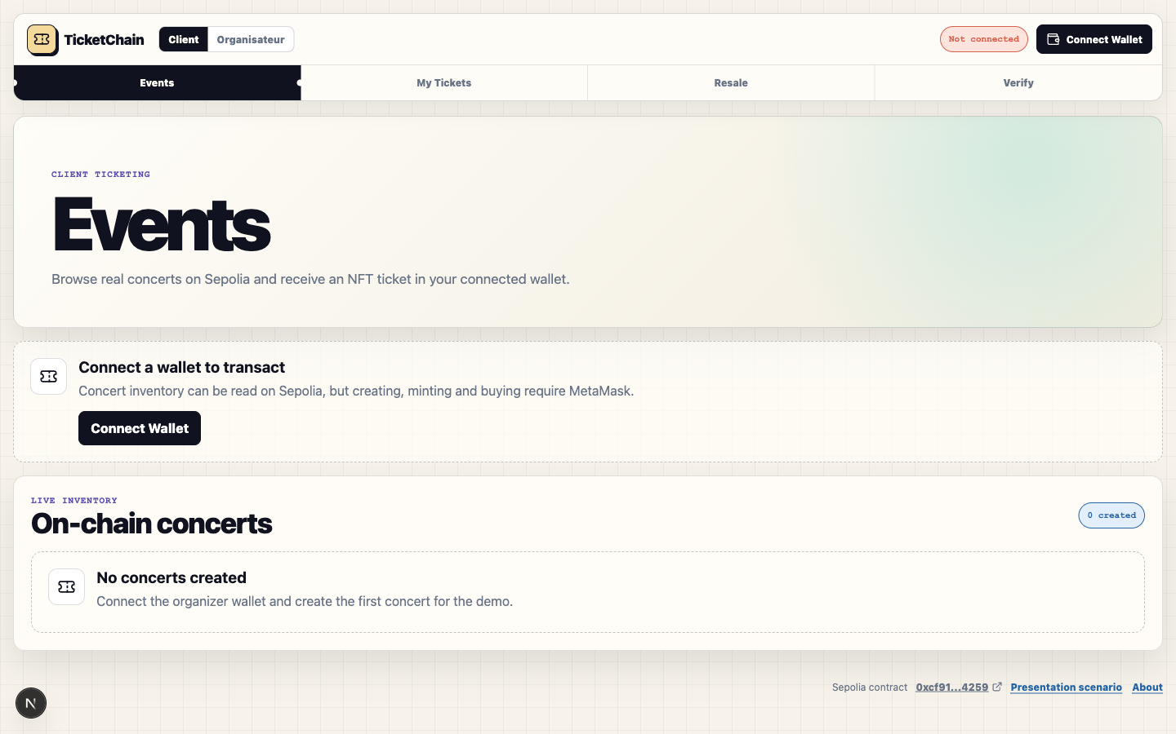
05 · MVP
The product, live
Landing — the pitch in one screen
Problem · solution · why blockchain
Events — on-chain concert inventory
Show, don't tell. Real screens from the deployed app — the same UI we drive in the live demo.
Notes:
Use this to bridge from the journey into the live demo. These are real screenshots of the deployed app, not mockups.

Slide 10
05 · MVP
Live demo — the run of show
1
Set up the organiser
2
Create a concert
Show the proof
Owner wallet for organizer actions.
The jury demo event, on-chain.
Live app
[your-app].vercel.app
Contract
0xcf91…4259
Explorer
sepolia.etherscan.io
3
Confirm a partner sale → issue NFT
4
Open My Tickets → show the NFT
The ticket lands in the buyer's wallet.
Ownership is public and current.
5
Verify + gate entry
6
Mark used → second scan refused
Holder signs proof with their own wallet.
The anti-double-use moment, live.
Backup video ready.
Notes:
~4 min — THE CORE. Do the demo early. Replace [your-app].vercel.app with the real URL. Keep this run-of-show in view. Have the backup video open in a tab. Show a real transaction on Etherscan. (Order mirrors the app's own /demo page.)

Slide 11

06 · BUSINESS
Unit economics
Item (per resold ticket) | Value | Status
Average primary ticket price | ~25 CHF | hypothesis
Resale cap (maxResalePrice) | +20% of primary price | existing
Platform commission on resale | 5–10% of resale price | to decide + to build
Gas cost (on an L2 in prod) | a few cents / transaction | chain-dependent
Net margin / resold ticket | commission − gas − amortized CAC | computable next
Revenue model
Commission on resale
The contract pays the seller while withholding a % for the platform / organizer.
Honesty: this commission is not in the contract yet — it's our next engineering step, not a box already ticked.
Notes:
~1 min (economics). ~25 CHF and 5–10% are HYPOTHESES to anchor on a real pilot-event price. Be explicit that the commission is the next engineering step, not built yet — never let it look functional in the demo.

Slide 12


06 · BUSINESS
Go-to-market
Channels
First-100 plan
Direct outreach to 1–2 local venues for a pilot event.
1
A pilot event with one real partner venue.
BEACHHEAD
Small independent venues
2
Recruit the first buyers via that venue's community.
Discord / Reddit communities of the venue's music scene.
200–500 seats. Immediate, concrete pain and a short sales cycle — far faster than a Ticketmaster-scale giant.
3
Measure: tickets verified at the gate, resale captured vs. lost.
Proof on screen (Etherscan) over an abstract pitch.
Then move upmarket: the pilot's results become the proof to approach bigger operators.
Notes:
~1 min. One channel first: direct outreach to independent venues. The pilot is the proof for moving upmarket. Win ONE channel before spreading out.

Slide 13
07 · COMMUNICATION
Positioning & message
“Concert tickets you can't copy, can't overprice on resale, and can't use twice.”
Value proposition — passes the “12-year-old” test.
1
2
3
Capture resale instead of suffering it
Guaranteed authenticity, checkable by anyone
Fraud-free entry
The black market pockets the speculation; TicketChain caps resale and pays you a commission on it.
Each ticket is a unique NFT: no more fakes or duplicates, provable on a block explorer.
The holder proves it with their own wallet — a screenshot or a photo is not enough.
Notes:
~1 min. Start with the pain, not the tech. The message speaks first to the B2B buyer (Karim). Stay consistent: same name, same tagline everywhere.

Slide 14

IN CLOSING
A product that runs. A real pain. A clear model.
Working MVP on Sepolia — 17/17 validated on-chain, demoed live.
A real use of blockchain: authenticity anyone can verify.
A model: commission on resale, beachhead = small independent venues.
Our ask: your feedback, and an intro to an independent venue to launch the pilot.
TicketChain · BTS FinTech Summer School — Geneva
Notes:
~1 min. Close with a clear ask (the brief requires it). Be ready for 'why blockchain?' in one crisp sentence. Thanks + questions.

