Slide 1



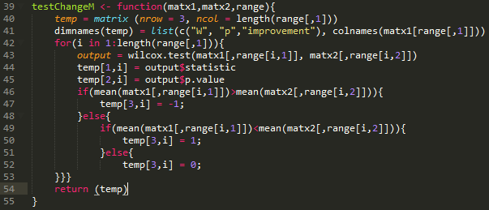
CSC216 Comparison: Fall 2015 and Fall 2016
Adam Abram, Dr. Sarah Heckman
{agabram,sarah_heckman}@ncsu.edu
Methodology
Analysis of grade data was done in RStudio, and revolved around creating several flexible scripts that could run statistical tests on the data, as well as other potential data with similar values.
Conclusions
The interventions were beneficial overall to student learning
The new lab system was beneficial to student learning
The addition of process points was not a worthwhile change
Introduction
Computer Science is a field with a notoriously high drop rate. The goal of this research increase student learning, efficacy, engagement, and retention through several interventions in CSC216. I focused on analyzing the impact these interventions had on learning, through the lens of student grades.
 | Final Average | EOOT | Testing Tutorial | P1P1 | P1P2 | P2P1 | P2P2 | P3P1 | P3P2 | In Class Labs | Exam1 | Exam2 | Final Exam
All | + | + |  |  | - |  |  | - |  | + |  | +
White | + | + |  |  | - |  | + | - |  | + |  | +
Asian |  | + | + |  |  |  |  |  |  | + |  | +
Other | + | + |  |  |  |  |  |  |  | + |  | +
Women | + | + | + |  |  |  |  |  |  | + |  | +
Men | + | + |  |  | - |  |  |  |  | + |  | +
Experienced Students | + | + |  |  |  | + |  |  |  | + |  | +
New Students |  | + |  |  | - |  |  |  |  | +
First Attempt | + | + |  |  | - |  |  |  |  | + |  | +
2nd+ Attempt |  | +
Sophomore | + | + |  |  |  |  |  |  |  | + |  | +
Junior |  |  |  |  | - |  |  |  |  | +
Experiment
The Fall 2016 CSC216 course had several interventions compared to the Fall 2015 course, including:
An increase in credit hours (3 to 4)
Addition of a Guided Project
Addition of Process Points
Addition of 110-minute lab
Labs built into a larger project
Several datasets were taken in both the Fall 2015 and 2016 classes including grades, survey responses, office hours and message board activity.
Future Work
In order to follow up on this research, analysis needs to be done on survey responses in order to determine how the efficacy of students changed between semesters. Evaluating office hour and message board data can also be performed to determine the level of engagement of students with the class.
Notes:
If you need more space, suggested font sizes: Title 70 – 80pt Headings 54pt+ Text: Minimum 30pt

