Slide 1



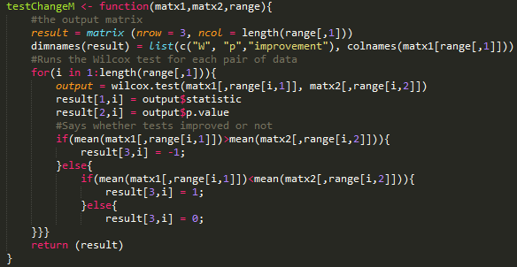
CSC216 Comparison: Fall 2015 and Fall 2016
Adam Abram, Dr. Sarah Heckman
{agabram,sarah_heckman}@ncsu.edu
Methodology
Analysis of grade data was done in RStudio, and revolved around creating several flexible scripts that could run statistical tests on the data, as well as other potential data with similar values.
Introduction
Early computer science classes at NC state have a 25% fail rate on average. The goal of this research is to increase student learning, efficacy, engagement, and retention through several interventions in CSC216. I focused on analyzing the impact these interventions had on learning, through the lens of student grades.
Conclusions
The interventions were beneficial overall to student learning
he redesign and renaming of the first object oriented assignment from tutorial to guided project appears to lead to better student success
The lab changes may have contributed to higher exam 2 scores due to the increased emphasis on implementing linear data structures.
 | Object Oriented | Testing | P1P1 | P1P2 | P2P1 | P2P2 | P3P1 | P3P2 | Exam 1 | Exam 2 | Final Exam | Final Average
All | + |  |  | - |  |  | - |  |  | + |  | +
White | + |  |  | - |  | + | - |  |  | + |  | +
Asian | + | + |  |  |  |  |  |  |  | +
Other | + |  |  |  |  |  |  |  |  | + |  | +
Women | + | + |  |  |  |  |  |  |  | + |  | +
Men | + |  |  | - |  |  |  |  |  | + |  | +
Experienced Students | + |  |  |  | + |  |  |  |  | + |  | +
Unexperienced Students | + |  |  | -
First Attempt | + |  |  | - |  |  |  |  |  | + |  | +
2nd+ Attempt | +
Sophomore | + |  |  |  |  |  |  |  |  | + |  | +
Junior |  |  |  | -
Interventions
The Fall 2016 CSC216 course featured:
An increase in credit hours (3 to 4)
Addition of a Guided Project
Addition of 110-minute lab
Labs built into a larger project
Future Work
Examine Survey Responses to determine change in student efficacy
Examine grades by soft drop
Examine office hours to determine the level of engagement students had
Data Sources
Student grades
Survey responses
Office hours
Message board activity
Notes:
If you need more space, suggested font sizes: Title 70 – 80pt Headings 54pt+ Text: Minimum 30pt

