Slide 1
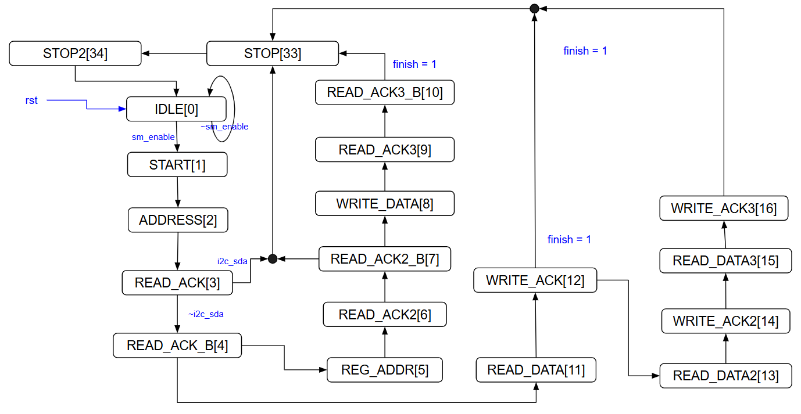
Write_cmd

Slide 2
mode CPU_WREG

Slide 3
mode CPU_RREG

Slide 4
mode HW
3. Wait DRDY low
1. MUX
4-1 RDATA
4-2 READ_ADC
2. START

