Slide 1
程式功能描述 (把uartISR丟入chatGPT)
This is a function named uartISR that handles interrupts for a UART (Universal Asynchronous Receiver/Transmitter) interface. It takes two arguments: context, which is a void pointer to a structure that contains information about the UART buffers, and id, which is an unsigned integer representing the ID of the interrupt.
The function starts by declaring an integer variable b and a pointer to a UartBuffer_t structure named pUartBuffer that points to the context passed in as an argument.
Next, the function checks if the RRDY (Receive Ready) bit is set in the status register of the UART. If it is set, it reads a byte from the UART's receive buffer using the IORD_ALTERA_AVALON_UART_RXDATA function and stores it in the receive buffer pointed to by pUartBuffer. It then increments the receive buffer's put index, wrapping around if it reaches the end of the buffer. Finally, it increments the count of bytes in the receive buffer if it hasn't reached its maximum size.
After this, the function checks if the TRDY (Transmit Ready) bit is set in the status register of the UART. If it is set, and there are bytes in the transmit buffer pointed to by pUartBuffer, it writes a byte to the UART's transmit buffer using the IOWR_ALTERA_AVALON_UART_TXDATA function. It then increments the take index of the transmit buffer, wrapping around if it reaches the end of the buffer, decrements the count of bytes in the transmit buffer, and turns off the transmit interrupt if the transmit buffer is empty.
Overall, this function handles interrupts from a UART interface and manages the receive and transmit buffers for the UART.

Slide 2
pUartBuffer->rxBufPut &= RX_BUF_SIZE_MASK; 的用意
The line pUartBuffer->rxBufPut &= RX_BUF_SIZE_MASK; is used to ensure that the put index of the receive buffer pointed to by pUartBuffer stays within the bounds of the buffer size.
RX_BUF_SIZE_MASK is a bitmask that has all its bits set to 1, with a number of bits equal to the receive buffer size minus one. For example, if the receive buffer size is 16, RX_BUF_SIZE_MASK would be 0x000F.
When a new byte is received and stored in the receive buffer, the put index pUartBuffer->rxBufPut is incremented. However, if pUartBuffer->rxBufPut reaches the end of the buffer, it needs to be wrapped around to the beginning of the buffer. The line pUartBuffer->rxBufPut &= RX_BUF_SIZE_MASK performs a bitwise AND operation between pUartBuffer->rxBufPut and RX_BUF_SIZE_MASK, which effectively sets all the bits of pUartBuffer->rxBufPut beyond the buffer size to zero.
For example, if pUartBuffer->rxBufPut is 17 and RX_BUF_SIZE_MASK is 0x000F, the bitwise AND operation will result in pUartBuffer->rxBufPut being set to 1 (i.e., (17 & 0x000F) == 1). This ensures that the put index stays within the bounds of the receive buffer size and avoids overwriting previously received bytes.

Slide 3
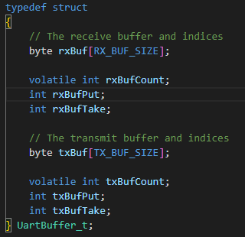
buffer index 分為put 與 take:
“put” into the Buffer
“take” from the Buffer

Slide 4
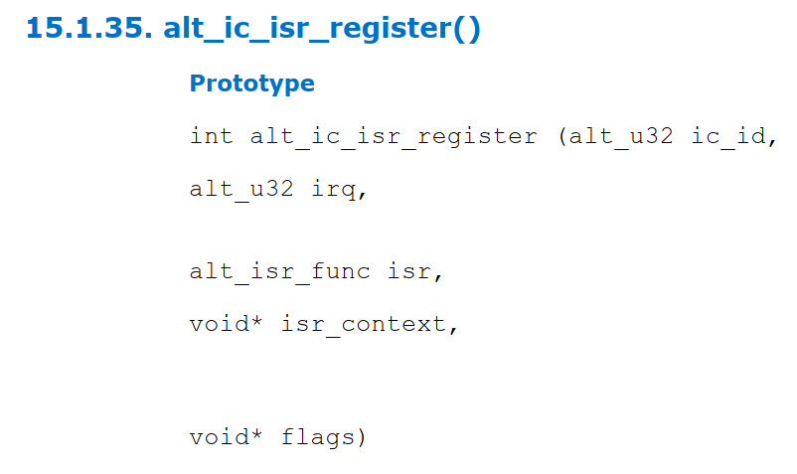
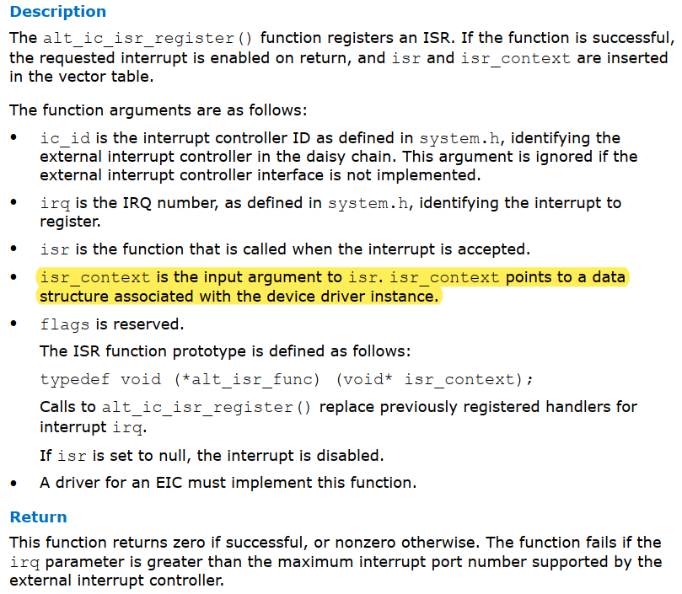

Slide 5
當有新資料進來時增加put index, 會在0~255間循環。 -> uartISR
當有新資料進來時增加rx buffer count, 最多到255就不會增加了。 -> uartISR
當讀取rx buffer數據時會增加take index，會在0~255間循環。-> uartGetByte
rxBuffer
255
254
253
……..
4
3
2
1
0
rx buffer count

Slide 6
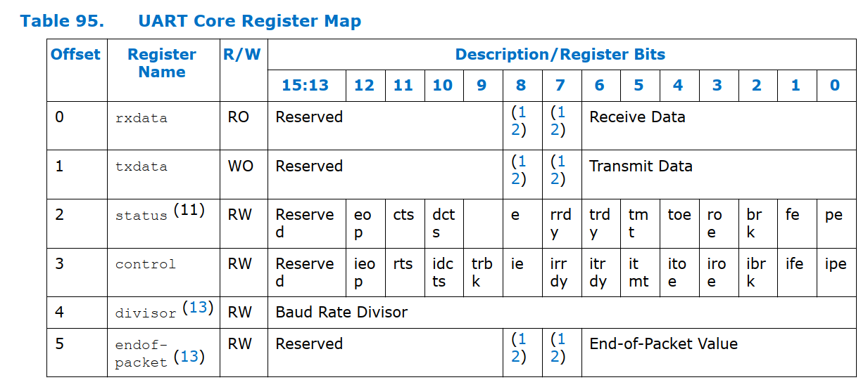

Slide 7
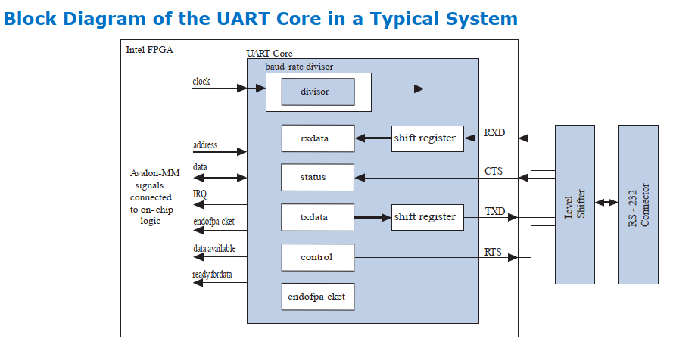
The user interface to the UART core consists of six, 16-bit registers: control, status, rxdata, txdata, divisor, and endofpacket.
The UART core provides an active-high interrupt request (IRQ) output that can request an interrupt when new data has been received, or when the core is ready to transmit another character.
The UART transmitter consists of a 7-, 8-, or 9-bit txdata holding register and a corresponding 7-, 8-, or 9-bit transmit shift register.
The transmit shift register is loaded from the txdata register automatically when a serial transmit shift operation is not currently in progress.
The master peripheral can monitor the transmitter‘s status by reading the status register‘s transmitter ready (TRDY), transmitter shift register empty (tmt), and transmitter overrun error (TOE) bits.
The UART receiver consists of a 7-, 8-, or 9-bit receiver-shift register and a corresponding 7-, 8-, or 9-bit rxdata holding register.
The rxdata holding register is loaded from the receiver shift register automatically every time a new character is fully received.
A master peripheral can monitor the receiver‘s status by reading the status register‘s read-ready (RRDY), receiver-overrun error (ROE), break detect (BRK), parity error (PE), and framing error (FE) bits.

Slide 8
rxdata Register:
rxdata register 有值時: status register.rrdy = 1, 無值時為0。只有當status register.rrdy = 1時才能將值讀出!
The rxdata register holds data received via the RXD input. When a new character is fully received via the RXD input, it is transferred into the rxdata register, and the status register's rrdy bit is set to 1.
The status register's rrdy bit is set to 0 when the rxdata register is read.
txdata Register:
txdata register 有值時: status register.rrdy = 0, 無值時為1。只有當status register.rrdy = 1 時才能寫新的值到txdata!
Avalon-MM master peripherals write characters to be transmitted into the txdata register.
Characters should not be written to txdata until the transmitter is ready for a new character, as indicated by the TRDY bit in the status register.
The TRDY bit is set to 0 when a character is written into the txdata register. The TRDY bit is set to 1 when the character is transferred from the txdata register into the transmitter shift register.

Slide 9
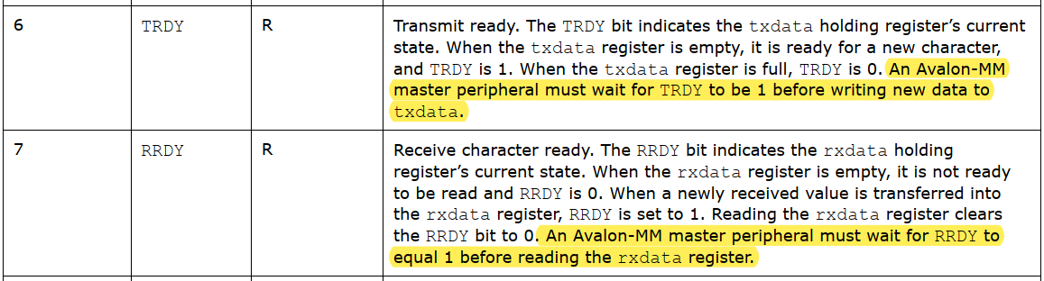

Slide 10
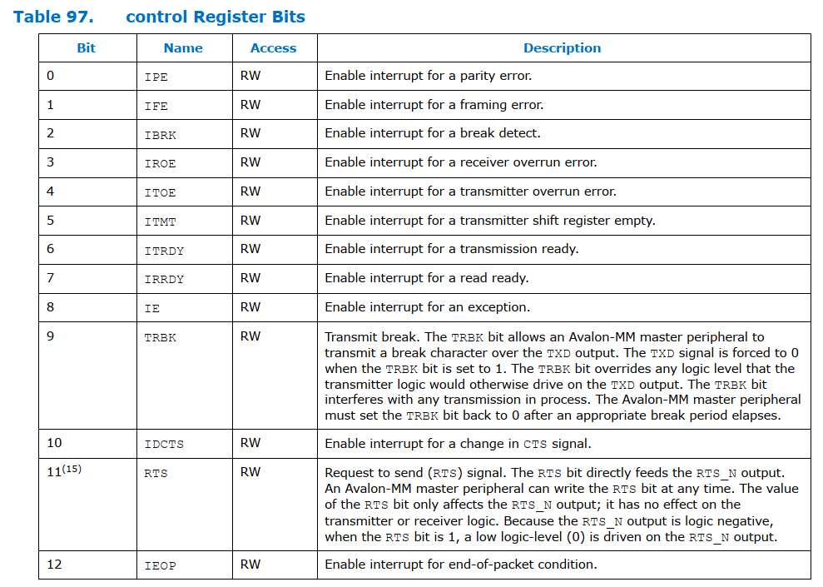
Control Register:
Each bit in the control register enables an IRQ for a corresponding bit in the status register. When both a status bit and its corresponding interrupt-enable bit are 1, the core generates an IRQ.

