Slide 1
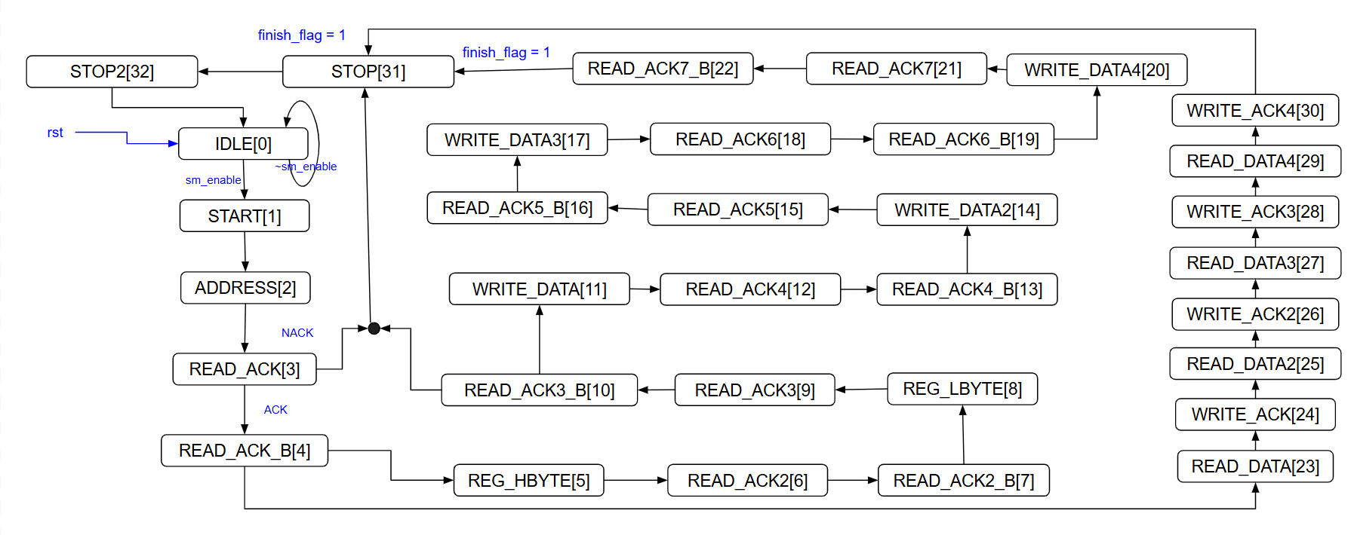

Write operation

Slide 2


Read operation

