Slide 1
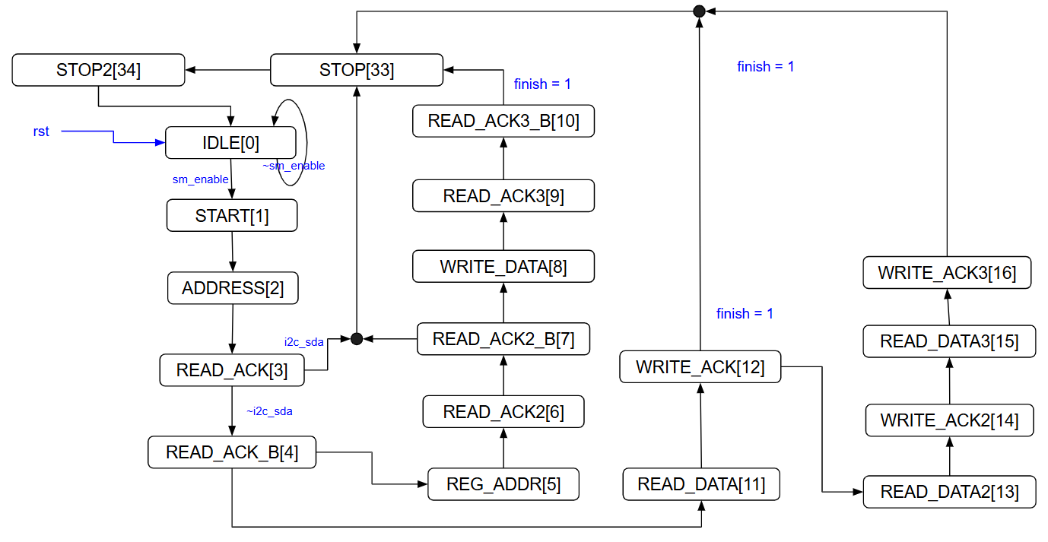
Write_cmd

Slide 2
Write_register

Slide 3
Read_register

Slide 4
Read_data
3. Wait DRDY low
1. MUX
4-1 RDATA
4-2 read 24bit data
2. START

