Slide 1
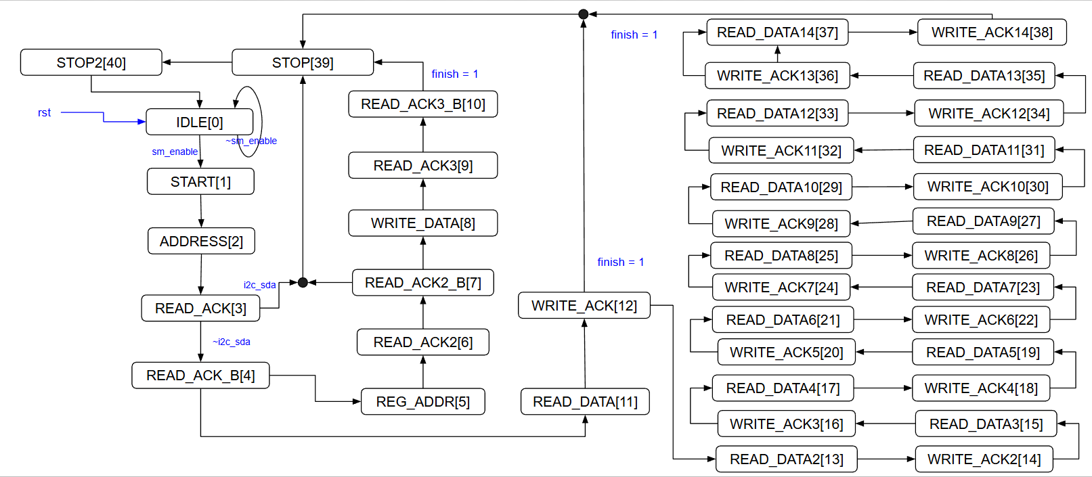

mode CPU_WREG

Slide 2


mode CPU_RREG

Slide 3



mode HW
1. 等INT1 (DRDY )訊號來時才進入SM

