Slide 1
程式功能描述 (把uartISR丟入chatGPT)
This is a function named uartISR that handles interrupts for a UART (Universal Asynchronous Receiver/Transmitter) interface. It takes two arguments: context, which is a void pointer to a structure that contains information about the UART buffers, and id, which is an unsigned integer representing the ID of the interrupt.
The function starts by declaring an integer variable b and a pointer to a UartBuffer_t structure named pUartBuffer that points to the context passed in as an argument.
Next, the function checks if the RRDY (Receive Ready) bit is set in the status register of the UART. If it is set, it reads a byte from the UART's receive buffer using the IORD_ALTERA_AVALON_UART_RXDATA function and stores it in the receive buffer pointed to by pUartBuffer. It then increments the receive buffer's put index, wrapping around if it reaches the end of the buffer. Finally, it increments the count of bytes in the receive buffer if it hasn't reached its maximum size.
After this, the function checks if the TRDY (Transmit Ready) bit is set in the status register of the UART. If it is set, and there are bytes in the transmit buffer pointed to by pUartBuffer, it writes a byte to the UART's transmit buffer using the IOWR_ALTERA_AVALON_UART_TXDATA function. It then increments the take index of the transmit buffer, wrapping around if it reaches the end of the buffer, decrements the count of bytes in the transmit buffer, and turns off the transmit interrupt if the transmit buffer is empty.
Overall, this function handles interrupts from a UART interface and manages the receive and transmit buffers for the UART.

Slide 2
pUartBuffer->rxBufPut &= RX_BUF_SIZE_MASK; 的用意
The line pUartBuffer->rxBufPut &= RX_BUF_SIZE_MASK; is used to ensure that the put index of the receive buffer pointed to by pUartBuffer stays within the bounds of the buffer size.
RX_BUF_SIZE_MASK is a bitmask that has all its bits set to 1, with a number of bits equal to the receive buffer size minus one. For example, if the receive buffer size is 16, RX_BUF_SIZE_MASK would be 0x000F.
When a new byte is received and stored in the receive buffer, the put index pUartBuffer->rxBufPut is incremented. However, if pUartBuffer->rxBufPut reaches the end of the buffer, it needs to be wrapped around to the beginning of the buffer. The line pUartBuffer->rxBufPut &= RX_BUF_SIZE_MASK performs a bitwise AND operation between pUartBuffer->rxBufPut and RX_BUF_SIZE_MASK, which effectively sets all the bits of pUartBuffer->rxBufPut beyond the buffer size to zero.
For example, if pUartBuffer->rxBufPut is 17 and RX_BUF_SIZE_MASK is 0x000F, the bitwise AND operation will result in pUartBuffer->rxBufPut being set to 1 (i.e., (17 & 0x000F) == 1). This ensures that the put index stays within the bounds of the receive buffer size and avoids overwriting previously received bytes.

Slide 3
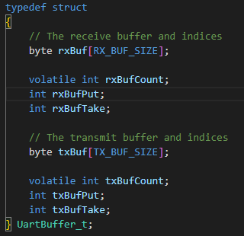
buffer index 分為put 與 take:
“put” into the Buffer
“take” from the Buffer

Slide 4
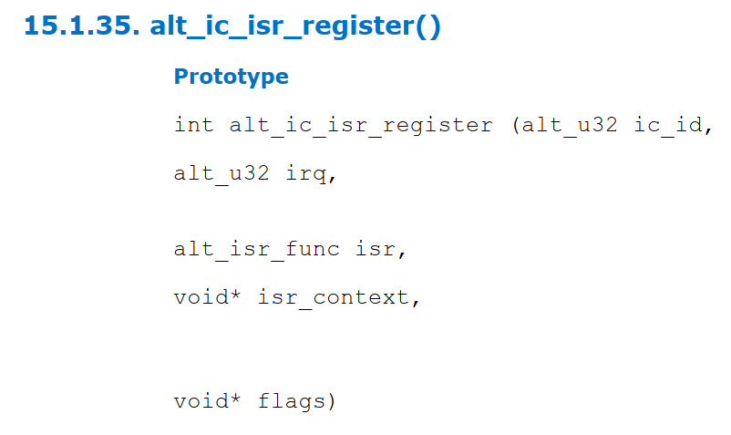
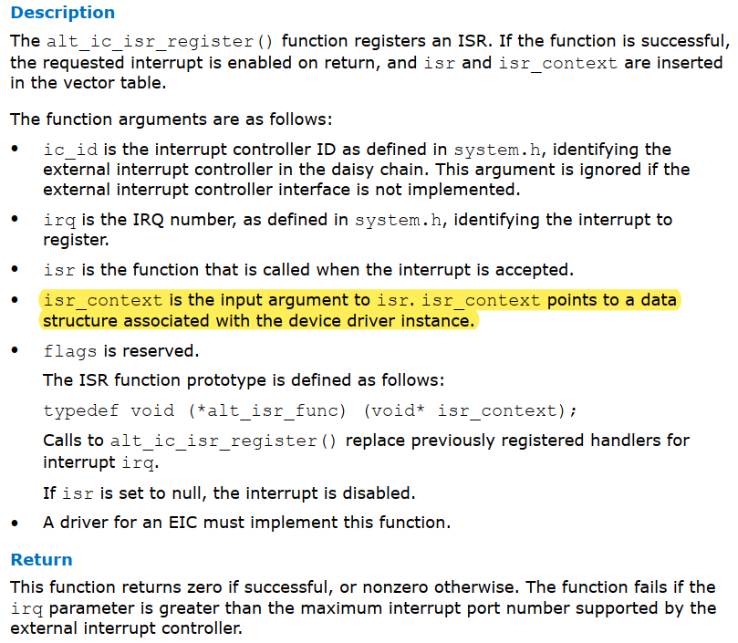

Slide 5
當有新資料進來時增加put index, 會在0~255間循環。 -> uartISR
當有新資料進來時增加rx buffer count, 最多到255就不會增加了。 -> uartISR
當讀取rx buffer數據時會增加take index，會在0~255間循環。-> uartGetByte
rxBuffer
255
254
253
……..
4
3
2
1
0
rx buffer count

