Slide 1

Threshold q-voter model
Paweł kossowski-skop, katarzyna macioszek, Ada Majchrzak

Slide 2
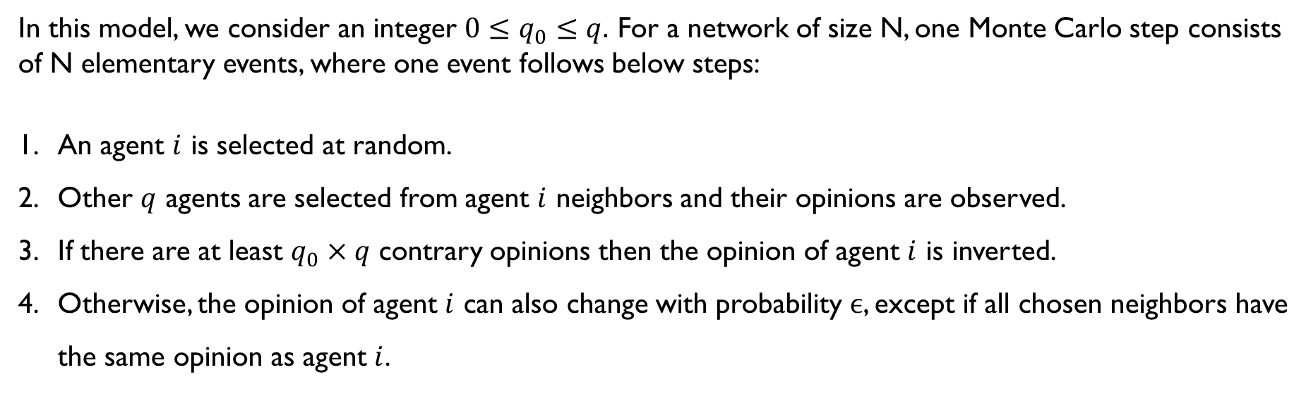
Standard threshold model
In this model, we consider an integer $0≤q_{0}≤q.$ For a network of size N, one Monte Carlo step consists of N elementary events, where one event follows below steps:
An agent $i$ is selected at random.
Other $q$ agents are selected from agent $i$ neighbors and their opinions are observed.
If there are at least $q_{0}×q$ contrary opinions then the opinion of agent $i$ is inverted.
Otherwise, the opinion of agent $i$ can also change with probability $ϵ$, except if all chosen neighbors have the same opinion as agent $i$.

Slide 3
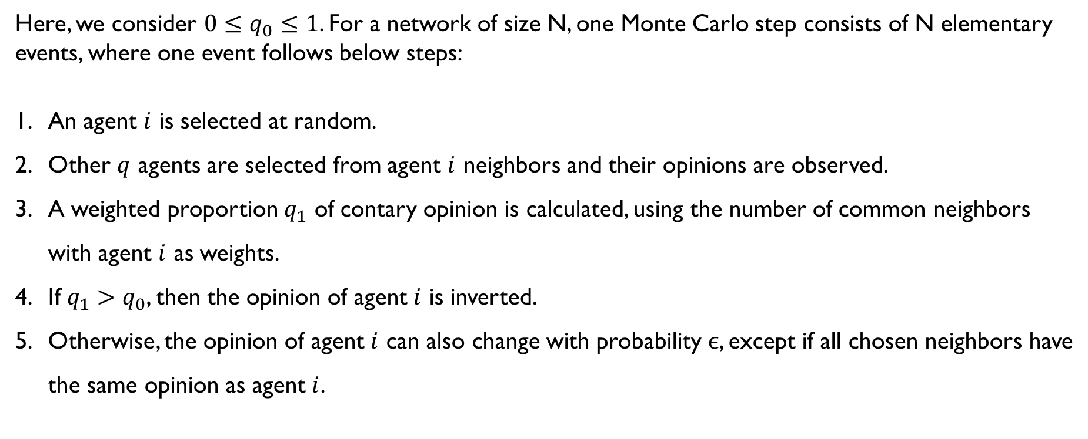
Our modification of the Standard threshold model
Here, we consider ${0≤q}_{0}≤1$. For a network of size N, one Monte Carlo step consists of N elementary events, where one event follows below steps:
An agent $i$ is selected at random.
Other $q$ agents are selected from agent $i$ neighbors and their opinions are observed.
A weighted proportion $q_{1}$ of contary opinion is calculated, using the number of common neighbors with agent $i$ as weights.
If $q_{1}>q_{0}$, then the opinion of agent $i$ is inverted.
Otherwise, the opinion of agent $i$ can also change with probability $ϵ$, except if all chosen neighbors have the same opinion as agent $i$.

Slide 4
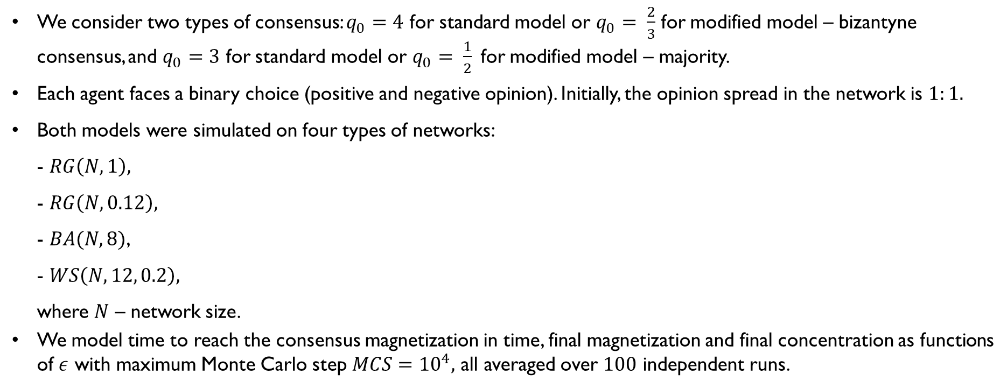
Model parameters used in simulations
We consider two types of consensus: $q_{0}=4$ for standard model or $q_{0}= \frac{2}{3}$ for modified model – bizantyne consensus, and $q_{0}=3$ for standard model or $q_{0}= \frac{1}{2}$for modified model – majority.
Each agent faces a binary choice (positive and negative opinion). Initially, the opinion spread in the network is $1:1.$
Both models were simulated on four types of networks:
- $RG\left(N, 1\right),$
- $RG\left(N, 0.12\right),$
- $BA(N, 8)$,
- $WS\left(N, 12, 0.2\right),$
where $N$ – network size.
We model time to reach the consensus magnetization in time, final magnetization and final concentration as functions of $ε$ with maximum Monte Carlo step $MCS={10}^{4},$ all averaged over $100$ independent runs.

Slide 5
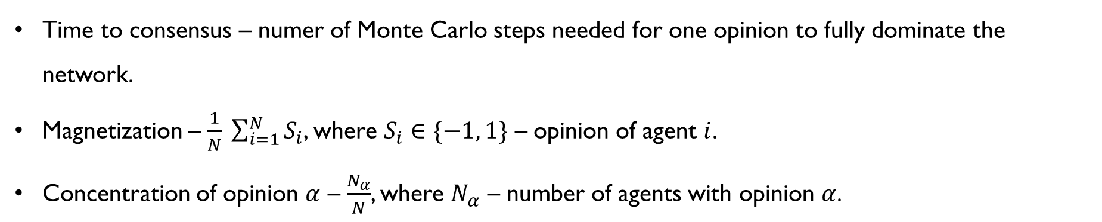
definitions
Time to consensus – numer of Monte Carlo steps needed for one opinion to fully dominate the network.
Magnetization – $\frac{1}{N} \sum_{i=1}^{N}{S_{i}}$, where $S_{i}∈\{−1, 1\}$ – opinion of agent $i$.
Concentration of opinion $α$ – $\frac{N_{α}}{N}$, where $N_{α}$ – number of agents with opinion $α$.

Slide 6

Results
Time to consensus
Magnetization
Concentration

Slide 7
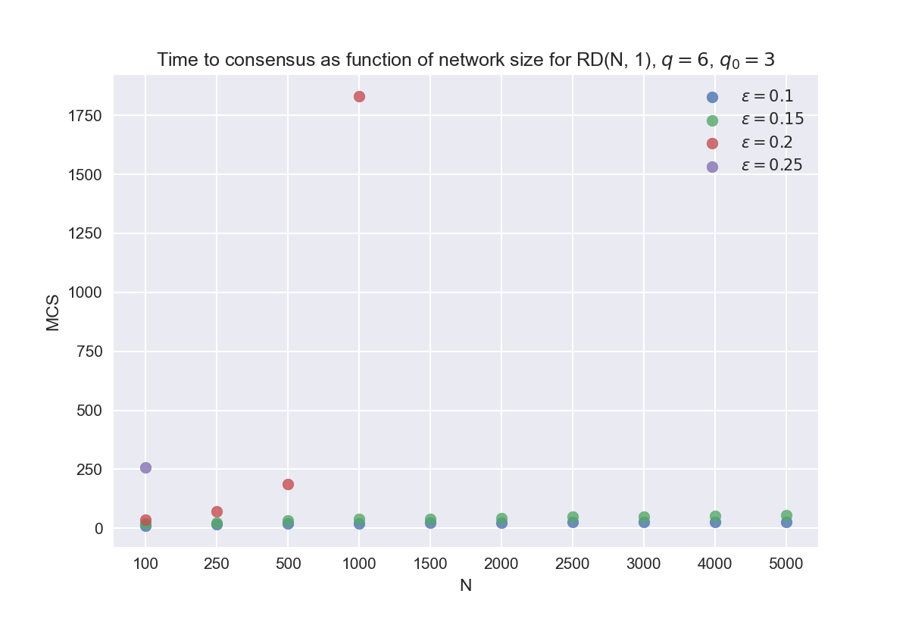
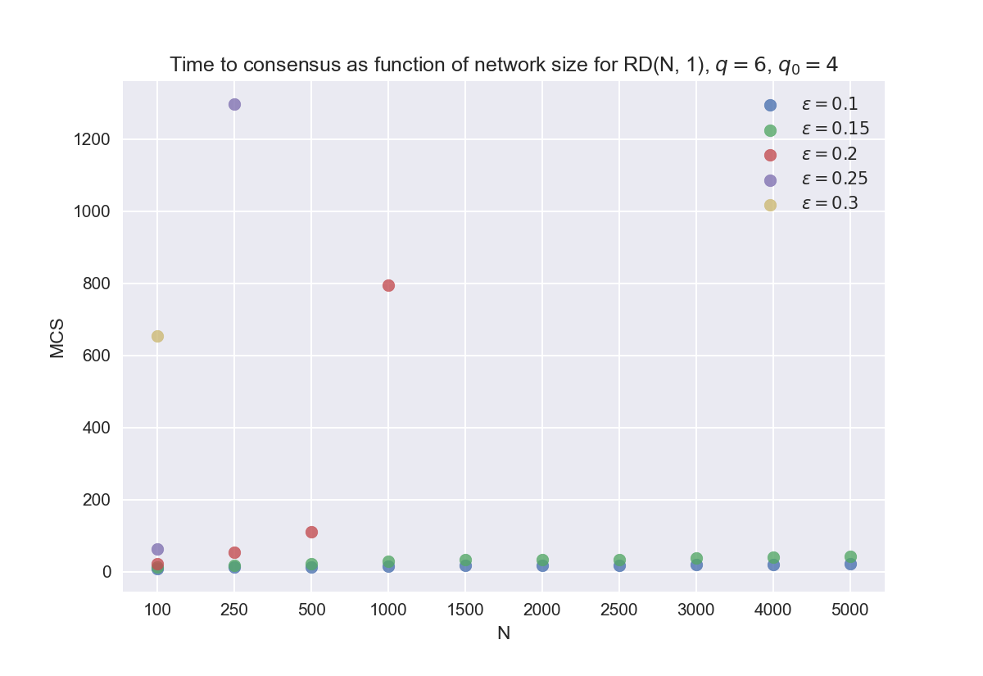
Time to consensus – standard model

Slide 8
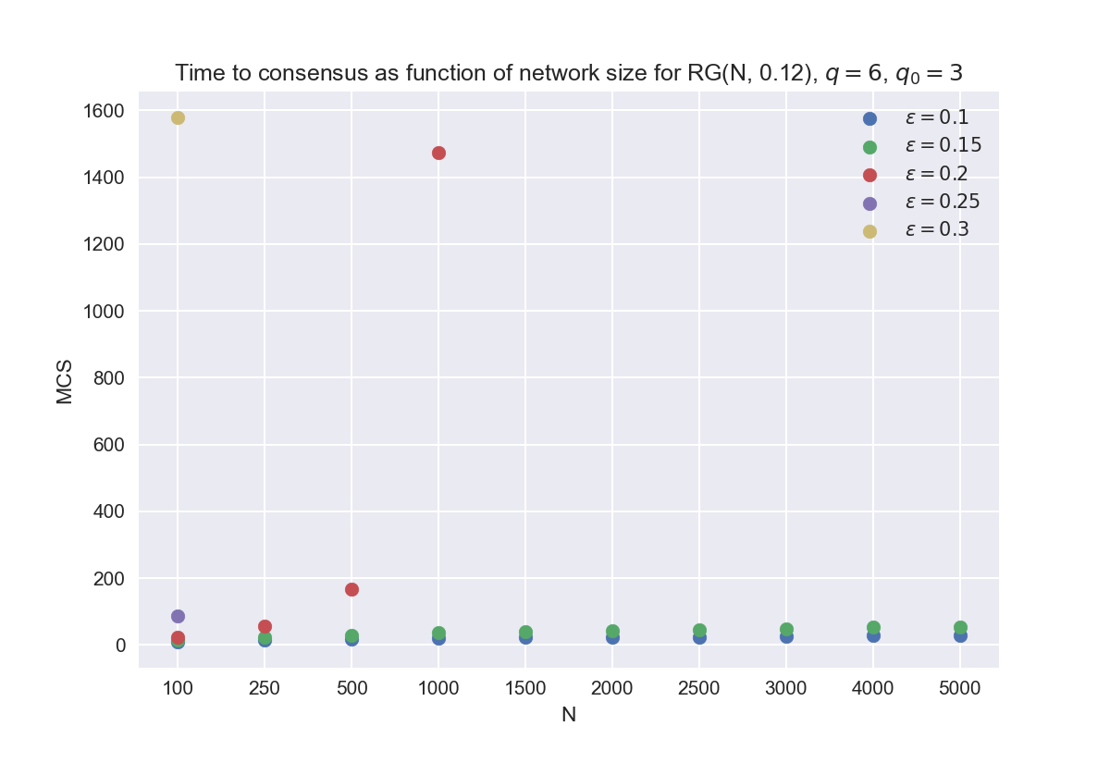
Time to consensus – standard model

Slide 9
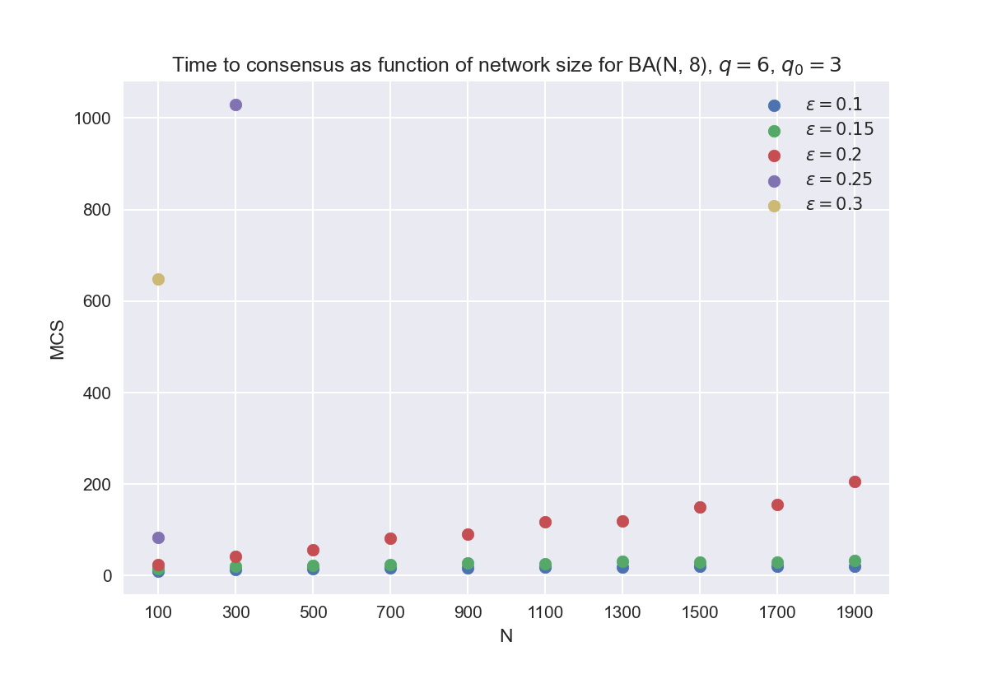
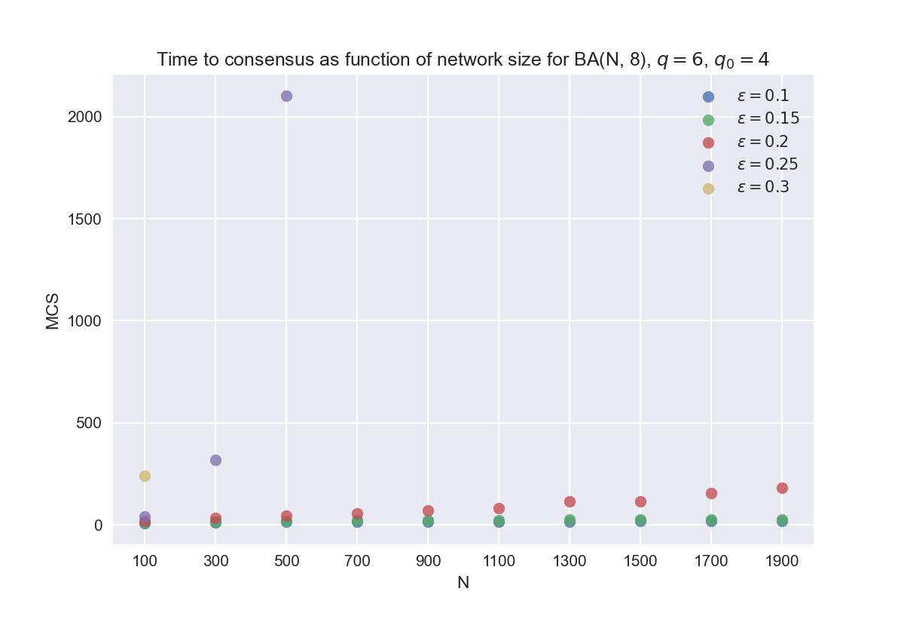
Time to consensus – standard model

Slide 10
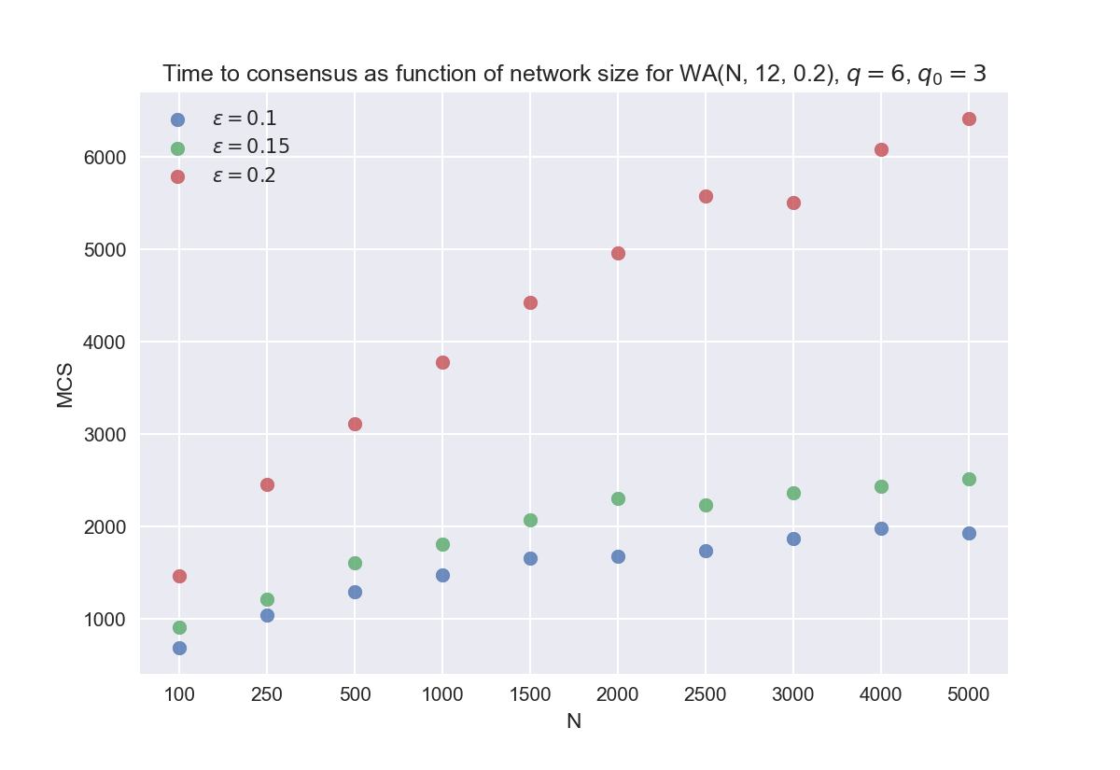
Time to consensus – standard model

Slide 11

Dziękujemy!
osoba@example.com

