Slide 1
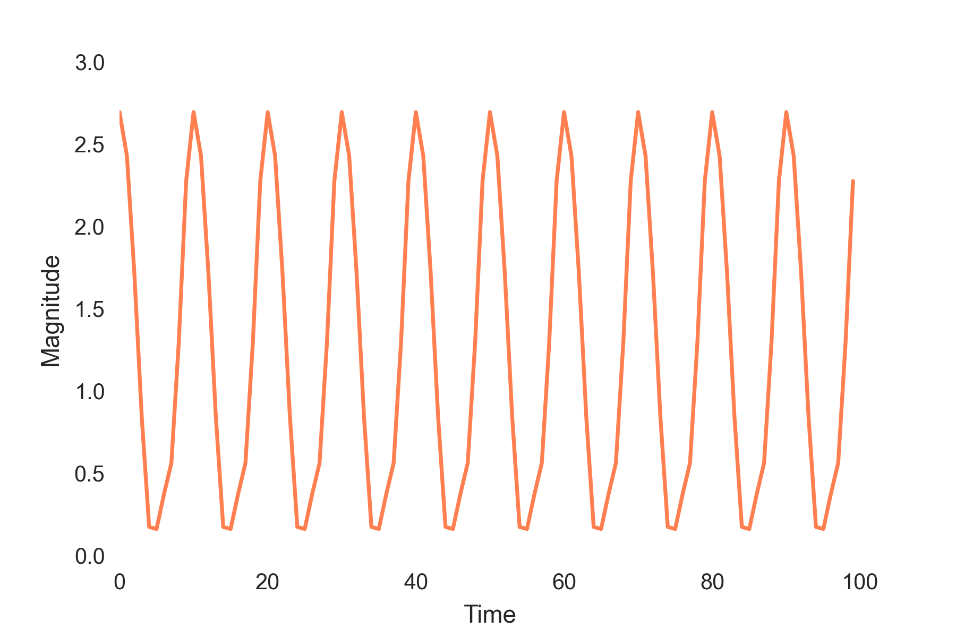
An ordinary time series…
…becomes useful information
Period
Amplitude
Std
Mean

