Slide 1
RFID based attendance system
Mansi Adamanke.
Shubham Bharti.
Prajwal More.

Slide 2
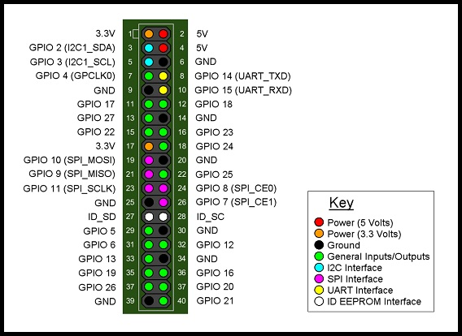
Raspberry Pi
40 pins
Vcc : 5V
Vcc: 3.3V
GND pins
GPIO pins:
Interfaces:
I2c – 2,3,4
UART – 14,15
SPI – 7,8,9,10,11

Slide 3
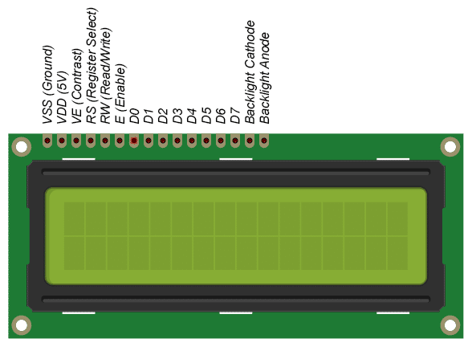
16*2 LCD display
16 pins
Pin 1– GND
Pin 2– Vcc
Pin 3– cnt: PoT
Pin 4– RS: 20 /38
Pin 5– GND
Pin 6– E: 5/29
Pin11– D4: 26/37
Pin12 – D5: 19/35
Pin13 – D6: 13/33
Pin 14– D7: 6/31
Pin 15– Vcc
Pin 16-- GND

Slide 4
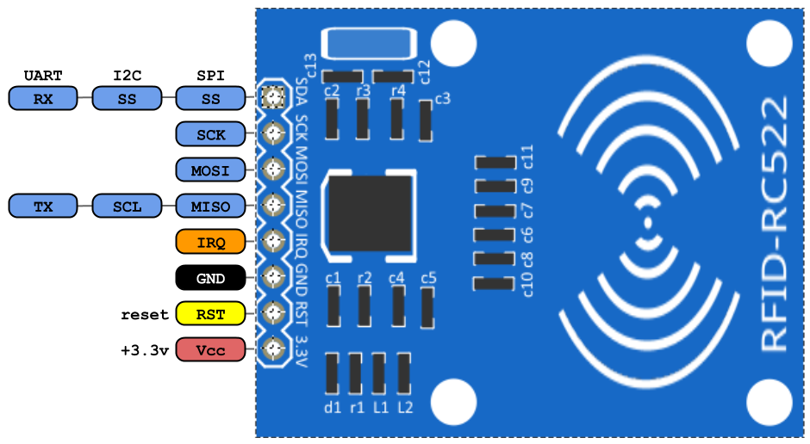
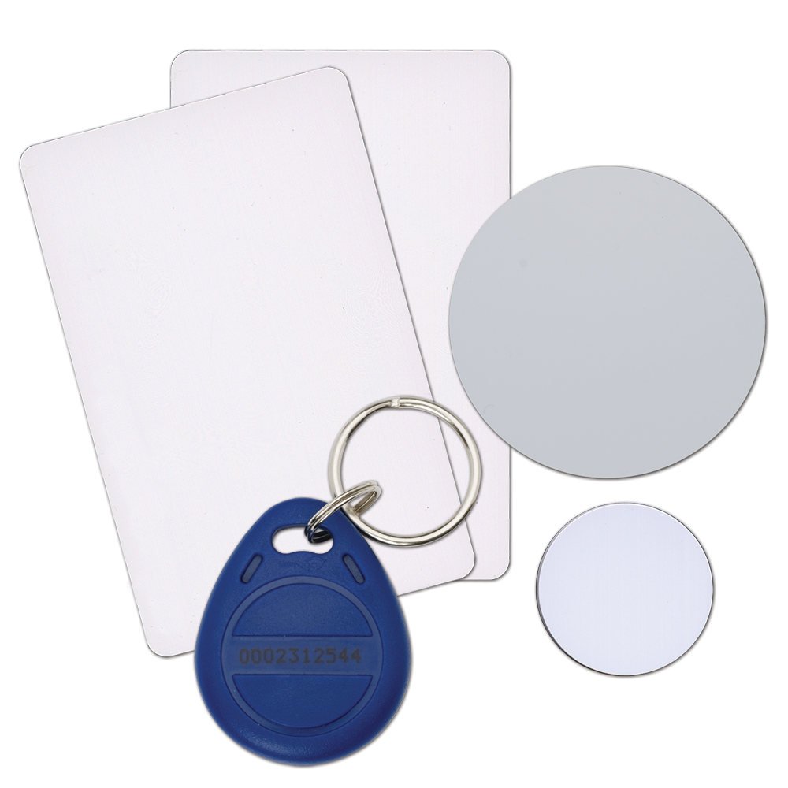
RFID card reader
8 pins
Pin 1— SDA: 8/24
Pin 2— SCK: 11/23
Pin 3— MOSI: 10/19
Pin 4— MISO: 9/21
Pin 6— GND:
Pin 7— RST: 25/22
Pin 8— Vcc: 3.3V/1

Slide 5
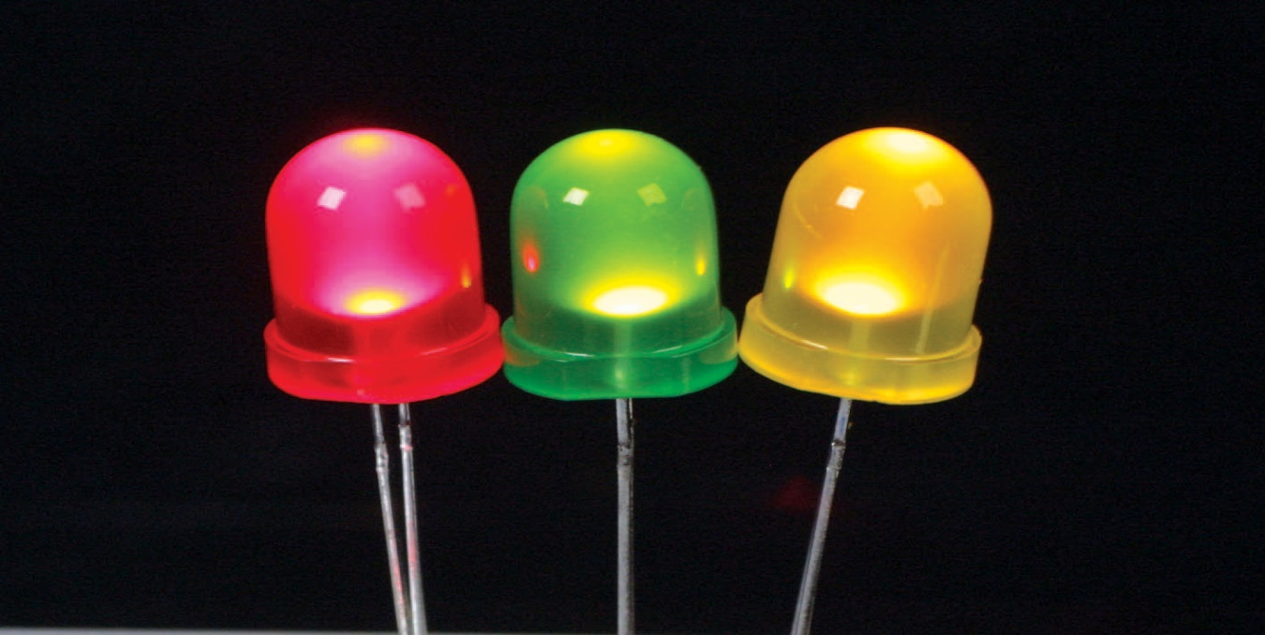
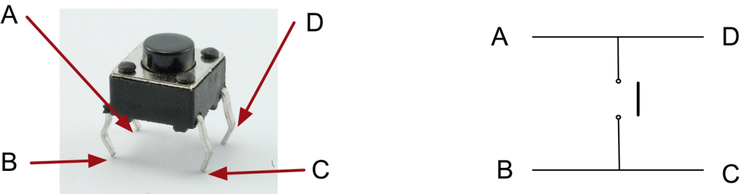
LED’s & Push buttons
LEDs
LED1: 17/11
LED2: 27/13
LED3: 22/15
Push buttons
PS_IN: 23/16
PS_OUT: 24/18
Remaining pins to GND

