Slide 1
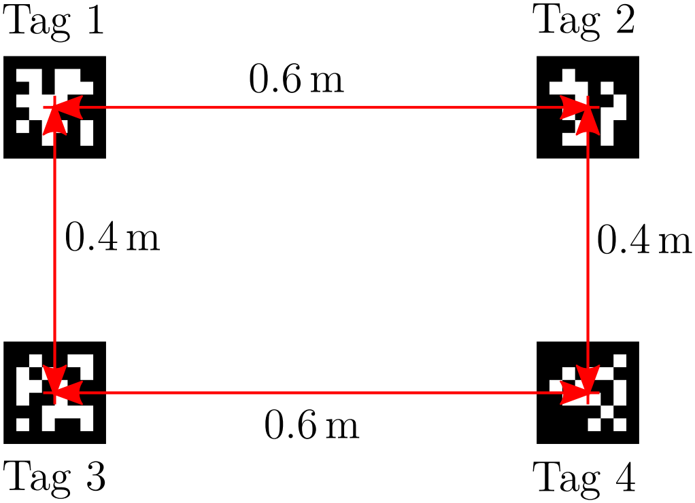
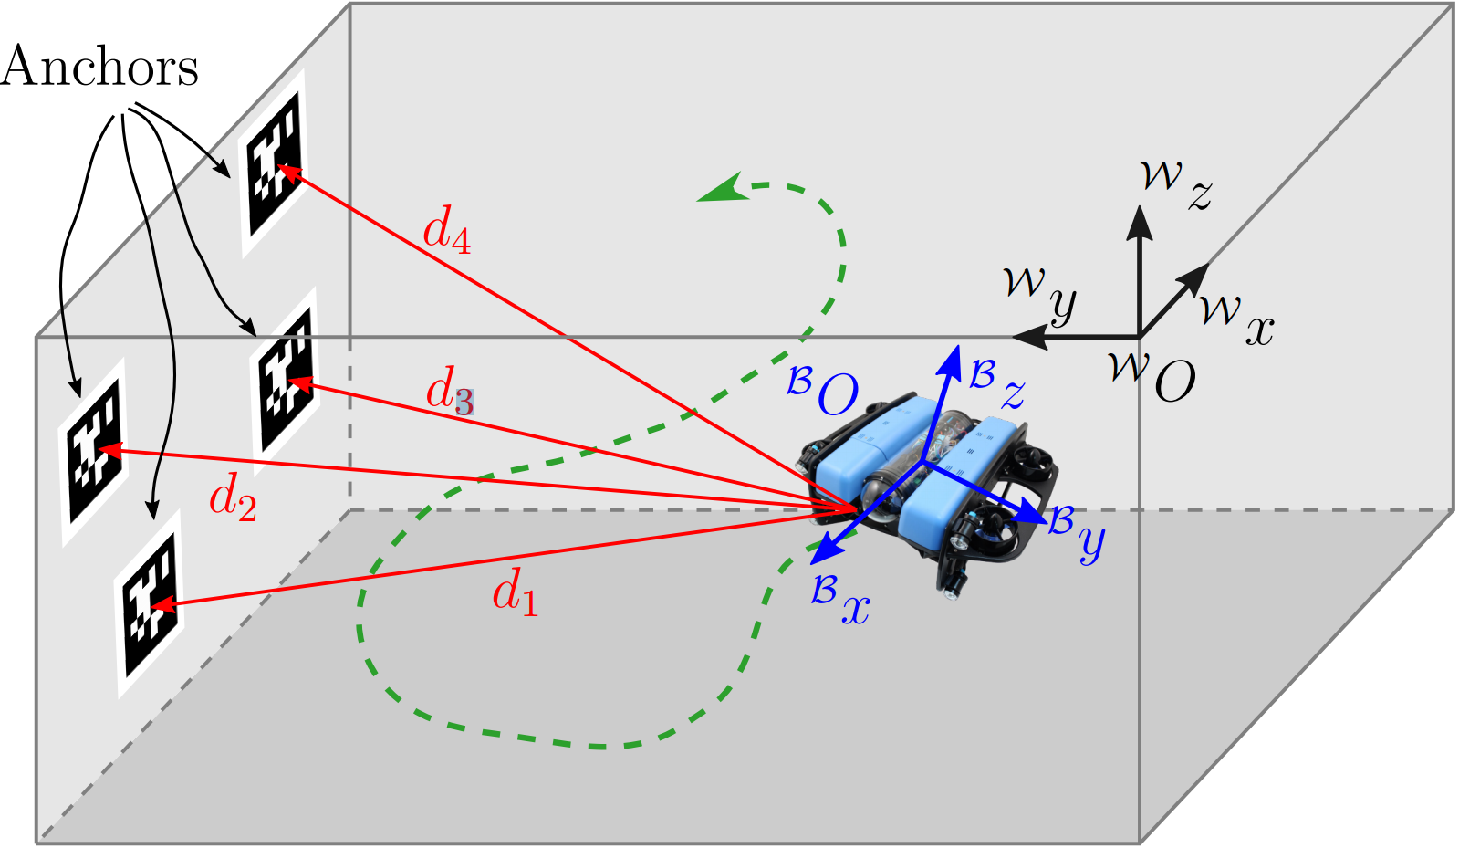
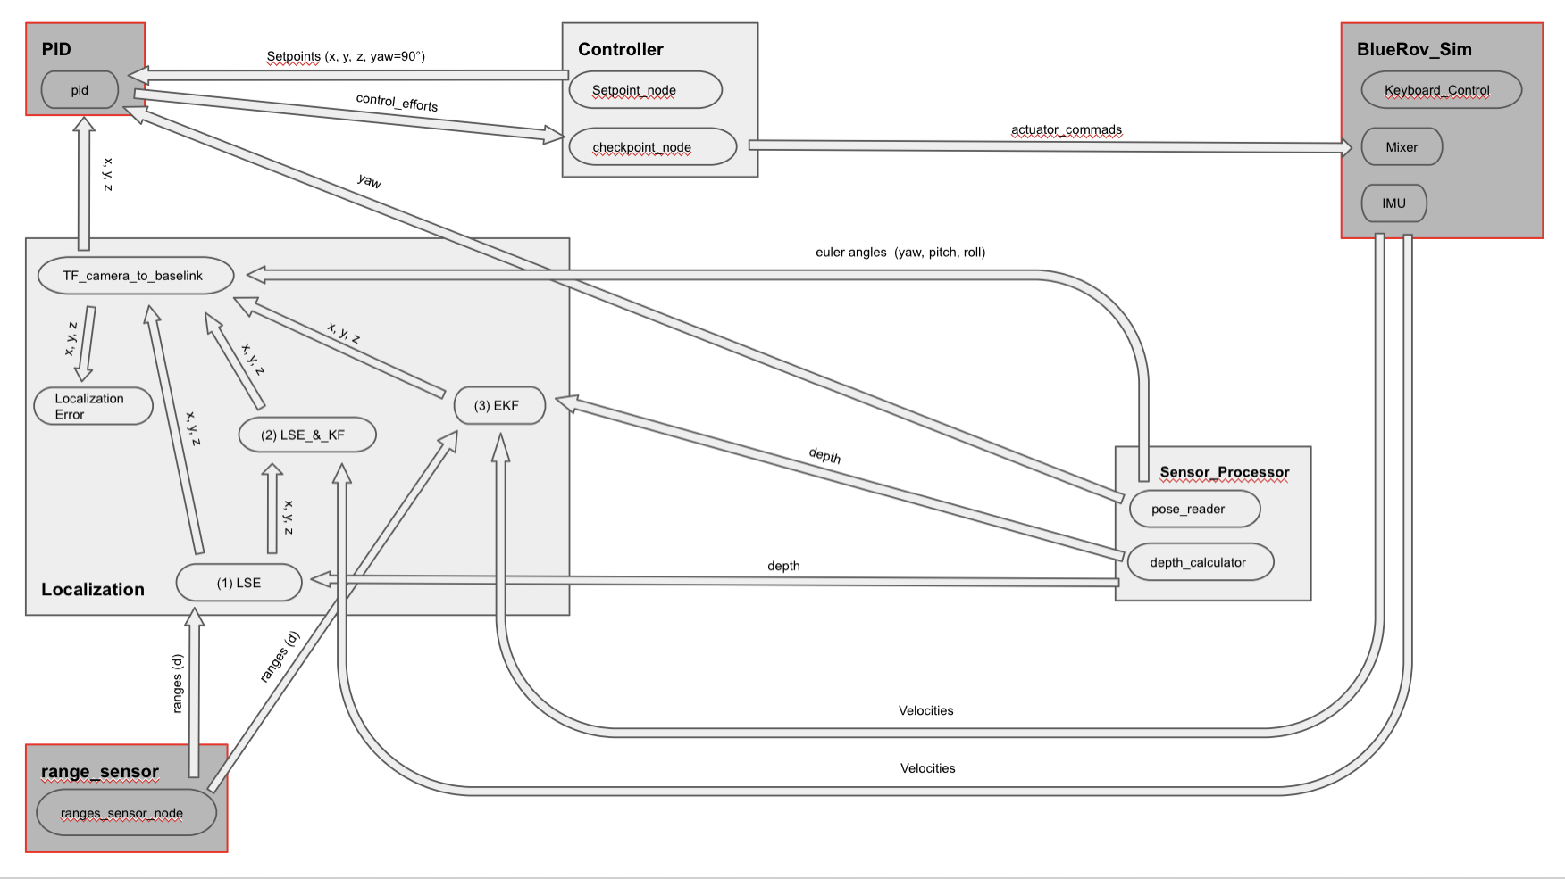






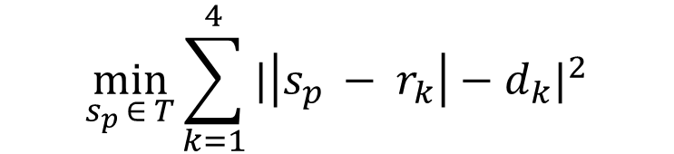

















Controller and Localization
Wet Whale: Asan Adamanov¹, Sven Dierfeld¹, Tolga Dirikgil¹, Jonathan Hellwig²
¹Hamburg University of Technology, Hamburg, Germany, ²University of Hamburg, Hamburg, Germany
Localization
Node Structure
Tag to ROV distances & with pressure calculated depth
$d_{1}$, $d_{2}$, $d_{3}$, $d_{4}$, $depth$
LSE
Package
Node
LSE
$$s_{p}$$
EKF
Messages sent
KF
Least Square
Estimation (LSE)
Controller
Evaluation
$$s_{p}= \left[\begin{matrix}x \\ y \\ z\end{matrix}\right]$$
Method
Current Position
Expectation: LQR/LQG
Reality: 4 independent PIDs
$$\min_{s_{p }∈ T}{\sum_{k=1}^{4}{|\left|s_{p }− r_{k}\right|−d_{k}|^{2}}}$$
z
h
yaw
Kalman Filter (KF)
Extended Kalman Filter (EKF)
Prediction
Prediction
y
$$s^{′}=Fs+u$$
$$s^{′}=Fs+u u=0$$
$$P^{′}=FPF^{T}+Q$$
$$P^{′}=FPF^{T}+Q$$
Measurement update
Measurement update
x
$$y=z−Hx′$$
$$y=z−J_{H_{1}}x′$$
One PID for each of these states
$$S=HP′H^{T}+Q$$
$$S=J_{H_{1}}P′J_{H_{1}}^{T}+Q$$
$$K=P′H^{T}S^{−1}$$
$$K=P′J_{H_{1}}^{T}S^{−1}$$
$$s=s′+Ky$$
$$s=s′+Ky$$
Pitch and roll?
$$P=\left(I−KH\right)P′$$
$$P=\left(I−KJ_{H_{1}}\right)P′$$
Mapping state to range
Mapping state to depth
Mechanically stable on their own!
$H_{1}\left(s\right)=(|s_{p}−r_{k}|)_{k=1}^{4}$
$$H_{2}\left(s\right)=\left(0,0,1,0,0,0\right)∗s$$
Constant velocity model
State vector
$$F= \left[\begin{matrix}1 & 0 & 0 \\ 0 & 1 & 0 \\ \begin{aligned}0 \\ 0 \\ 0 \\ 0\end{aligned} & \begin{aligned}0 \\ 0 \\ 0 \\ 0\end{aligned} & \begin{aligned}1 \\ 0 \\ 0 \\ 0\end{aligned} \end{matrix}\begin{matrix}∆t & 0 & 0 \\ 0 & ∆t & 0 \\ \begin{aligned}0 \\ 1 \\ 0 \\ 0\end{aligned} & \begin{aligned}0 \\ 0 \\ 1 \\ 0\end{aligned} & \begin{aligned}∆t \\ 0 \\ 0 \\ 1\end{aligned}\end{matrix}\right]$$
$$s= \left[\begin{matrix}x \\ y \\ \begin{matrix}\begin{matrix}z \\ v_{x}\end{matrix} \\ v_{y} \\ v_{z}\end{matrix}\end{matrix}\right]$$
Final Project?
Jacobian of state to range mapping function
Environment mapping
Obstacle avoidance
Face recognition to be able saying hello to people near the tank
$$J_{H_{1}}\left(s\right)= \left[\begin{matrix}\begin{matrix}\frac{x−r_{1_{x}}}{\left|s_{p}− r_{1}\right|} \\ \frac{x−r_{2_{x}}}{\left|s_{p}− r_{2}\right|}\end{matrix} & \begin{matrix}\frac{y−r_{1_{y}}}{\left|s_{p}− r_{1}\right|} \\ \frac{y−r_{2_{y}}}{\left|s_{p}− r_{2}\right|}\end{matrix} & \begin{matrix}\begin{matrix}\frac{z−r_{1_{z}}}{\left|s_{p}− r_{1}\right|} & 0 & \begin{matrix}0 & 0\end{matrix}\end{matrix} \\ \begin{matrix}\frac{z−r_{2_{z}}}{\left|s_{p}− r_{2}\right|} & 0 & \begin{matrix}0 & 0\end{matrix}\end{matrix}\end{matrix} \\ \frac{x−r_{3_{x}}}{\left|s_{p}− r_{3}\right|} & \frac{y−r_{3_{y}}}{\left|s_{p}− r_{3}\right|} & \begin{matrix}\frac{z−r_{3_{z}}}{\left|s_{p}− r_{3}\right|} & 0 & \begin{matrix}0 & 0\end{matrix}\end{matrix} \\ \frac{x−r_{4_{x}}}{\left|s_{p}− r_{4}\right|} & \frac{y−r_{4_{y}}}{\left|s_{p}− r_{4}\right|} & \begin{matrix}\frac{z−r_{4_{z}}}{\left|s_{p}− r_{4}\right|} & 0 & \begin{matrix}0 & 0\end{matrix}\end{matrix}\end{matrix} \right]$$

