Slide 1
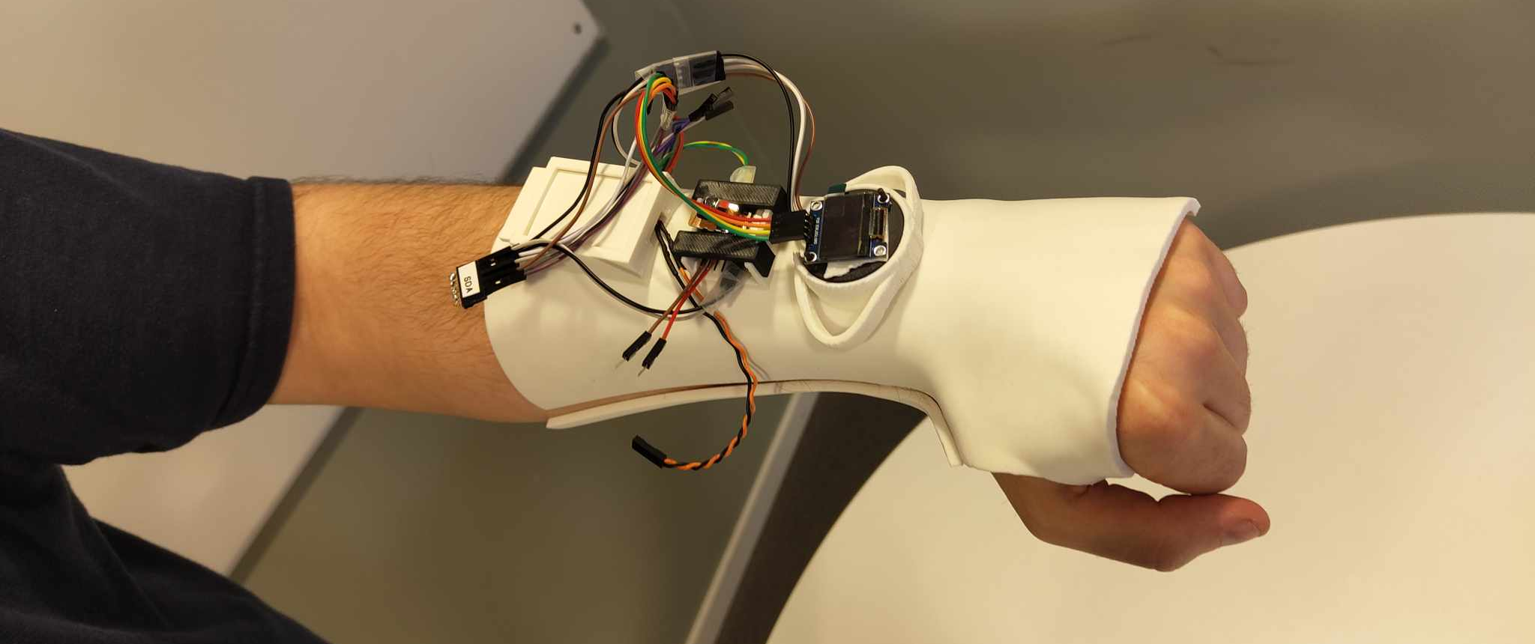

Compliance Monitoring Orthosis
Adam Emile Aske
Viktoria Huszar
Yang Cui Solås
Notes:
Introduction
We are presententing our project developing a compliane monitoring static wrist orhtosis

Slide 2
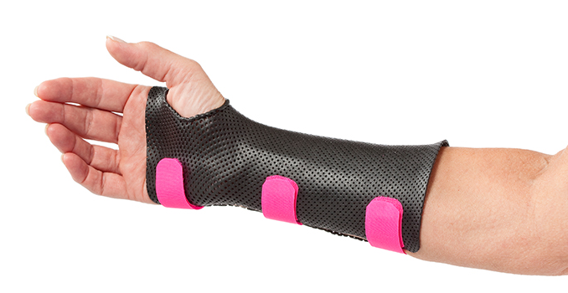
Orthoses
Purpose
Different types
Problems
Potential
Notes:
Introduction to what an orthosis is:
SCRIPT HERE
What are static orthosis for?
What types exitsts?
What are the problems with current manufacturing and orthses
What are some potenial fixes -> 3D Scanning and 3D Priniting may offer intersting solutions to these problems

Slide 3

Compliance Monitroing
Why compliance monitoring
Traditional compliance monitoring
Our solution for improvements
3D Scanned
3D Printed
Sensors
Notes:
How we implemneted

Slide 4
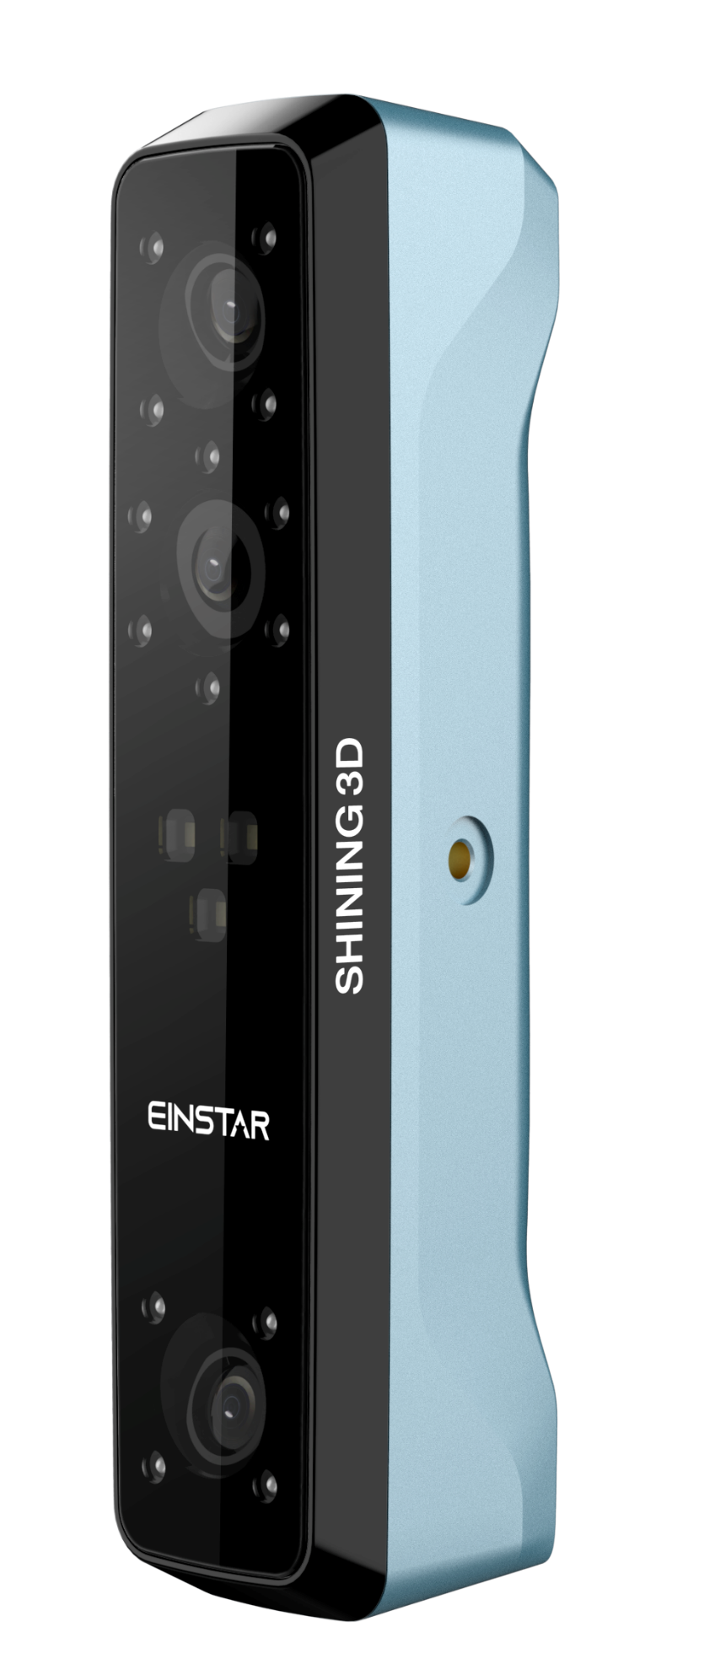
3D Scanning
Einstar
Brief technology
Advatges of 3D scanning
Somehting
Notes:
INTRODUCTION TO 3D SCANNING
SCRIPT HERE
What is 3D Scanning ? -> Turn reallife stuff into di3D models
Advatages of 3D scanning comapred to other methods -> Alternative technolgoies
How can 3D scanning be acomplished ? -> Einstar 3D skanner

Slide 5
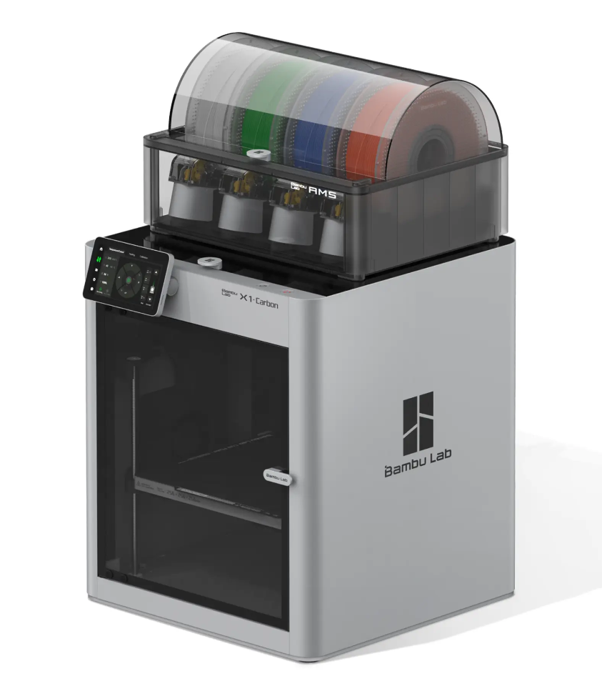
3D PRINTING
Biocompatibility
Strength
Weight
Rigidity
Notes:
INTRODUCTION TO 3D PRINTING

Slide 6

Methodology
Literature Review
3D Scans
3D Printing
Electronics
Testings

Slide 7
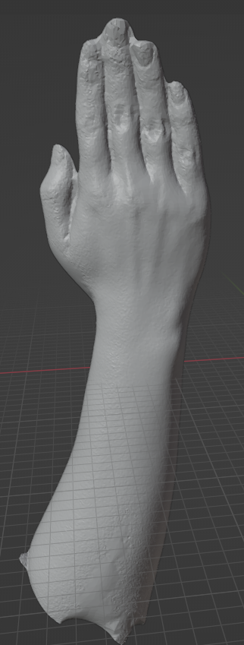
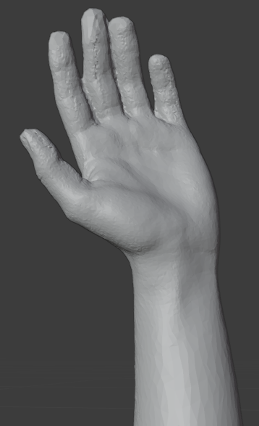
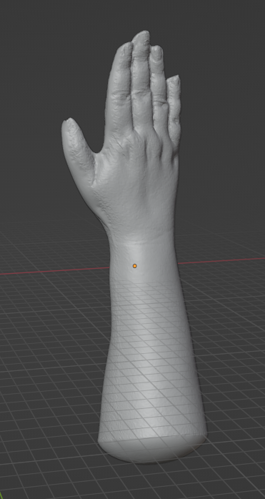
3D SCANNING
Notes:
The art of turning objects into digital 3D models.

Slide 8
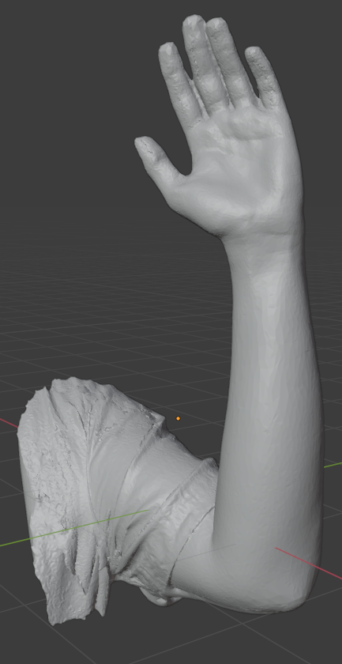
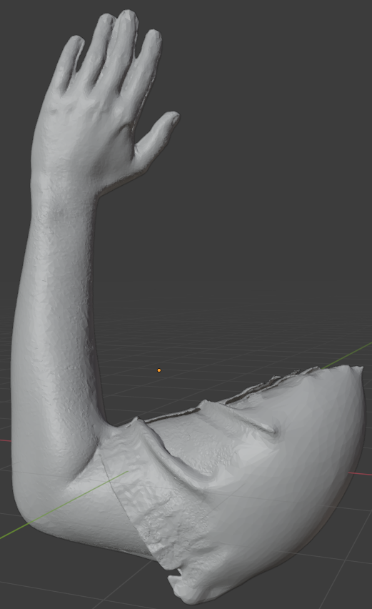

Slide 9
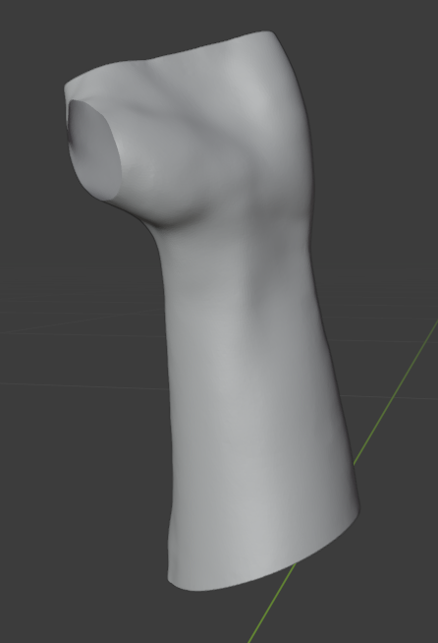
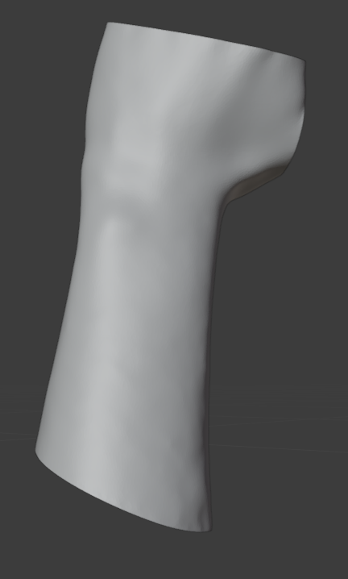

Slide 10
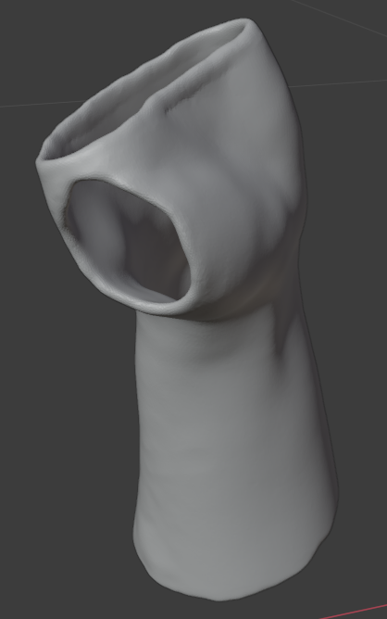
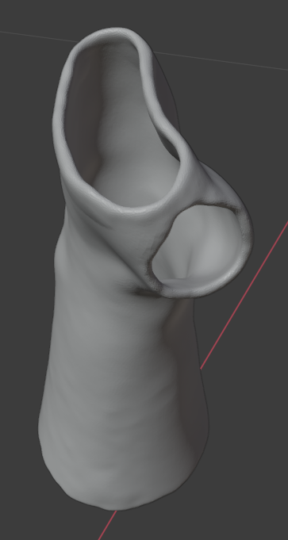

Slide 11
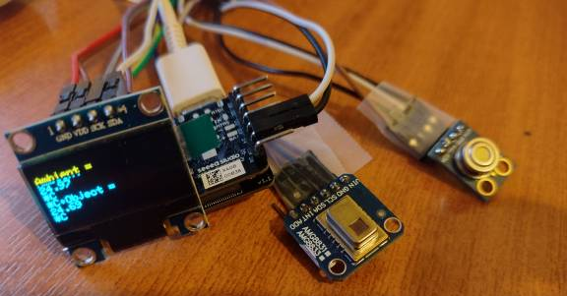
Electronics
Microcontroller
SD Card
Battery
OLED Screen
Tempretaure Sensor
Notes:
Infrared temperature sensor
Contactless
Emissivite
Human preseance sensor
Skin specific infrared radiation
Thresholds
Lense oppurtunities
3D print in black

Slide 12
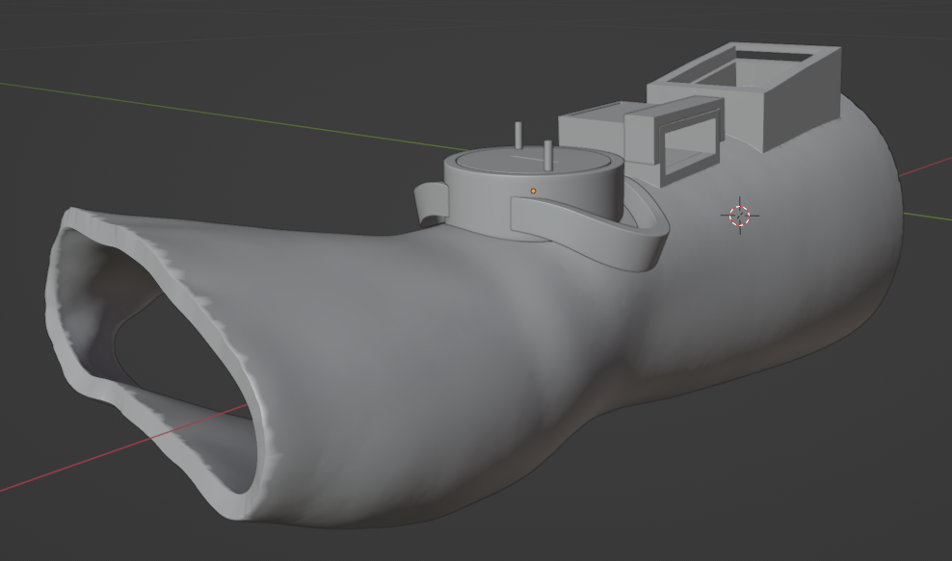

Slide 13
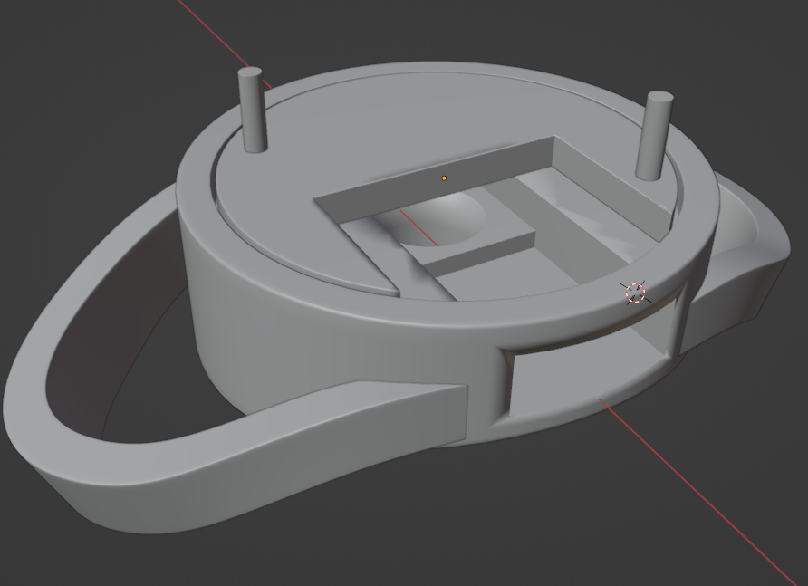

Slide 14
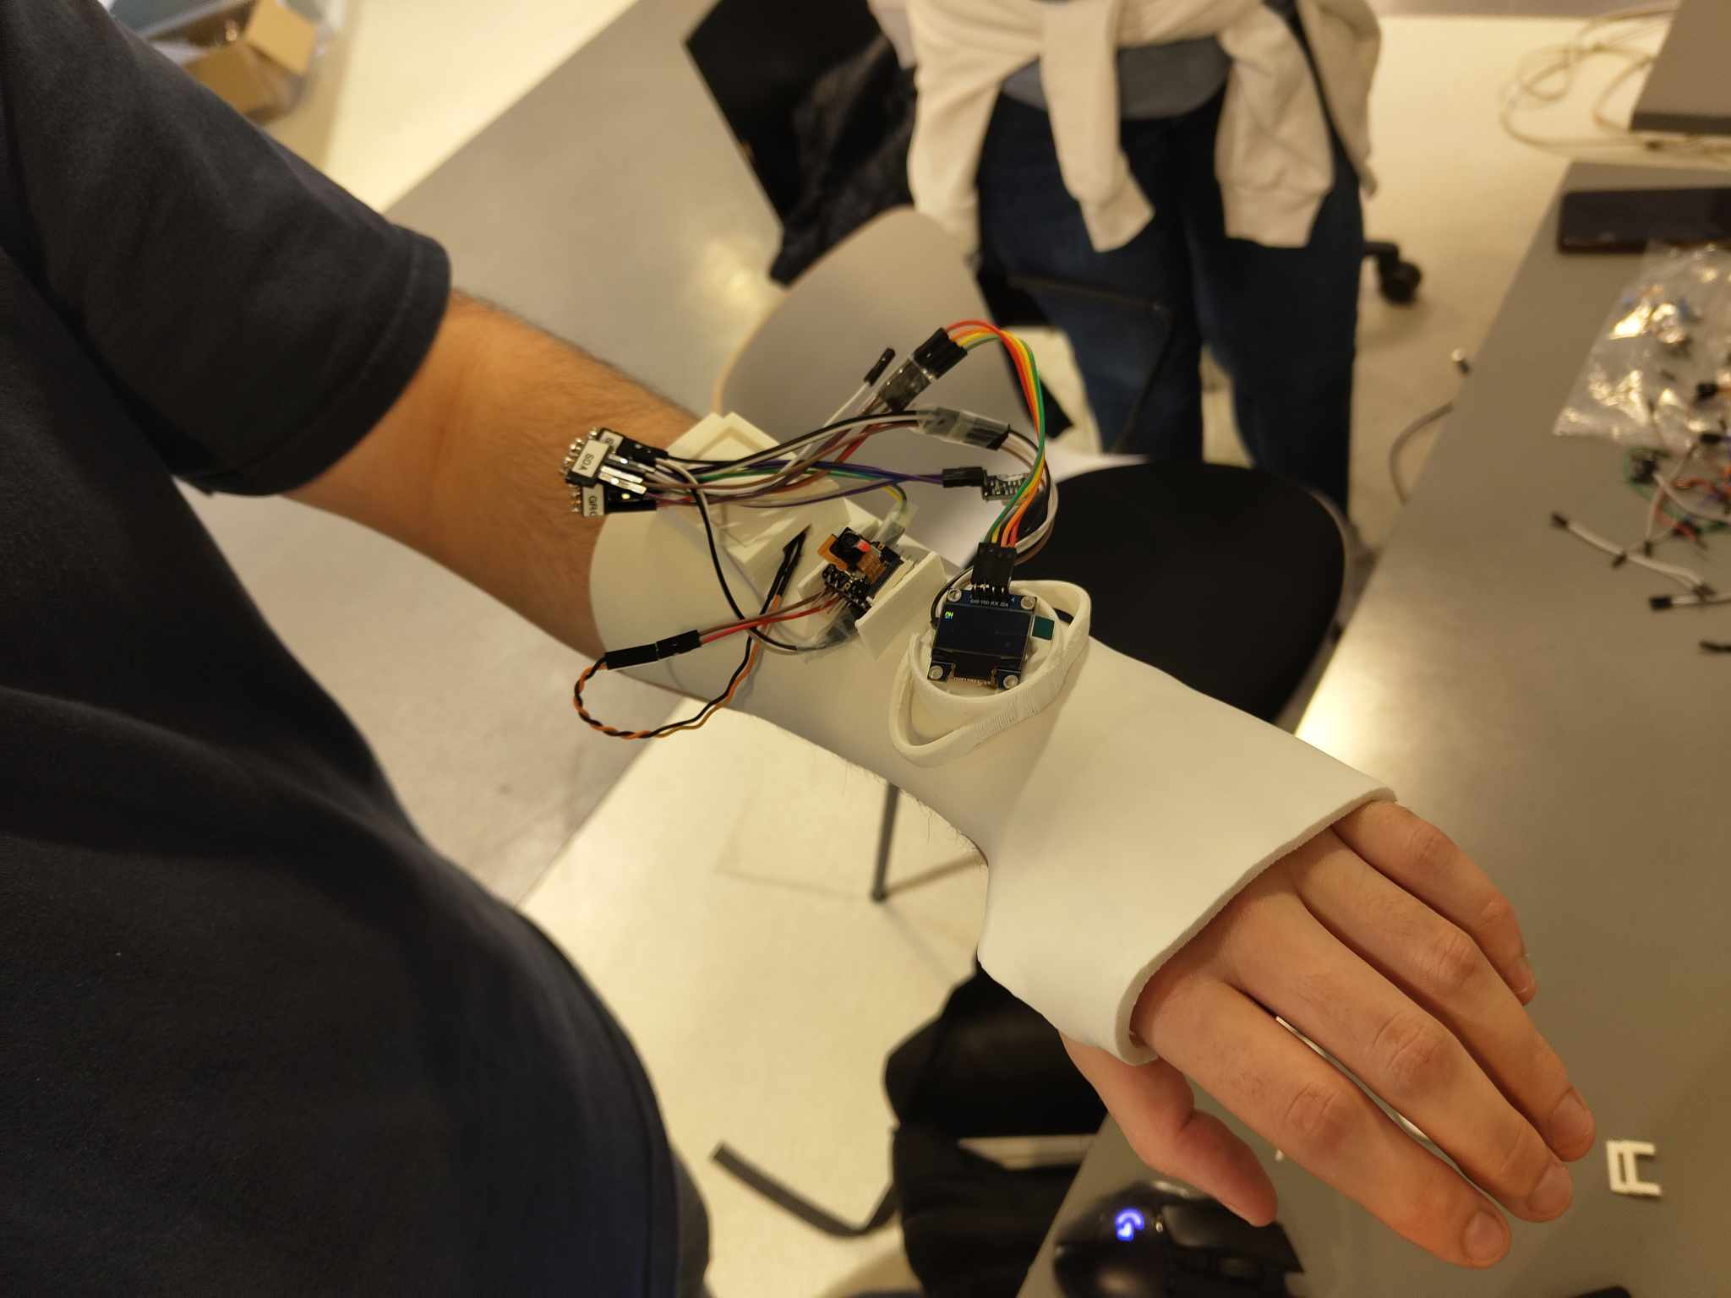
Final Product
Screen says ON / OFF
Writes to SD Card
Removable Mechanism
Notes:
So all in all we have developed a static wrist orthosis via 3D scanning and printing. It is enabled with sensory elements enabling wear detection. Specfiically, an infrared tempreature sensor is measured by an ESP32 microcontroller.
The microcontroller periodically reads the temperature sensor and logs it to the SD card, achieveing compliance monitoring.

Slide 16
Testing
How will we test?
Temprature calibration
SD Card graphs
Block design

Slide 17
Future Work
WiFi
Sensor Fusion
Battery

Slide 18
Sources
Orfit, 2018, The Circumferential Wrist Orthosis, https://www.orfit.com/physical-rehabilitation/blog/splint-in-the-spotlight-the-circumferential-wrist-orthosis-
Zoho, 2019, 10 Reasons Why Time Tracking Matters, https://www.zoho.com/blog/invoice/10-reasons-tracking-time-matters.html
Research Methods, Study-Aids, 2012, https://study-aids.co.uk/dissertation-blog/research-methods/

