Slide 1
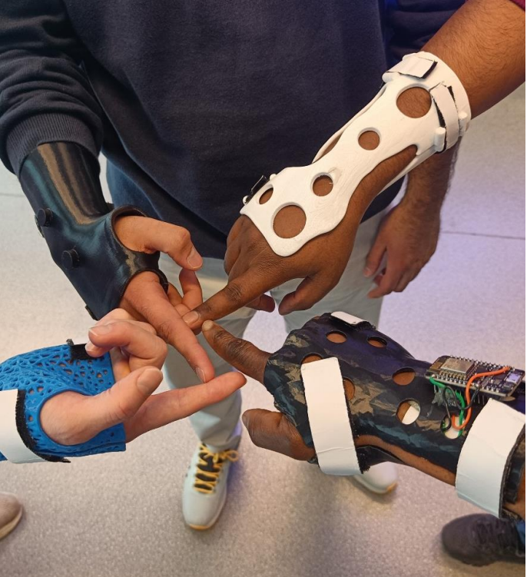

3D SCANNING & PRINTING
ORTHOSIS

Slide 2
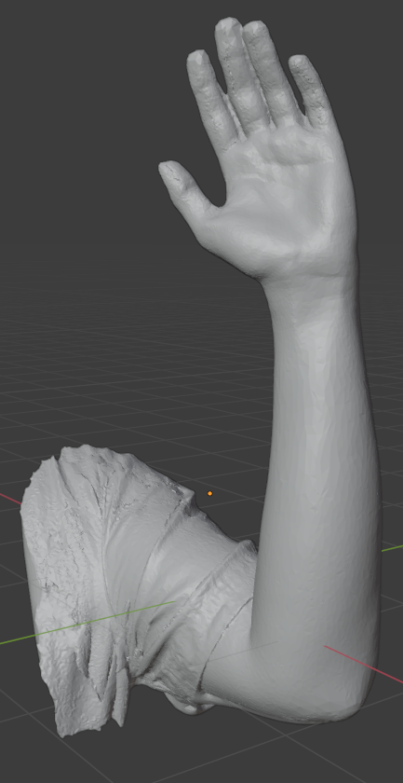
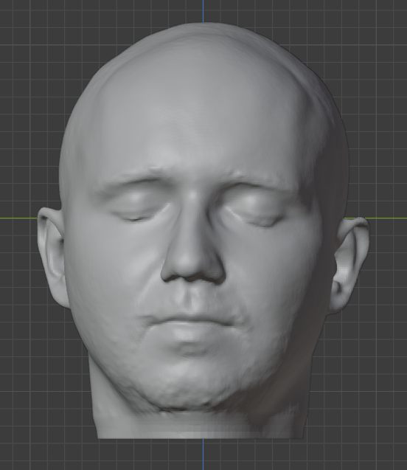
3D SCANNING
Notes:
The art of turning objects into digital 3D models.

Slide 3
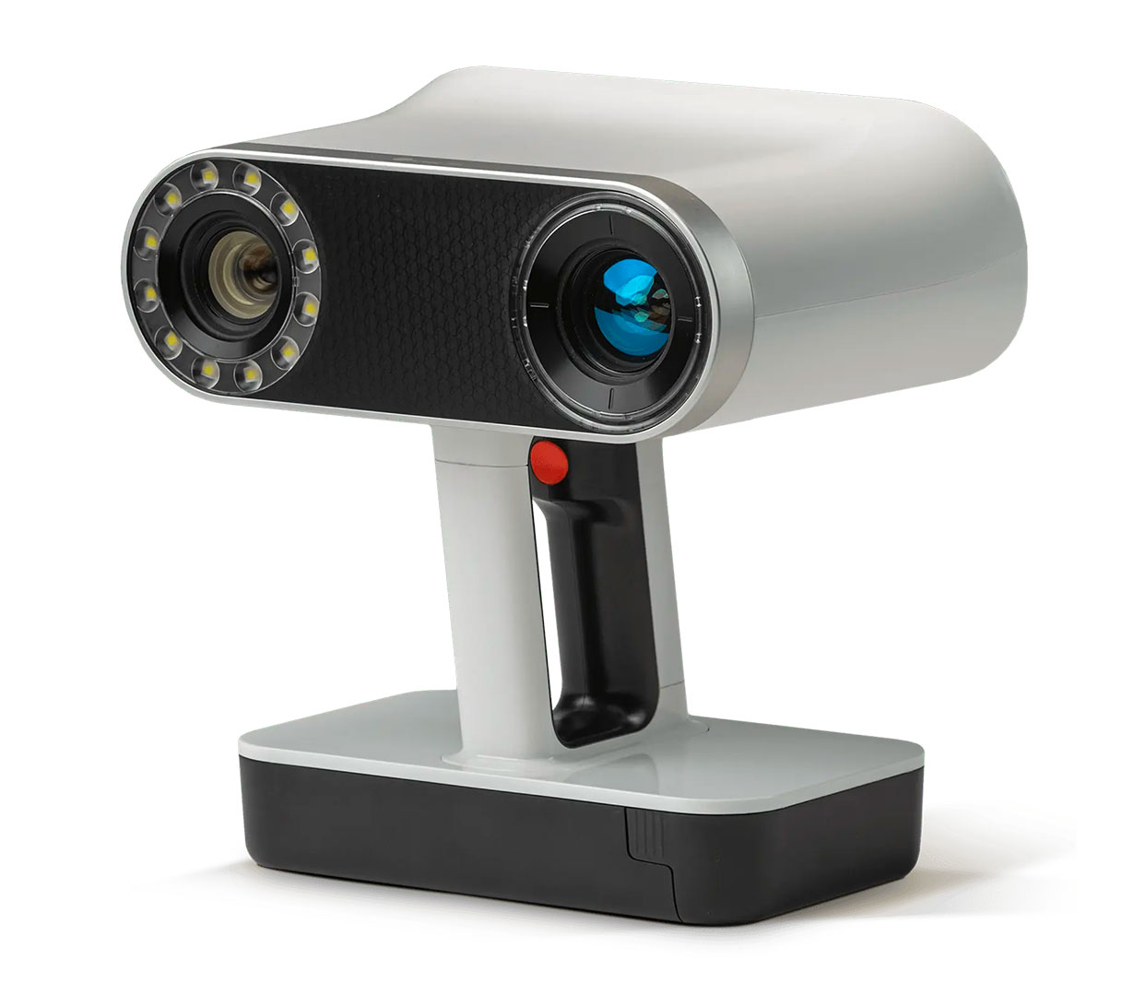
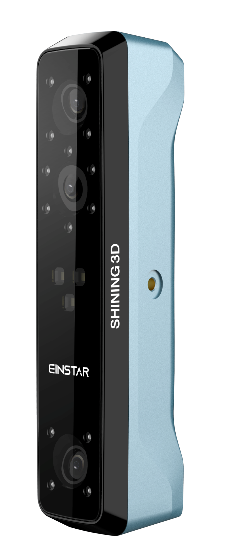
Artec Leo
Einstar
Notes:
Two examplse of 3D scanners. These are basicly fancy infrared cameras. By swirling these around an object, they can produce highly detailed 3D models.

Slide 4
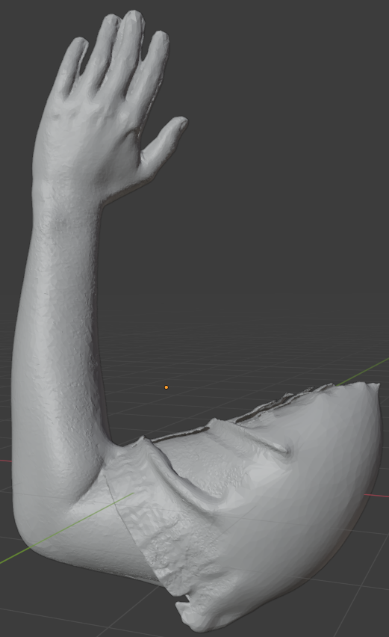

Slide 5
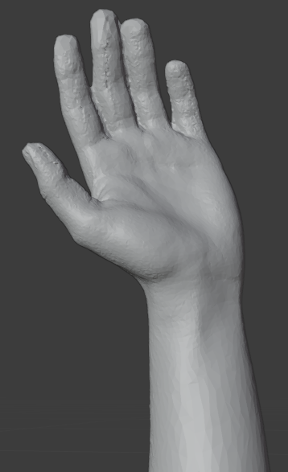

Slide 6
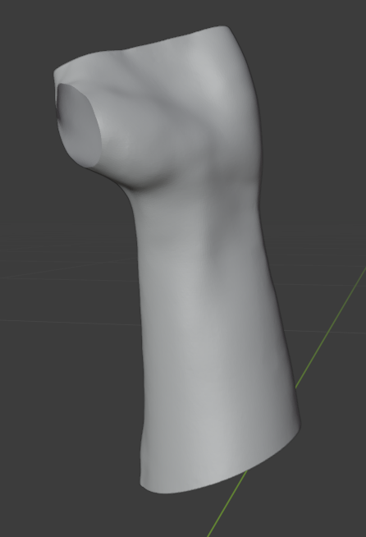
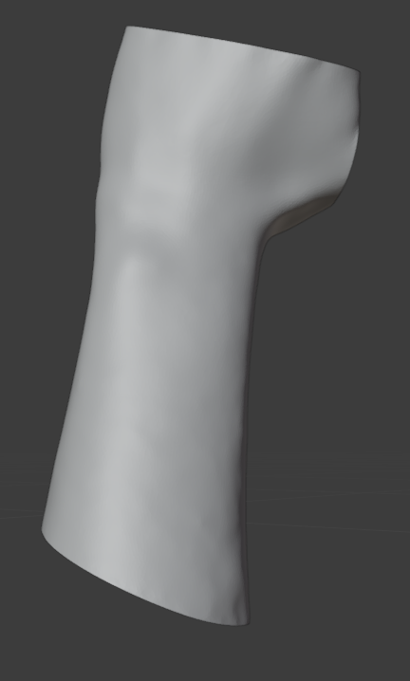

Slide 7
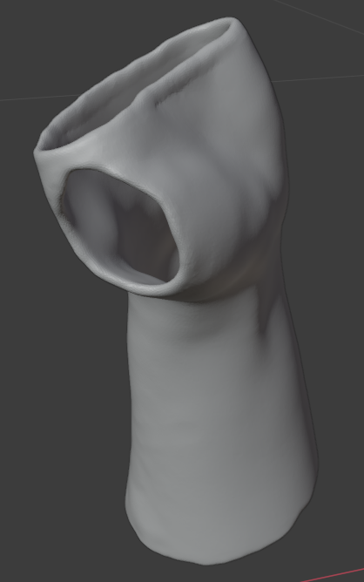
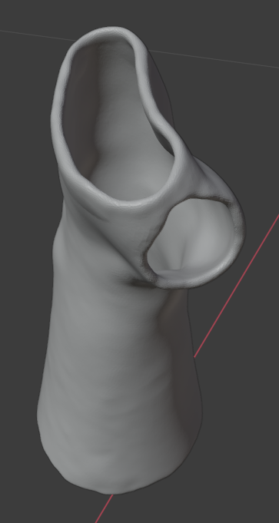

Slide 8
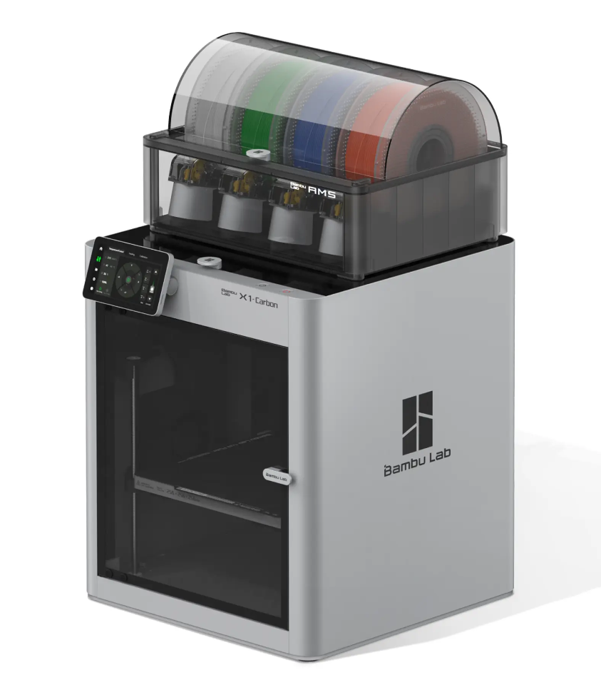
3D PRINTING
Biocompatibility
Strength
Weight
Rigidity

Slide 9
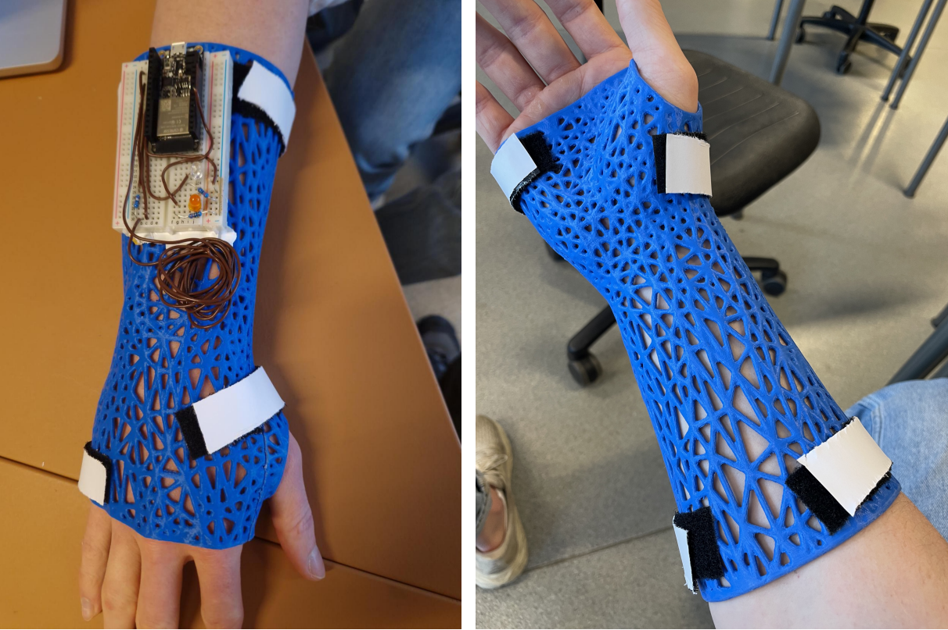

Slide 10
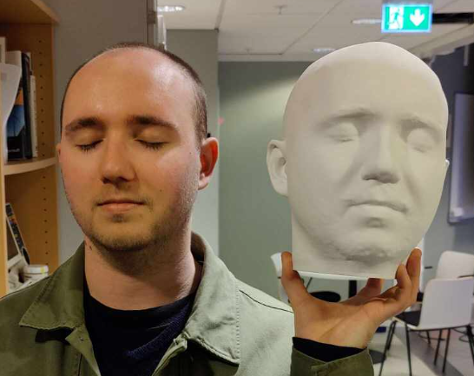
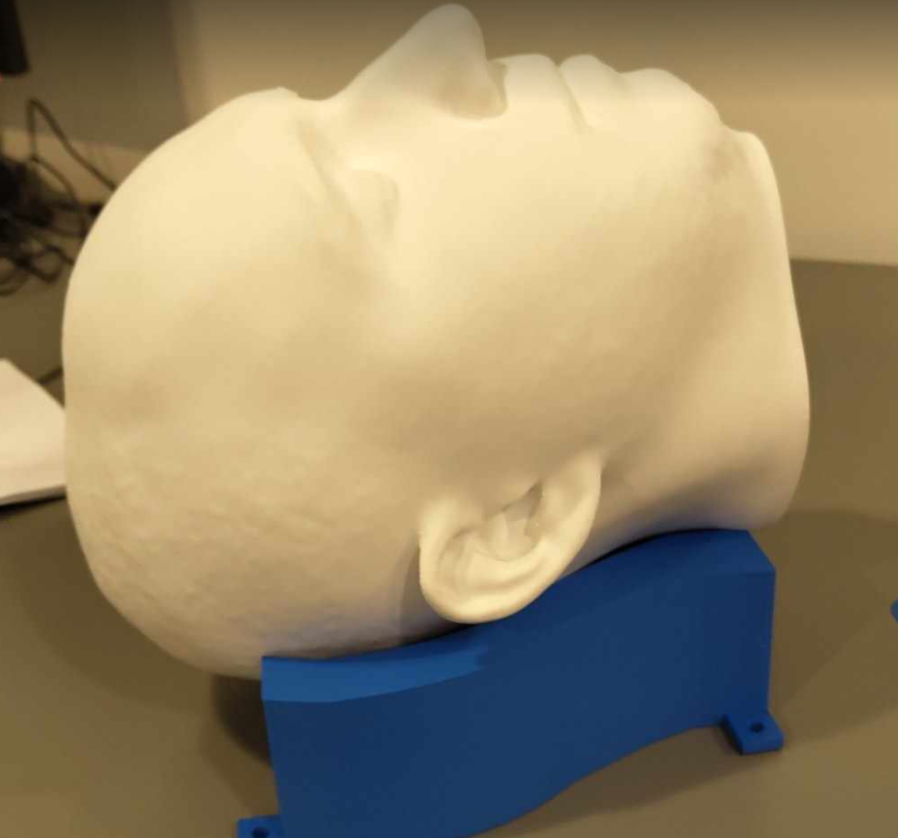

Slide 11
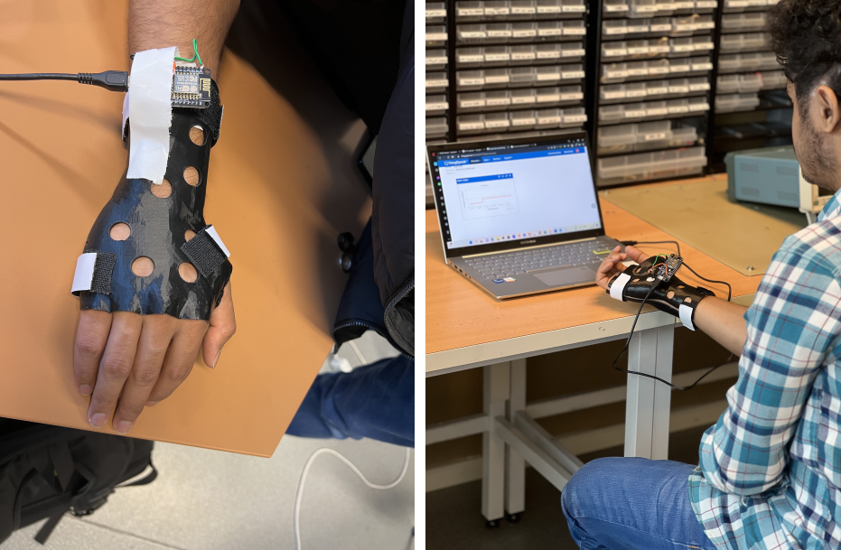
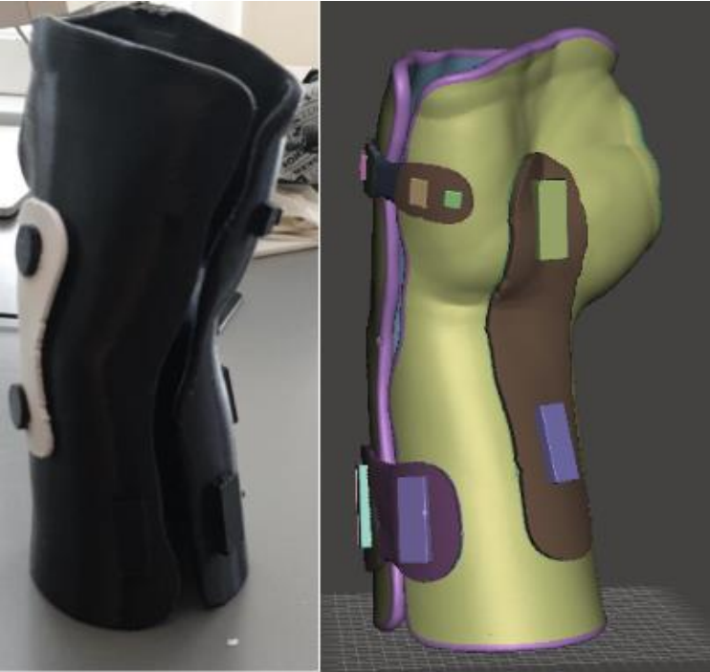
Strong
Lightweight
Rigidity
Iteration speed
Design flexibility
Breathability
Comfort

Slide 12
Sensors
Temperature
Movement
Heart rate
Pressure
Components
Elastic bands
Motors
Hooks

Slide 13

TIME TRACKING
Objective time-worn measurements
Sensor integration
USB-PC interface

Slide 14
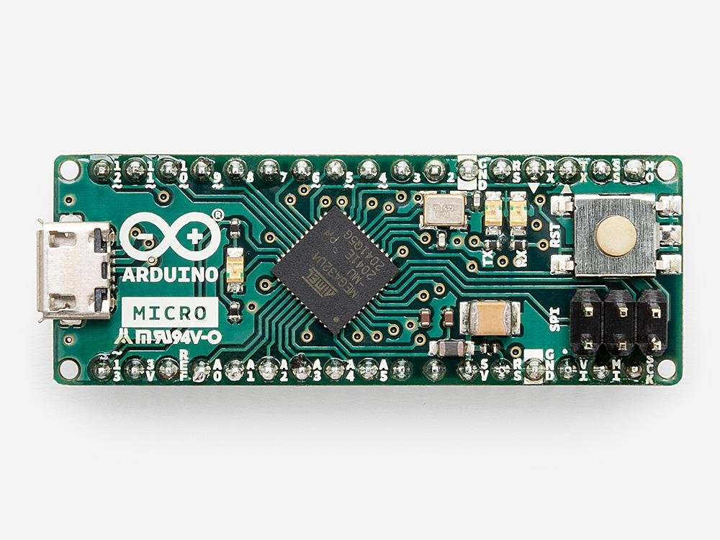
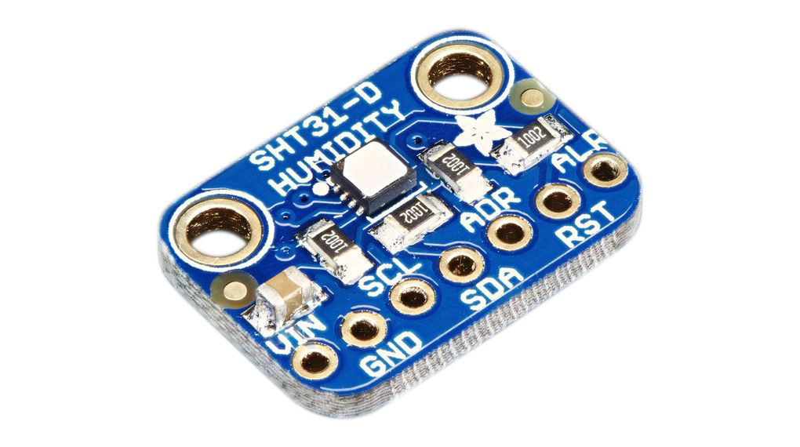
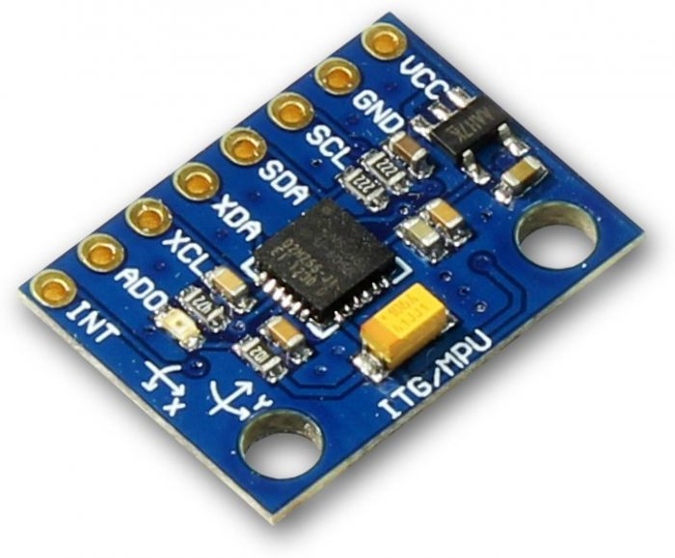
TIME TRACKING
Temperature
Accelerometer
Micorcontroller

Slide 16
Sources
“Smart Orthosis by using 3D scanning and printing technique” - Yameen Irteza Hossain, Devendra Joshi, Joshua Ifeanyi Okonkwo
“Implementing 3D Scan-model-print for orthosis
development” - Ali Abdinur Ali, Yousaf Muzafar Yousaf, Marwa Sabeeh Alogidi
“Enhancing Rehabilitation with Custom 3D Printed
Orthoses Integrated with Sensory Technology for
Arm and Wrist Injuries” - Ifunanya Barbara Onyekwelu, Muhammad Umar Anwar, Andreas Kjernlie
https://eu.store.bambulab.com/en-no/products/x1-carbon-3d-printer
https://www.artec3d.com/de/portable-3d-scanners/artec-leo
https://www.einstar.com/products/einstar-3d-scanner?variant=43551575507118

