Slide 1
Lecture 2 – Introduction to Algorithms
CST370 – Design & Analysis of Algorithms
Dr. Byun
Computer Science

Slide 2
Lecture Objectives
After completion of this lecture, you will be able to
  describe the definition of algorithm.
  calculate the greatest common divisor (gcd) using three different approaches.
  introduce an algorithm to generate prime numbers.

Slide 3
Chapter 1: Introduction
1.1 What is an Algorithm?
1.2 Fundamentals of Algorithmic Problem Solving
1.3 Important Problem Types
1.4 Fundamental Data Structures

Slide 4
What is an algorithm?
An algorithm is a sequence of unambiguous instructions for solving a problem, i.e., for obtaining a required output for any legitimate input in a finite amount of time.

Slide 5
The Notion of Algorithm

Slide 6
Example – GCD Calculation
The greatest common divisor of two nonnegative, not-both-zero integers m and n, denoted gcd(m, n), is defined as the largest integer that divides both m and n evenly, i.e., with a remainder of zero.
  In the description, note that input values, m and n, can’t be zero at the same time.

Slide 7
Example

Slide 8
Euclid’s Algorithm
Euclid’s algorithm is based on repeated application of equality
gcd(m, n) = gcd(n, m mod n)
until the second number becomes 0, which makes the first number become the solution.

Slide 9
Euclid’s Algorithm – Example 1

Slide 10
Euclid’s Algorithm – Example 2

Slide 11
Exercise

Slide 12
More Structured Description of Euclid’s Algorithm
Euclid’s algorithm for computing gcd(m, n)
  Step 1 If n = 0, return m and stop; otherwise go to Step 2
  Step 2 Divide m by n and assign the value for the remainder to r
  Step 3 Assign the value of n to m and the value of r to n. Go to Step 1.

Slide 13
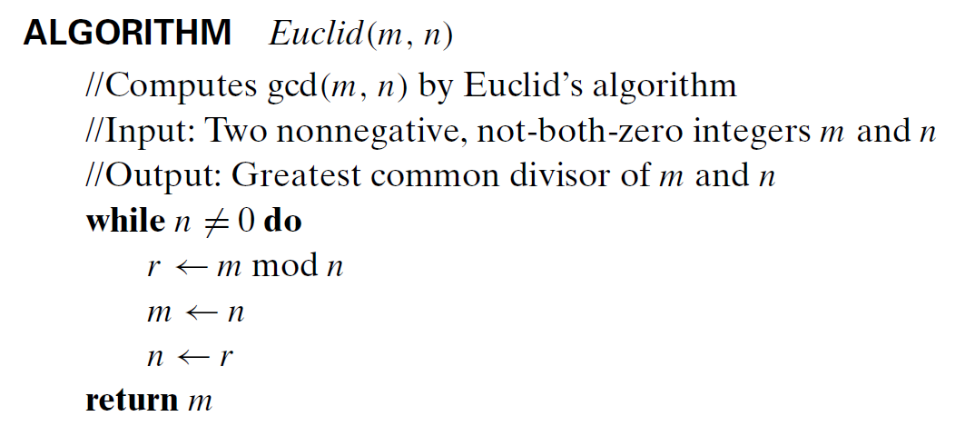
Alternative description – Pseudocode

Slide 14
Pseudocode (1 of 3)
Pseudocode is an informal high-level description of an algorithm.
  It uses the structural conventions of a normal programming language.
  It typically omits details that are essential for machine understanding of the algorithm, such as variable declarations.
No standard for pseudocode syntax exists.
  In the class, we will try to follow the pseudocode convention in our textbook.

Slide 15
Pseudocode (2 of 3)
The pseudocode in the textbook does not contain error handling used in the actual programming implementation.
  Therefore, you should assume that the algorithms described in the textbook work only on the appropriate inputs.

Slide 16
Pseudocode (3 of 3)
Read the following document to get the basic pseudocode notation used in our textbook.
  https://goo.gl/H88yR1

Slide 17
Pseudocode Example
Algorithm Average (A[0..n-1])
// Input: An array A with n numbers from
// the index 0 to n-1
// Output: Average of numbers in an array A
sum ← A[0]
for i ← 1 to n - 1 do
sum ← sum + A[i]
avg ← sum / n
return avg

Slide 18
Two Other Methods to Calculate GCD
Euclid’s algorithm works well to find gcd.
However, there exist several other approaches to compute it.

Slide 19
Consecutive integer checking for gcd
Step 1 Assign the value of min{m,n} to t
Step 2 Divide m by t. If the remainder is 0, go to Step 3; otherwise, go to Step 4
Step 3 Divide n by t. If the remainder is 0, return t and stop;otherwise, go to Step 4
Step 4 Decrease t by 1 and go to Step 2

Slide 20
Middle-school procedure for gcd
Step 1 Find the prime factorization of m
Step 2 Find the prime factorization of n
Step 3 Find all the common prime factors
Step 4 Compute the product of all the common prime factors and return it as gcd(m,n)

Slide 21
Middle-school procedure – Example

Slide 22
Some Important Points for Algorithms
Input has to be specified carefully.
The same algorithm can be represented in several different ways.
Several algorithms for solving the same problem may exist.
Algorithms for the same problem can be based on very different ideas and can solve the problem with dramatically different speeds.

Slide 23
Sieve of Eratosthenes
This is an algorithm to identify prime numbers.
Example

Slide 24
Sieve of Eratosthenes - Resource
To get the basic idea of the algorithm, watch this video
  https://youtu.be/klcIklsWzrY

Slide 25
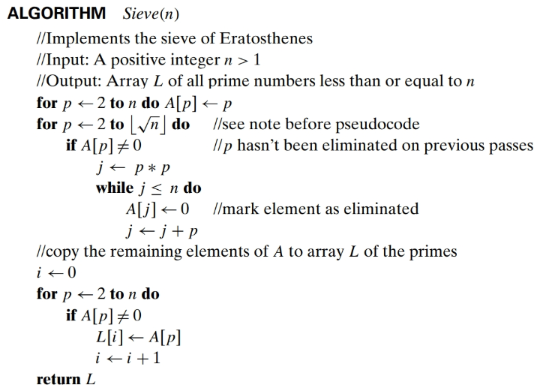

Slide 26
Algorithmic Puzzle

Slide 27
Solution

