Slide 1
Lecture 2 (2) – Introduction to HackerRank.com for Homework
CST370 – Design & Analysis of Algorithms
Dr. Byun
Computer Science

Slide 2
C++ Programming in CST370
In the class, you will use repl.it for the programming.
  Example: https://repl.it/@YBYUN/HelloCST370
As another platform, especially for homework, you will use hackerrank.com
  https://www.hackerrank.com
  If you don’t have an account of it, create one at the website.

Slide 3
HackerRank.com for Homework
Using the website, you will be able to test your homework program and see how many test cases your program can pass.

Slide 4
Sample Homework
Typically, a homework assignment will be composed of the problem solving part and programming part.
As a sample, go to “Homework 0” on the iLearn and read “hw0.doc”.

Slide 5
Problem Solving Questions
Example question
  In CST370, there will be three exams (= two midterms and one final exam) in the class. (True/False)
Write your answer to the problem solving questions on a PDF file.
  Then, submit it on the iLearn.
  Don’t forget to write your name and class ID at the top of your homework document.

Slide 6
Programming Part
Example: hw0_1.cpp should read input data from an end user and display the correct result on the screen.
Sample run
  Input
    1 1 2
    1 -5 -9
    9
  Output
    3
    -14

Slide 7
Programming Steps for Homework
Read the homework description carefully
Develop the program at repl.it
Test at hackerrank.com
Submit your code on the iLearn

Slide 8
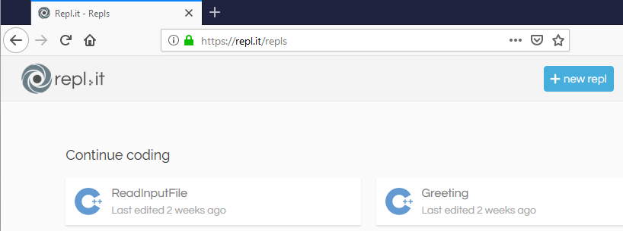
Develop the program at repl.it (1 of 3)
Use the repl.it (https://repl.it/) as your main development tool.

Slide 9
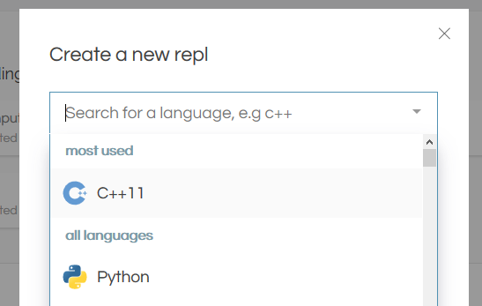
Develop the program at repl.it (2 of 3)
Pick “C++11”.
  Do not pick “C++”.

Slide 10
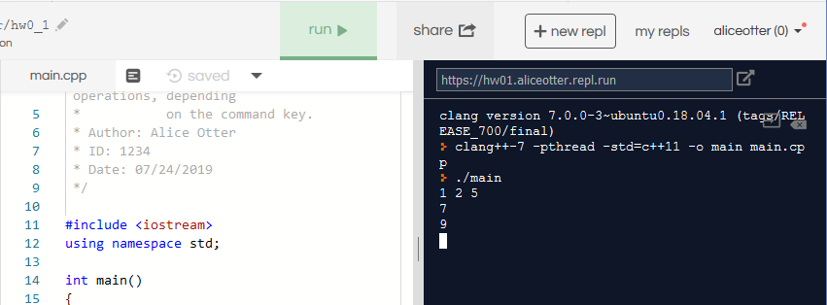
Develop the program at repl.it (3 of 3)
You can test your code while developing it.

Slide 11
Test at hackerrank.com (1 of 9)
After you finish the development at repl.it, go to the HackerRank to test your program against to all test cases of the assignment.
This is a link for the homework 0.
  https://www.hackerrank.com/cst370-s20-hw0

Slide 12
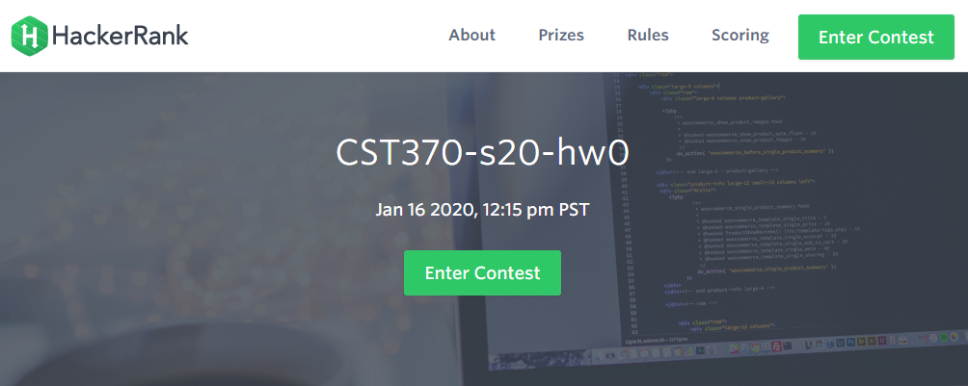
Test at hackerrank.com (2 of 9)
https://www.hackerrank.com/cst370-s20-hw0

Slide 13
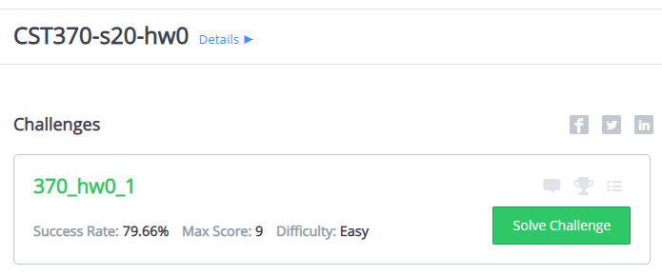
Test at hackerrank.com (3 of 9)

Slide 14
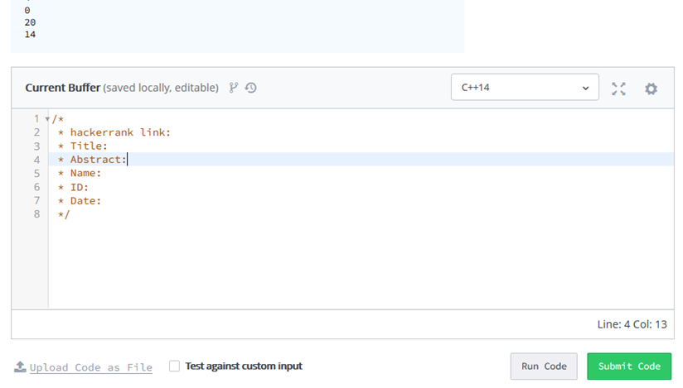
Test at hackerrank.com (4 of 9)

Slide 15
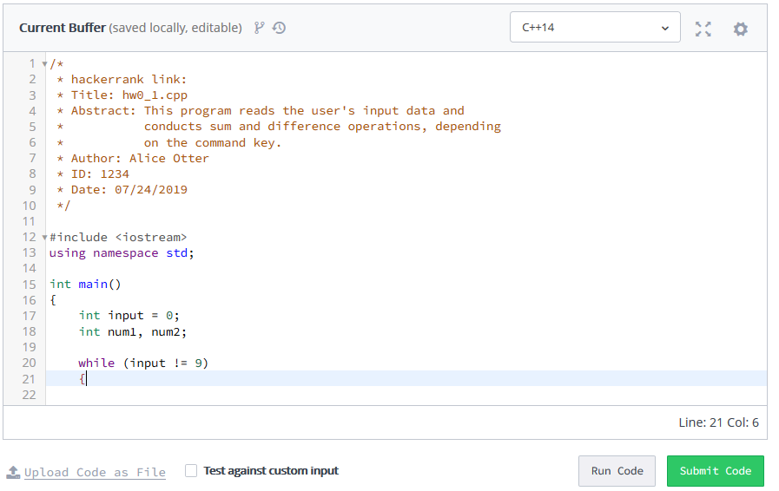
Test at hackerrank.com (5 of 9)

Slide 16
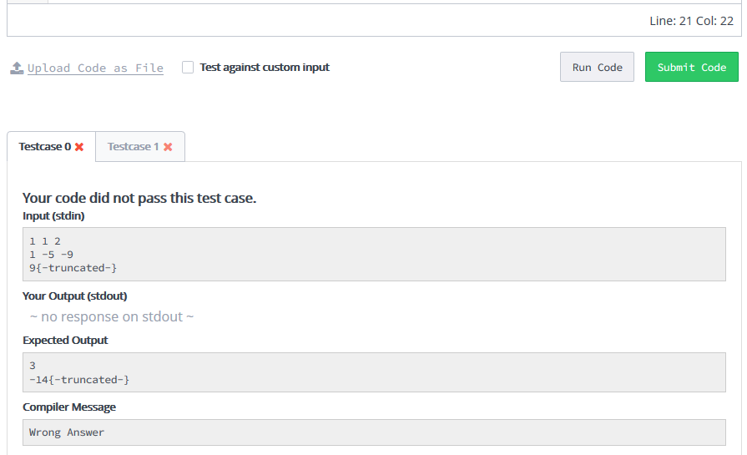
Test at hackerrank.com (6 of 9)

Slide 17
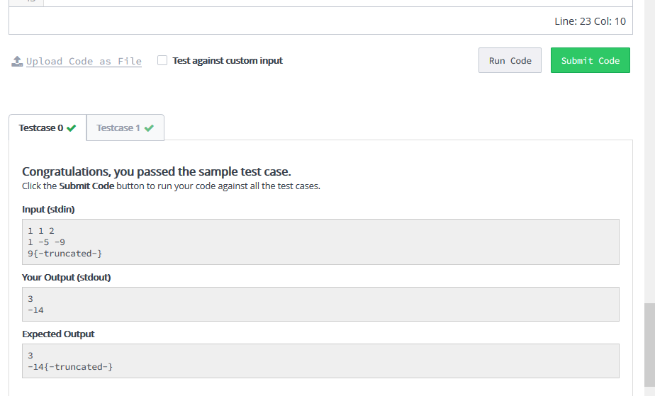
Test at hackerrank.com (7 of 9)

Slide 18
Test at hackerrank.com (8 of 9)

Slide 19
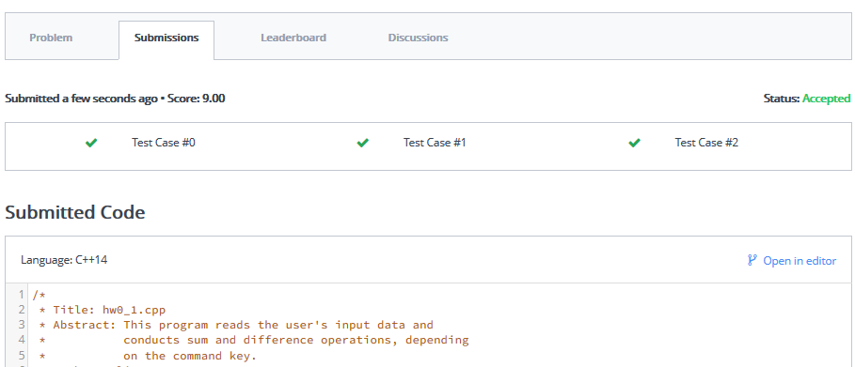
Test at hackerrank.com (9 of 9)

Slide 20
Submit your code on the iLearn
After finishing at hackerrank.com, submit your source code on the iLearn.
  In the source code, you have to include the hackerrank link of your code.
  And also, you should include the head comment such as “Title”, “Abstract”, “ID”, “Name”, and “Date”.

Slide 21
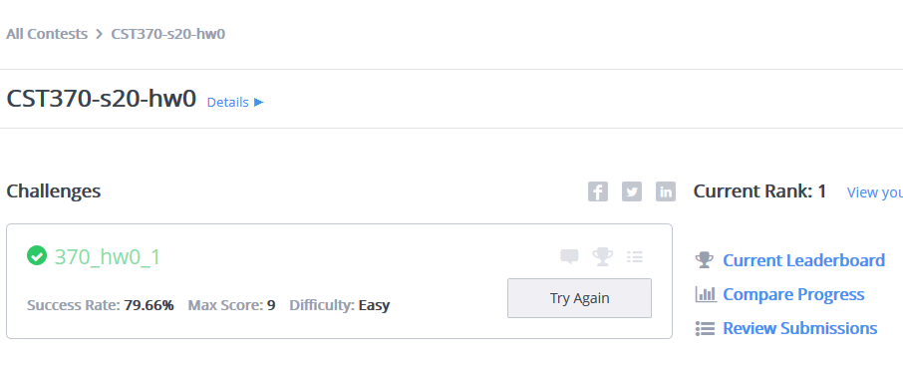
hackerrank link of your source code (1 of 4)

Slide 22
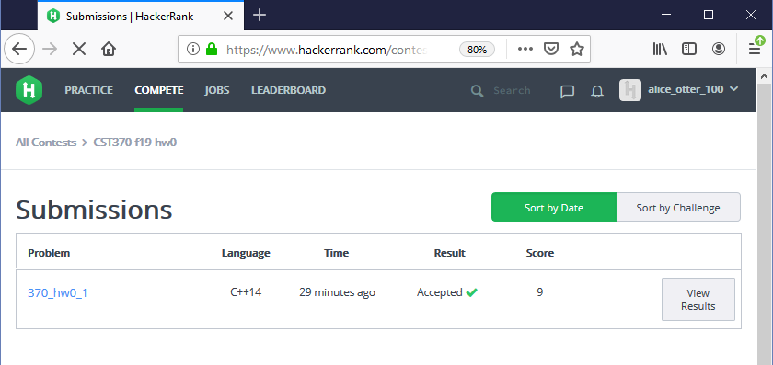
hackerrank link of your source code (2 of 4)

Slide 23
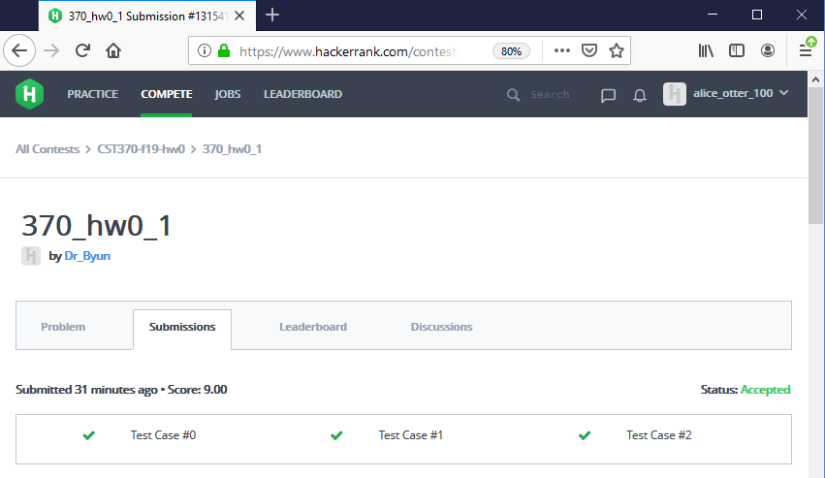
hackerrank link of your source code (3 of 4)

Slide 24
hackerrank link of your source code (4 of 4)
The link will look like this:
  https://www.hackerrank.com/contests/
  cst370-s20-hw0/challenges/370-hw0-1/
  submissions/code/1315417852
Don’t forget to include this link in your source code.
  You will get a lot of penalty if you miss it.
Also, include the head comment.
  You will get the penalty for this as well.

Slide 25
Sample Program of the iLearn Submission
/*
* HackerRank link: https://www.hackerrank.com/contests/cst370-s20-hw0/challenges/370-hw0-1/submissions/code/1315408386
* Title: hw0_1.cpp
* Abstract: This program reads the user's input data and
* conducts sum and difference operations, depending
* on the command key.
* Author: Bob Otter
* ID: 8899
* Date: 01/23/2020
*/
#include <iostream>
using namespace std;
int main()
{
cout << "Hello World!\n";
return 0;
}

Slide 26
Question
What if your source code doesn’t pass all test cases at hackerrank.com?

Slide 27
Homework Submission Summary
Write your answer to the problem solving questions on a PDF file.
  Write your name and class ID.
For the programming questions, submit your C++ source files.
  Pay attention to the file name (e.g., hw0_1.cpp).
  Don’t forget the hackerrank link and head comment.
Due is 11:55(PM).
  Submit it early.

