Slide 1
Lecture 3 – Important Problem Types
CST370 – Design & Analysis of Algorithms
Dr. Byun
Computer Science

Slide 2
Lecture Objectives
After completion of this lecture, you will be able to

Slide 3
Chapter 1: Introduction
1.1 What is an Algorithm?
1.2 Fundamentals of Algorithmic Problem Solving
1.3 Important Problem Types
1.4 Fundamental Data Structures

Slide 4
Why study algorithms?
You can learn a set of standard algorithms in different computing areas.
You will be able to design a new algorithm to solve a new problem and analyze the efficiency of your algorithm.
It is the cornerstone of computer science.
  The computer program will not exist without the algorithm.
  It is also considered a common troubleshooting strategy.

Slide 5
Google Recruiter Email
The following list is a part of an email from a google recruiter regarding their interview questions.
  Many problems are about algorithms.
  Algorithm Complexity: You need to know Big-O. If you have difficulty analyzing the basic Big O complexity, you will rarely be hired.
  Sort: You should know how to sort.
  Hashtables: Probably the single most important single data structure known to mankind. ...
  Tree: ...
  Graph: ...
  Other data structures: As many different data structures and algorithms as possible should be studied.
  …

Slide 6
Basic Issues Related to Algorithms
How to design algorithms
How to analyze algorithm efficiency
Proving correctness
Optimality

Slide 7
Algorithm Design and Analysis Process
An algorithm is a procedural solution to a problem.
  An algorithm is specific instructions for getting an answer.
There is a sequence of steps one typically goes through in designing and analyzing an algorithm.

Slide 8
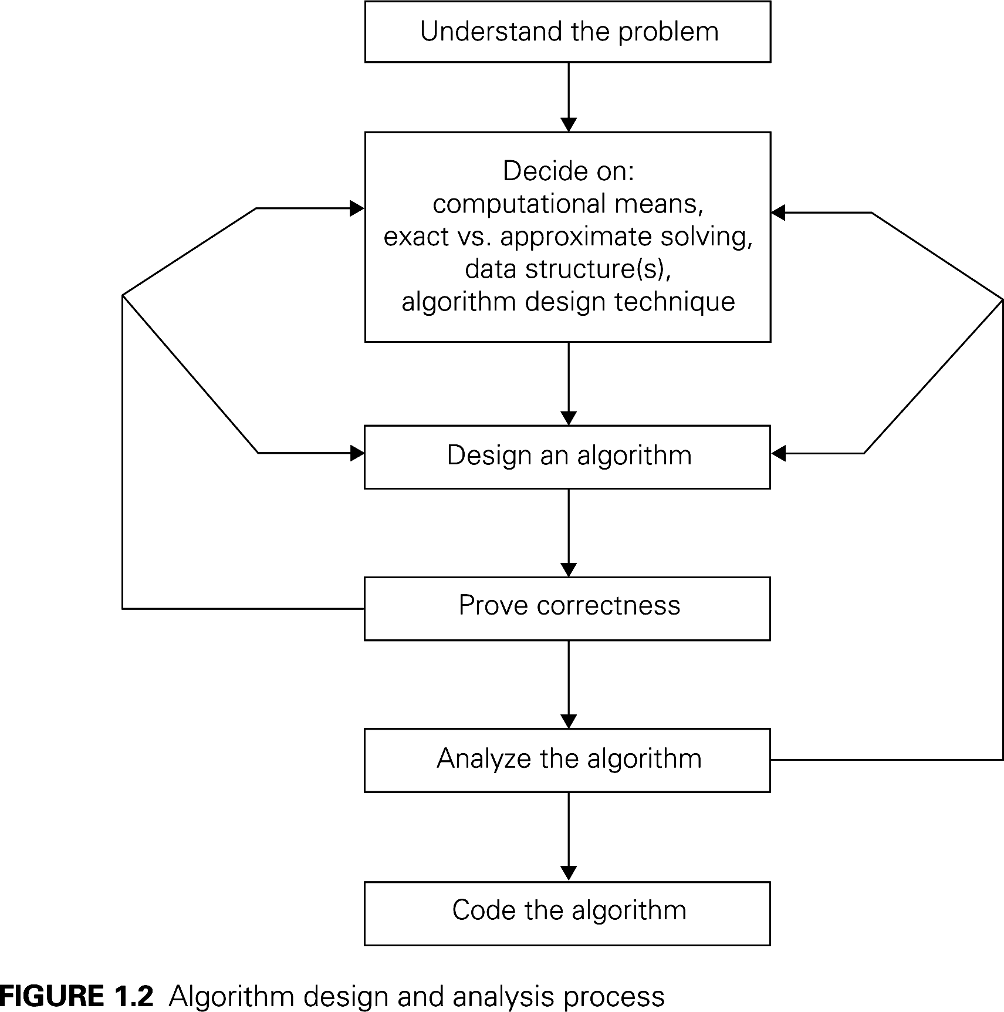

Slide 9
Algorithm Design and Analysis Process
Understanding Problem
  There are a few types of problems that are arise in applications quite often.
  Example: sorting, searching, string matching, etc.
Ascertaining Capabilities of a Computational Device
  Typically von Neumann machine
  Sequential algorithms vs. parallel algorithms
Deciding an Appropriate Data Structures
  Example: list, stack, queue, tree, etc.
Methods of Specifying Algorithms
  English, pseudo code, flowchart

Slide 10
Chapter 1: Introduction
1.1 What is an Algorithm?
1.2 Fundamentals of Algorithmic Problem Solving
1.3 Important Problem Types
1.4 Fundamental Data Structures

Slide 11
Important Problem Types
Sorting
Searching
String processing
Graph problems
Combinatorial problems
Geometric problems
Numerical problems

Slide 12
Sorting
Sorting is to arrange items in either ascending order or descending order.
  Sometimes, we call it non-ascending order or non-descending order.
Why is the sorting important?

Slide 13
Sorting – Time Efficiency
So far, many sorting algorithms are proposed.
O(n*logn) is considered the fastest one for comparison-based sorting.

Slide 14
Stable Sorting
A sorting algorithm is said to be stable if the algorithm preserves the relative order of any two equal elements in its input.

Slide 15
In-Place Sorting Algorithm
An algorithm is said to be in-place if it does not require extra memory, except for a few memory units.

Slide 16
Searching
Finding a given value, called a search key, in a given set.
  e.g., sequential search, binary search, hashing, etc.

Slide 17
String Processing
String examples: Text strings, bit strings, gene sequences, etc.
One important problem: string matching – searching for a given word in a text.

Slide 18
Question
Present a simple string-matching algorithm.

Slide 19
Puzzle: Three mislabeled baskets

Slide 20
Solution

Slide 21
Graph Problems (1 of 2)
A graph in Computer Science is composed of nodes (= vertices) and lines (= edges).
Example

Slide 22
Graph Problems (2 of 2)
A graph is used for modeling many real-life applications.
  e.g.,: transportation, communication networks, project scheduling, etc.
Graph traversal problem
Shortest-path problem

Slide 23
Traveling Salesman Problem (TSP)
It is one of the best known graph problems in Computer Science.

Slide 24
TSP Example

Slide 25
Graph Coloring Problem
Assign the smallest number of colors to vertices so that no two adjacent vertices are the same.

Slide 26
Puzzle: Hamiltonian path (1 of 2)
A Hamiltonian path is a path in a graph that visits each vertex exactly once.

Slide 27
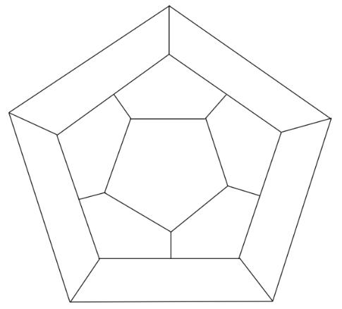
Puzzle: Hamiltonian path (2 of 2)

Slide 28
Combinatorial Problems
Finding a combinatorial object - such as a permutation, a combination or a subset - that satisfies certain constraints and has some desired property (e.g., maximize a value or minimize a cost).
Examples
  TSP, knapsack problem, etc.
Most difficult problems in computing.
  The number of combinatorial objects typically grows extremely fast.

Slide 29
Knapsack Problem

Slide 30
Geometric Problems
Deal with geometric objects such as points, lines, and polygons.
  Many applications in computer graphics, robotics, and tomography.
Closest-pair problem: given n points in the plane, find the closest pair among them.
Convex-hull problem: find the smallest convex polygon that would include all points of a given set.

Slide 31
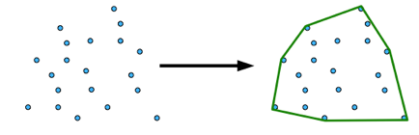
Convex-Hull Problem
Convex hull
  Given a set of N points in the plane, find the minimum area convex area that contains all the points.
Example
  http://axon.cs.byu.edu/Dan/312/projects/ConvexHull.php

Slide 32
Numerical Problems
Originally, a computer was developed to solve many mathematical problems such as solving equations, computing definite integrals, etc.
  But the focus has shifted to business applications.
  But still important.

