Slide 1
Lecture 5 – Analysis Framework
CST370 – Design & Analysis of Algorithms
Dr. Byun
Computer Science

Slide 2
Lecture Objectives
After completion of this lecture, you will be able to
  explain the concept of “orders of growth” in algorithm analysis.
  distinguish the difference between an “operation” and a “basic operation” in algorithm description.
  understand the difference between “best case” and “worst case” in algorithm analysis.

Slide 3
Chapter 2: Fundamentals of the Analysis of Algorithm Efficiency
2.1 The Analysis Framework
2.2 Asymptotic Notations and Basic Efficiency Classes
2.3 Mathematical Analysis of Nonrecursive Algorithms
2.4 Mathematical Analysis of Recursive Algorithms

Slide 4
Introduction to Algorithm Analysis
Algorithm analysis is to determine the efficiency of an algorithm.
  It measures the amount of resources, typically time and memory, necessary to execute the algorithm.
Our main focus is time efficiency.
  It’s also called time complexity.

Slide 5
Reading Assignment
Read this Google document for your understanding.
  https://goo.gl/VKeErt (Introduction to Algorithm Analysis)

Slide 6
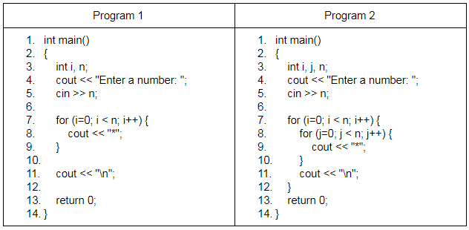
Two Sample Programs in C++
Which one looks fast and how much?
  Assume that n is a very big number.

Slide 7
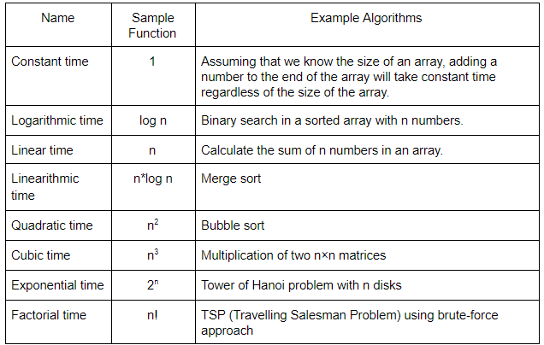
Common Time Complexities

Slide 8
Analysis Framework
Time efficiency depends on
  speed of machine
  quality of source code
  quality of compiler
We count the number of basic operation executed while an algorithm runs.
  But since it’s not trivial to get the accurate number, we try to get an approximated one.

Slide 9
Example: Calculate the sum of an array
Algorithm SequentialAdd (A[0..n-1])
// Input: An array A with n numbers
// from the index 0 to n-1
// Output: Sum of the numbers in the array A
sum ← 0
i ← 0
while ( i < n ) do
sum ← sum + A[i]
i ← i + 1
return sum

Slide 10
Example: Identifying the basic operation
Algorithm SequentialAdd (A[0..n-1])
sum ← 0
i ← 0
while ( i < n ) do
sum ← sum + A[i]
i ← i + 1
return sum

Slide 11
Summary of Basic Operation
“Operation” means every operation in the pseudocode such as +, -, *, /,%, >, <, etc.
  In the class, we exclude the assignment operation.
“Basic operation” is the most frequently performed operation among all operations in a pseudocode (= algorithm).
Small difference between the numbers of operations executed is not important.

Slide 12
Analysis Framework
Algorithm efficiency analysis is to identify the order of growth of the counter of basic operation executed for large-size inputs.

Slide 13
Common Time Complexities: Again

Slide 14
Exercise
Present the eight most popular time complexity categories in the algorithm analysis.
If your program takes n² and your classmate’s program takes n*log n, whose program is faster?

Slide 15
Exercise
How many basic operation(s) in an algorithm (or pseudocode)?

Slide 16
Exercise: Identify Basic Operation
Algorithm FindMax (A[0..n-1])
// Input: An array A from the index 0 to n-1
// Output: Determine the max number of A
maxvalue ← A[0]
i ← 1
while ( i < n ) do
if (A[i] > maxvalue)
maxvalue ← A[i]
i ← i + 1
return maxvalue

Slide 17
Exercise: Identify Basic Operation
Algorithm Display_2D_Stars (n)
// Input: A positive integer number n
// Output: Display the * symbol in two dimensions.
i ← 0
while ( i < n ) do
j ← 0
while ( j < n ) do
write '*'
j ← j + 1
write '\n'
i ← i + 1
return 0

Slide 18
Worst-Case, Best-Case, and Average-Case Efficiencies
Some algorithms can have different execution times depending on the characteristics of the particular input.
  Thus, when we analyze those algorithms, we should consider the best-case, average-case, and worst-case time complexities separately.

Slide 19
Example – Sequential Search (1 of 3)
Algorithm SequentialSearch(A[0..n − 1], K)
// Input: An array A[0..n − 1] and a search key K
// Output: The index of the first element in A that
// matches K or −1 for no matching elements
i ←0
while ((i < n) AND (A[i] != K)) do
i ←i + 1
if i < n
return i
else
return −1

Slide 20
Example – Sequential Search (2 of 3)

Slide 21
Example – Sequential Search (3 of 3)

Slide 22
Exercise
Assume that your program find the max value in an array.
  Would the efficiency be different depending on input form?

Slide 23
Time analysis for the “for” loop
Example
  Algorithm Average (A[0..n-1])
  // Input: An array A with n numbers
  // Output: Average of the numbers
  sum ← A[0]
  for i ← 1 to n - 1 do
  sum ← sum + A[i]
  avg ← sum / n
  return avg

Slide 24
Puzzle

Slide 25
Best Case Situation

Slide 26
Worst Case Situation

