Slide 1
Meshing To Realistic Domains
Applied Modelling and Computation Group http://amcg.ese.ic.ac.uk
By Mihai Jiplea, Shaun Lee, Elliot Lynch and Varun Verma

Slide 2
Introduction
  We were tasked with developing a user-friendly graphical interface for the meshing of realistic domains
  The method chosen was to create Python plugins for Quantum GIS (QGIS)
  Produced: Rasterise Polygons, RasterCalc and Mesh NetCDF

Slide 3

Domains
Domains to be meshed are stored as Shapefile polygons
QGIS can extract the domain from either bathymetric data or a Shapefile layer such as GSHHS

Slide 4
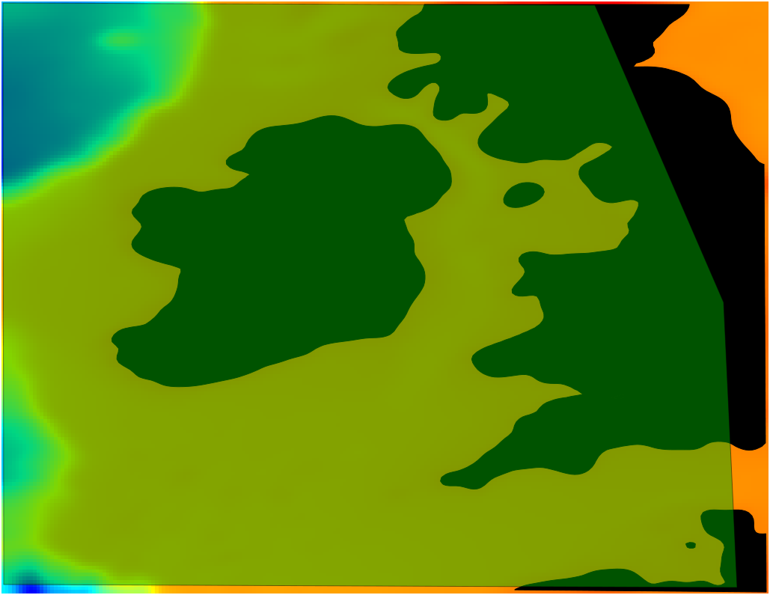
Obtaining Domain
  Extract the 0 m contour and create polygon(s) from the contour
  Add a boundary layer defining the extent of the domain

Slide 5

Obtaining Domain
  Perform a 'difference' vector operation to obtain the domain

Slide 6
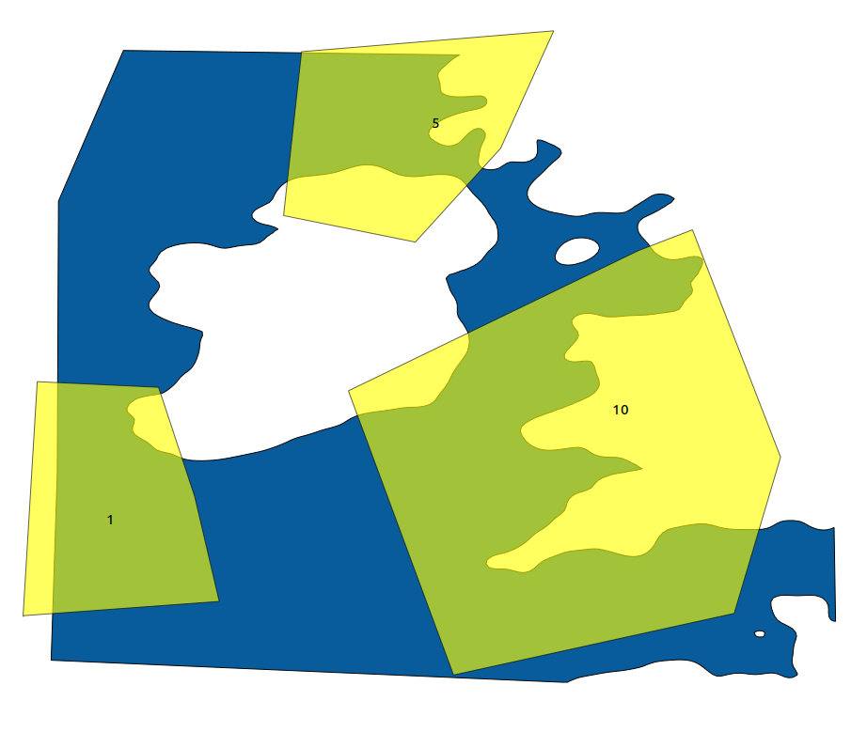
Define Physical ID's
  We are able to define unique ID's for domain boundaries
  Distinct ID's allow separate boundary conditions to be used in Fluidity
  A layer is added with polygons defining the ID
  The part of the boundary lying underneath a polygon obtains that ID when the Geo file is created

Slide 7
Mesh-Size Metric
  The Mesh NetCDF plugin uses a NetCDF file as a mesh-size metric
  The value contained by the pixels define how fine the mesh element size shall be
  One example is mesh size related to depth – fine where shallow and coarse in deeper areas

Slide 8
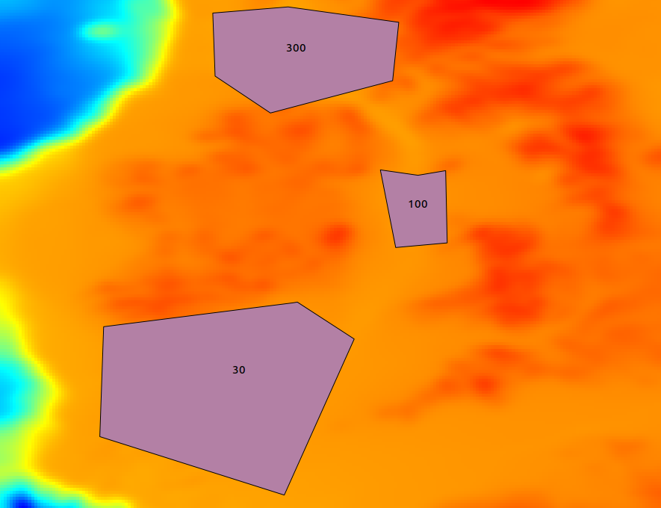
Defining Mesh Metric
  Regions can be defined for specific mesh size
  Add a new layer above the bathymetry
  Each ID of the polygon represents depth in that area

Slide 9
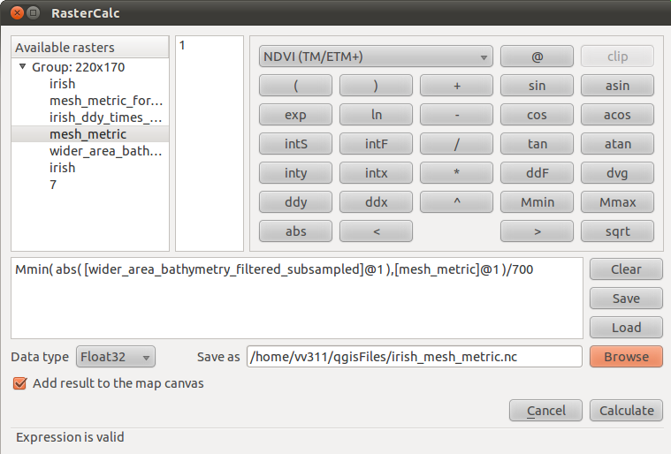
Calculations with Rasters
  To combine the bathymetry and the specific mesh size raster we can use RasterCalc

Slide 10
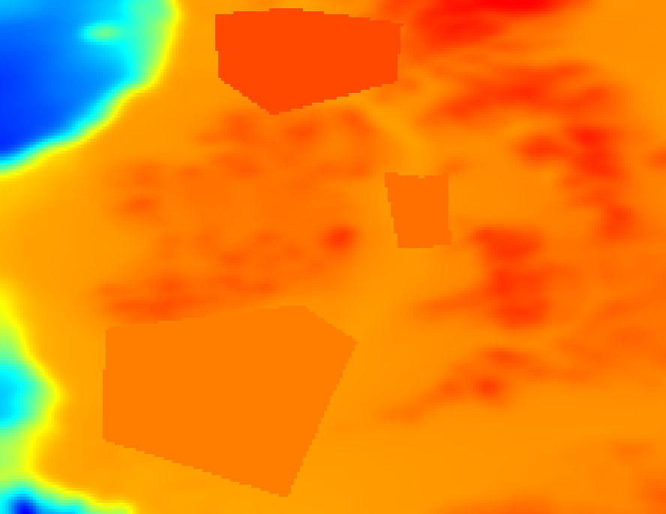
Mesh Metric

Slide 11
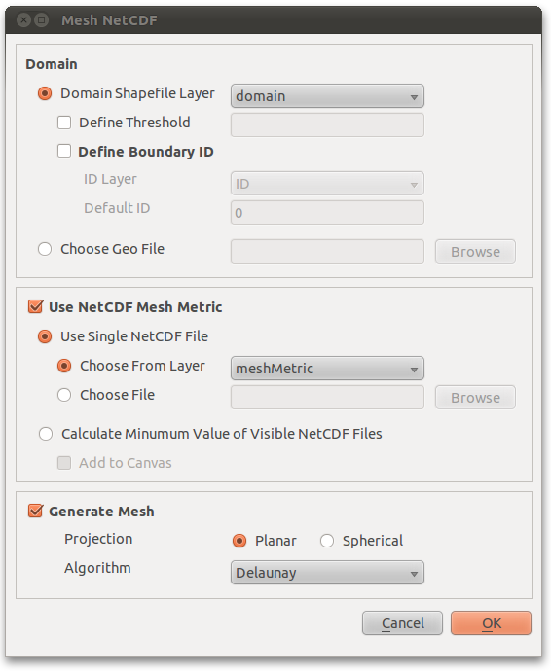
Meshing
  Now there is a domain, boundary ID and mesh-size metric layer we are able to mesh
  Mesh NetCDF will create a Geo file and use the mesh-size metric as the background field

Slide 12
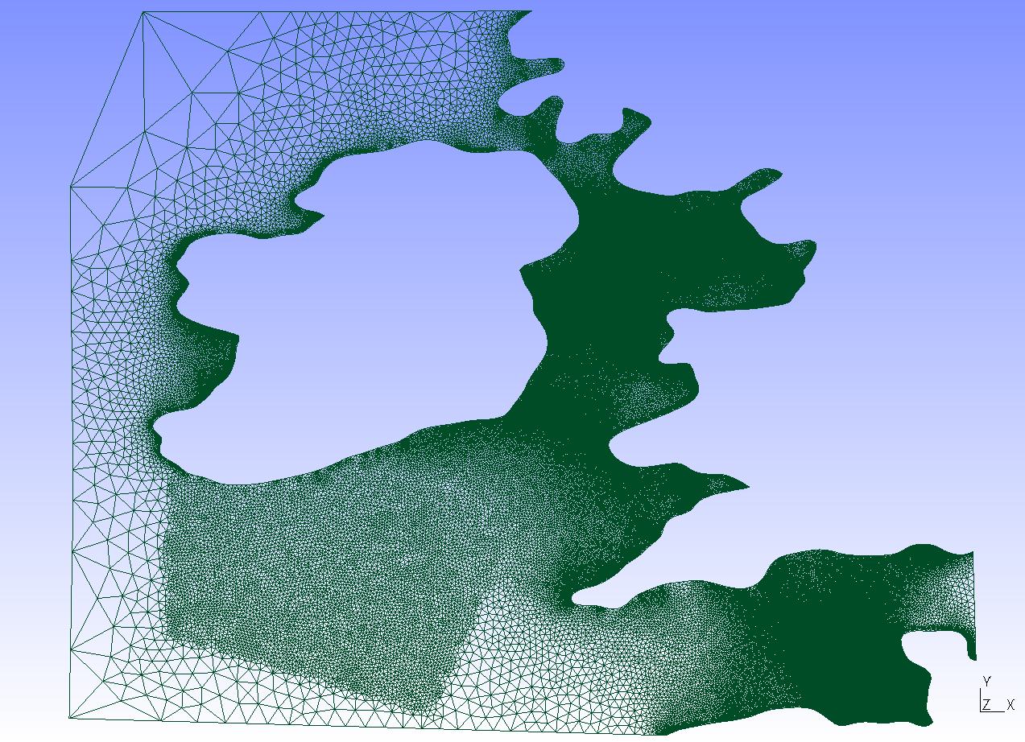
Mesh

Slide 13
Multiple Domains
  The plugin allows the meshing of multiple domains
  For example, meshing the ocean and ice shelf of Antarctica as separate domains

Slide 14
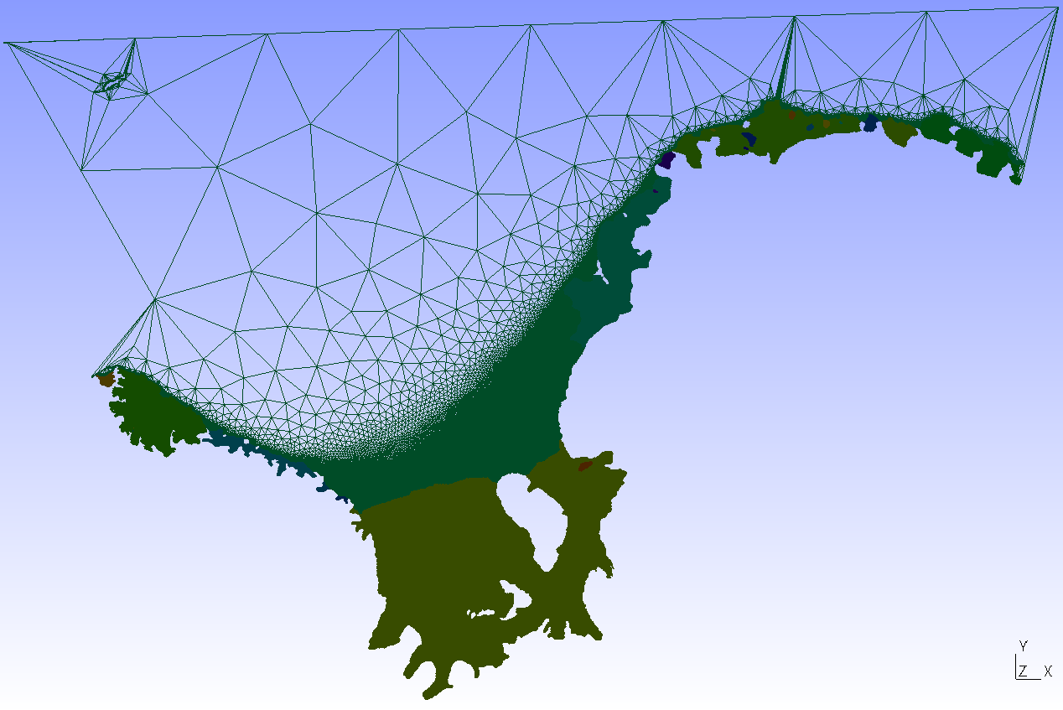
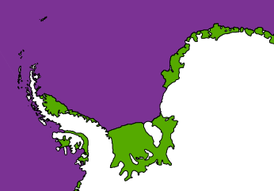
Antarctica Ocean and Ice Shelf Domains

