Slide 1
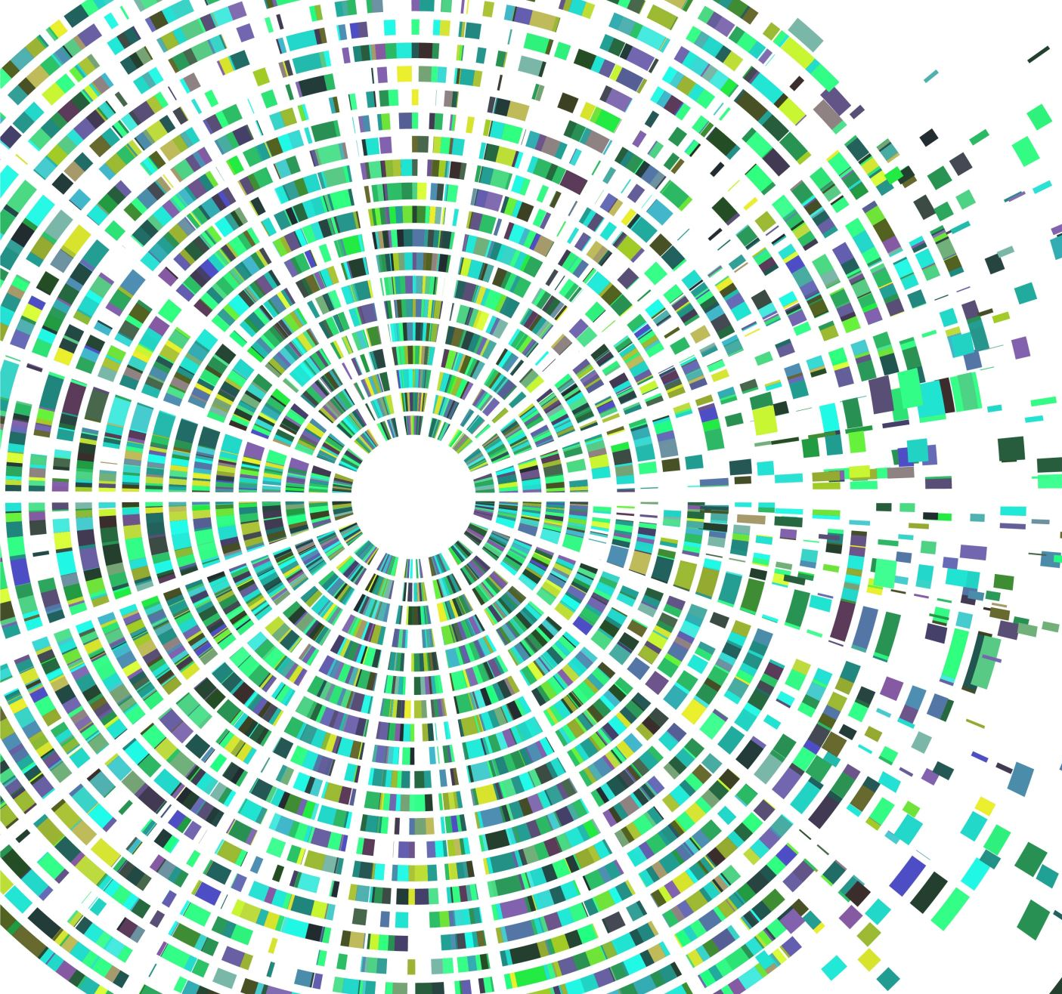
Algorithms for autonomous vehicles and traffic condition understanding: salient object detection, semantic and instance segmentation
Adam Catto

Slide 2
Agent architecture
Environment: image datasets
KITTI dataset
2D Object Recognition: 7481 images, 9 classes, n bounding boxes (with class label) per image
Cityscapes Dataset
Semantic/Instance Segmentation: 5000 images, 30 classes, fine-grained annotations
Agent type: Learning agent

Slide 3
Major components of autonomous driving
Road segmentation – Separate road from rest of scene, know where to drive
Object detection/localization – locate regions of scene meaningful for driving actions
Classification – obtaining specific meaning from localized objects
Traffic signs
Pedestrians
Other vehicles
Semantic/Instance Segmentation – sequence of object localization ➔ classification

Slide 4

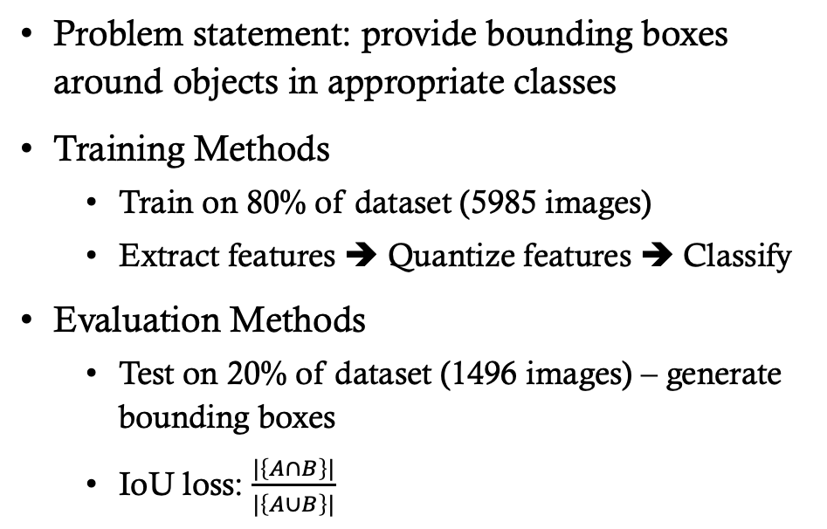
Case: object detection / localization
Problem statement: provide bounding boxes around objects in appropriate classes
Training Methods
Train on 80% of dataset (5985 images)
Extract features ➔ Quantize features ➔ Classify
Evaluation Methods
Test on 20% of dataset (1496 images) – generate bounding boxes
IoU loss: $\frac{|\left\{A∩B\right\}|}{|\left\{A∪B\right\}|}$
IoU loss = $\frac{intersection}{union}$

Slide 5
Classification with bag of features
1. Extract Features
2. Quantize
3. Classify
Detect points of interest – SIFT
Compute description around each POI
Clustering – K-means
Frequency Histogram
Naïve Bayes
SVM
Logistic Regression
Etc.

Slide 6
Step 1: Feature extraction
SIFT – Scale-Invariant Feature Transformation

Slide 7
Step 2: quantization

Slide 8
Step 3: classification (SVM)

Slide 9

Role of Linear regression in object detection
R-CNN
Compute Features
Find Regions of Interest
Classify / Identify Objects
Tighten Bounding Boxes
Train Convolution Layers
Region Pooling Layers
SVM
Train Linear Regression Model – Bbox Regression

Slide 10

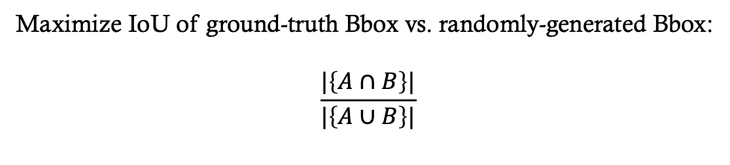
Universal Bounding box regressor
Predict tuple <x, y, h, w>
Maximize IoU of ground-truth Bbox vs. randomly-generated Bbox:
$$\frac{|\left\{A∩B\right\}|}{|\left\{A∪B\right\}|}$$

Slide 11
Sub-problem: Object localization – Tighten bounding boxes for object detection
When doing object detection:
Compute features
Find regions of interest from features
Compute candidate object bounding boxes
Tighten bounding boxes
Optimal object localization

Slide 12
Next step
Implement UBBR (last layer of network) on images with ground-truth Bboxes – KITTI dataset object tracking
Compare classifiers acting on output images passed through pre-trained CNN’s conv layers

Slide 13
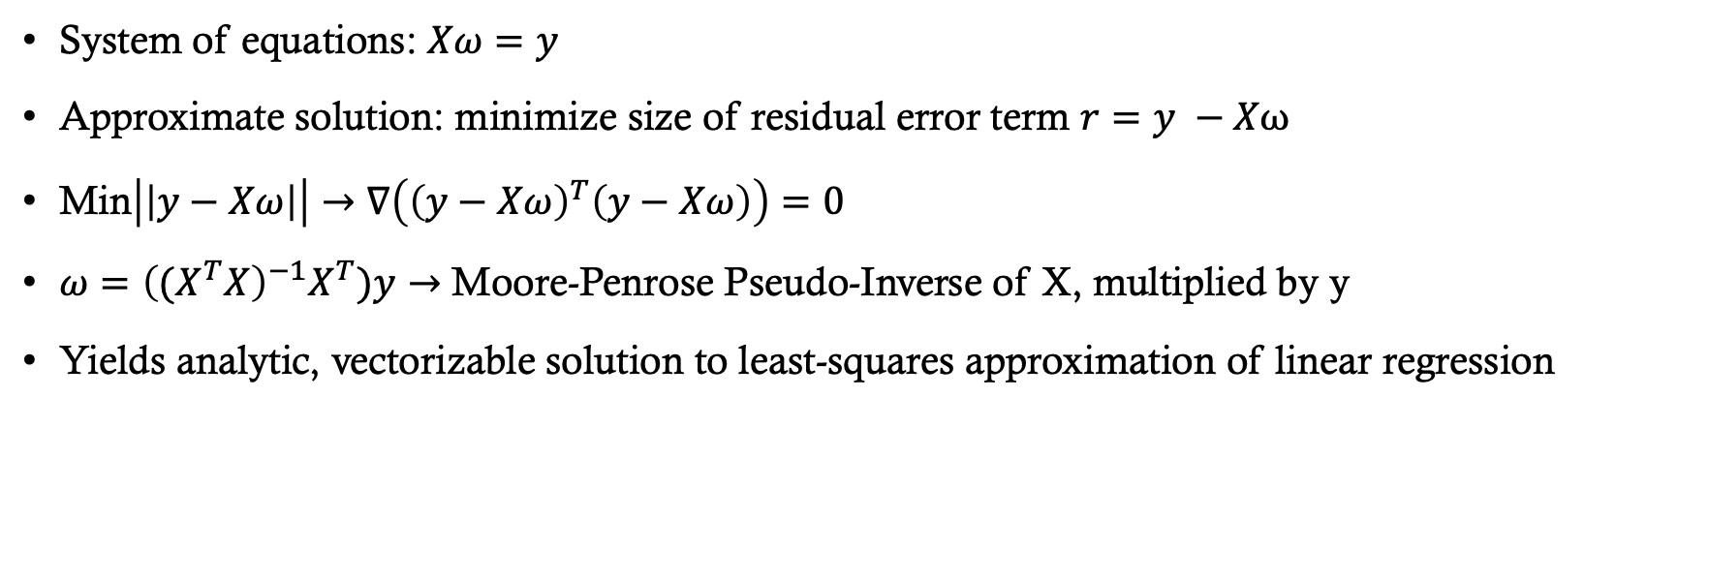
An Implementation of linear regression with mean-square error
System of equations: $Xω=y$
Approximate solution: minimize size of residual error term $r=y −Xω$
Min$\left|\left|y−Xω\right|\right|→∇\left({\left(y−Xω\right)}^{T}\left(y−Xω\right)\right)=0$
$ω={\left((X^{T}X\right)}^{−1}X^{T})y→$ Moore-Penrose Pseudo-Inverse of X, multiplied by y
Yields analytic, vectorizable solution to least-squares approximation of linear regression

Slide 14
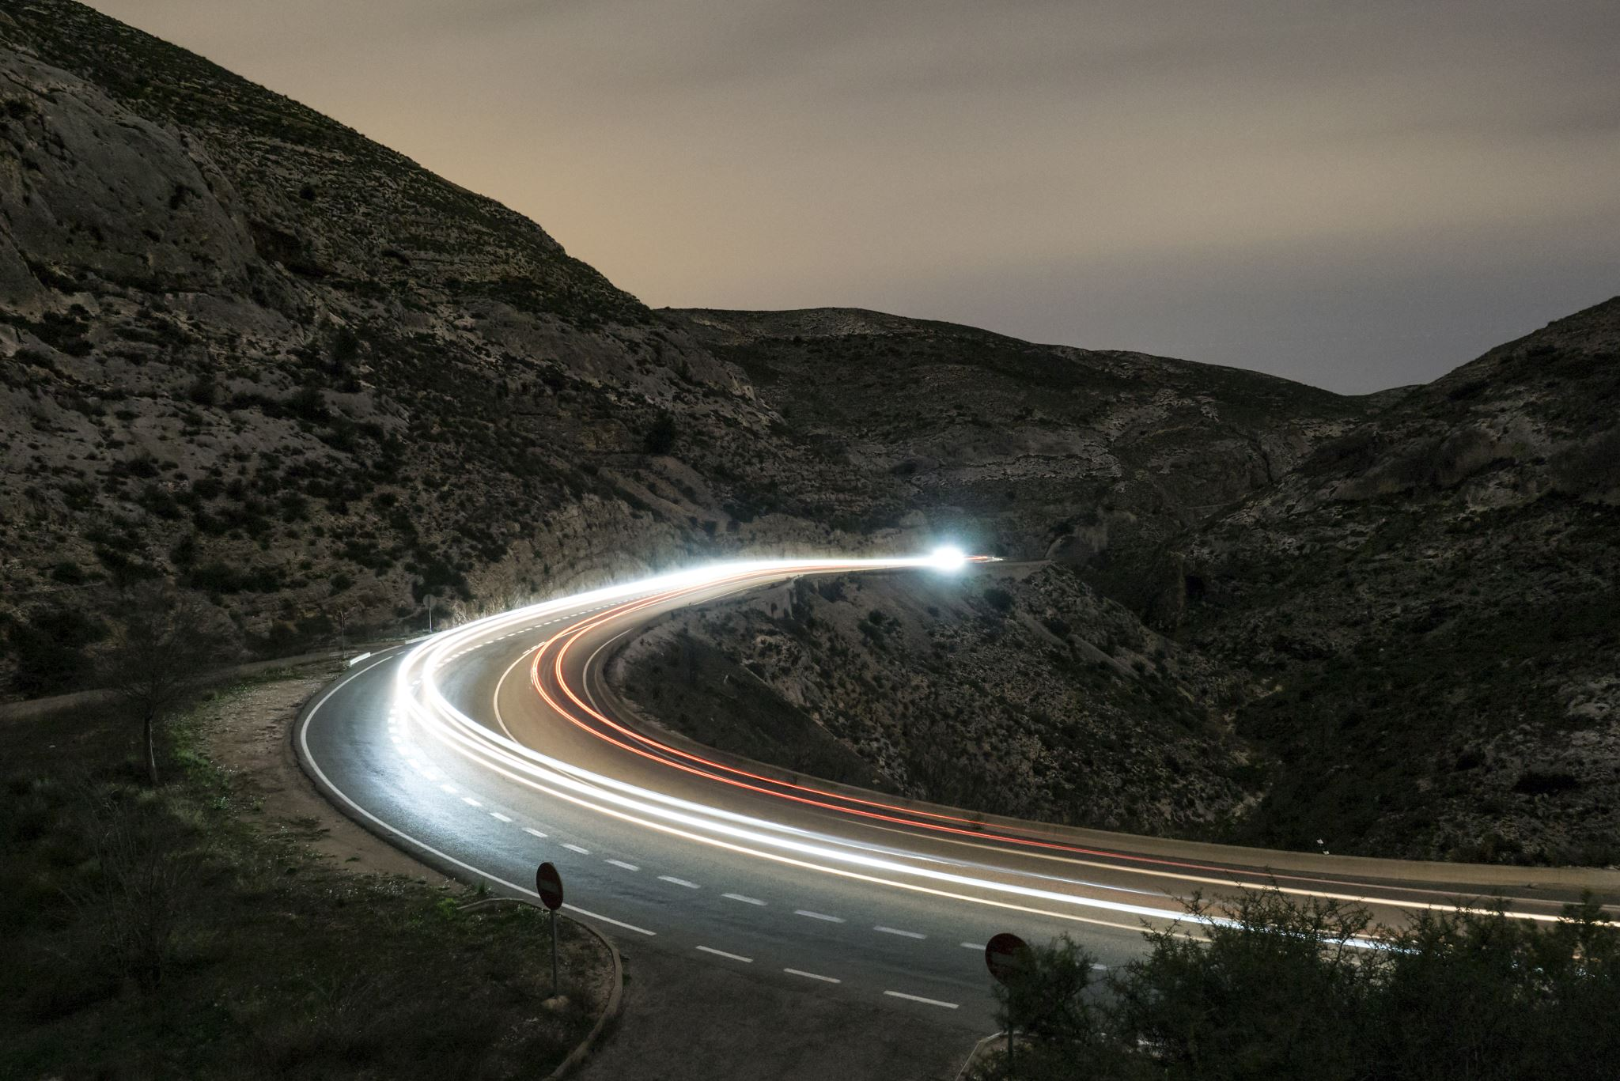
Salient object detection: workflow
Segmentation
Prior Calculation
Prior Combination
Saliency
Map
Reference: https://digitalcommons.usu.edu/cgi/viewcontent.cgi?article=5671&context=etd

Slide 15
Segmentation: types
Pixel-Based
Not a good representation of objects at relevant scale
Cluster-Based
Groups of objects (pixels) arranged by some feature(s)
Superpixel-Based
Spatially-continuous clusters (only relevant feature = spatial adjacency)
Meaning in an image is not strictly a function of 2D spatial continuity (depth, light, etc.) ➔ Cluster-Based Segmentation

Slide 16
K-Means clustering approach to segmentation
Transform image:
RBG ➔ LAB
Initialize Centroids in LAB color space
Iteratively adjust centroids, map pixel ➔cluster
NO
Threshold met?
YES
Return Image

Slide 17
Experiment: pedestrian segmentation
KITTI Dataset – Multi-Object Tracking & Segmentation
Compare K-means randomized initialization with K-means plus plus
Slightly different ending centroids, same clustering
Problem Statement: Can we effectively segment images to prepare for SOD?

Slide 18
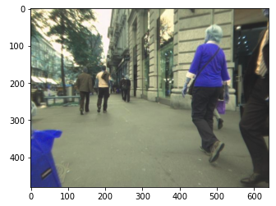
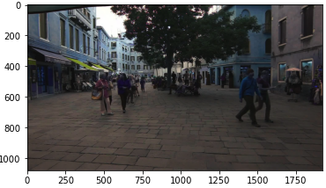
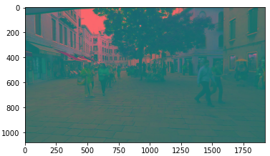
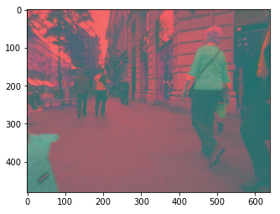
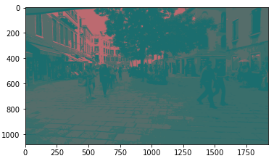
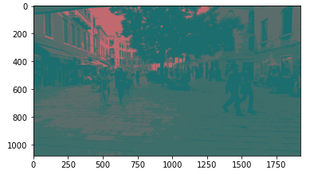
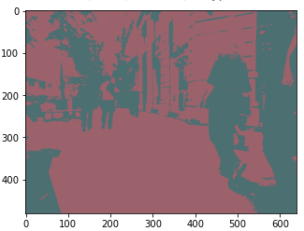
Illustration
K = 2
Max iters = 100
Threshold = 0.85
K = 4
Max iters = 100
Threshold = 0.85
Notes:
Show difference between methods
Table
How to determine value of k

Slide 19
Shortcomings of k-means for sod in autonomous vehicles
Many salient objects in the scene
Number of objects is not pre-determined
More refined methods needed
Potential further steps:
Subclustering
Transform distance metric / base space
Different centroid representation (e.g. rectangular centroid)
Prior computations (for detection)

Slide 20
todo
Naïve bayes classifier
Agent architecture
Bag of features
Search algorithm

