Slide 1
□□□□□□
□
□□□□ □□□□□□□□□
□□□□□□□□ □□□□□□□□□□

Slide 2
Unicode
☢
Adam Cavendish
Shanghai University

Slide 3
Unicode诞生之前——
单字节编码
Single-Byte Encoding

Slide 4
ASCII
Ref: http://en.wikipedia.org/wiki/ASCII
!"#$%&'()*+,-./0123456789:;<=>?@ABCDEFGHIJKLMNOPQRSTUVWXYZ[\]^_`abcdefghijklmnopqrstuvwxyz{|}~

Slide 5
ASCII
7位二进制编码
32个控制字符
95个可显示字符
基本通用，但经常使用替换和扩展
适合英语的编码方式，但不适合其他语言

Slide 6
扩展ASCII
Ref: http://en.wikipedia.org/wiki/Extended_ASCII
IBM提出Code Page概念
CP437 (Latin US)
CP737 (Greek)
Apple: Mac OS Roman
DEC: Multinational Character Set
ISO/IEC 8859
… 扩展ASCII种类不计其数

Slide 7
Code Page 437
IBM-PC (MS-DOS) 编码CP437:
西班牙语、法语、葡萄牙语、德语
荷兰货币Florin (ƒ)，西班牙货币Peseta (₧)
…

Slide 8
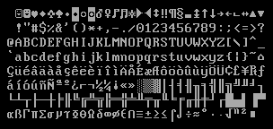
Code Page 437

Slide 9
Latin-1 Western European
Latin-2 Central European
Latin-3 South European
Latin-4 North European
Latin/Cyrillic
Latin/Arabic
Latin/Greek
Latin/Hebrew
Latin-5/Turkish
Latin-6/Nordic
Latin/Thai
Latin-7/Baltic Rim
Latin-8/Celtic
Latin-9 (revision of Latin-1)
Latin-10
15
Parts
!!!

Slide 10
ISO/IEC 8859-1 (Latin-1)
¡¢£¤¥¦§¨©ª«¬®¯°±²³´µ¶·¸¹º»¼½¾¿
ÀÁÂÃÄÅÆÇÈÉÊËÌÍÎÏÐÑÒÓÔÕÖ×ØÙÚÛÜÝÞß
àáâãäåæçèéêëìíîïðñòóôõö÷øùúûüýþÿ

Slide 11
ISO/IEC 8859-5 (Latin/Cyrillic)
ЁЂЃЄЅІЇЈЉЊЋЎЏАБВГДЕЖЗИЙКЛМНОП
РСТУФХЦЧШЩЪЫЬЭЮЯабвгдежзийклмноп
рстуфхцчшщъыьэюя№ёђѓєѕіїјљњћќ§ўџ

Slide 12
Unicode诞生之前——
单字节编码
Single-Byte Encoding
Good or Bad?

Slide 13
ISO/IEC 8859-5 (Latin/Cyrillic)
А л л о \0
↓ ↓ ↓ ↓ ↓
B0 DB DB DE 00

Slide 14
ISO/IEC 8859-5 (Latin/Cyrillic)
B0 DB DB DE 00
↓ ↓ ↓ ↓ ↓
А л л о \0

Slide 15
ISO/IEC 8859-1 (Latin-1)
B0 DB DB DE 00
↓ ↓ ↓ ↓ ↓
° Ϋ Ϋ ή \0
Gibberish!!!!

Slide 16
Unicode诞生之前——
变长字节编码
Variable-Length Encodings

Slide 17
Code Page 936 (ISO/IEC 2022)
Ref: http://en.wikipedia.org/wiki/Code_page_936
Ref: http://msdn.microsoft.com/en-US/goglobal/cc305153
一部分字符使用【单字符编码】，另一部分使用【双字符编码】
前127使用ASCII编码，扩展部分使用双字节

Slide 18
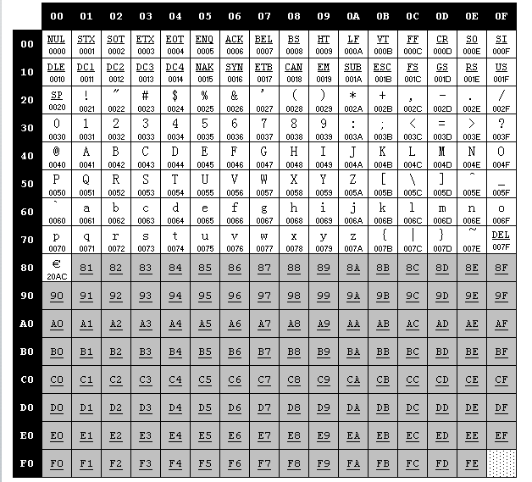
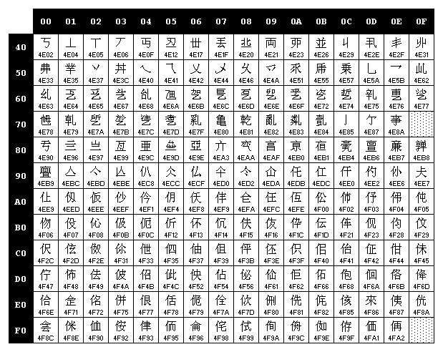
Code Page 936

Slide 19
Unicode诞生之前——
变长字节编码
Variable-Length Encodings
Good or Bad?

Slide 20
编码重叠
65 -> e
84 65 -> 别
84 84 -> 剟

Slide 21
编码重叠
84 65 65 65 84 84 84 65
↓ ↓ ↓ ↓ ↓
别 e e 剟 别

Slide 22
编码重叠
… 65 65 65 …… 65
↑
pointer

Slide 23
Unicode 1.0

Slide 24
Unicode设计信条
一种编码，一统江湖

Slide 25
Unicode 1.0 实际情况
每一个字符使用16位二进制进行编码
理论最多可编码65, 536个字符（实际上当然不到）
完美兼容Latin-1 (ISO/IEC 8859-1)
使用UCS-2编码，即后来的UTF-16

Slide 26
Unicode 1.0
H e l l o ! \0
↓ ↓ ↓ ↓ ↓ ↓ ↓
U+0048 U+0065 U+006C U+006C U+006F U+0021 U+0000

Slide 27
Unicode 1.0
H e l l o ! \0
↓ ↓ ↓ ↓ ↓ ↓ ↓
U+0048 U+0065 U+006C U+006C U+006F U+0021 U+0000

Slide 28
Unicode 1.0
A α Ж あ 羽 ❤
↓ ↓ ↓ ↓ ↓ ↓
U+0041 U+03B1 U+0416 U+3042 U+7FBD U+2764

Slide 29
Unicode 1.0
Good or Bad?

Slide 30
Unicode 1.0
00 48 00 65 00 6C 00 6C 00 6F 00 21 00 00
↓ ↓ ↓ ↓ ↓ ↓ ↓
U+0048 U+0065 U+006C U+006C U+006F U+0021 U+0000
↓ ↓ ↓ ↓ ↓ ↓ ↓
H e l l o ! \0

Slide 31
Unicode 1.0
48 00 65 00 6C 00 6C 00 6F 00 21 00 00 00
↓ ↓ ↓ ↓ ↓ ↓ ↓
U+4800 U+6500 U+6C00 U+6C00 U+6F00 U+2100 U+0000
↓ ↓ ↓ ↓ ↓ ↓ ↓
䠀 攀 氀 氀 漀 ℀ \0

Slide 32
Unicode 1.0
FE FF 00 48 00 65 00 6C 00 6C 00 6F 00 21 00 00
↓ ↓ ↓ ↓ ↓ ↓ ↓ ↓
U+FEFF U+0048 U+0065 U+006C U+006C U+006F U+0021 U+0000
↓ ↓ ↓ ↓ ↓ ↓ ↓
H e l l o ! \0

Slide 33
Unicode 1.0
FF FE 48 00 65 00 6C 00 6C 00 6F 00 21 00 00 00
↓ ↓ ↓ ↓ ↓ ↓ ↓ ↓
U+FEFF U+0048 U+0065 U+006C U+006C U+006F U+0021 U+0000
↓ ↓ ↓ ↓ ↓ ↓ ↓
H e l l o ! \0

Slide 34
Unicode 1.0
“With over 30,000 unallocated character positions, the Unicode character encoding provides sufficient space for foreseeable future expansion.”
– Unicode 1.0 Introduction

Slide 35
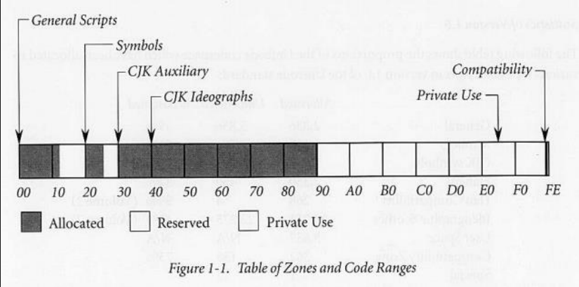
Unicode 1.0编码使用情况

Slide 36
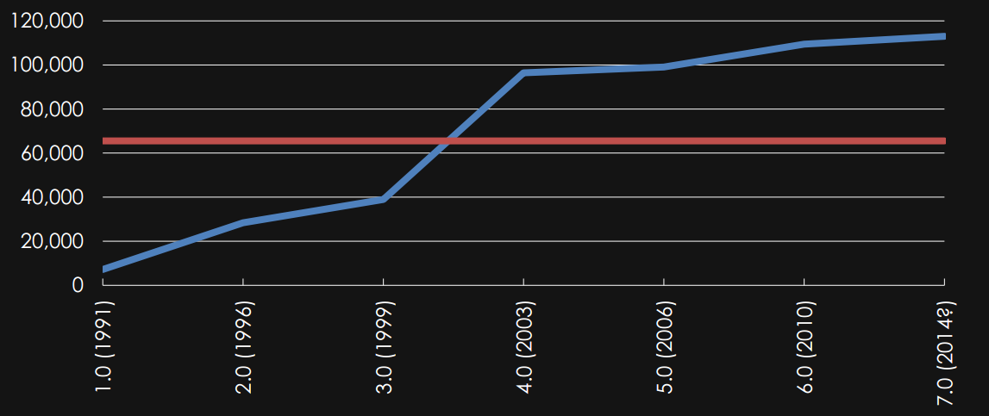
编码使用增长情况

Slide 37
现代Unicode

Slide 38
现代Unicode
我们需要扩展容量！

Slide 39
UTF-32

Slide 40
UTF-32
00 00 00 48 00 00 00 69 00 00 00 21
↓ ↓ ↓
U+0048 U+0065 U+0021
↓ ↓ ↓
H i !

Slide 41
UTF-32
00 00 FE FF 00 00 00 48 00 00 00 69 00 00 00 21
↓ ↓ ↓ ↓
U+FEFF U+0048 U+0065 U+0021
↓ ↓ ↓
H i !

Slide 42
UTF-32
FF FE 00 00 48 00 00 00 69 00 00 00 21 00 00 00
↓ ↓ ↓ ↓
U+FEFF U+0048 U+0065 U+0021
↓ ↓ ↓
H i !

Slide 43
UTF-32
00 00 FE FF 00 00 00 48 00 00 00 69 00 01 F4 30
↓ ↓ ↓ ↓
U+FEFF U+0048 U+0065 U+1F430
↓ ↓ ↓
H i 🐰

Slide 44
UTF-32
Good or Bad?

Slide 45
UTF-8

Slide 46
UTF-8
码 位 | 第一 码位 | 最后 码位 | 字 节 | 1 | 2 | 3 | 4
7 | U+0000 | U+007F | 1 | 0xxxxxxx
11 | U+0080 | U+07FF | 2 | 110xxxxx | 10xxxxxx
16 | U+0800 | U+FFFF | 3 | 1110xxxx | 10xxxxxx | 10xxxxxx
21 | U+10000 | U+1FFFFF | 4 | 11110xxx | 10xxxxxx | 10xxxxxx | 10xxxxxx

Slide 47
UTF-8
48 65 6C 6C 6F 21 00
↓ ↓ ↓ ↓ ↓ ↓ ↓
U+0048 U+0065 U+006C U+006C U+006F U+0021 U+0000
↓ ↓ ↓ ↓ ↓ ↓ ↓
H e l l o ! \0

Slide 48
UTF-8
A α Ж あ 羽 ❤ 🐰
↓ ↓ ↓ ↓ ↓ ↓ ↓
U+0041 U+03B1 U+0416 U+3042 U+7FBD U+2764 U+1F430
↓ ↓ ↓ ↓ ↓ ↓ ↓
41 C1 A6 A8 A7 A2 A4 D3 F0 A4 9D E2 B0 90 9F F0

Slide 49
UTF-8
Good or Bad?

Slide 50
UTF-8 BOM?
码 位 | 第一 码位 | 最后 码位 | 字 节 | 1 | 2 | 3 | 4
7 | U+0000 | U+007F | 1 | 0xxxxxxx
11 | U+0080 | U+07FF | 2 | 110xxxxx | 10xxxxxx
16 | U+0800 | U+FFFF | 3 | 1110xxxx | 10xxxxxx | 10xxxxxx
21 | U+10000 | U+1FFFFF | 4 | 11110xxx | 10xxxxxx | 10xxxxxx | 10xxxxxx

Slide 51
UNICODE字符生成

Slide 52
UNICODE字符生成
基本字符：A
组合字符：ÀÁÂÃÄÅ

Slide 53
UNICODE字符生成
A + ̈ → Ä
U+0041 U+0308

Slide 54
UNICODE字符生成
e + ̃ + ̽ + ̪ → ẽ̪̽
U+0065 U+0303 U+033D U+032A
e + ̽ + ̃ + ̪ → e̪̽̃
U+0065 U+033D U+0303 U+032A

Slide 55
字符串长度？

Slide 56
字符串长度：string().size()
"1 Ä 🍸“
1 A ¨ 🍸
U+0031 U+0041 U+0308 U+1F378
 |  |  |  |  | Length
UTF-8 | 31 | 44 | CC 88 | F0 9F 8D B8 | ?
UTF-16 | 0031 | 0041 | 0308 | D83C DF78 | ?
UTF-32 | 00000031 | 00000041 | 00000308 | 0001F378 | ?

Slide 57
字符串长度：in Bytes
"1 Ä 🍸“
1 A ¨ 🍸
U+0031 U+0041 U+0308 U+1F378
 |  |  |  |  | Length
UTF-8 | 31 | 44 | CC 88 | F0 9F 8D B8 | 8
UTF-16 | 0031 | 0041 | 0308 | D83C DF78 | 10
UTF-32 | 00000031 | 00000041 | 00000308 | 0001F378 | 16

Slide 58
字符串长度：in 编码单元
"1 Ä 🍸“
1 A ¨ 🍸
U+0031 U+0041 U+0308 U+1F378
 |  |  |  |  | Length
UTF-8 | 31 | 44 | CC 88 | F0 9F 8D B8 | 8
UTF-16 | 0031 | 0041 | 0308 | D83C DF78 | 5
UTF-32 | 00000031 | 00000041 | 00000308 | 0001F378 | 4

Slide 59
字符串长度：in 码位
"1 Ä 🍸“
1 A ¨ 🍸
U+0031 U+0041 U+0308 U+1F378
 |  |  |  |  | Length
UTF-8 | 31 | 44 | CC 88 | F0 9F 8D B8 | 4
UTF-16 | 0031 | 0041 | 0308 | D83C DF78 | 4
UTF-32 | 00000031 | 00000041 | 00000308 | 0001F378 | 4

Slide 60
字符串长度：in 字符个数
"1 Ä 🍸“
1 A ¨ 🍸
U+0031 U+0041 U+0308 U+1F378
 |  |  |  |  | Length
UTF-8 | 31 | 44 | CC 88 | F0 9F 8D B8 | 3
UTF-16 | 0031 | 0041 | 0308 | D83C DF78 | 3
UTF-32 | 00000031 | 00000041 | 00000308 | 0001F378 | 3

