Slide 1
Cookie Clicker
Event-driven programming in JavaScript
Chris Dalziel and Adam Chapman-Dodd,
with design help from Moth Dalziel

Slide 2
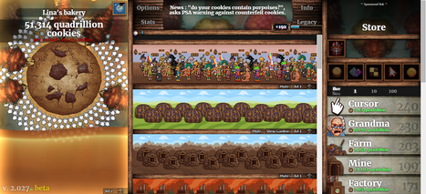
What is Cookie Clicker?
Cookie Clicker is a web-based incremental video game written in JavaScript by French developer Julien “Orteil” Thiennot.
Screenshot from https://en.wikipedia.org/wiki/Cookie_Clicker

Slide 3
What is Cookie Clicker?
The game has a simple progression loop revolving around the collection and spending of cookies, which serve both as points and as a kind of currency.
Cookies can be spent to purchase upgrades and auto-clickers, which in turn allows for the collection of more cookies.

Slide 4

Try Cookie Clicker!
Try it at https://orteil.dashnet.org/cookieclicker/ for five-ish minutes.
What are the most important parts of the game? How might you implement these?

Slide 5
Event-based Programming
An event is an interaction between the user and the webpage.
Event-based programming is a kind of reactive “When x do y” approach, which allows web-pages to react to the actions of the user dynamically.
Event | Description
click | User clicks an element
mouseover | User moves the mouse over an element
onmouseout | User moves the mouse off an element
keydown | User presses a key
There are loads of events, not just these: https://www.w3schools.com/jsref/dom_obj_event.asp

Slide 6
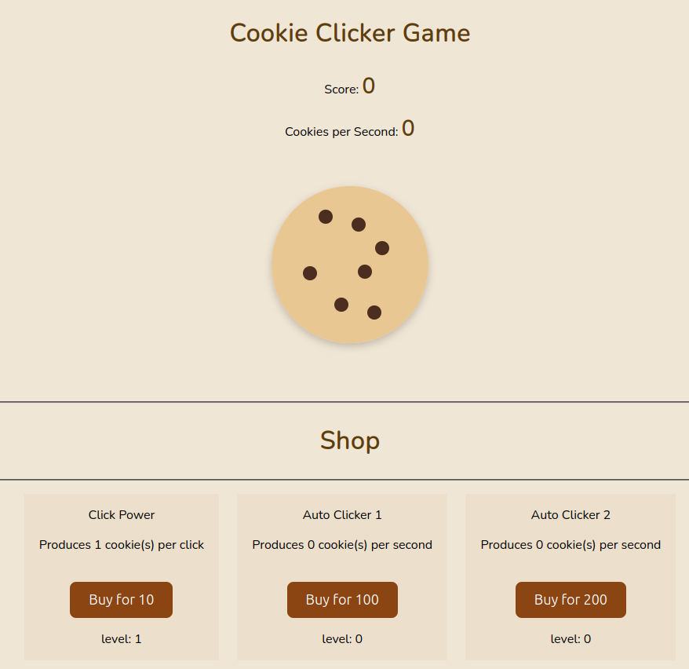
Event-based Programming
Event-based approaches are also used in designing video games, where user interactions are of central importance.
We can use event programming and the “click” event to build our own Cookie Clicker!
The provided project file contains an incomplete implementation of a Cookie Clicker game. Some of the code is missing, and there are bugs which need to be addressed.
Materials adapted from https://www.geeksforgeeks.org/how-to-make-a-cookie-clicker-using-html-and-javascript/

Slide 7
id and class in HTML
id and class are HTML attributes which can be set for any given element tag, and allow us to set properties for those elements. A class can be given to many elements, where an id is unique (and therefore identifying).
At National 5 we use these purely to set the styles of elements with CSS, but they can also be used with JavaScript to create “event handlers” for an element.

Slide 8
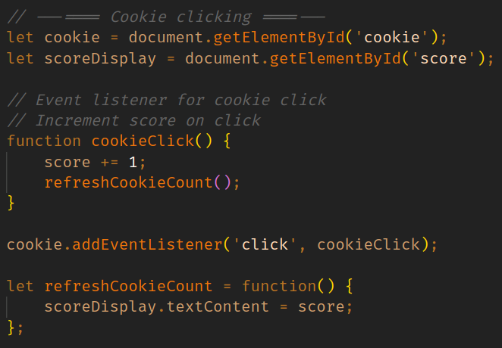
Event Listeners - Learn
An event listener is a piece of code which waits for an event to happen, and runs function whenever it does.
In this example, the code which updates the user’s score runs whenever the cookie is clicked.

Slide 9
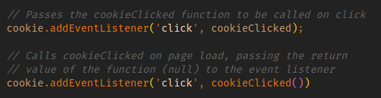
Aside — Functions as Arguments
JavaScript allows for functions themselves to be passed as an argument to other functions.
This allows the function to be called from within these other functions, rather than just passing the result of these functions.
This is useful for event listeners because we don’t necessarily want to call the function immediately when the page loads.

Slide 10
Event Listeners - Do
Your first task is to use an event listener to implement the most important feature in the game — a clickable cookie!

Slide 11
Event Listeners - Discuss
Why do we separate logic (JS), styling (CSS) and structure (HTML) rather than keep it all in the same file?
How might you use different types of events (like mouseenter, dblclick or keydown) to change how players interact with this game?
Why is refreshCookieCount() called after increasing the score? What would happen if we forgot to call it?
How could you make this click interaction more engaging or apparent for a user?

Slide 12
Event Listeners - Summary
You can use different types of events, like keydown, to make a game more interactive and accessible (e.g. making the spacebar act like cookie click allows the webpage to be usable even by those who might struggle with mouse.
Event listeners allow us to separate the behaviour of the game from the design and keep functions running if and only if a specific event occurs - like clicking the cookie.
This first task should have shown you the basics of developing interactive webpages: event listeners are attached to elements and the necessary functions are called when the event occurs.

Slide 13
Periodic Functions - Learn
One “event” we might want to react to is the passage of a set amount of time.
The setInterval function lets us run a function every time the provided interval has passed, allowing for functions which run repeatedly with a delay.

Slide 14
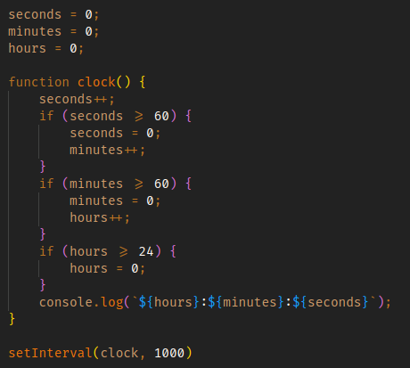
Periodic Functions - Learn
This clock() function increments the number of seconds that have passed and then adjusts the minutes and hours.
For this to work correctly, we must call the clock() function exactly every second, which we do by passing the function and 1000 milliseconds to setInterval.
Similarly to passing functions earlier we don’t put brackets on the function name in the setInterval call.

Slide 15
Periodic Functions - Do
Now you should look at fixing the cookies per second counter, using the setInterval function to update it every second.

Slide 16
Periodic Functions - Discuss
Why use setInterval() instead of updating CPS on each click? What problems could occur if CPS was updated on every frame?
Why do we need to reset the counter each second? What happens if you don’t do this?

Slide 17
Periodic Functions - Summary
Periodic functions, like setInterval(), allow us to run tasks at regular intervals (such as updating the CookiesPerSecond value and updating the display every second). This is especially useful when we want to perform actions purely based on time instead of any user interactions, which allows the game to update its elements without waiting for a click to be detected with event listeners.
This task should have helped you understand that some elements need to be updated periodically: if we were waiting for the cookie to be clicked to update, the CPS meter may not change when it should, and if we updated it every frame, the display may not be smooth or even legible.

Slide 18
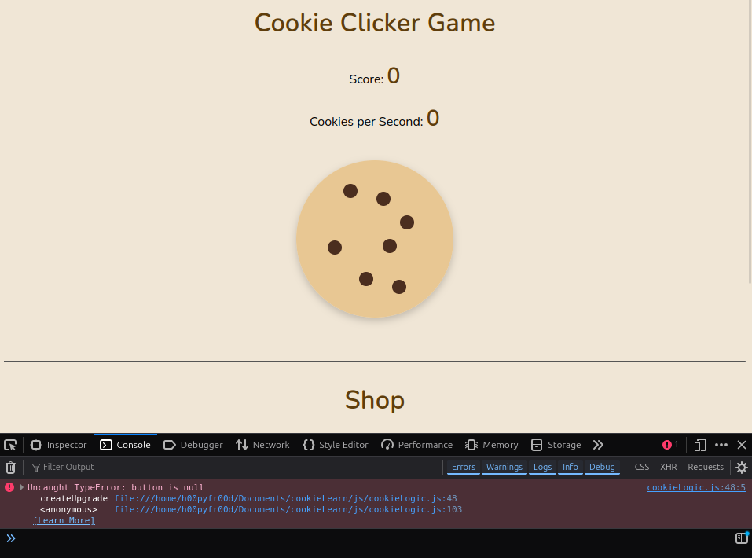
Console debugging and Functions - Learn
The console tab of the debugger (accessible via Ctrl+Shift+K) can be very useful for finding bugs, as it shows any errors or warnings produced by your code.
Additionally you can print your own messages to the console using console.log().

Slide 19
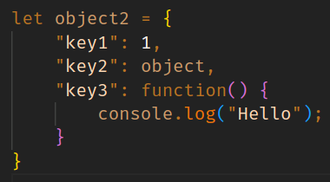
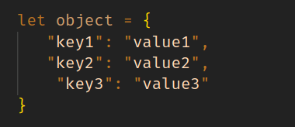
Aside — JavaScript Object Notation (JSON)
JavaScript’s Object type is very versatile, as it allows us to collect many values into one object.
JavaScript Object Notation (more commonly abbreviated to JSON) lets us define the properties and values of an object using key-value syntax. The keys must be strings (quotes may be omitted), but the value may be any type — even functions and other objects.

Slide 20
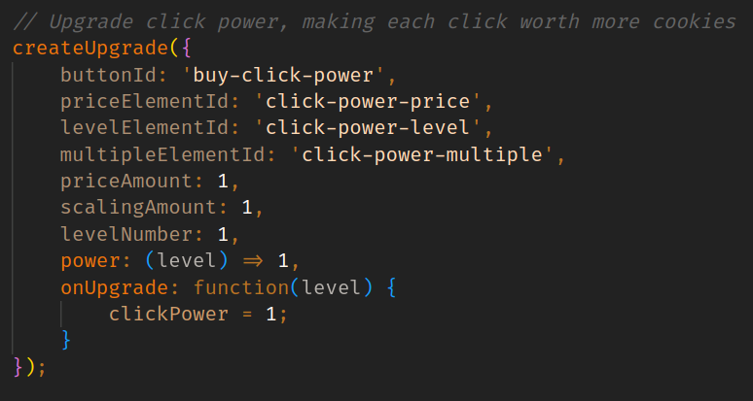
Aside — JavaScript Object Notation (JSON)
We use JSON in the createUpgrade function to make it clearer what each argument is meant to be when calling the function.

Slide 21
Console debugging and Functions - Do
Now you should look at fixing the first upgrade to scale the correct values and, using console debugging, find and correct the error in the second upgrade making sure that the correct values are changed and the necessary elements updated every second.
Then use functions to create your own auto-clicker upgrade, making sure to add it as a HTML element.

Slide 22
Console debugging and Functions - Discuss
Why is it a good idea to have one function like createUpgrade() handle upgrade setup?
What is the issue with upgrade prices not scaling with level?
How do HTML element IDs help JavaScript interact with the correct parts of a web page? What would happen if IDs are reused?

Slide 23
Console debugging and Functions - Summary
Using functions helps to manage code and keep it organised: in this case, the createUpgrade() function makes it much more efficient to create, update and manage upgrades in the shop. Reusing code in this way makes it much easier to scale as the game gets bigger and more complex: this is a large part of a game of this nature.
Using the console to check things are working as intended is an incredibly important skill. Being able to use error messages to find where the mistakes are in code means you can create a robust site without worry of things not working as intended.

Slide 24
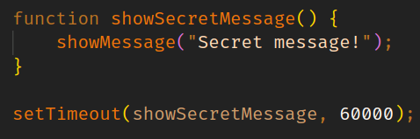
Timed Functions - Learn
Sometimes we’d like to time a function to happen some interval in the future, but not necessarily periodically.
This example shows a secret message a minute after the page loads. We only want to show the message once, so we use a timed function instead with setTimeout.

Slide 25
Timed Functions - Do
Fill in the missing code in the spawnGoldenCookie() function definition to assign random values to the golden cookies being spawned.
Read through the function and start the cycle of spawning these bonus cookies.
The golden cookies doesn’t have any chips. Use CSS and HTML to add some!

Slide 26
Timed Functions - Discuss
Why do we use Math.random() for the values of bonus cookies? How could you skew that to be weighted towards lower numbers?
Why do we use setTimeout() instead of setInterval() for controlling how long a golden cookie stays on screen?
How could we make golden cookies rarer or more powerful? How would you start with implementing that?

Slide 27
Timed Functions - Summary
Timed functions, like setTimeout(), allow us to run tasks once after a delay (such as despawning the golden cookie after a certain duration has passed). This is useful when we want to perform an action based on time instead of any user interactions but only want to do it once rather than periodically.
This task should have helped you understand that some elements need to be updated only once after a certain amount of time: in this instance, if we tried to instead use a periodic function, setInterval(), the code would keep trying to remove the golden cookie over and over again rather than only once, which doesn’t make sense.

Slide 28
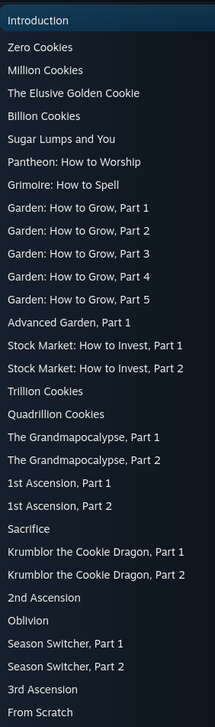
Where would you take it next?
Cookie Clicker has years of content — just look at this portion of a beginners Steam community guide!
Some of these mechanics are super out there, the potential for new ones is limitless: what would you add?
https://steamcommunity.com/sharedfiles/filedetails/?id=2591407770

Slide 29
Summary
Events are user interactions with the page.
We can react to events dynamically using event listeners.
If we want to delay the call of a function we can use setInterval and setTimeout, where an interval function will repeat periodically and a timeout function will run once (unless called within itself!).

