Slide 1

Employee Attrition Analysis
By: Adam Adrian Chua

Slide 2

Introduction
Objective: Identify key factors that contribute to employee turnover, provide insights for developing targeted retention strategies based on workplace demographics, internal factors, and other relevant employee data. This type of project would ultimately help HR departments to proactively address potential attrition risks and improve employee retention rates.
Expected Outcomes:
Improved decision-making on addressing attrition risks.
Gain ideas to develop effective programs and strategies to enhance employee retention.
Have a better understanding of workplace factors that lead to attrition.
Gain valuable insights into employee sentiments and views toward the organization.

Slide 3

Data Collection
Source: Kaggle.com - Employee Attrition Prediction Dataset
Contains data for 10,000 employees, designed for predictive modeling and analysis of employee attrition. It includes a variety of demographic, job-related metrics to help understand the factors contributing to employee turnover.

Slide 4

Dataset Information – Column Descriptions
1. Employee_ID – Unique identifier for each employee.
2. Age – Age of the employee
3. Gender – Gender of the employee
4. Marital_Status – Marital status
5. Department – Department of employment
6. Job_Role – Specific role within the department
7. Job_Level – Position level in the organizational hierarchy
8. Monthly_Income – Monthly salary
9. Hourly_Rate – Hourly wage for applicable employees
10. Years_at_Company – Tenure at the company
11. Years_in_Current_Role – Time spent in current role
12. Years_Since_Last_Promotion – Time since last promotion
13. Work_Life_Balance – Work-life balance rating
14. Job_Satisfaction – Job satisfaction score (1–5 scale)
15. Performance_Rating – Performance rating (1–5 scale)
16. Training_Hours_Last_Year – Training hours completed last year
17. Overtime – Whether employee works overtime (Yes/No)
18. Project_Count – Number of managed projects
19. Average_Hours_Worked_Per_Week – Average weekly work hours
20. Absenteeism – Days absent in the past year
21. Work_Environment_Satisfaction – Work environment satisfaction score
22. Relationship_with_Manager – Manager relationship rating
23. Job_Involvement – Engagement level in job role
24. Distance_From_Home – Commute distance (in kilometers)
25. Number_of_Companies_Worked – Total companies worked for
26. Attrition – Target variable: employee left the company (Yes/No)

Slide 5
Data Preprocessing
No Missing Values and Duplicates
Data inspection process revealed no missing values and no duplicates in the entire dataset.
No Outliers and Significant Skewness Detected
Histograms and Box Plotting displayed no outlier points and no skewness in all variables.
All the data points were retained and utilized.

Slide 6
Descriptive Analysis

Slide 7
General Descriptive Statistics
Attribute | Count | Mean | Median | Min | Max
Age | 10000 | 39.5618 | 20 | 40 | 59
Job Level | 10000 | 2.9908 | 1 | 3 | 5
Monthly Income | 10000 | 11436.72 | 3000 | 11401.5 | 19999
Hourly Rate | 10000 | 57.0323 | 15 | 57 | 99
Years at Company | 10000 | 14.9362 | 1 | 15 | 29
Years in Current Role | 10000 | 7.4513 | 1 | 7 | 14
Years Since Last Promotion | 10000 | 4.4719 | 0 | 4 | 9
Work Life Balance | 10000 | 2.5024 | 1 | 2 | 4
Job Satisfaction | 10000 | 3.038 | 1 | 3 | 5
Performance Rating | 10000 | 2.5077 | 1 | 3 | 4
Training Hours Last Year | 10000 | 49.5889 | 0 | 49 | 99
Project Count | 10000 | 4.9844 | 1 | 5 | 9
Avg. Hours Worked Per Week | 10000 | 44.4735 | 30 | 45 | 59
Absenteeism | 10000 | 9.4102 | 0 | 9 | 19
Work Environment Satisfaction | 10000 | 2.4931 | 1 | 2 | 4
Relationship with Manager | 10000 | 2.4914 | 1 | 2 | 4
Job Involvement | 10000 | 2.5054 | 1 | 3 | 4
Distance From Home | 10000 | 25.272 | 1 | 25 | 49
Number of Companies Worked | 10000 | 2.5166 | 1 | 2 | 4

Slide 8
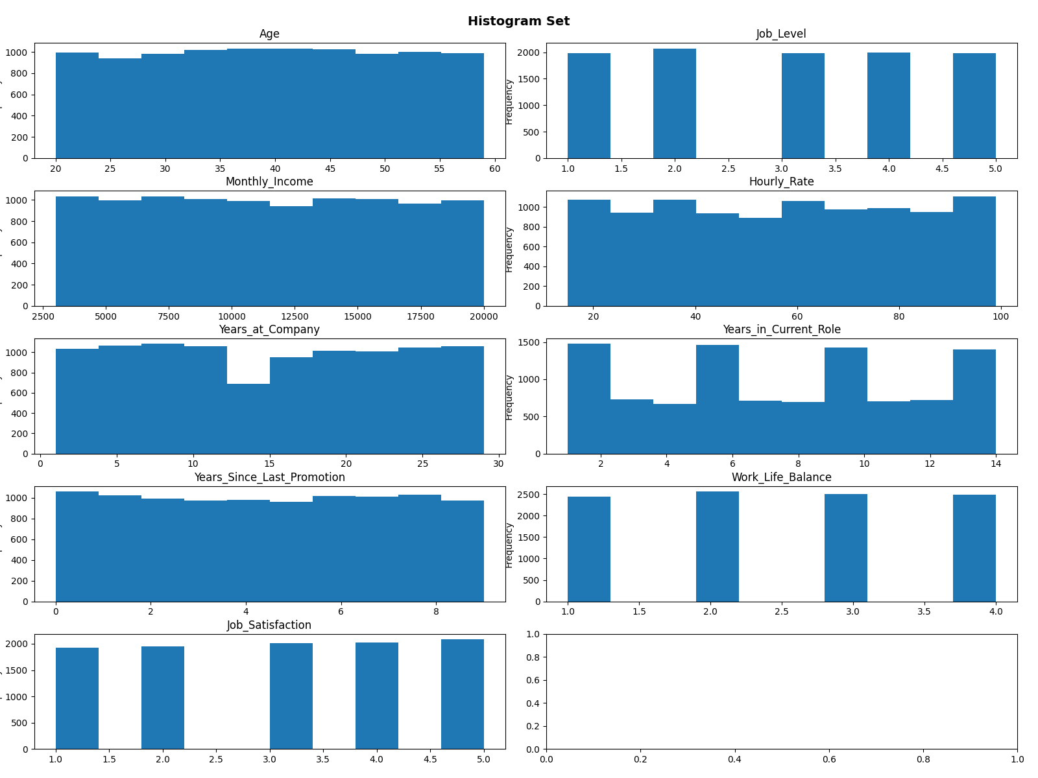

Slide 9
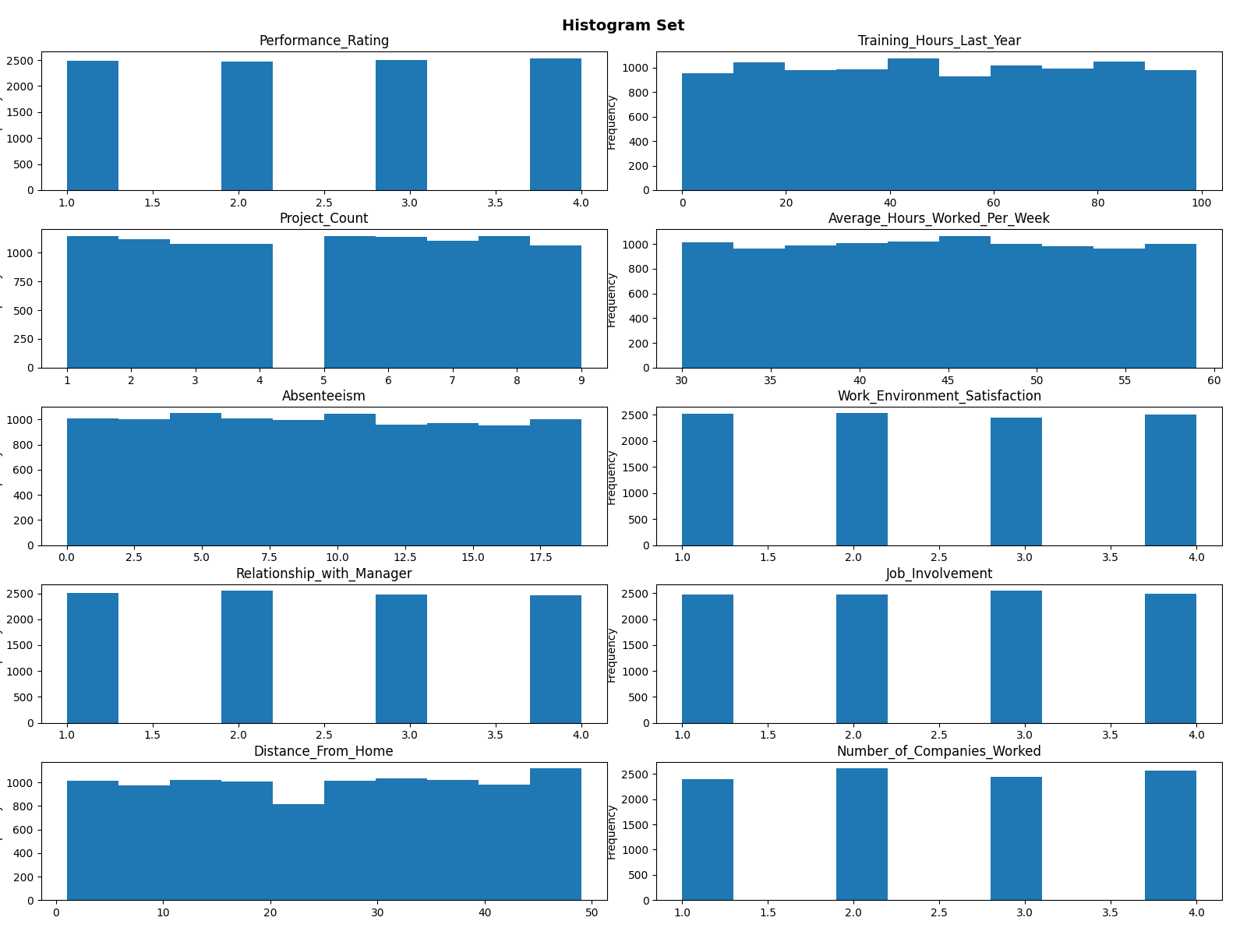

Slide 10
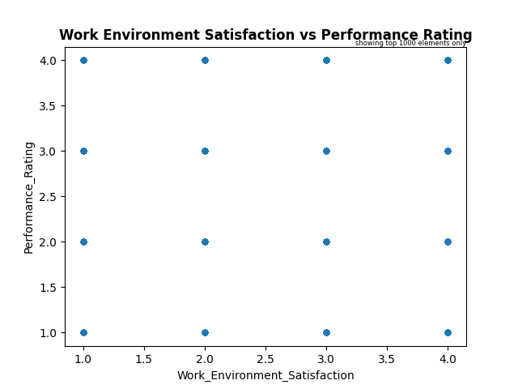
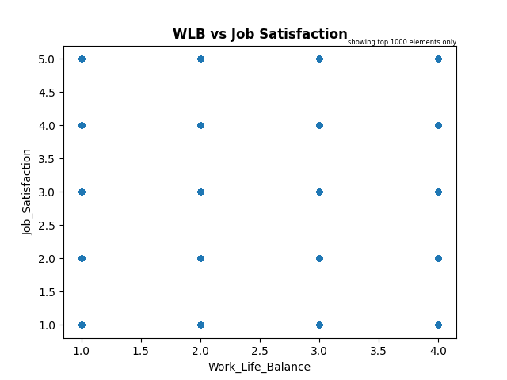
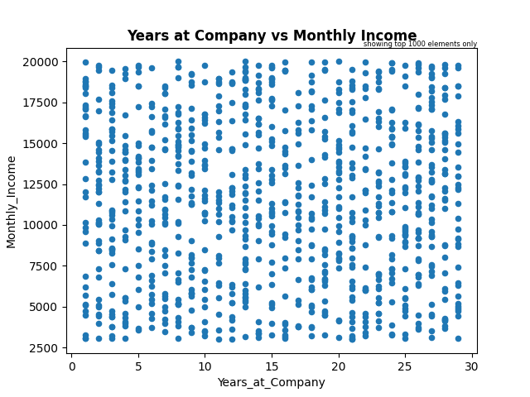
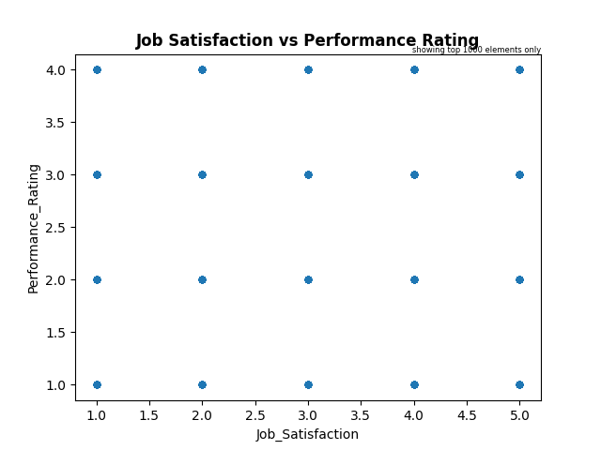

Slide 11
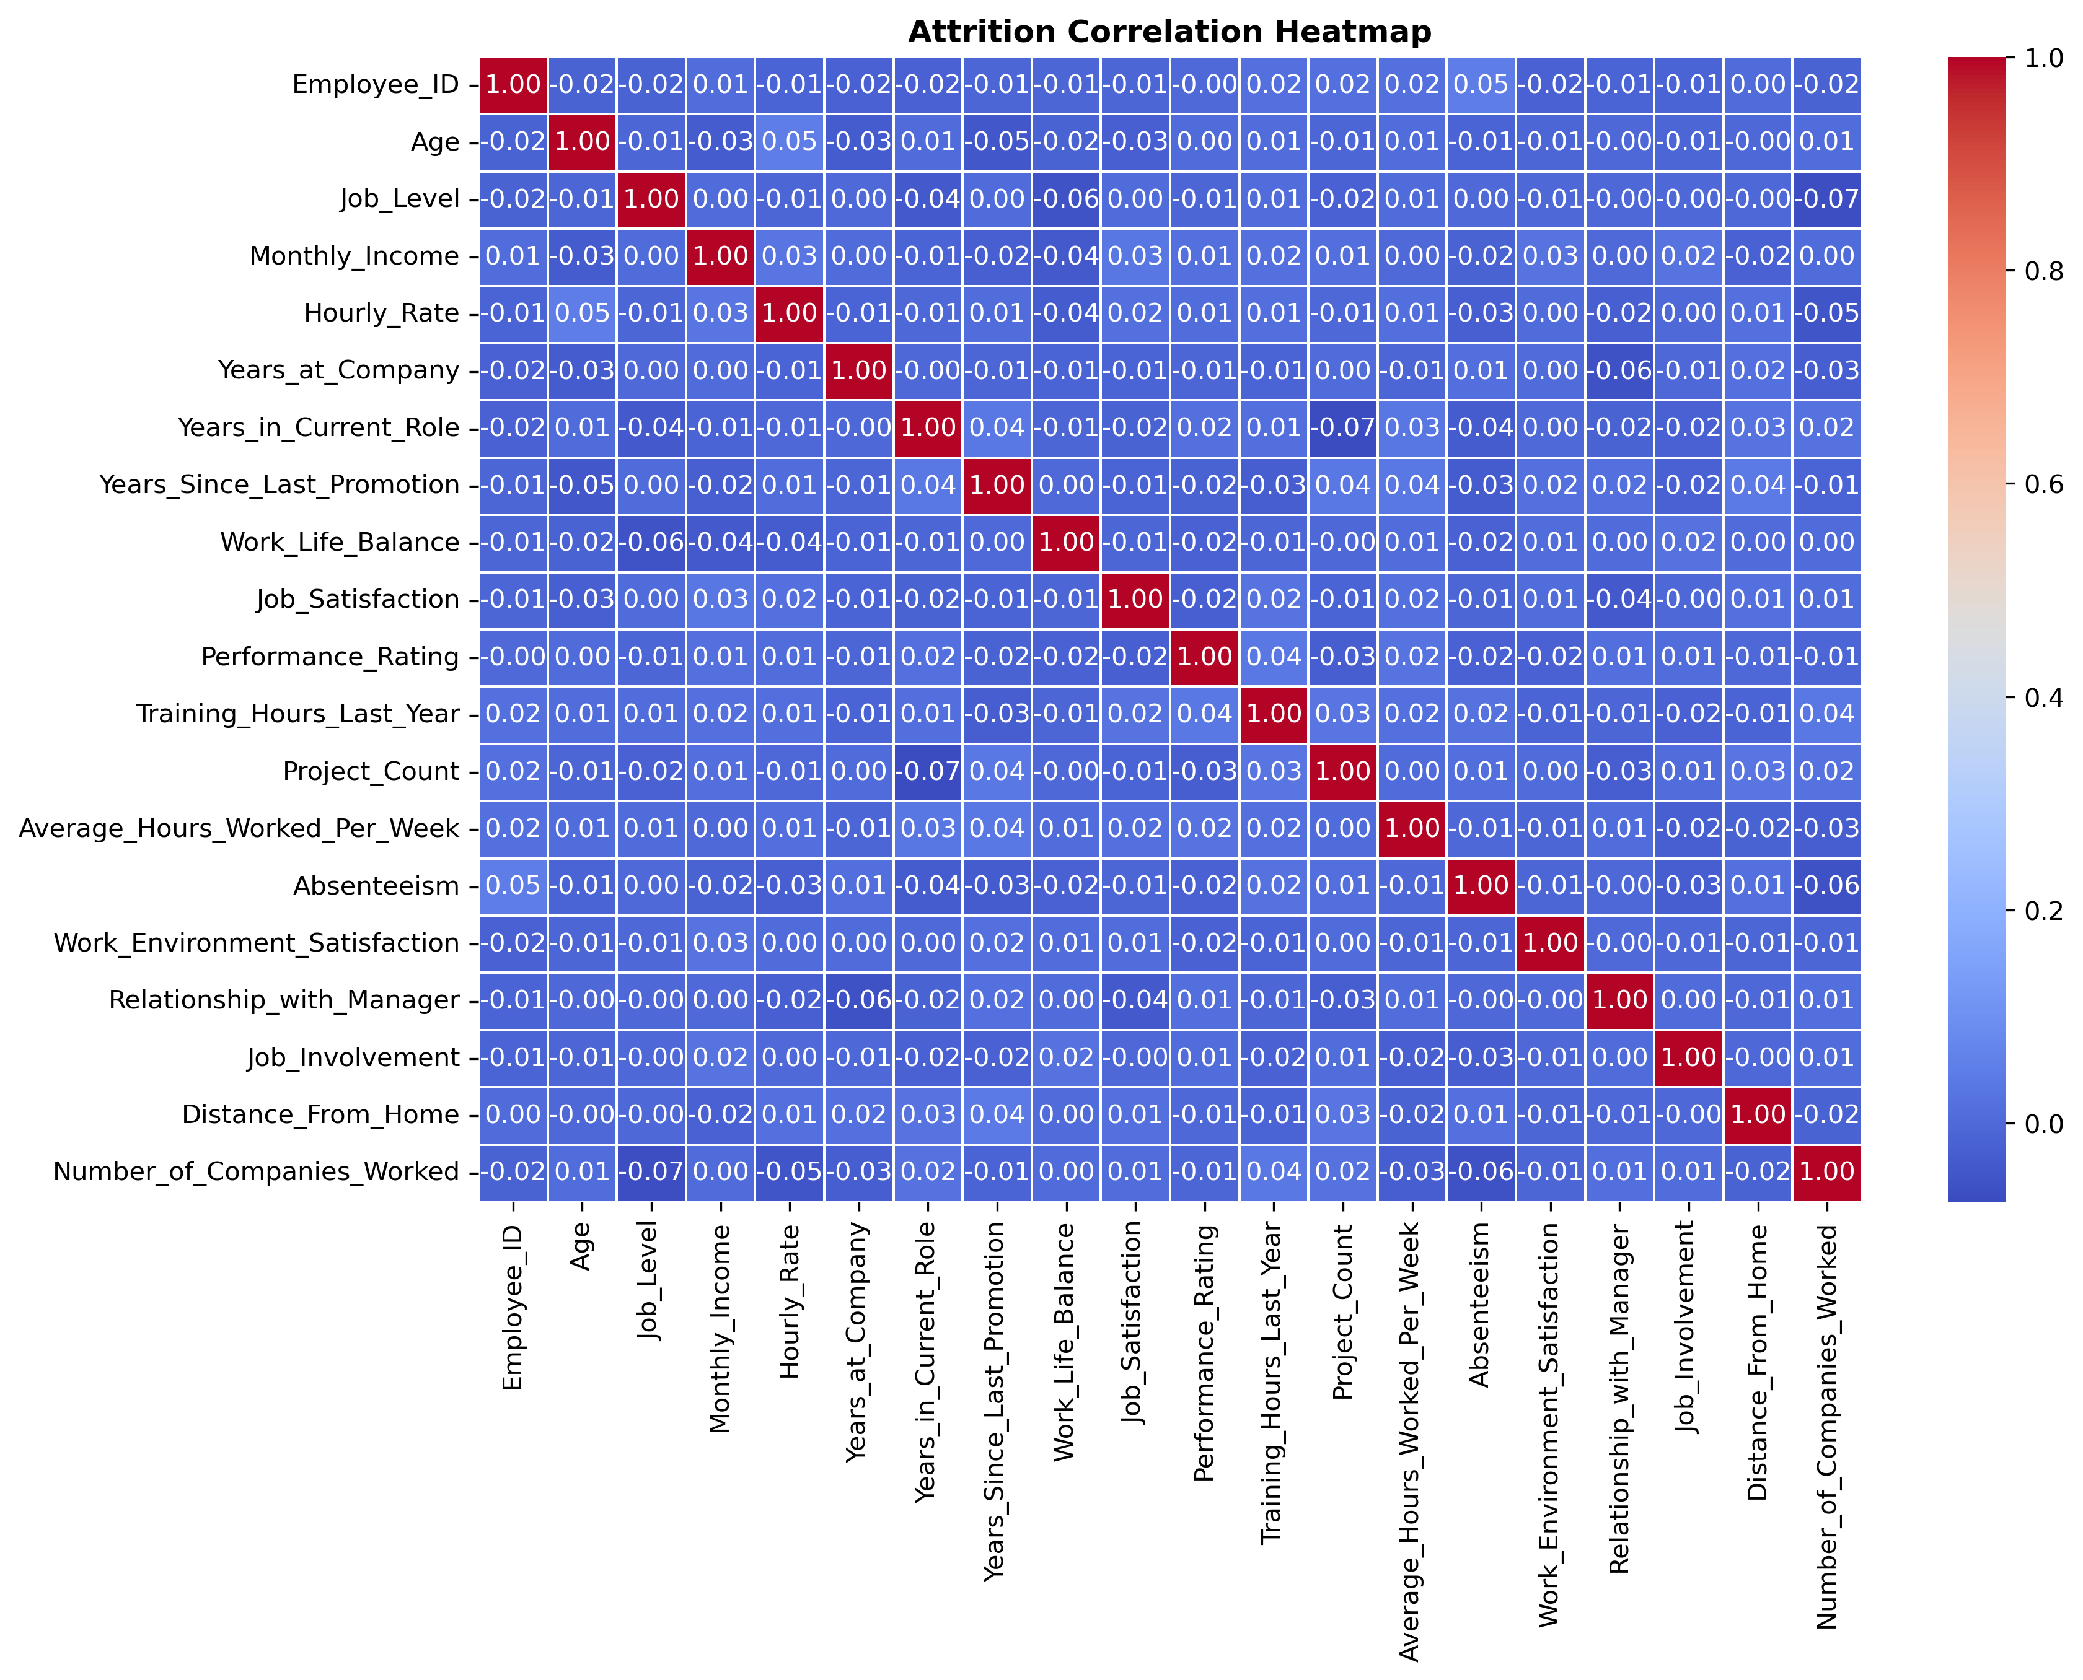
Pearson Correlation Data - statistical method that measures the similarity or correlation between two variables by comparing their attributes and calculating a score ranging from -1 to +1. A high score indicates high similarity, while a score near zero indicates no correlation.

Slide 12
Notable Patterns But All Still VERY WEAK
Age vs. Hourly Rate (0.021)
Slight positive trend: older employees may earn marginally higher hourly wages.
Age vs. Years in Current Role (0.008) & Age vs. Years at Company (-0.012)
No meaningful correlation: age does not significantly influence tenure.
Job Level vs. Work-Life Balance (-0.034)
Slight negative trend: higher job levels may perceive slightly lower work-life balance.
Monthly Income vs. Job Satisfaction (0.030)
Very weak positive link: higher income might slightly improve job satisfaction.
Years at Company vs. Performance Rating (0.014)
Weak positive relationship: longer tenure may relate to slightly better performance.
Training Hours Last Year vs. Hourly Rate (0.011)
Slight trend: higher-paid employees might receive more training.
Monthly Income vs. Average Hours Worked per Week (0.010)
Very small positive correlation: higher earners may work slightly longer hours.
Monthly Income vs. Relationship with Manager (0.021)
Slightly positive: higher income may align with better manager relationships.
Hourly Rate vs. Number of Companies Worked (-0.018)
Slight negative trend: higher-paid employees may have worked for fewer companies.
No significant correlations or relationships, positive or negative, between any variable based on correlation data. Most variables have very weak correlations, indicating little to no linear relationship among them. This might suggest independence between many HR-related attributes in this dataset.

Slide 13

Data Analysis

Slide 14
Methods of Analysis
Filtering Dataset to Employee Records Who Have Attritted (Left the Organization)
Objective: Focus on this subset to analyze distribution of values based on several factors like workplace demographics, tenure and job-related metrics that could have implied their attrition.
Implemented visualizations to better identify patterns and trends of data points.
This would ultimately help with creating targeted retention strategies.
Classification Model – Predicting Attrition
Objective: Input the various employee factors and variables in machine learning models to predict whether an employee is likely to leave the company, essentially classifying them as "Attritted“ (left) or "Not Attritted“(retained).
Techniques Used: Logistic Regression, Random Forest Classifier, Hyperparameter Tuning with GridSearch
Clustering Analysis
Objective: Identify groups of employees with similar characteristics who are more likely to leave.
Technique Used: K-Means Clustering

Slide 15
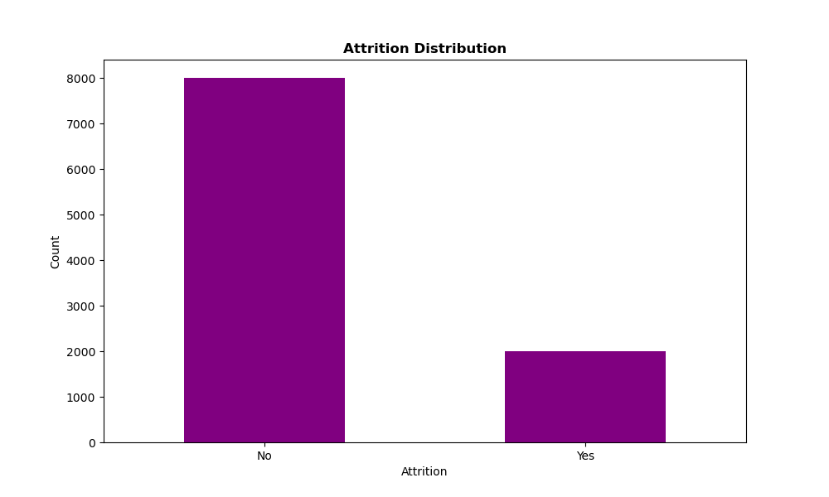
1,997 employees have left the organization based on this dataset.

Slide 16
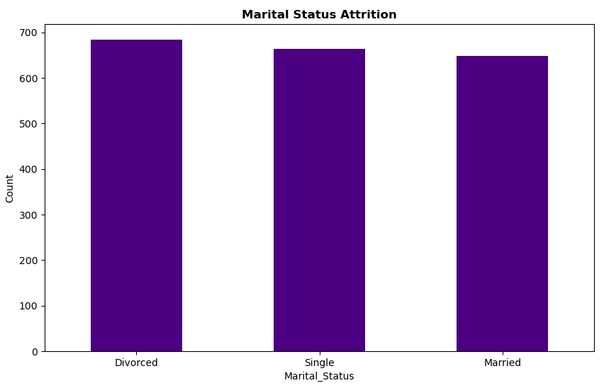
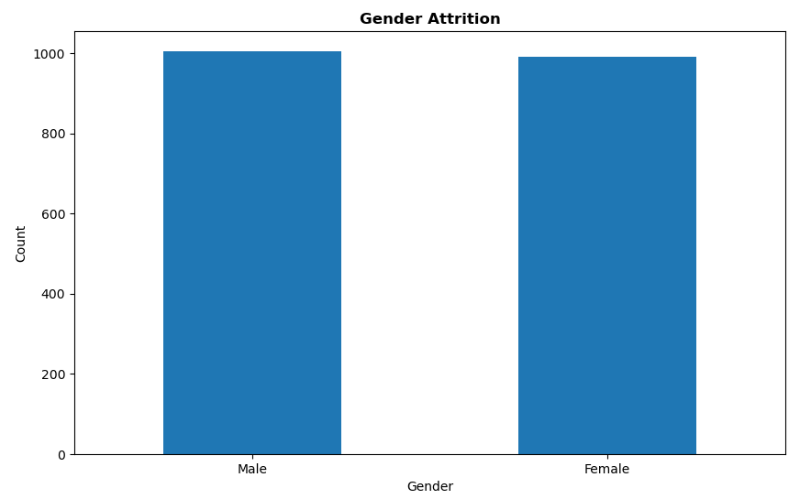
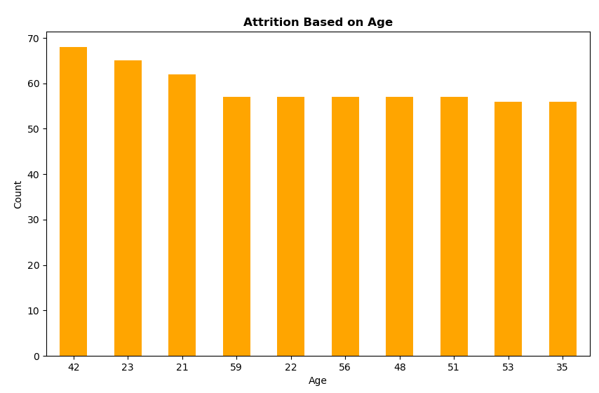

Slide 17
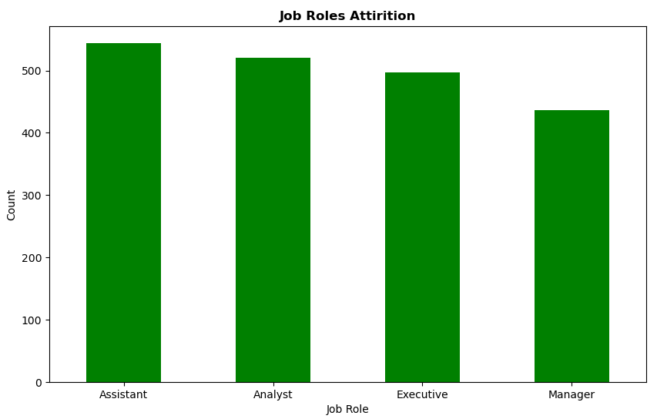
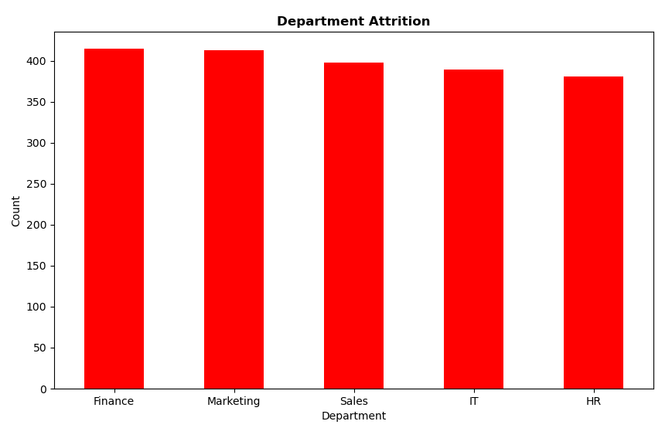
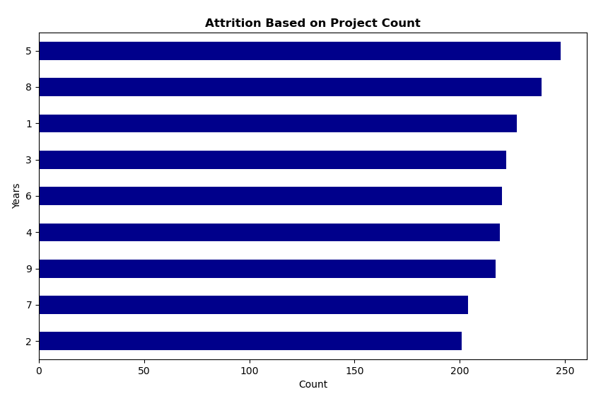

Slide 18
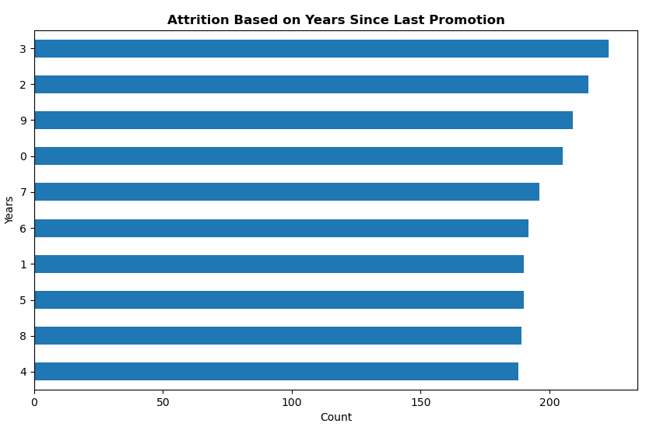
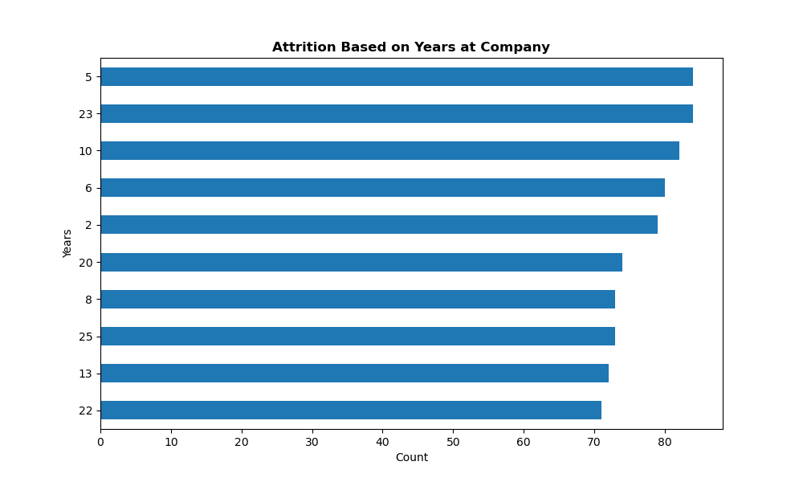
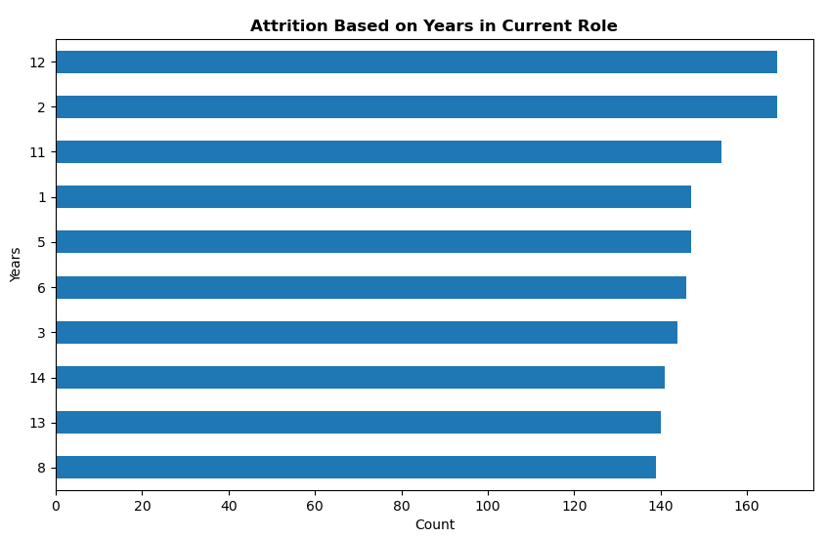

Slide 19
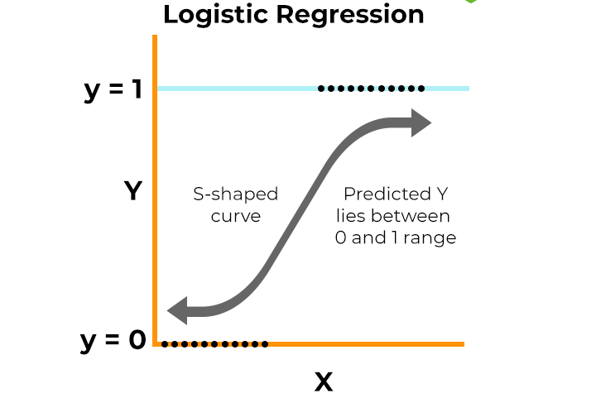
Logistic Regression Model Performance Results
Accuracy: 0.804 (80.4%)
Indicates solid overall performance — the model predicts correctly ~80% of the time.
Caution: Can be misleading if data is imbalanced (e.g., far fewer attrition cases).
Recall: 0.804 (80.4%)
Successfully identifies ~80% of employees who actually left.
Helps flag most at-risk employees, minimizing false negatives.
Precision: 0.646 (64.6%)
Of the employees predicted to leave, only ~64.6% actually did.
About 35% are false positives — may trigger unnecessary retention actions.
F1 Score: 0.717 (71.7%)
Balances precision and recall — reflects moderately strong, well-rounded model performance.
Good at identifying attrition but still prone to some false alarms.
Attritted = 1
Non-Attritted = 0

Slide 20
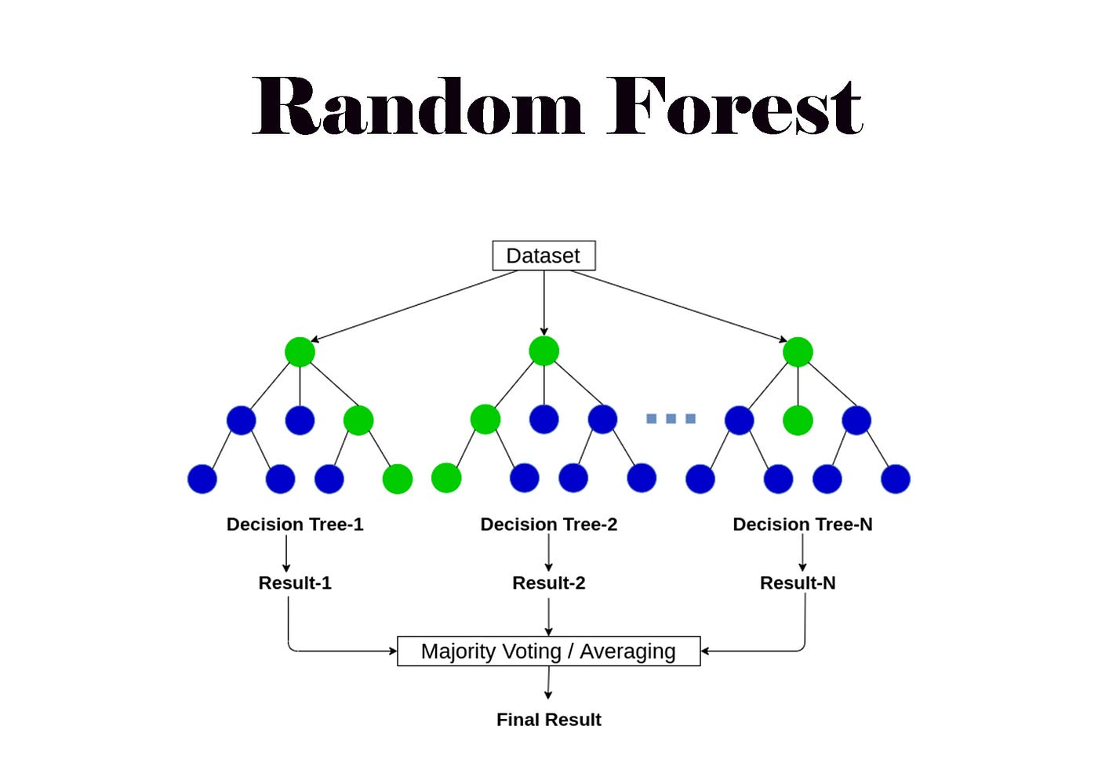
Random Forest Classifier Performance Results
Accuracy: 0.787 (78.7%)
The model correctly classifies ~79% of the test data.
Note: Accuracy can be misleading in imbalanced datasets (e.g., when most employees stay).
Recall: 0.787 (78.7%)
Captures ~79% of actual attrition cases.
Useful for identifying at-risk employees early for proactive retention.
Precision: 0.687 (68.7%)
About 69% of predicted attrition cases are correct.
Moderate false positive rate — some employees are flagged unnecessarily.
F1 Score: 0.718 (71.8%)
Indicates a solid balance between precision and recall.
The model performs well overall in identifying and managing attrition risk.
Attritted Class = 1
Non-Attritted Class = 0

Slide 21
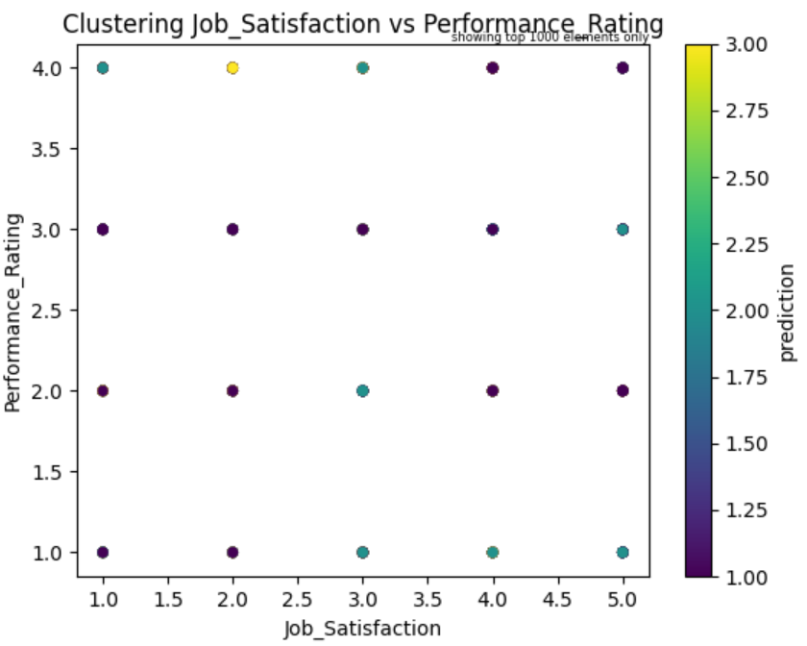
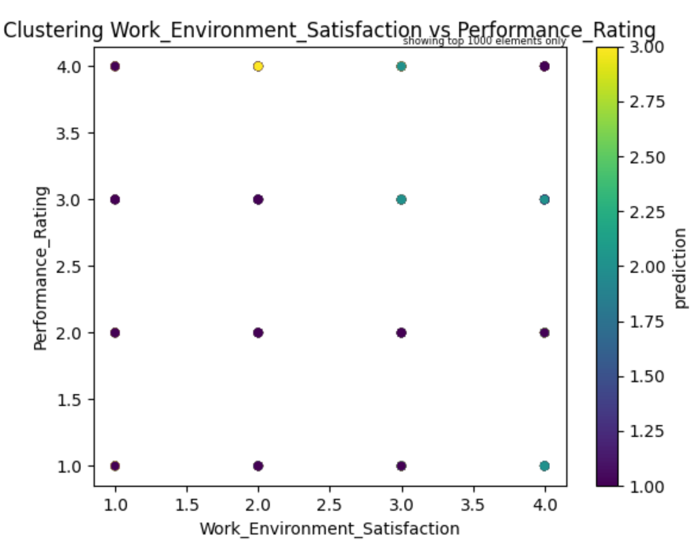

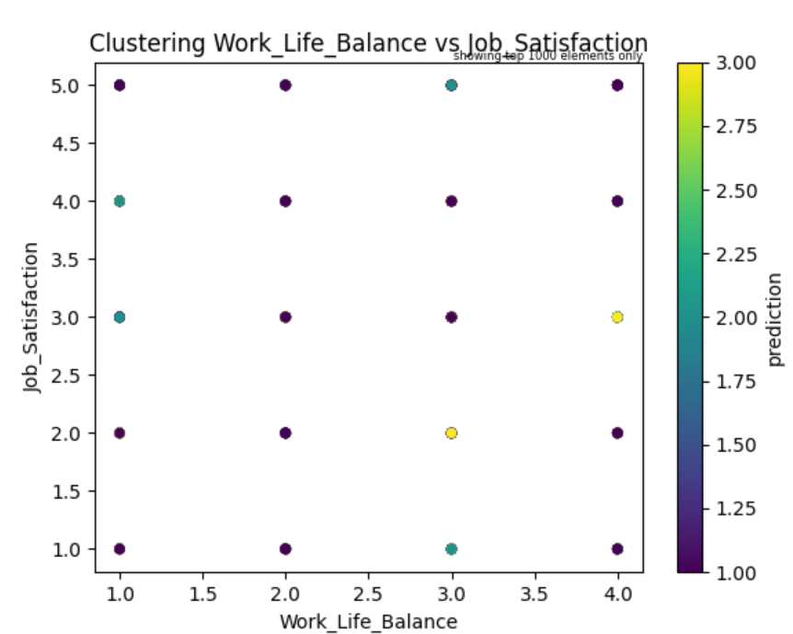

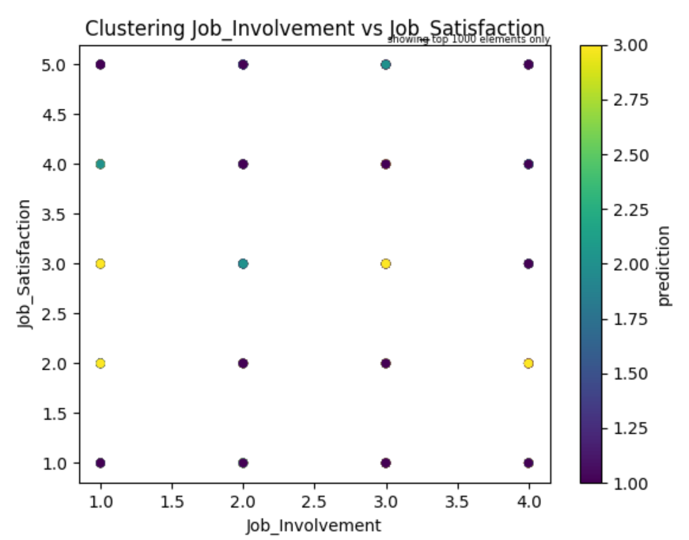
Clustering Results

Slide 22
Summary of Findings
Workplace Demographic Factors:
Attrition counts for males and females are nearly equal.
This suggests gender is not a significant differentiating factor in attrition in this dataset.
Higher attrition is observed among employees aged 21 to 23, as well as those around 42.
Attrition is relatively stable across mid to late career ages (35 to 59), with slightly lower rates.
Employees who are divorced have slightly higher attrition, followed by single employees; married employees show the lowest attrition.
This could suggest personal life stability may influence job retention.
Job-Related Factors:
Finance and Marketing departments show the highest attrition rates.
HR has the lowest attrition count, followed by IT.
Assistant-level positions have significantly higher attrition compared to other roles.
Manager positions show the lowest attrition rate.
There's a clear inverse relationship between seniority and attrition - as job level increases, attrition decreases.
Project counts of 5 and 8 show the highest attrition rates.
Project counts of 2 and 7 have the lowest attrition
There appears to be higher attrition with both very low (1-3) and very high (8-9) project counts.
Tenure-Related Factors:
Higher attrition is evident among employees with 5, 23, and 10 years at the company.
Employees with 13 and 22 years of tenure show the lowest attrition rates .
The pattern suggests two critical attrition periods: mid-career (5-10 years) and late career (23+ years, possibly pre-retirement).
Employees with 2 and 12 years in their current role show significantly higher attrition.
Lowest attrition is seen among those with 8, 13, and 14 years in role.
Highest attrition occurs among employees who have gone 3 and 2 years without promotion.
Employees with 4-8 years since promotion show lower but still significant attrition rates.
The data clearly indicates that promotion stagnation beyond 2-3 years significantly increases attrition risk.
Clustering → Best K-Means model had a silhouette score of ~0.131995, indicating very weak clustering structure:
Very Low score → clusters are not well defined
Data points within the same cluster are not much closer to each other than to points in other clusters
The dataset may not have natural groupings, or the features used don't reveal them effectively

Slide 23
Implications → Develop Retention Strategies
Workplace Demographics-Based
Ensure equity in development opportunities, pay, and work-life balance for all genders.
Continue promoting inclusive culture and policies that support both men and women equally, as no major imbalance is detected.
For younger employees (21–23): Introduce mentorship programs, clearer career paths, and onboarding support to boost early-career engagement.
For mid-career employees (around 42): Explore role enrichment, lateral mobility, or flexible working to maintain motivation and reduce burnout or career stagnation.
Offer employee wellness programs, counseling services, and flexibility that supports work-life balance—especially helpful for single or divorced employees.
Promote inclusive social engagement initiatives to help non-married employees feel more connected at work.
Job-Related/Internal-Based
Conduct focused exit interviews in Finance and Marketing to identify department-specific issues and implement targeted solutions.
Develop department-specific career advancement programs, particularly for high-attrition departments.
Apply successful retention practices from HR to other departments where appropriate.
Create enhanced onboarding, mentorship, and clear advancement paths specifically for entry-level positions.
Implement regular check-ins and targeted development plans for Assistant and Analyst roles.
Review compensation and benefits packages for junior roles relative to market standards.
Optimize workload by targeting 2-4 projects per employee and providing additional support for those handling 5+ projects.
Implement a project feedback system to identify which specific projects contribute most to employee dissatisfaction.
Assess project complexity alongside count when distributing assignments.
Tenure-Based
Develop targeted revitalization programs for mid-career employees (5-10 years) offering new challenges and growth opportunities.
Create retention plans for long-tenured employees (20+ years) with mentorship roles and flexible work arrangements.
Conduct "stay interviews" at key tenure milestones (5, 10, and 20 years).
Perform formal role reviews at the 2-year mark with clear paths for advancement or lateral movement.
Implement rotation programs allowing employees to gain new experiences without leaving the company.
Create job enrichment opportunities for employees in long-term roles (8+ years).
Establish a consistent promotion review cycle ensuring employees aren't overlooked for more than 2 years.
Develop alternative growth opportunities for employees who can't be promoted due to structural limitations.
Implement transparent promotion criteria with regular feedback on progress toward advancement.

Slide 24
Limitations
External factors and/or other variables not included in the dataset that could have more significant relationships with attrition.
MORE DATA will always be useful for deeper and more extensive analysis.
The dataset used does not include time-based variables, which could help give a better picture of attrition trends over time.
There may be other values that could be considered for each feature (e.g., there could be more job roles or departments that may help explain attrition patterns).

Slide 25
End of Presentation Thank You

