Slide 1
Sentiment Analysis
LA Reddit Community Analysis · r/LosAngeles · Aug 2025 – Jun 2026
Four methods.
The same 498,147 comments.
Between 23% and 63% of them negative.
Notes:
PACE: fast, about 15 seconds.
Open on the problem. Four sentiment methods applied to the same half-million comments from r/LosAngeles, and depending which one you trust, anywhere from 23% to 63% of the community's comments are negative. That is not a rounding difference — the methods disagree about what kind of place this community is. Everything that follows is about resolving that.

Slide 2
Two families of method
Four methods applied to all 498,147 comments
Lexicon-based
Transformer-based
Look up each word in a pre-built dictionary and combine the scores.
Neural models trained on labelled examples, accounting for word order and context.
TextBlob
Averages the sentiment values of recognised words
VADER
Adds rules for negation, intensifiers, capitalisation, emoji
Twitter-RoBERTa
Trained on social media text; outputs three classes directly
Multilingual BERT
General-purpose; outputs a 1–5 star rating, converted to three
No representation of context — each word scored independently.
One domain-matched, one not — so the benchmark can test whether that matters.
Sentiment scored on text preserving capitalisation and emoji — signals the standard cleaned text discards.
Notes:
PACE: fast. One line each — this is setup.
Two families that work differently. Lexicons look up words in a dictionary: fast and transparent, but no sense of context, so sarcasm and negation defeat them. Transformers are trained on labelled examples and read word order. We picked one social-media-trained model and one general-purpose model deliberately, so the benchmark could test whether domain matching helps.
IF ASKED about the text preparation: the standard cleaned text is lowercased with emoji stripped, which suits topic modelling but throws away what these methods use — VADER reads capitalisation as emphasis, transformers tokenise emoji as meaningful. Preserving both changed 5.08% of RoBERTa's labels, against 0.80% for VADER and 0.04% for TextBlob.
IF ASKED about thresholds: the ±0.05 cut-off is VADER's published convention. TextBlob has no equivalent, so we tested wider values — its neutral share nearly doubles across the range, meaning its distribution is substantially an artifact of an arbitrary cut-point.

Slide 3
The four methods disagree sharply
Same 498,147 comments, scored four ways
39.9
point spread on the
negative class
19.5%
of comments get the same
label from all four
23.5%
get every possible label
across the four
Notes:
PACE: HOLD. This is the problem slide — give it time.
The same half-million comments, scored four ways. The share labelled negative runs from 23% under TextBlob to 63% under BERT. A forty-point spread on identical text — the methods disagree about the basic character of the community, not about edge cases. All four agree on under a fifth of comments, and for nearly a quarter of them they produce every possible answer between them.
So the obvious question: which one is right? Nothing in these outputs can tell you, because the outputs are the thing being evaluated.
IF ASKED about coverage: all four methods ran on the complete corpus, all 498,147 comments. No sampling.

Slide 4
Why the lexicons look neutral
Most of their neutral labels are non-answers
TextBlob and VADER return a score of exactly zero when no word in a comment appears in their dictionary. That result is recorded as "neutral" — indistinguishable from a genuine judgment that a comment is balanced.
1.7%
 | Labelled neutral | Of those, exactly zero | Genuine judgments
TextBlob | 34.5% | 75.4% | 8.5%
VADER | 22.7% | 92.6% | 1.7%
of the corpus is genuine neutral sentiment under VADER. It is effectively a two-class method with a large bin of unread text attached.
For comparison: hand-labelling puts genuinely neutral content at 37% of the corpus. Neither lexicon method finds it reliably.
Notes:
PACE: HOLD. Best diagnostic finding in the deck.
Part of the answer is a specific, measurable weakness in the lexicons. Both return exactly zero when they recognise none of the words in a comment. That is the method saying it has nothing to go on — but it lands in the neutral bucket looking like a real judgment.
Strip those out and VADER identifies genuine neutral sentiment in under 2% of half a million comments. It is not really a three-class method at all. Hand-labelling says 37% of this corpus is genuinely neutral, so neither lexicon is finding it.

Slide 5
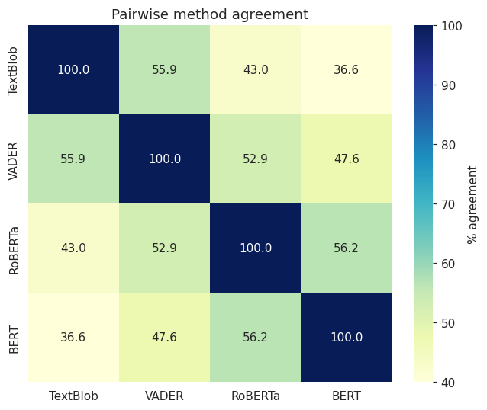
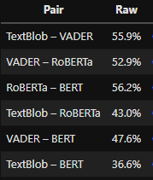
Raw Agreement Heatmap
Notes:
Raw pairwise agreement ranges from 36.6% to 56.2%. All four methods assign the same label to only **97,088 comments — 19.5% of the corpus** Raw agreement has a floor problem: two methods that both predict negative frequently will match often through coincidence alone, with no real correspondence between their judgments. Cohen's kappa adjusts for the agreement expected by chance given each method's class proportions.

Slide 6
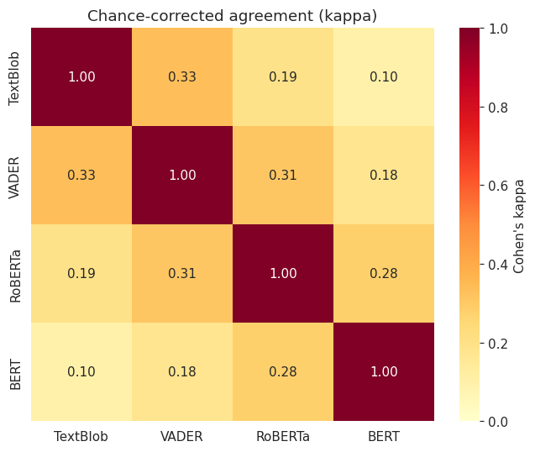
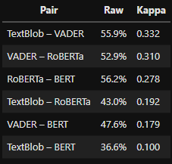
Cohen’s Kappa Heatmap
Notes:
After correcting for chance, the two lexicons correspond more closely (kappa = 0.332 against 0.278) — the transformers only appeared close because both lean heavily negative, inflating coincidental matches. Every pair falls in the "slight" or "fair" band. None reaches moderate agreement.

Slide 7
Raw Agreement follows negativity, not model type
Cohen's kappa, which discounts agreement expected by chance
TextBlob
VADER
RoBERTa
BERT
Labeled 22.7% negative
Labeled 35.0% negative
Labeled 52.1% negative
Labeled 62.6% negative
Adjacent pairs
κ = 0.33, 0.31, 0.28
Two apart
κ = 0.19, 0.18
Opposite ends
κ = 0.10
Agreement falls steadily with distance along the spectrum. VADER and RoBERTa — one lexicon, one transformer — agree more with each other than the two transformers do. What predicts agreement is not shared architecture but how readily a method reaches for a negative label.
Notes:
PACE: fast — the diagram reads itself. One or two sentences.
Raw agreement is misleading, because two methods that both label most things negative will match often by coincidence. Cohen's kappa discounts that. Once corrected, a clean pattern appears: order the methods by how negative they are, and agreement drops steadily with distance along that line. The two transformers are not the closest pair — VADER and RoBERTa are, despite coming from different families.
The takeaway: what predicts whether two methods agree is not their architecture, it is how readily each reaches for a negative label.
Kappa never exceeds 0.33 here, which is 'fair' at best on the standard interpretation. No pair reaches moderate agreement.

Slide 8
Human-Coded Benchmark: Settling it with human labeling
The models' own output cannot say which model is right
1
100
comments drawn at random and labelled by hand, without seeing any model output
What the corpus actually is
Negative
44%
2
Rules first
coding rules written and agreed before annotation began, to prevent adjusting toward the models
Neutral
37%
3
One rule above all
Positive
19%
label the attitude the commenter expresses — not whether the subject matter is pleasant
A further 25 comments where the methods most disagreed were labelled for error analysis only — never counted in any accuracy figure.
Notes:
PACE: HOLD. This is the methodological core.
Because the methods contradict each other, we needed an external reference. We hand-labelled 100 randomly drawn comments.
Two design points matter. The annotation file contained no model predictions — seeing that three methods said negative would anchor the judgment, and then you are measuring agreement with the models rather than with the truth. And the coding rules were written down before starting.
The key rule is the third one: label the attitude the commenter expresses, not whether the subject matter is pleasant. A factual statement about something unwelcome is neutral. That is exactly the distinction the four methods were spread along, so applying it consistently is what determines the result.
The answer: this corpus is 44% negative, 37% neutral, 19% positive.

Slide 9
One method is clearly more accurate
Scored against the 100 hand-labelled comments
Method | Accuracy | Macro-F1 | F1 neutral
Twitter-RoBERTa | 70.0% | 70.3 | 64.1
TextBlob | 50.0% | 49.7 | 44.4
VADER | 49.0% | 47.2 | 37.7
BERT | 50.0% | 44.4 | 17.8
Characteristic errors
Lexicons
Find "good" in a factual comment and call it positive
Transformers
Read unpleasant subject matter as an unpleasant attitude
Reversals — negative comments called positive:
TextBlob 13 · VADER 15 · RoBERTa 1
Why macro-F1. It weights all three classes equally rather than letting the largest dominate. TextBlob and BERT record identical accuracy and look equivalent — macro-F1 separates them by five points, because BERT catches only 4 of the 37 neutral comments.
What it can't tell you
Is the gap real? Comparing each pair on only the comments where they disagreed, RoBERTa beats all three (p = 0.000, 0.002, 0.003). The other three are statistically indistinguishable — the ranking is RoBERTa first, then a three-way tie.
~30% of individual comments are labelled wrong — reliable in aggregate, not for any single comment
It over-reads negative, so absolute levels are inflated — though comparisons hold
Notes:
PACE: HOLD. This is the result.
RoBERTa is twenty points ahead of everything else.
Two things worth pointing out. First, macro-F1 rather than accuracy. TextBlob and BERT both score exactly 50% and look equivalent — macro-F1 separates them by five points because BERT catches only 4 of the 37 neutral comments in the benchmark. Choosing that metric in advance is what made the difference visible.
Second, we tested whether the gaps are real by comparing each pair only on comments where they disagreed. RoBERTa beats all three significantly. The other three are statistically indistinguishable — so the honest ranking is RoBERTa first, then a three-way tie.
The panel: every method's most common error involves neutral comments, but the families fail in opposite directions. And the serious one — genuinely negative comments called positive — happens 13 and 15 times for the lexicons against RoBERTa's once.
Be upfront about the limits: it is wrong on about 30% of individual comments, so it is dependable in aggregate but you should not quote any single comment's label. And it over-reads negative, so absolute levels are inflated even though comparisons between groups hold.

Slide 10
What RoBERTa catches that others miss
25 deliberately hard cases where the four methods produced all three labels
On thirteen of these, only one method matched the human label — and that method was RoBERTa eight times.
"AB 253: California Residential Private Permitting Review Act... would remove the requirement for a city to contract with..."
human label
A verbatim summary of a housing bill. Neutral to any reader — every other method scored it as carrying sentiment.
neutral
"This whole country is the Wild West now."
human label
Negative, with no negative word in it. "Wild West" is an idiom a dictionary cannot resolve.
negative
"You are an unfit mother."
human label
Hostile, but contains nothing a lexicon would flag. Requires reading the phrase as a whole.
negative
These 25 were selected for difficulty and excluded from every accuracy figure — they illustrate how each method fails, they do not measure performance.
Notes:
PACE: fast. Read ONE example aloud — the housing bill — and move on.
Alongside the numbers we looked at the hardest cases: 25 comments picked precisely because the four methods disagreed completely, producing all three labels between them. On thirteen of those, only one method matched the human label, and that method was RoBERTa eight times.
The pattern in those eight is consistent: factual or explanatory writing about a charged subject. The first example is a verbatim summary of a housing bill — obviously neutral to a person reading it, but every other method found sentiment in it, because the subject matter is contentious even though the writing is not.
The other two are the reverse problem: clearly negative comments containing no negative vocabulary at all. A lexicon has nothing to grab onto.
Important caveat: these were selected for difficulty and are excluded from every accuracy number. They show how the methods fail; they do not measure how often.

Slide 11
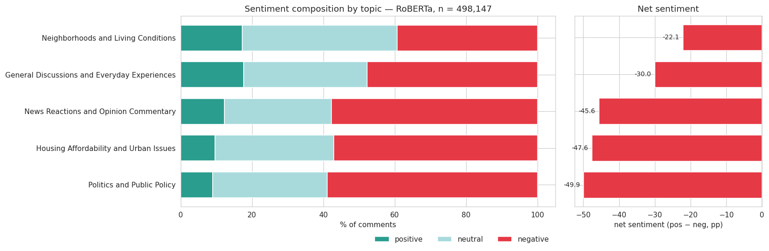
Sentiment Composition by Topic & Net Sentiment

Slide 12
Applied across the five topics
Net sentiment: positive share minus negative share, in percentage points
27.8
point gap between the most and least critical theme — criticism attaches to institutions, not to place.
Stable under three checks. Unchanged when weakly assigned comments are excluded, when replies are separated from top-level comments, and month by month.
Topics from LDA (K=5), selected on coherence and diversity by the topic modelling component; reproduced here to align assignments with sentiment scores. Two of the five are residual groupings without a coherent subject — General Discussions and News Reactions — so their figures reflect mixed content rather than attitude toward a theme.
Notes:
PACE: HOLD. This answers the first research question.
Applying the selected model across the five topics gives a clear ranking. Politics is the most critical theme, housing close behind, and neighbourhoods the least critical by a wide margin — a 27.8 point gap.
The reading: criticism attaches to institutions and policy rather than to the city itself. Housing is the interesting case — it could have patterned with neighbourhoods, since where you live is a daily-life matter, but it sits with politics instead. This community discusses housing as a policy failure.
Credit where due: the topics come from the topic modelling component — LDA with five topics, chosen on coherence and diversity. We reproduced the model on our side so the assignments line up exactly with the sentiment scores.
One honest qualification: two of the five topics did not resolve into coherent subjects. General Discussions and News Reactions are mixed bags, so their sentiment numbers reflect heterogeneous content. The three interpretable themes are the ones the conclusion rests on.
IF ASKED about the robustness checks: the ranking is identical when we keep only comments confidently assigned to their topic, it holds when top-level comments and replies are analysed separately — replies are uniformly a few points more negative but the ordering does not move — and no topic overtakes another in any of the eleven months.

Slide 13
What this answers
Two of the study's research questions
RQ2 — How do the themes differ in sentiment?
Answered
Sentiment differs by 27.8 percentage points across the five themes. Politics (−49.9) and housing (−47.6) draw the sharpest criticism; neighbourhoods and daily life (−22.1) far less. The ranking is stable under every check applied.
RQ4 — Are the most negative themes also the most engaged?
Not supported
Politics is the most negative theme but only third by volume; neighbourhoods is the least negative yet second largest. Volume appears to track how central a theme is to daily life, not how negatively it is discussed.
Four methods on identical text disagreed by forty points on how negative this community is — which is why the model had to be chosen on evidence, not convenience.
Notes:
PACE: HOLD. Close here.
The sentiment work answers two of the study's research questions.
The first is answered cleanly — themes differ by nearly 28 points, and the ranking holds under every robustness check we applied.
The second is not supported, and that is itself a finding. The expectation going in was that negativity drives attention. It does not, at least here. Politics is the most critical theme but only third by volume; neighbourhoods is the least critical but second largest. The reading is that volume tracks daily relevance rather than negativity — people write most about what they encounter constantly, and criticise most what frustrates them institutionally.
Close on the takeaway: four methods, identical text, forty points apart on the most basic question you could ask of this corpus. That is why the model selection work mattered — pick the wrong one and every downstream conclusion changes.
IF ASKED why RQ4 uses volume: the corpus has no per-topic measure of reader response, so volume is the available proxy. A measure of reader response might behave differently.

