Slide 1


Prototype
By: Adam Chung, Zachary Okwuosa, Liam Hardage, Rutvik Marakana

Slide 2
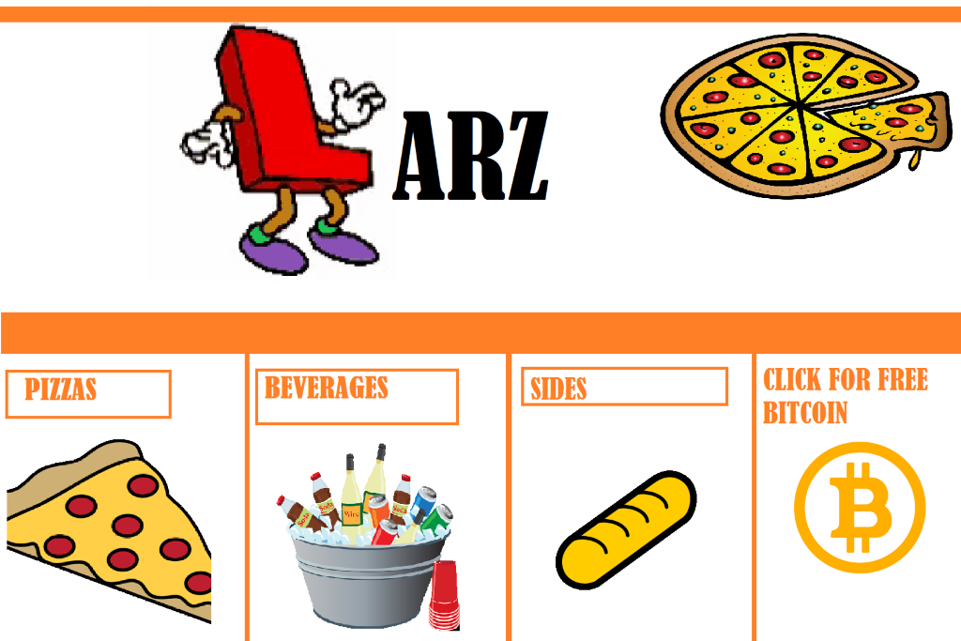
Main Menu
Here is our main menu of our pizza application.
Users are faced with 4 options to choice from when creating their cart.

Slide 3
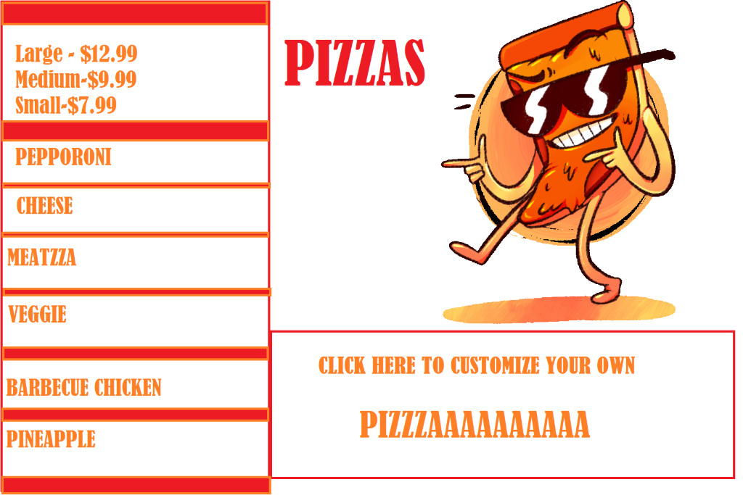
Pizza Selection
This page lists our Pizza with the sizes and prices that the customer would prefer.
Below we have an option for the customer to make their own pizza and customize it to their own liking.

Slide 4
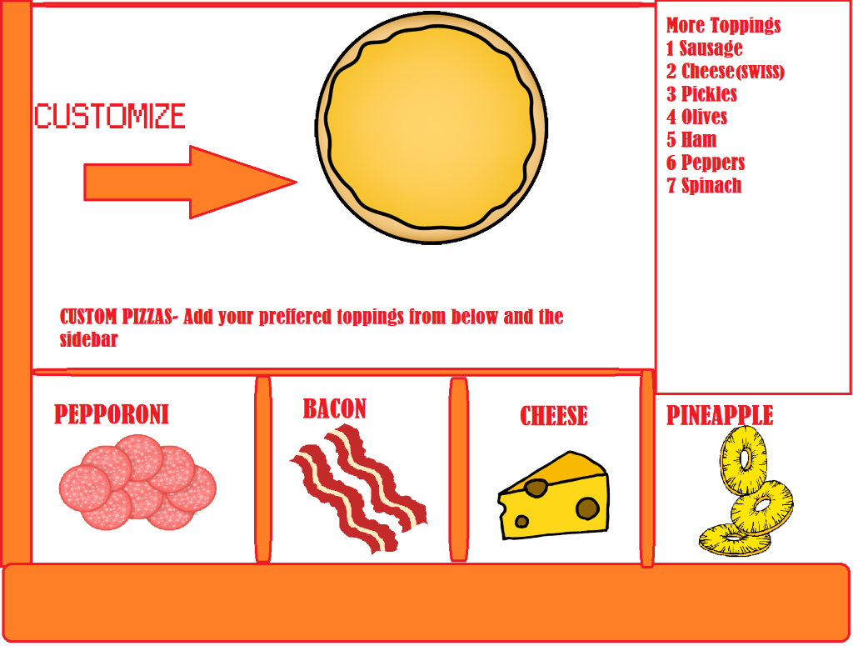
Pizza Customization Page
Here is the customization page itself, the customer has the choice to select various toppings
The sidebar allows for more options

Slide 5
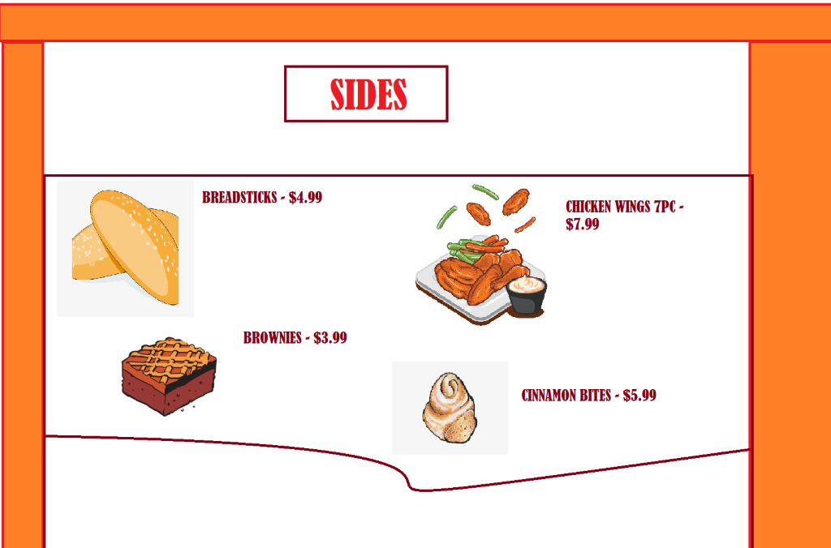
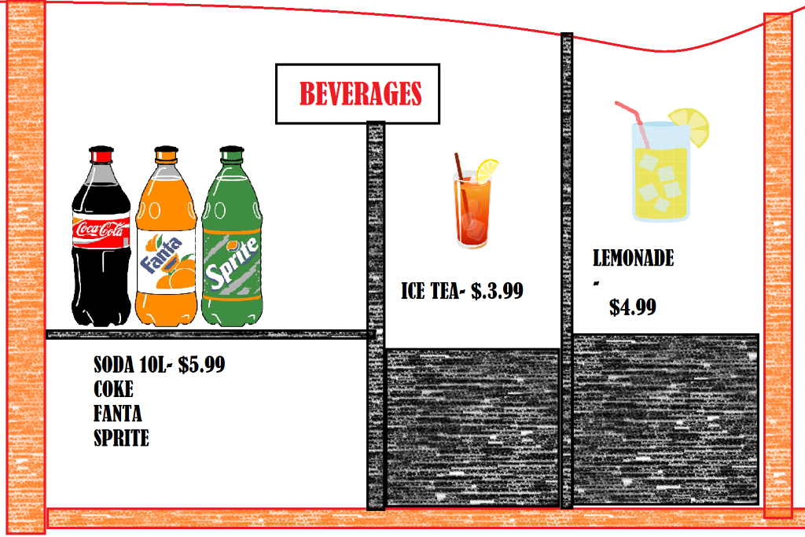
Sides & Beverages
Pizza isn't the same without side dishes, we offer a nice selection of them to go with our pizza
Below our beverages to relinquish the consumers thirst.

Slide 6
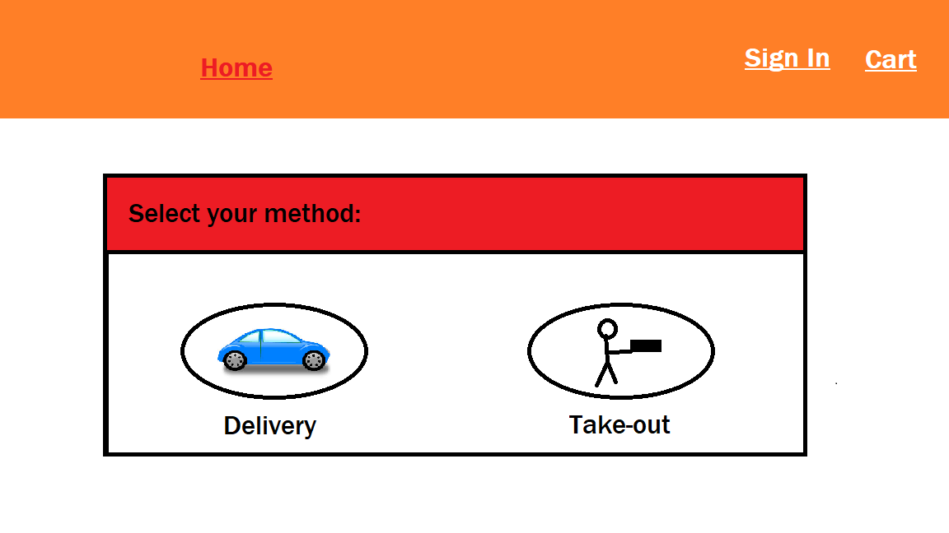

Cart Page
When accessing the cart page, the user is presented by two methods of order. Option 1: Delivery Option 2: Take-out
Depending on which option the user chooses, more information may need to be filled out.

Slide 7
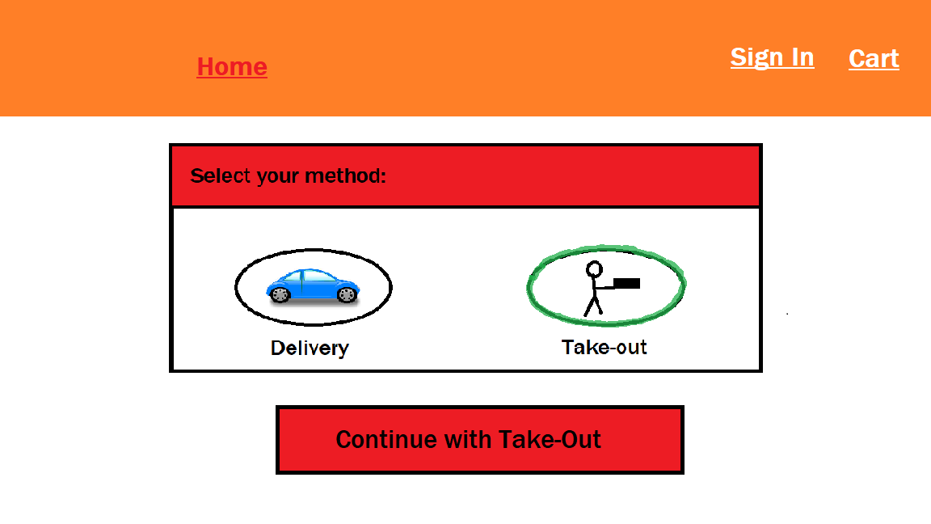
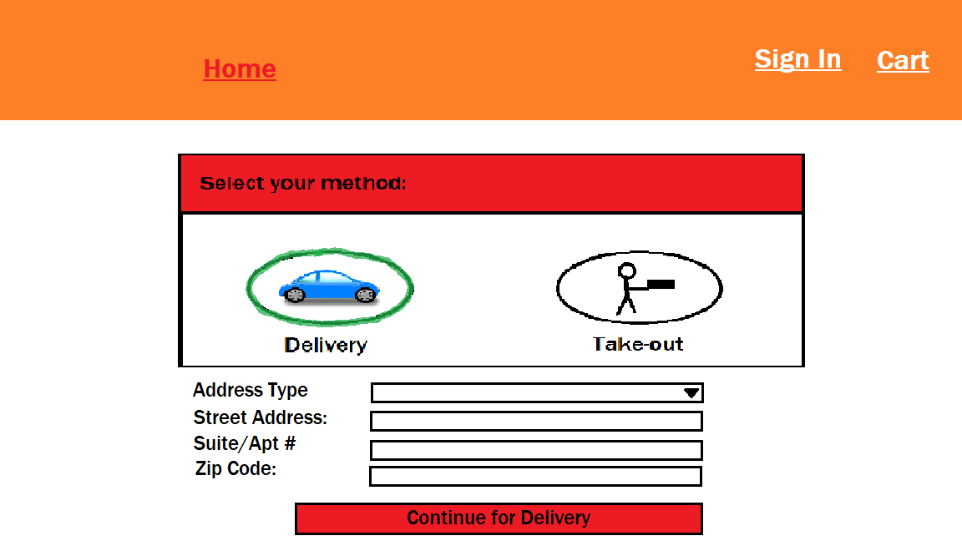
Cart Page(Take-out &Delivery Option)
When the user chooses the "Take-Out" option, they are presented to continue with their order to the Billing and Customer Info page.
When the user choose the "Delivery" option, they are presented by addition information about their address. This section need to be filled out before processing to the Billing and Customer Info page.

Slide 8
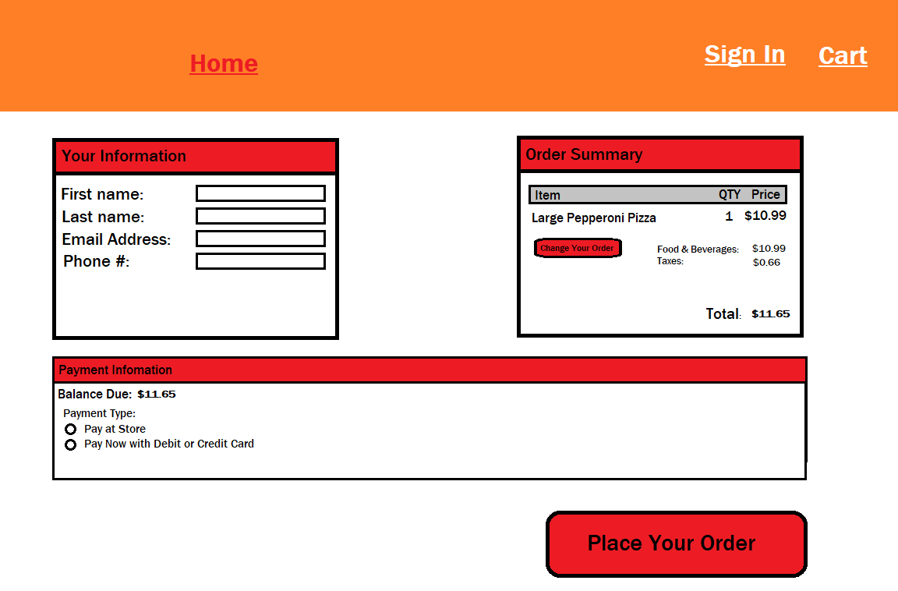
Billing & Customer Info
After selecting which method the user wants to order from, the user is given to a page with several text boxes to fill out, order summary, and two payment methods to select from
Payment methods differers depending on the order type.

Slide 9
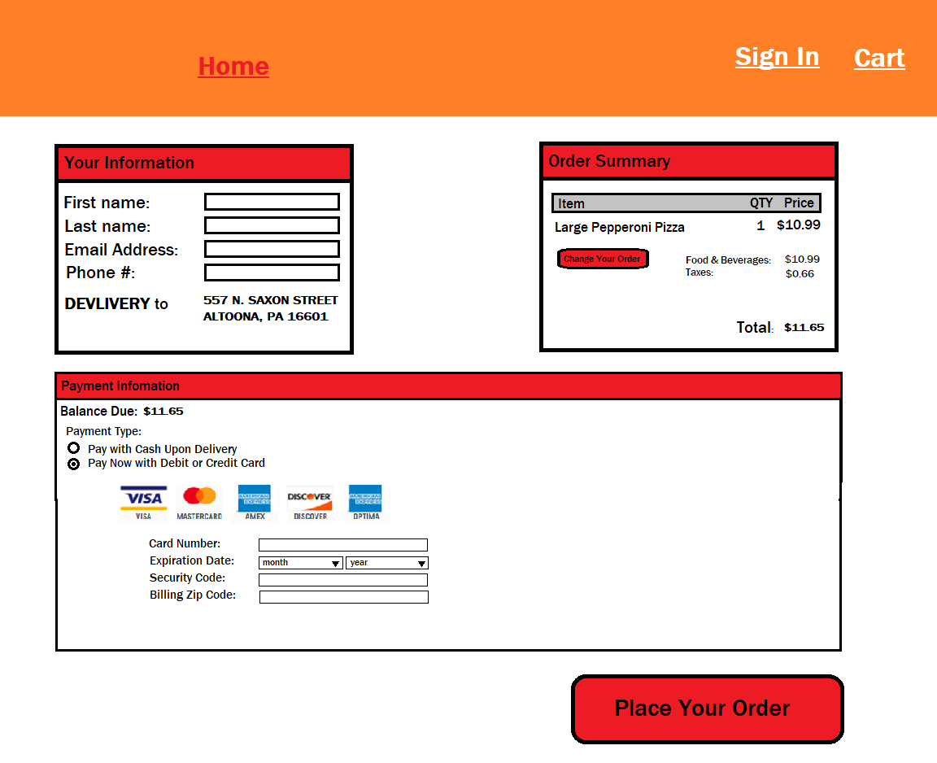
Billing & Customer Info (Card Info)
If the user selects to "Pay with Debit or Credit Card", the user needs to fill in their card information in order to place their order.
If any of the card information is incorrect, it will throw an error and the order will not be placed unless it is corrected.

Slide 10
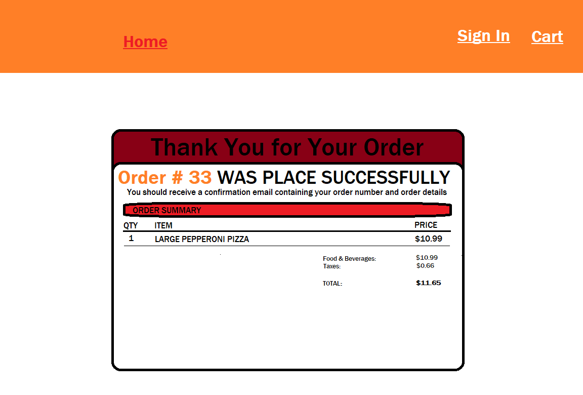
Confirmation Page
After everything is finalized, the user's order is placed, and an email should be sent out containing their order number and order details.

