Slide 1
FUN WITH POWERSHELL
Adam Clark
Boise Code Camp 2012 adamclerk@gmail.com
github.com/adamclerk

Slide 2
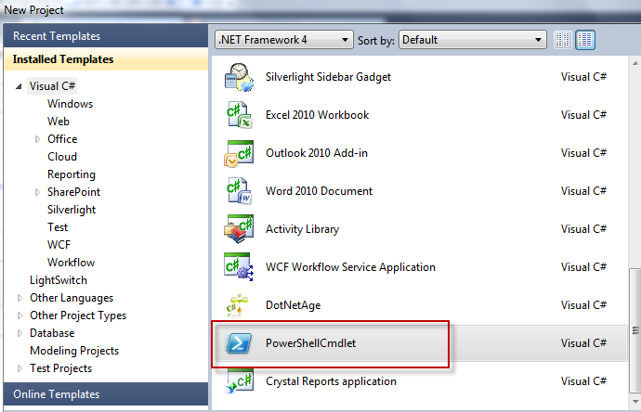
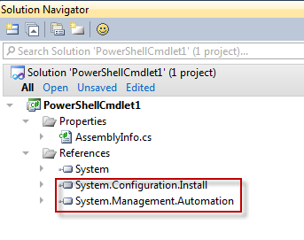
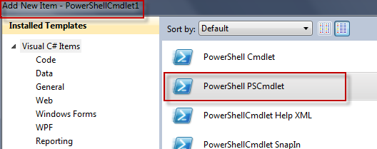
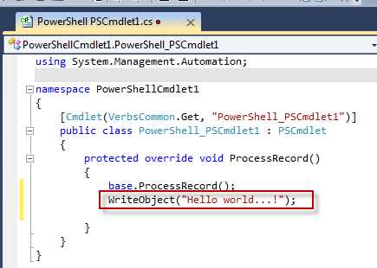
!FUN
Compiled
Cmdlets

Slide 3
FUN
Scripted
Cmdlets
!C#
!Compliation
!VS2010
Powershell
Fast, Easy and Fun

Slide 4
CODE
Get-Weather
Notes:
Get-Weather.ps1

Slide 5
!FUN
Too Many Parameters
!Readable
Messy
$param1 = Get-Stuff
$param2 = Get-More-Stuff $param1
$param3 = Get-Final-Stuff $param2
$output = Combine-Stuff $param3

Slide 6
FUN
Pipes
Object Pipes
!Text Pipes
Readable
Get-Stuff |
Get-More-Stuff |
Get-Final-Stuff |
Combine-Stuff

Slide 7
CODE
Count-Object Get-Weather v2

Slide 8
!FUN
Passwords
Plain Text
Typing @ Command Prompt
Not automated
Not secure

Slide 9
FUN
Secure
Strings
Encrypted
Retrievable
Automated
Slightly more secure than Plain Text
Simple

Slide 10
CODE
Read-Host
Get-Gmail-Unread-Count

Slide 11
!FUN
. Sourcing files
Not automated
Everything is public
!Fun with lots of files

Slide 12
FUN
Modules
Set and forget
Private methods
Automated
Simple

Slide 13
CODE
Import-Secure-String
Export-Secure-String

Slide 14
CONCLUSION

Slide 15
QUESTIONS?
Slide 1:
[pictures] Create a custom powershell cmdlet “Hello World..!” VS2010 + .NET Framwork 4 + Powershell 2.0
Slide 4+6:
[datasource] NOAA - XML Feeds of Current Weather Conditions
Slide 7:
[code] Count-Object – jaredpar’s WebLog - Site Home - MSDN Blogs
Slide 10:
[code] Check Gmail inbox via Windows 7 PowerShell
Slide 13:
[code] Converting Secure String

