Slide 1
Introductory statistics
Chapter 1 SAMPLING AND DATA
Sheet of paper: How many hours of sleep do you get on a typical night?
Round to the nearest whole number.

Slide 2


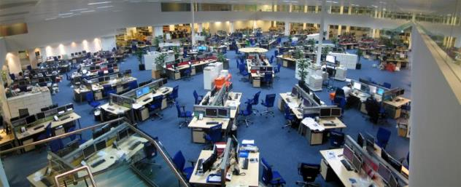
Figure 1.1
We encounter statistics in our daily lives more often than we probably realize and from many different sources, like the news. (credit: David Sim)
https://www.nytimes.com/2018/08/27/upshot/a-surprisingly-simple-way-to-help-level-the-playing-field-of-college-admissions.html
https://ourworldindata.org
https://www.scientificamerican.com/article/a-superconductor-scandal-scientists-question-a-nobel-prize-worthy-claim/

Slide 3
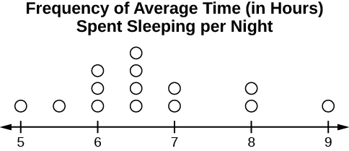
Figure 1.2

Slide 4
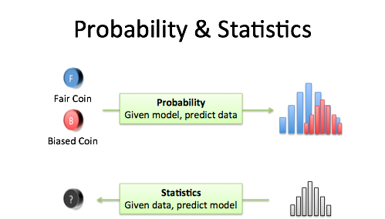
Probability and statistics
Probability is starting with an animal, and figuring out what footprints it will make.
Statistics is seeing a footprint, and guessing the animal.

Slide 5
Key terms
Population parameters
Sample statistics
Variable vs data
described by
Represented by
estimate
described by

Slide 6
Practice: Key terms
Example 1: A cardiologist is interested in the mean recovery period of her patients who have had heart attacks.
identify: a. the population, b. the sample, c. the parameter, d. the statistic, e. the variable, and f. the data.
Example 2: A politician is interested in the proportion of voters in his district who think he is doing a good job.
identify: a. the population, b. the sample, c. the parameter, d. the statistic, e. the variable, and f. the data.

Slide 7
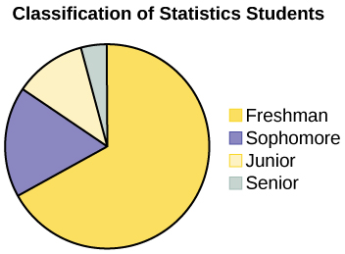
Figure 1.3

Slide 8
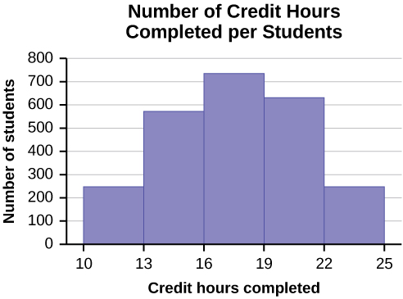
Figure 1.4

Slide 9
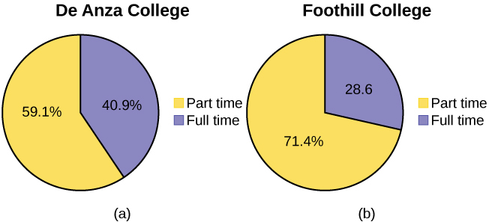
Figure 1.5

Slide 10
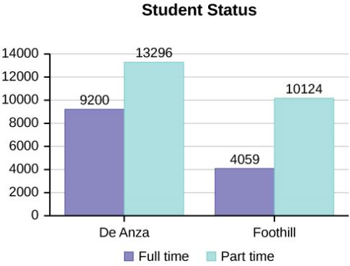
Figure 1.6

Slide 11
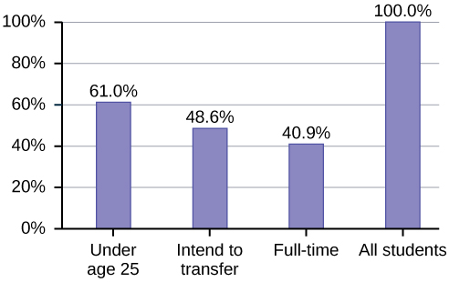
Figure 1.7

Slide 12
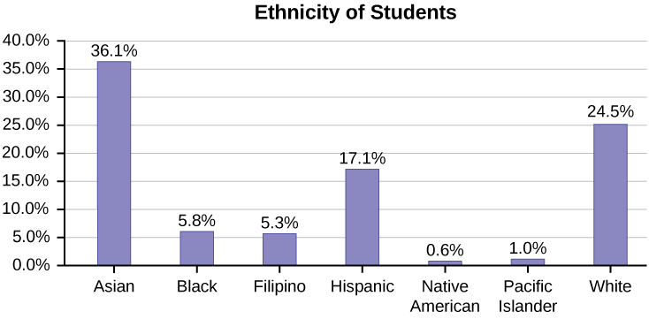
Figure 1.8

Slide 13
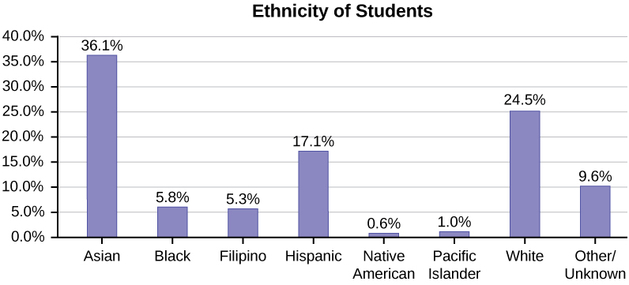
Figure 1.9
Bar graph with Other/Unknown Category

Slide 14
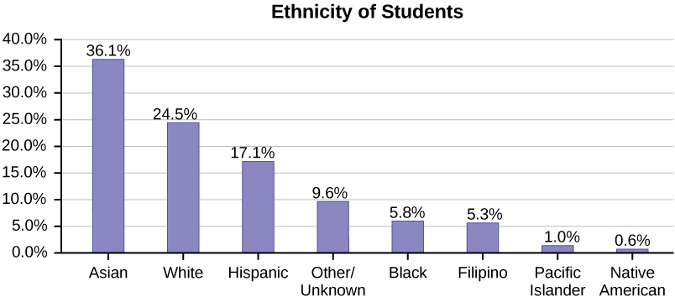
Figure 1.10
Pareto Chart With Bars Sorted by Size

Slide 15
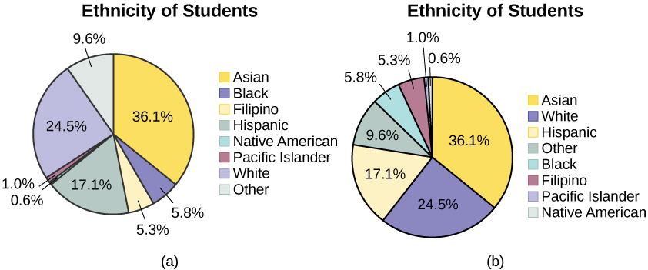
Figure 1.11

Slide 16
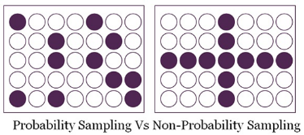
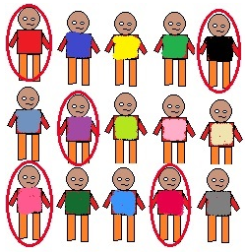
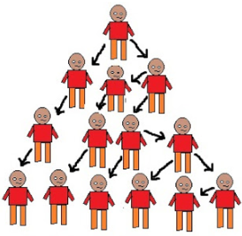
Sampling

Slide 17
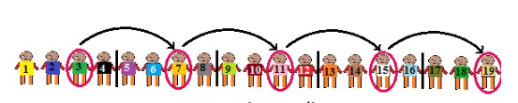
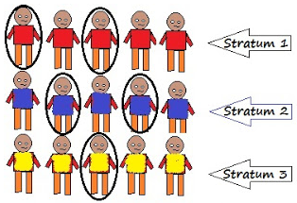
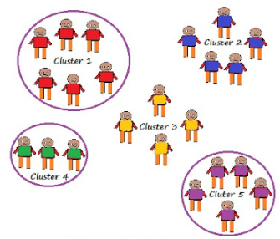
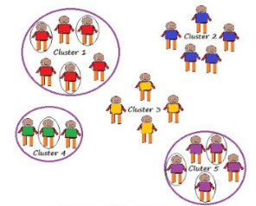
Sampling

Slide 18
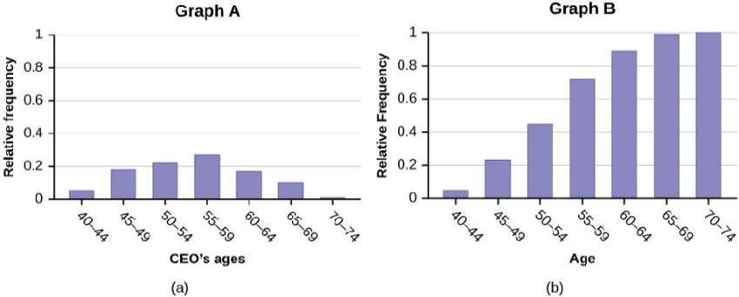
Figure 1.13

Slide 19
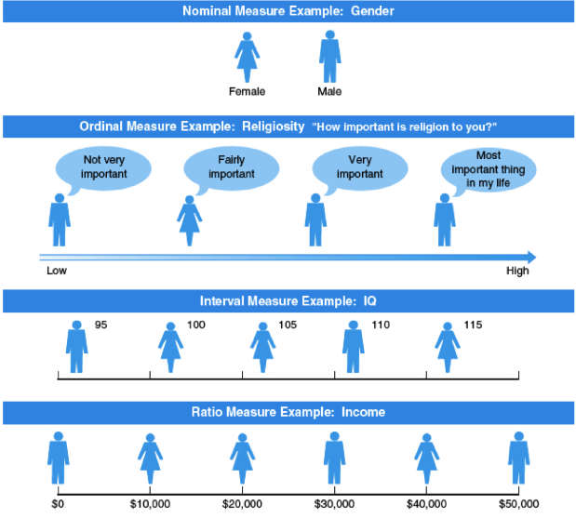
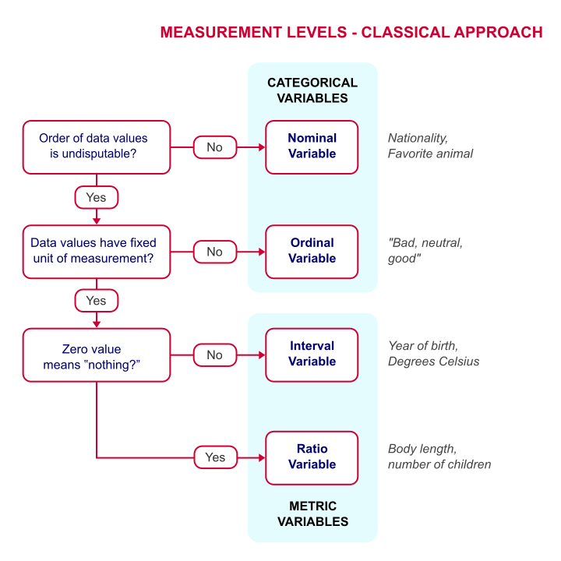
Levels of measurement

Slide 20
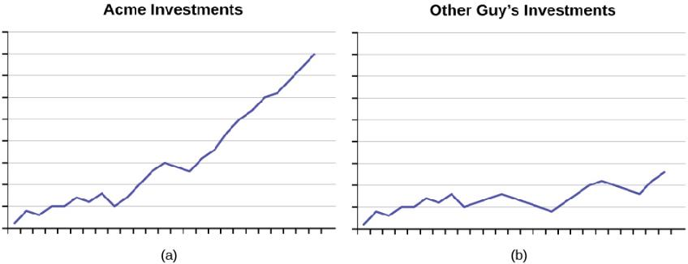
Figure 1.14
As the graphs show, Acme consistently outperforms the Other Guys!

Slide 21
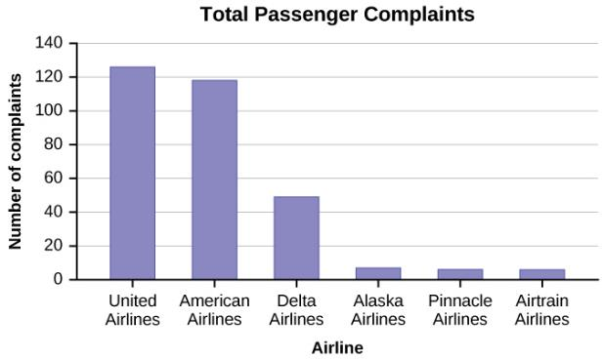
Figure 1.15

Slide 22
This OpenStax ancillary resource is © Rice University under a CC-BY 4.0 International license; it may be reproduced or modified but must be attributed to OpenStax, Rice University and any changes must be noted.

Slide 23
This OpenStax ancillary resource is © Rice University under a CC-BY 4.0 International license; it may be reproduced or modified but must be attributed to OpenStax, Rice University and any changes must be noted.

