Slide 1
Computer Vision Assisted Workouts
Problem: Many people are unaware how to properly do certain workouts and they don’t have a trainer to watch and adjust their form.
This can impede in obtaining good results and can be detrimental to health
Main Idea: Use computer vision to monitor the user’s form when performing an exercise.
Focus on one exercise first (squats or deadlifts) then add more exercises depending on how much time is available.

Slide 2
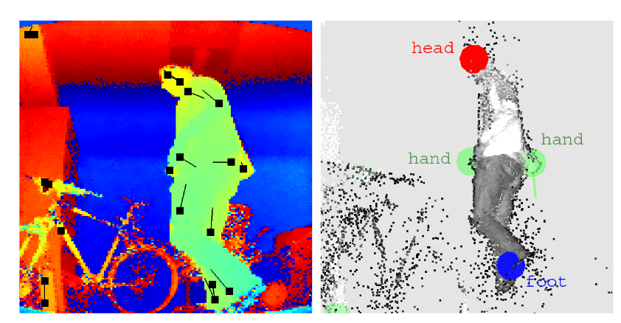
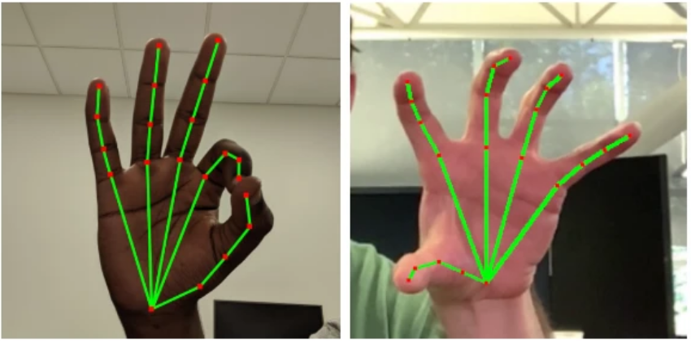
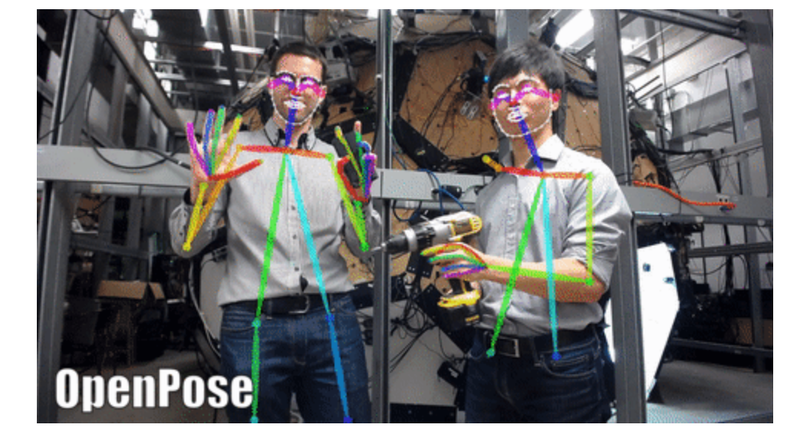
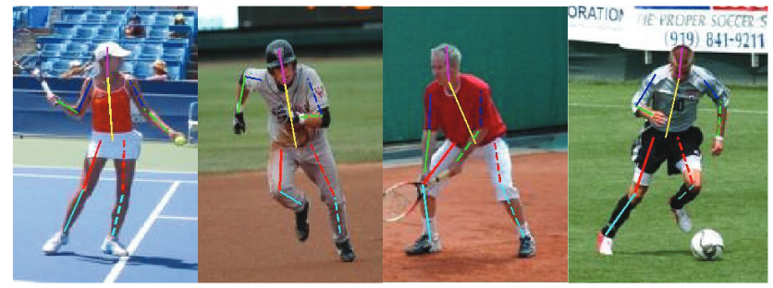
Need to identify body parts (shoulders, feet, hands, head, etc) in a video (in real time if possible)
Associate nodes to each of these points and connect them with segments
Hard code rules for each exercise
based on where your body parts
should be in respect to other parts
Google’s Sign Language Translator
https://github.com/CMU-Perceptual-Computing-Lab/openpose
http://www.robotics.stanford.edu/~koller/Papers/Plagemann+al:ICRA10.pdf
https://arxiv.org/pdf/1804.01984.pdf

Slide 3
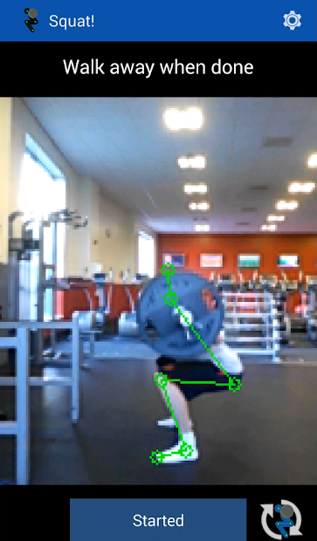
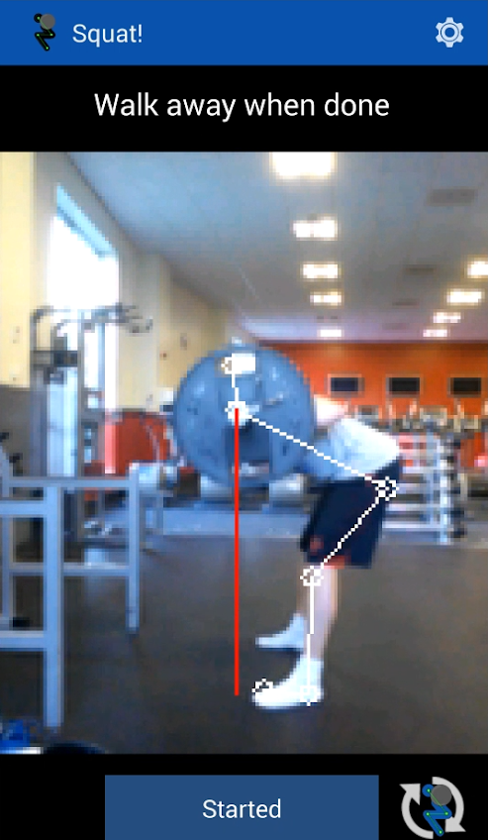
Dataset can probably be self made in terms of videos performing different exercises.
Existing Apps:
Barbell Tracker GT. Tracks the motion of the barbell for very specific types of lifts. Only 2.3 stars. Doesn’t really guarantee proper form.
Squat! App that is very similar to what this idea is. However, it only works for squats. 2.8 stars

