Slide 1
Google adds that 40% of millennials trust YouTube for content; 60% say videos they’ve watched have changed their world view.
Almost 50% of web users look for a video before visiting a store, says Google.
Wyzowl says that 79% of consumers prefer watching video to reading about a product.
Wistia’s research shows that videos up to 2 minutes long hold viewers’ attention; then there’s a drop off. Attention picks up again for videos between 6 and 12 minutes long.
https://optinmonster.com/video-marketing-statistics-what-you-must-know/

Slide 2
60% of all the age groups questioned confirmed they would by a product or service from a brand endorsed by a YouTuber creator.” Among 18-24 year olds—a key buying bloc—a whopping 62% say that they trust endorsements from popular YouTubers.
YouTube’s recently-launched Awesome Stuff Week channel, which features only product review videos by prominent YouTubers, boasts an impressive 3.6 million total views to date.
https://mediakix.com/blog/youtube-product-reviews-from-youtubers-trusted-by-millennials/

Slide 3
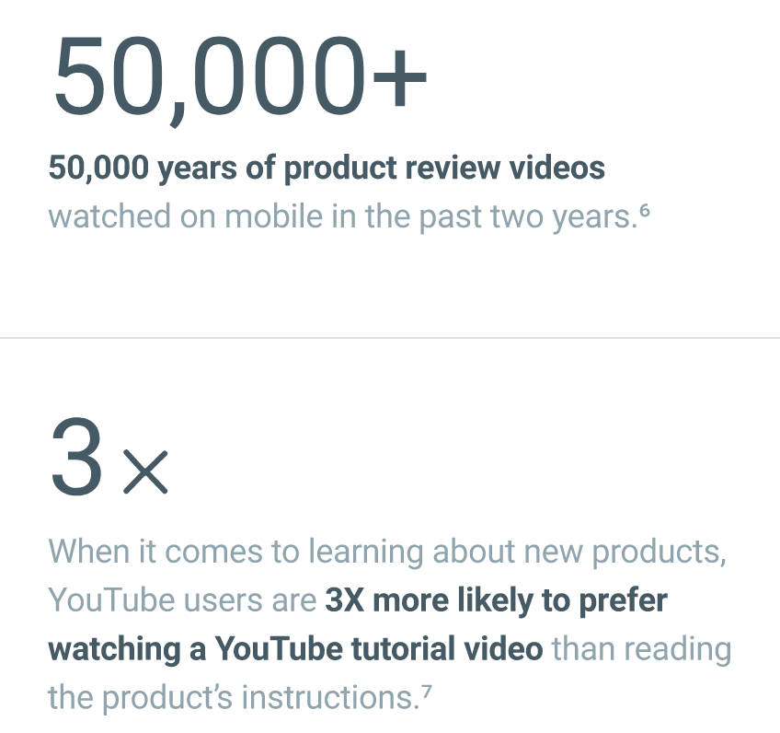
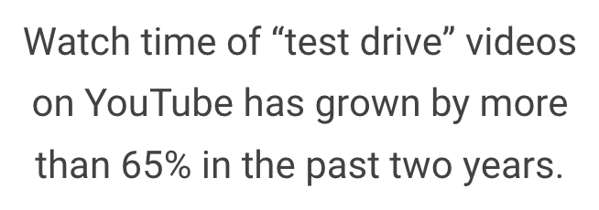
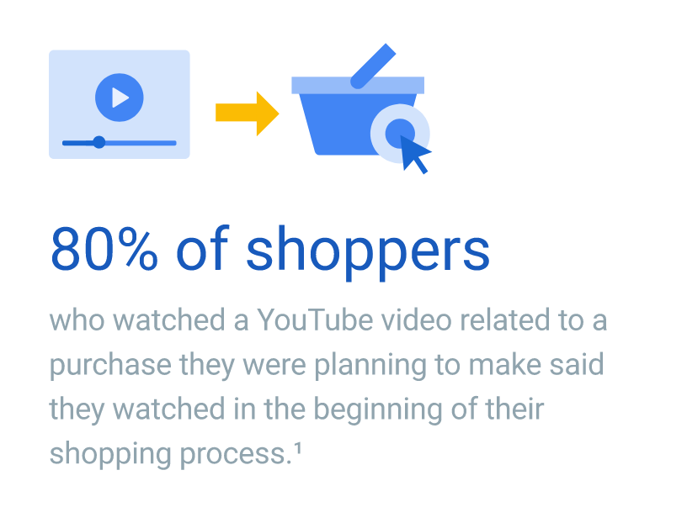
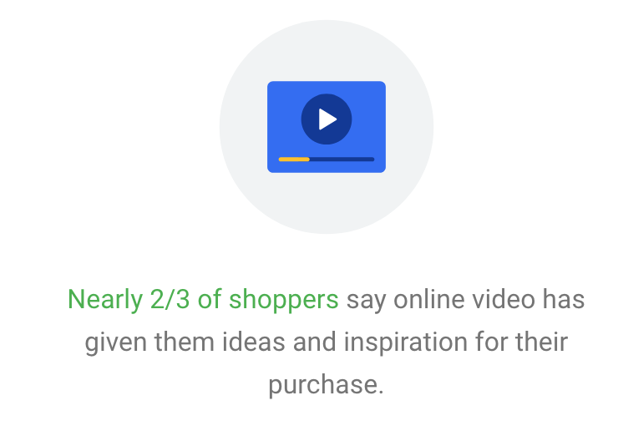
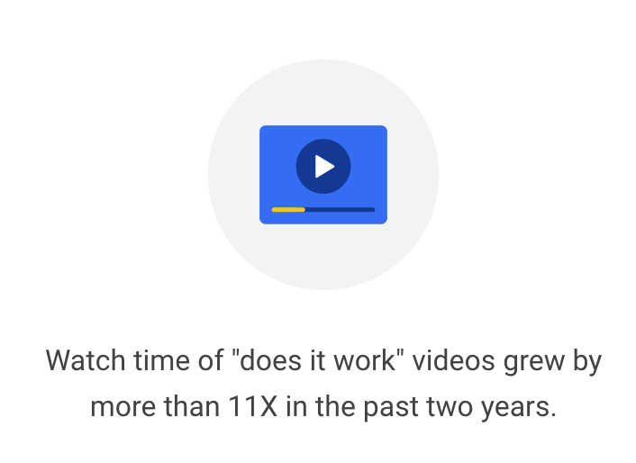
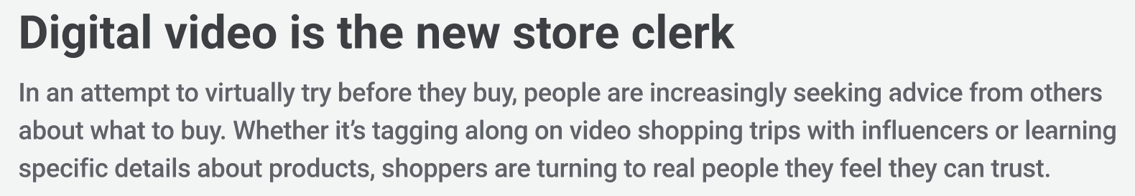
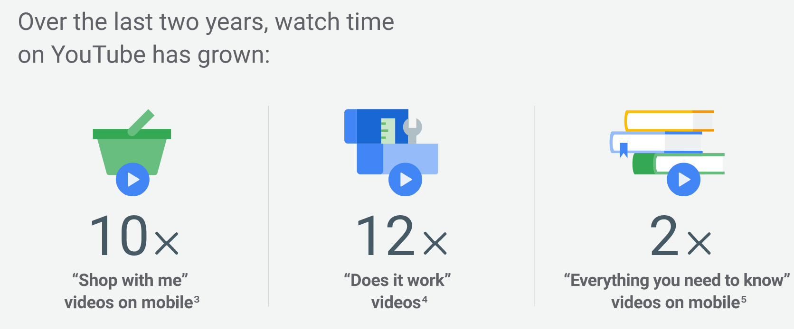
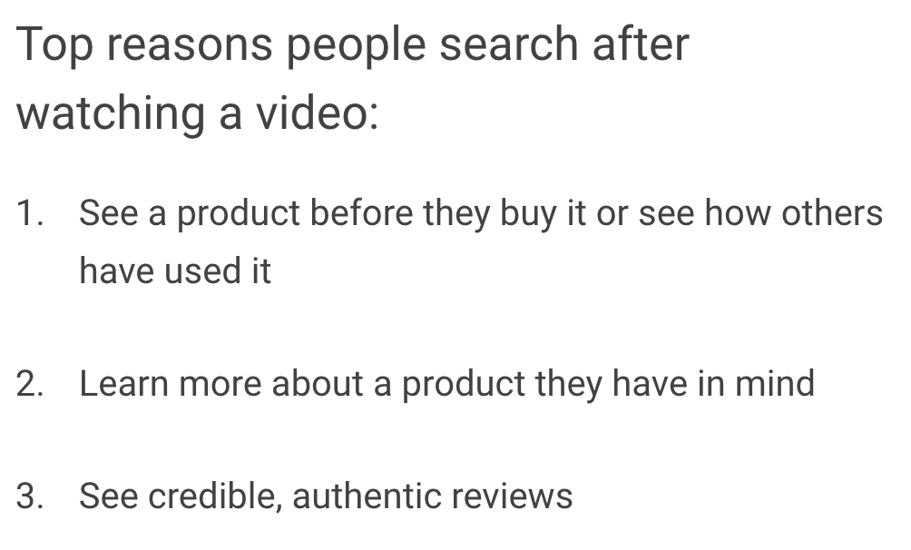
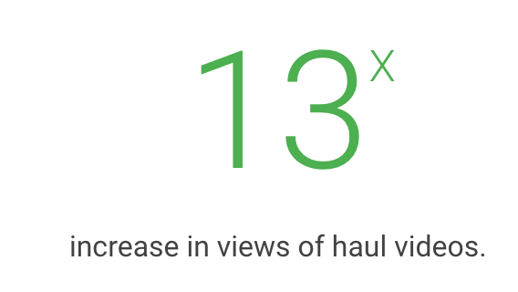
https://www.thinkwithgoogle.com/consumer-insights/online-video-shopping/

Slide 4
26% of Consumers Turn to YouTube for Shopping Inspiration
In 2015 alone, people in the U.S. have watched 60 million hours of unboxing videos on YouTube, totaling 1.1 billion views, according to YouTube data. The research also shows the video sharing site has become an important part of the purchase process for consumer electronics. A surprising 64% of consumer electronics shoppers watch consumer electronics videos on YouTube one week before they purchase and 65% do so the week after they purchase, according to a Google Millward Brown CE Study in December 2014. With 2.7 million subscribers, Unbox Therapy takes a deep dive into the latest electronics on the market and gives the consumer a thorough insight into a potential purchase. Its unboxing video of the iPhone 6s and 6s plus generated 1.5 million views and 126K engagements, proving there’s a real appetite for this kind of content.
https://tubularinsights.com/64-percent-consumers-youtube-to-review-electronics-purchase/

Slide 5
67% of YouTube viewers watch videos for informational product reviews to help with a purchasing decision.
https://neilpatel.com/blog/e-commerce-selling-with-youtube/

Slide 6
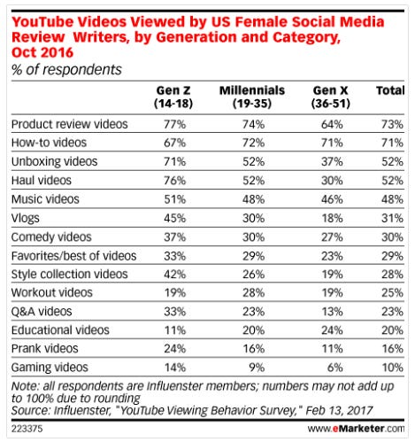
An October 2016 Influenster survey, which polled US female influencers who are heavy users of at least two social networks, found that 93% of respondents ages 14 to 18 watch product reviews on YouTube, compared to 86% of overall influencers.
In fact, these teen influencers are more likely to watch product reviews than any other type of video on YouTube, with 77% saying they go to YouTube to view such content.
The survey found that 76% of female 14-to-18-year-old respondents said they watch haul videos on YouTube, compared with just over half of the total number of review writers, while 71% of teens polled watch unboxing videos, vs. 52% of the total.
https://www.businessinsider.com/gen-z-really-likes-watching-product-reviews-on-youtube-2017-3

Slide 7
86 percent of the top 200 beauty videos on YouTube were made by creators.
This indicates that consumers really prefer to hear from a creator, rather than a brand, when it comes to purchasing decisions. The level of trust is higher, even if the creator is affiliated with the brand in some way, than hearing the same review or unboxing from the brand itself.
https://medium.com/sponsokit/more-people-than-ever-are-turning-to-youtube-for-product-reviews-4956d3647e34

Slide 8
The use of videos as reviews are overtaking written reviews - back this up with stats and data
How much influence does a video review have on someone buying the product. – how many views does a video review on YouTube. 5M iphone 9 review.
Selling the value of video reviews as source of data for companies to work with.
2 prongs, current marketing strategy based on what people like, future development of the product to fix what people don’t like.
Consumer use. Eliminate the need to watch the video. A summary of sorts.

Slide 9
11/4
Website – description of our project. Model explanation. Team composition, data, methods used, model explanation. What do we do? who are we targeting? When/why would you want to use this product?
Parts of speech model working
Good progress on key-word extraction
Progress on sentiment model

Slide 10
Keywords:
Performance – adjectives used to describe the word (Average sentiment score for these adjectives)
Samsung – adjectives used to describe the word (Average sentiment score for these adjectives)
Cost – adjectives used to describe the word (Average sentiment score for these adjectives)
Interface - adjectives used to describe the word (Average sentiment score for these adjectives)
Screen -
Speed – Fast (5/5)
.
Average sentiment score of the video
Video 1
Keywords:
Performance – adjectives used to describe the word (Average sentiment score for these adjectives)
Samsung – adjectives used to describe the word (Average sentiment score for these adjectives)
Cost – adjectives used to describe the word (Average sentiment score for these adjectives)
Interface - adjectives used to describe the word (Average sentiment score for these adjectives)
Screen -
Speed – Fast (5/5)
.
Average sentiment score of the video
Video 2

Slide 11
Enter YouTube URL
Input:
Upload Video File
Keywords:
Performance – adjectives used to describe the word (Average sentiment score for these adjectives)
Samsung – adjectives used to describe the word (Average sentiment score for these adjectives)
Cost – adjectives used to describe the word (Average sentiment score for these adjectives)
Interface - adjectives used to describe the word (Average sentiment score for these adjectives)
Screen -
Speed – Fast (5/5)
.
Average sentiment score of the video
Output:
Parts of Speech Tagging – Tag Nouns vs adjectives
Key-word extraction (most common nouns in on a per document and per corpus basis maybe? TF-IDF or RAKE) (Or a graph based approach) https://monkeylearn.com/keyword-extraction/ or Conditional Random Fields approach (CRF) Evaluate using Rouge.
A way to locate all adjectives used to describe the noun. (dependency parser)
Assign sentiment scores to adjectives

Slide 12
Extra Time Stuff
Dashboard – How many times does this key word come up in different reviews?

Slide 13
Pros and Cons
Pros
Interesting, relevant, sense of pride
Don’t have to worry about frame by frame features
Only an NLP project which makes computation a lot less expensive that what we were originally intending to do
Cons
No ready dataset (Most of the 8M videos are very short and poor quality which means poor quality captions)
We would have to go out and download all the good quality review videos from YouTube to create our own dataset. How many is enough? I used youtube-dl to download a Marques Brownlee review video and it worked fine. We don’t even have to pull the videos, just the captions.
Purely an NLP problem which takes away the multi-modal aspect that we were excited about
Not sure about the difficulty because we don’t have extensive NLP experience. However, it will definitely be harder than a classification problem.

Slide 14
Input:
Upload Video File
Output:
Timestamps of highlights (Maybe type of highlight as well. Goal, slamdunk, etc)
Pretty in line with what we were doing. 3 classification models, one with rgb features, one with text, and one with audio features to classify a “slamdunk” video segment. And then a way to combine the outputs of these three models to classify whether a segment is a slamdunk or not.
For the model to work on the video we upload, we would need a way to replicate the YouTube 8M data in terms of slicing up the video into segments and creating rgb and audio features of those segments. < This part is something we haven’t figured out yet because we weren’t working in a segment-based context before. Text would just be speech to text.

Slide 15
Pros and Cons
Pros
Multi-modal approach
8M Youtube data is useable
Pretty in-line with what we’ve already been doing – Nothing too complicated
Cons
Lots of existing highlight extracting products available on the web and we might not be able to do a better job
Not as exciting as the other project
Have to worry about segment level data and the training of all 3 models with all the per segment data can take a long time and be expensive.

