Slide 1
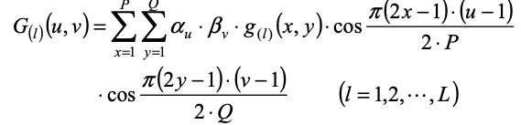
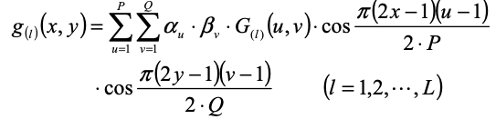
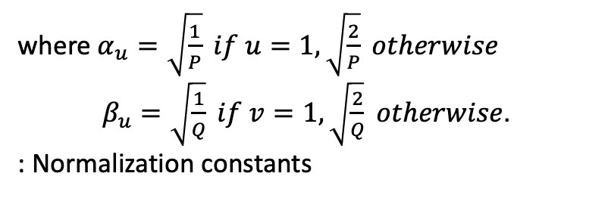
Toward Efficient Spatial Variation Decomposition via Sparse Regression
2011, IEEE/ACM ICCD, CMU, MIT, and UIUC.
1. Spatially correlated variation carries a unique sparse signature in frequency domain.
2. Accurately separate spatially correlated variation from uncorrelated random variation.
3. Simultaneous Orthogonal Matching Pursuit solves sparse regressions effectively with orthogonality of DCT basis.
Spatially Correlated Variation and Uncorrelated Random one present different signatures in frequency domain.
g_{l}(x,y) = s_{l}(x,y) + r_{l}(x,y) (l = 1..L) in space domain, x=1..P, y=1..Q,
g: variation ex) Vth, leakage current, s: signal, r: random, L: total # of wafers or chips
G_{l}(u,v)= S_{l}(u,v) + R_{l}(u,v) (l = 1..L) in freq. domain, u=1..P, v=1..Q
SCV S_{l} ~ Unique sparse structure in freq. domain.
URV R_{l}(x,y) ~ White frequency spectrum ~ Even over all frequencies.
where $α_{u}=\sqrt{\frac{1}{P}} if u=1, \sqrt{\frac{2}{P}} otherwise$
$β_{u}=\sqrt{\frac{1}{Q}} if v=1, \sqrt{\frac{2}{Q}} otherwise$.
: Normalization constants

Slide 2
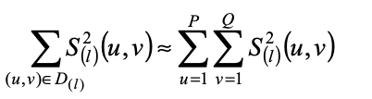

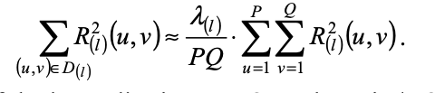

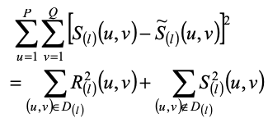
Decomposition, Localization, and Error
D_{(l)}: the indices of the dominant DCT coefficients for S_{(l)}(u, v), λ_{(l)} << PQ

Slide 3
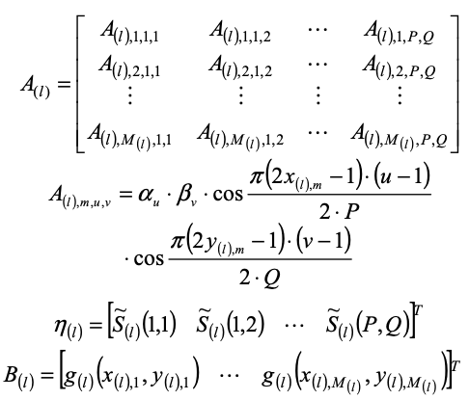

Orthogonal Matching Pursuit
A: Basis associated with IDCT
B: Measurement data from M_{l} spatial locations {(x_{l,m}, y_{l,m}); m=1..M_{l}}
η: Unknown DCT coffi.
L=2
Wf#1
Wf#2
Suggestion
1. Data set with interpolated values in empty chips.
2. Data set w/o interpolated values in empty chips.
M₁=7
M₂=6

Slide 4

Algorithm 1
Given integer λ_{l}s specifying the total number of basis vectors.
Start at Ω_{l}={} and iteration index p=1 then Res_{l}=B_{l}
Select the new basis A_{l,s} that maximizes |<Res_{l}, A_{l,s}>|.
Update Ω_{l}=Ω_{l} U {s}
Solve the least-square fitting Res_{l} for η_{l} ,
If p<λ_{l}, p = p+1 and go to step 3.
For any i not in Ω_{l}, η_{l,i}=0
L=2
Wf#1
Wf#2
M₍₁₎=7
M₍₁₎=1..7
A_{(1) 7 x PQ}
M₍₂₎=6
M₍₂₎=1..6
A_{(2) x PQ}

Slide 5

Algorithm 2. Simultaneous OMP
A given integer λ (=λ_{l}) specifying the total number of basis vectors.
Start at Ω_{l}={} and iteration index p=1 then Res_{l}=B_{l}
Select the new basis A_{l,s} that maximizes .
Update Ω_{l}=Ω_{l} U {s}
Solve the least-square fitting Res_{l} for η_{l} ,
If p<λ_{l}, p = p+1 and go to step 3.
For any i not in Ω_{l}, η_{l,i}=0
L=2
Wf#1
Wf#2
M₍₁₎=7
M₍₁₎=1..7
A_{(1) 7 x PQ}
M₍₂₎=6
M₍₂₎=1..6
A_{(2) 6x PQ}

