Slide 1
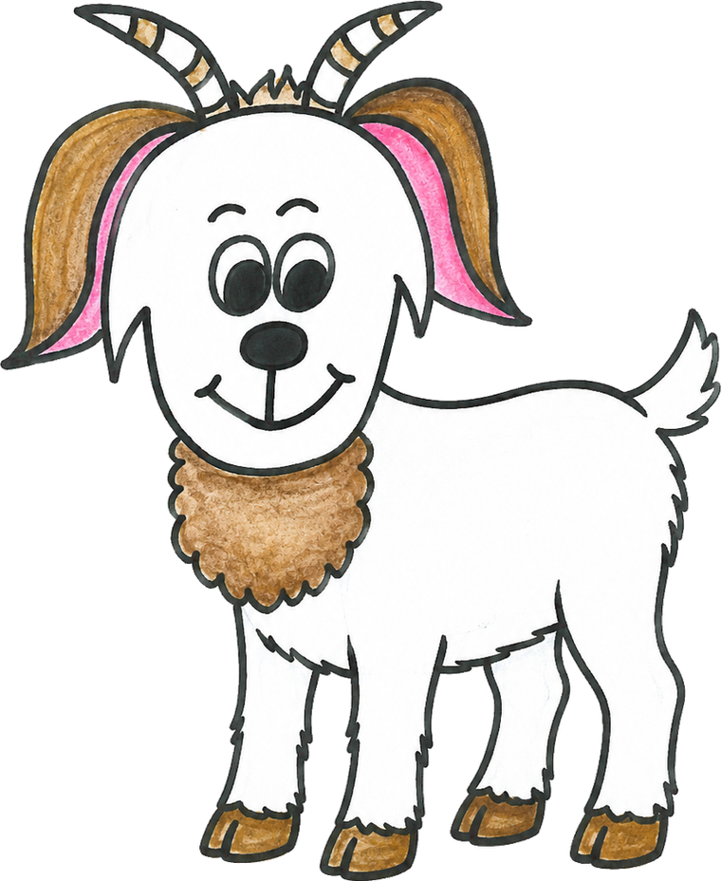
Growing with Gritty
Your website — where it stands, and what happens next
Build Grit. Grow Strong. Never Quit!
Prepared by Adam · All character art by Kim Rekowski
Notes:
Goal today: show Kim the three directions, explain why V3, agree next steps, and collect what I need — the drawings and the domain details.

Slide 2
What I’ve done so far
3
Three full design versions
Each one built and clickable, not a mockup — so you can react to something real.
20+
Sites and studies reviewed
The best children’s book sites in the world, and what child-development research says actually works.
9
Pages already built
Home, Meet Gritty, a page for each of your four books, About You, and the Grown-Up Grit Guide.
Nothing is decided. You pick the direction — and mixing pieces from different versions is a perfectly good answer.
Notes:
Emphasize: everything is built and live at a link she can click on her phone.

Slide 3
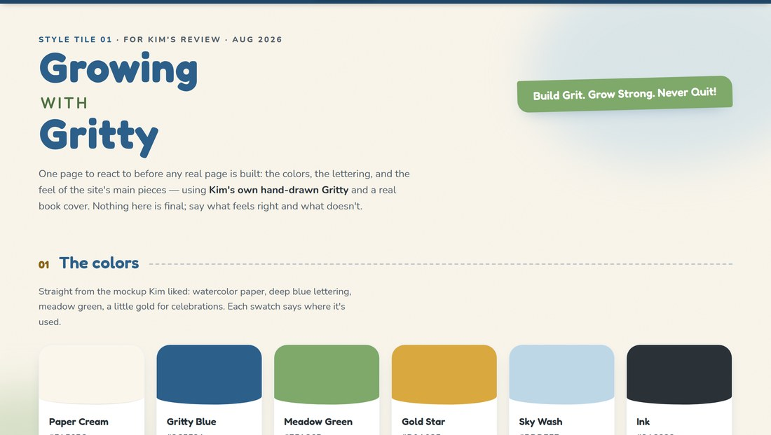
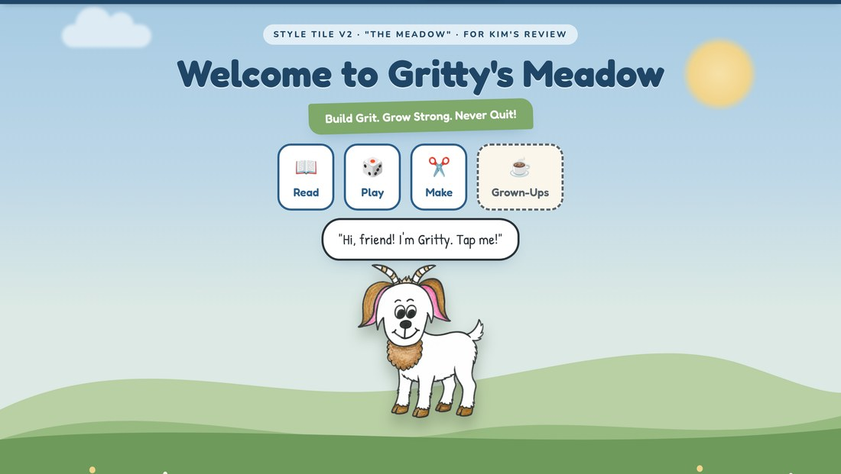
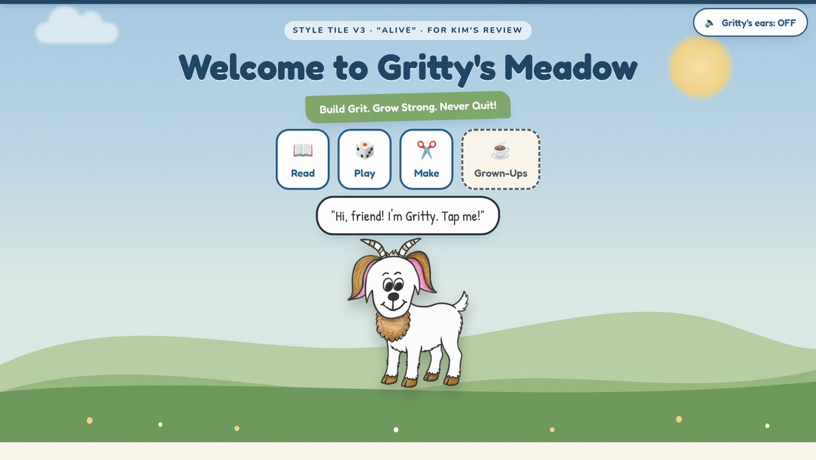
Three directions I built for you
MY PICK
Version 1
Version 2
Version 3
The Sheet
The Meadow
Alive
A calm sample page: your colors, your lettering, one book card. Everything sits still.
The page becomes a place. Gritty stands in a meadow and reacts when children tap him.
Gritty breathes and his lines shimmer like hand-drawn animation. Every activity rebuilt around the research.
All three are live — you can click between them at the top of any page.
Notes:
Open all three on the laptop here. Let her tap Gritty on V3.

Slide 4
Why the research changed my mind
Three things I built into Version 2 turned out to work against your books. Version 3 undoes them.
Sticker charts that show what you haven’t earned yet
1
Locked grey stickers actually reduce a child’s own motivation. Now stickers only appear for what a child has already done — souvenirs, never a scoreboard.
Rewarding a child for pressing “YET”
2
The moment encouragement pays out, it becomes a transaction. Pressing YET now earns nothing at all.
“YET!” on its own
3
Carol Dweck calls effort-praise with no strategy “false growth mindset.” Now Gritty names the real thing — “you can’t tie your laces… yet” — and offers one idea to try.
Notes:
The point for Kim: this is not decoration, it is the difference between a site that supports the books and one that quietly undermines them.

Slide 5
What the research actually says
These are large studies, not opinions — and they shaped real decisions on your site.
128
1,978
43
experiments
children
studies
showed promised rewards reduce children’s own motivation.
showed tap-to-play features do nothing for story understanding — games made it worse.
found the harm falls hardest on children with least support at home.
This is a claim you can make that no competitor can: “there’s nothing to tap during the story — and here’s the research why.” Teachers forward that.
Notes:
Character Lab — Angela Duckworth’s grit organization — shut down in 2024. The parents and teachers who used it have nowhere to go. That gap is an opening for Gritty.

Slide 6
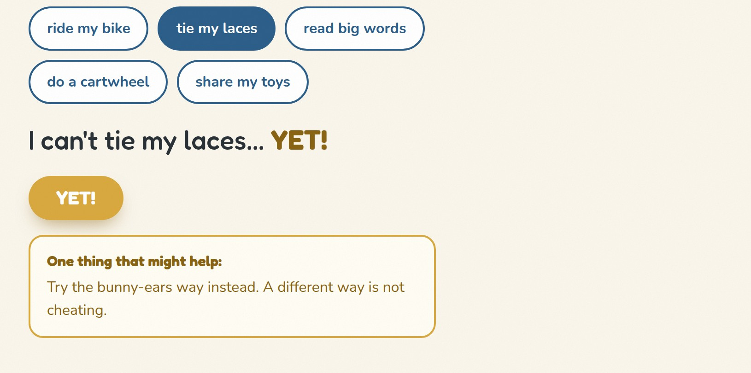
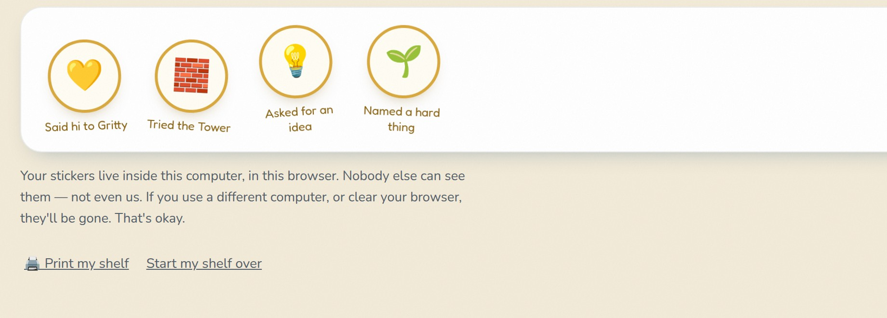
Your drawing, brought to life
On Version 3, Gritty breathes, and his outline shimmers the way hand-inked cartoons do — all from the single drawing you already gave me. Nothing was redrawn by a computer.
What I’d love you to draw
Gritty with his eyes closed — just the two eyes, so he can blink
Trace your own Gritty twice, as close as you can — that makes his lines shimmer for real
That’s it. Two small things.
Blinking is the single strongest sign of life a character can have — old animation studios cut arms and legs from cartoons so they could afford to animate the eyes.
Notes:
Reassure her: no AI-generated Gritty, ever. If a pose is needed, we ask her to draw it.

Slide 7
The site itself is already built
Nine working pages, waiting on your final artwork and buy links.
🏡
Home
🐐
Meet Gritty
📚
Your books
Gritty welcomes visitors, the four values, all four books
Gritty and his whole family, and “what is grit?”
One page per book — story, lesson, characters, a grit challenge
☕
Grown-Up Grit Guide
✍️
About you
🔒
Nothing collected
Free printables and conversation starters for parents and teachers
Your story as a teacher, author and illustrator
No sign-ups, no ads, no tracking — anywhere on the site
It is not on the internet yet — that happens when you’re happy with the look and we point the web address at it.
Notes:
Phase 1 is done. Phase 2 is Gritty’s World — the activities.

Slide 8
How you’ll change things yourself
No code, ever. You fill in a form on a web page, press Save, and the site updates in about two minutes.
1
Open one bookmark
A page called Pages CMS. You sign in once and never think about it again.
2
Pick what to change
A simple list down the side: Books, Characters, Printables, Home page, About.
3
Type in the boxes
Same as filling in a form. Upload a PDF or a drawing by dragging it in.
4
Press Save
Two minutes later it’s live for everyone. Every version is kept, so nothing is ever lost.
You can’t break it. A half-finished form just doesn’t show that bit yet — and any change can be undone.
Notes:
Things she can change herself: buy links, new books, character portraits, printables, all the words on the home and about pages, and new Grit Zone questions.

Slide 9
The web address: polkadotbackpack.com
Heads up — that address is already in use. It currently points at a Shopify store, and www points somewhere different again. So before anything moves, I need to know what’s there.
What I need from you
The choice to make
Where did you buy it? (GoDaddy, Namecheap, Shopify…)
The login for that account — or you drive and I’ll talk you through it
What’s on the Shopify store now, and is it staying?
Do you want an email address there, like kim@polkadotbackpack.com?
A
Gritty takes the main address
polkadotbackpack.com becomes the book site; the shop moves to shop.polkadotbackpack.com
B
Gritty gets its own address
The store stays exactly as it is, and the books live somewhere like growingwithgritty.com
Once that’s decided the technical side is about twenty minutes, and the site gets a padlock (https) automatically — free, forever.
Notes:
Technical detail for me, not the slide: apex resolves to 23.227.38.65 (Shopify), www to 23.92.26.113. Cloudflare Pages needs either nameserver delegation or a CNAME. Update astro.config.mjs site URL once decided.

Slide 10
What I need from you
🎨
Drawings
📝
Words & files
🤔
Decisions
Gritty with closed eyes (just the eyes)
Two traces of your own Gritty
Portraits of Grandpa, Gabby, Grandma, Gibby
Photos of your book pages, inside
Where people buy each book
Your first coloring pages as PDFs
Anything you’d change in the words I wrote
Which version you like — or which bits of each
What happens to the Shopify store
Whether you want school-visit info on the site
None of it is urgent, and none of it has to arrive together. Send things as you finish them.
Notes:
Do not let the list feel like homework. Closed eyes is the one that matters most.

Slide 11
What happens next
Now
You pick a direction
Look at all three on your phone. Tell me what feels right and what doesn’t.
Then
I finish the look
I apply your choice across every page and send it back to you.
Next
We sort the address
Twenty minutes together to point polkadotbackpack.com where we agree.
Then
You get the keys
I set up your editing page and walk you through it once on a call.
After
Gritty’s World
The activities — the Grit Zone, the Calm Corner, the Power of YET.
“There’s no hurry. Gritty will be here.”
Notes:
Close by opening V3 on her phone and letting her press YET.

