Slide 1
FPGA Lecture 1
Adam Duncan Ph.D.

Slide 2
Class Introduction
About Me: Electrical/Computer Engineer at NSWC Crane
Class Goals: 1) Learn about FPGAs. 2) Program FPGAs to do fun things.
Class SW Materials: https://github.com/adamdunc/whs

Slide 3
This week we will do fun things with FPGAs!
Mon:
Build basic logic circuits on breadboards
Build basic logic circuits on FPGA
Introduce FPGA design project
Tues/Wed/Thurs:
Work on FPGA design project
Monday
Project Brief Outs

Slide 4
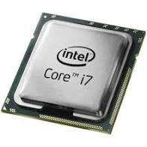
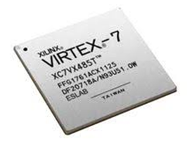
Field-Programmable Gate Arrays (FPGAs) are “Programmable Hardware” devices
CPU
~1 inch² with ~10 billion transistors
Fast (~3GHz)
Hardware does one thing really well (execute code)
FPGA
~1 inch² with ~10 billion transistors
Not as Fast (~500MHz)
Hardware can be programmed to do anything

Slide 5

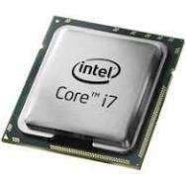
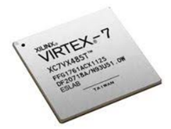
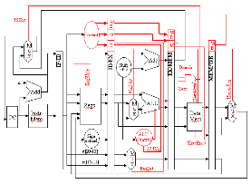
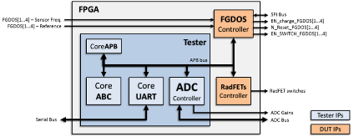
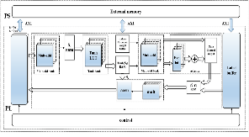
FPGA hardware behavior configured by “Bitstream” file
Custom
Sensor
Bitstream
Neutral Network
Bitstream
CPU
Bitstream
CPU
FPGA
CPU is always CPU Datapath
FPGA is now customized sensor driver/sampler
FPGA is now Neural Network Datapath
FPGA is now CPU Datapath

Slide 6
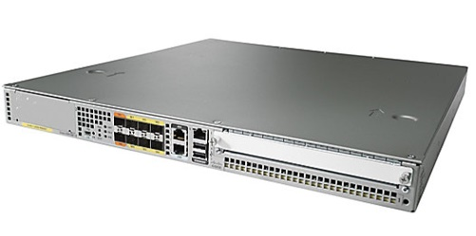
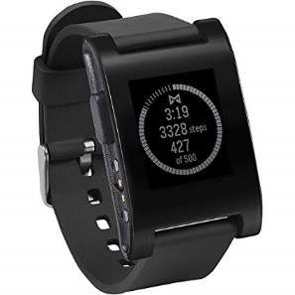


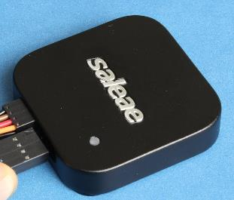
FPGAs in the Wild
Ease of use:
New HW designs in ~1 day
Design portability
Cost:
$1 for low-cost FPGAs
$100K for rugged/large FPGAs
Products with FPGAs:
Consumer electronics
DoD Programs
Automotive
Networking equipment
Test/Measurement equipment

Slide 7
FPGA Benefits for Department of Defense
HW ultimately drives performance (SW optimizations limited by HW)
Parallelization (i.e. 35 parallel ALUs executing at same time)
Unique needs (read non-standard sensors at deterministic time intervals)
Consolidates PCB circuitry (CPU + sensor logic + display driving)
Prototype Custom Integrated Circuits (wafers >$10M)
Update hardware in field (security updates, new features, bug fixes)
Replace obsolete hardware (configure FPGA to “emulate” obsolete component”

Slide 8
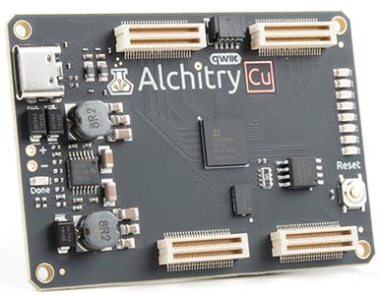
Meet Our FPGA: Lattice ICE40 ($9 FPGA)
Input/Output Pins
USB-C (Power)
LEDs
$9 FPGA
Reset Button
Input/Output Pins
https://alchitry.com/boards/cu

Slide 9
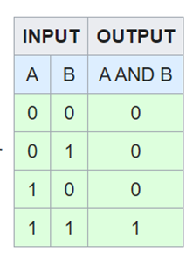

FPGAs use “logic gates” that implement Boolean equations
FPGAs can contain up to 20 million logic gates!
(Our FPGA has ~3000 logic gates)
“AND” logic gate
https://en.wikipedia.org/wiki/Logic_gate

Slide 10
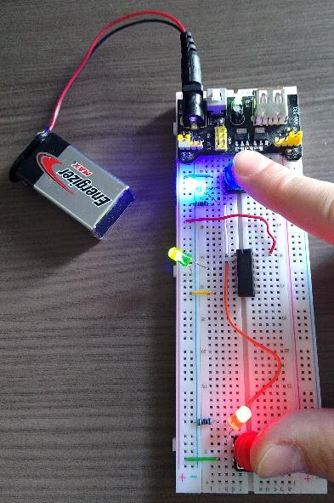
Project 1: AND gate with a breadboard
Input (Blue) | Input (Red) | Output (Green)
0 | 0 | 0
0 | 1 | 0
1 | 0 | 0
1 | 1 | 1
AND gate truth table
Blue LED lit if blue button pushed
Red Led lit if red button pushed
Green LED lit only if blue button AND red button pushed

Slide 11
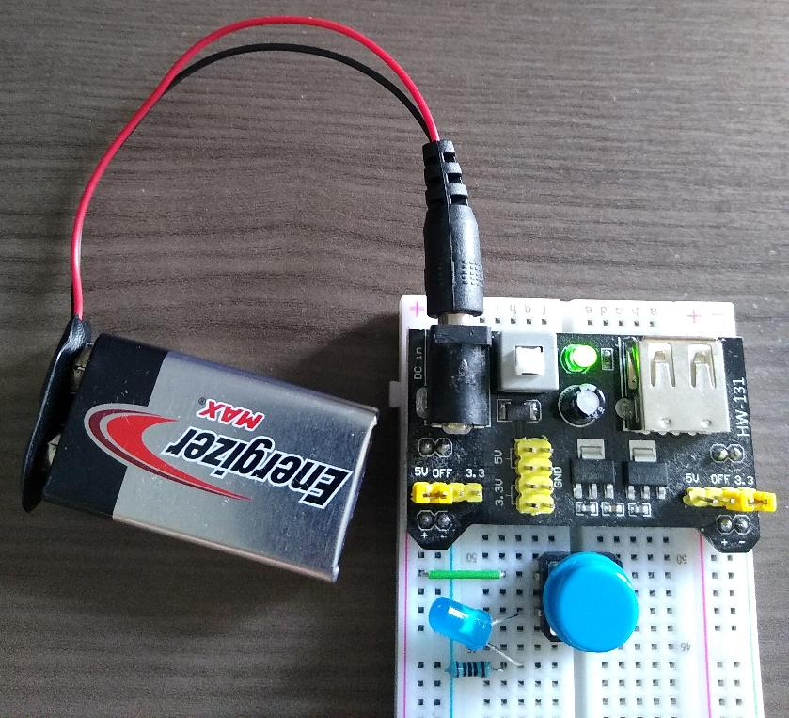
Project 1 Step1: Blue Button
Connect PS module to breadboard
Make sure PS “+ and –” line up with breadboard “+ and –”
Connect 9V adapter to PS module
Connect 9V to 9V adapter
Connect blue button just below PS module
Connect wire between “+” column and top button pin
Connect blue LED between bottom button pin and lower row on breadboard
Make sure longer blue LED lead is the lead connected to top button pin
Connect 1000 ohm resistor from bottom LED lead to “-” column
Turn on the “PS on switch”
Press the blue button and verify the blue LED is lit when pressed
PS on switch
PS module

Slide 12
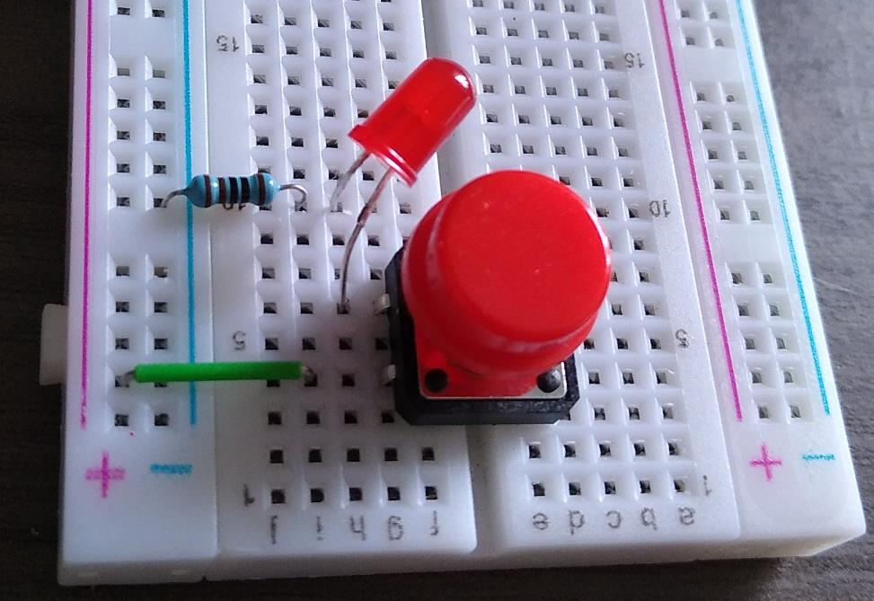
Project 1 Step2: Red Button
Connect red button near bottom of breadboard
Connect wire between “+” column and bottom button pin
Connect blue LED between bottom switch pin and lower row on breadboard
Make sure longer red LED lead is the lead connected to bottom button pin
Connect 1000 ohm resistor from top LED lead to “-” column
Turn on the “PS on switch”
Press the red switch and verify the red LED is lit when pressed
PS on switch

Slide 13
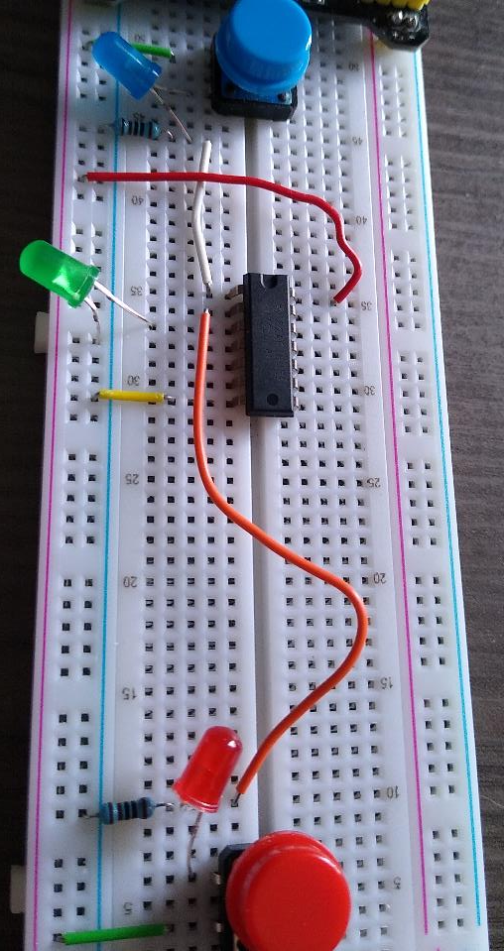
Project 1 Step3: AND Gate
AND pin 1
AND
pin 14
Place 14-pin AND Gate in middle of breadboard
Connect wire between AND pin 1 and bottom blue LED pin
Connect wire between AND pin 2 and top red LED pin
Connect wire between AND pin 7 and “-” column
Connect wire between AND pin 14 and “+” column
Connect LED from AND pin 3 to “-” column”
Make sure longer LED pin is connected to AND pin 3
Demonstrate circuit functions as AND
i.e. Green LED only on if blue and red buttons pushed together
PS on switch
AND
pin 7

Slide 14
Project 1 Step3: AND Gate
AND pin 1
AND
pin 14
Place 14-pin AND Gate in middle of breadboard
Connect wire between AND pin 1 and bottom blue LED pin
Connect wire between AND pin 2 and top red LED pin
Connect wire between AND pin 7 and “-” column
Connect wire between AND pin 14 and “+” column
Connect LED from AND pin 3 to “-” column”
Make sure longer LED pin is connected to AND pin 3
Demonstrate circuit functions as AND
i.e. Green LED only on if blue and red buttons pushed together
PS on switch
AND
pin 7

Slide 15
Project 1 Step4: other Gates
Replace AND gate with either NAND, OR, XOR, XNOR
Write out the truth table below for the gate you chose.
How is it different than the AND Truth table?
Input (Blue) | Input (Red) | Output (Green)
0 | 0 | 0
0 | 1 | 0
1 | 0 | 0
1 | 1 | 1
Input (Blue) | Input (Red) | Output (Green)
0 | 0 | ?
0 | 1 | ?
1 | 0 | ?
1 | 1 | ?
Replace this with NAND, OR, XOR, XNOR
AND gate truth table
Truth table for your gate

Slide 16
FPGA basics
Lattice “iCEcube2” is a software program used to design and compile code to program your FPGA in this class.
We write a code in a hardware description language (HDL) like Verilog to specify the intended hardware behavior of the FPGA.
iCEcube2 compiles the Verilog and automatically places logic gates inside the FPGA to realize the intended FPGA functionality.
iCEcube2 produces a bitstream file that is loaded into the physical FPGA to configure the FPGA behavior.
Lattice “Diamond Programmer” is a software program used to physically load a bitstream into your FPGA in this class

Slide 17
Verilog basics
A Verilog module is a hierarchal block in Verilog within input/output ports
An assign statement performs assignments and arithmetic operations on ports and wires within a module.
module top(
output LED
);
assign LED = 1;
endmodule
Arithmetic operators can be added to Verilog statements
module top(
input button1,
input button2,
output LED
);
assign LED = button1 & button2; // Logical AND arithmetic operator
endmodule

Slide 18
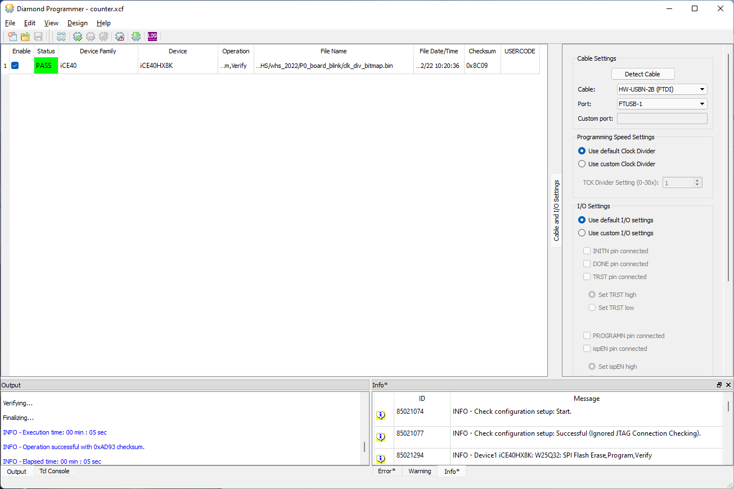
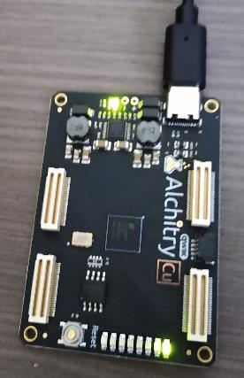
Project 2: Program the FPGA using Diamond Programmer
Connect Alchitry Cu to laptop USB-C
Open Diamond Programmer SW
Click “Open an existing project” or “File>Open File”
P2_board_blink/Counter.xcf
Design>Program
Should see blue text appear in lower left and then green LED should blink
USB-C
LED that should blink

Slide 19
Project 3: Program basic logic gate behavior into the FPGA
Goal: Use the FPGA to imitate the breadboard behavior
Write Verilog code to tell the FPGA how to behave in hardware
Compile the Verilog code into a “bitstream” file
Load the bitstream into the FPGA
Connect some “buttons” to show the FPGA in action

Slide 20
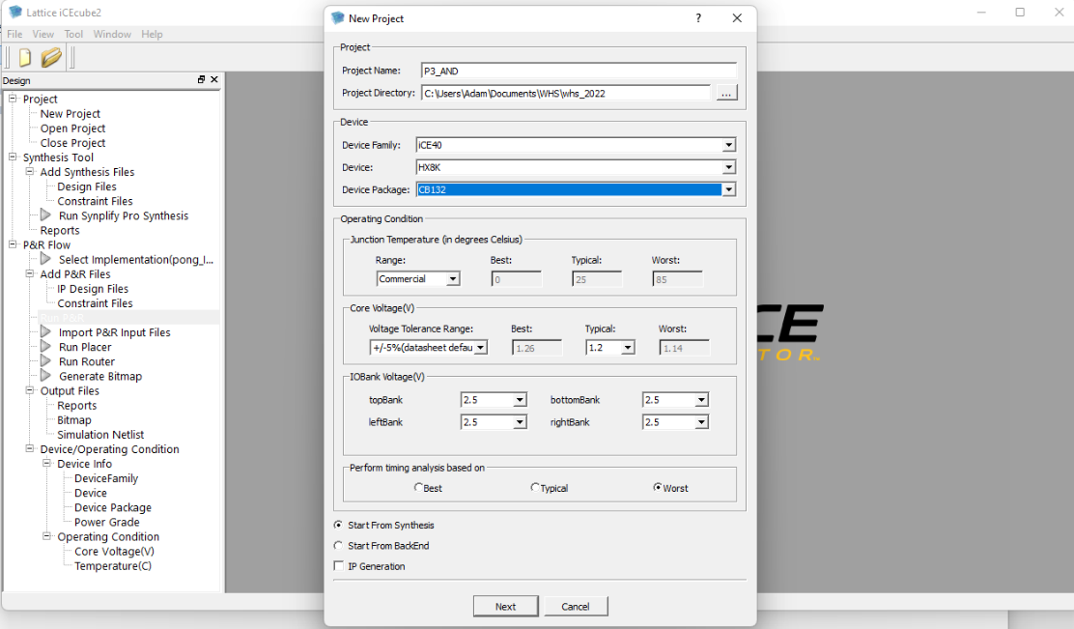
Project 3 Step 1: Create AND project in ICEcube2
Open iCEcube2 SW
File>New Project
Type Project Name = P3_AND
Set Device Family = ICE40
Set Device = HX8K
Set Device Package = CB132
Click Next

Slide 21
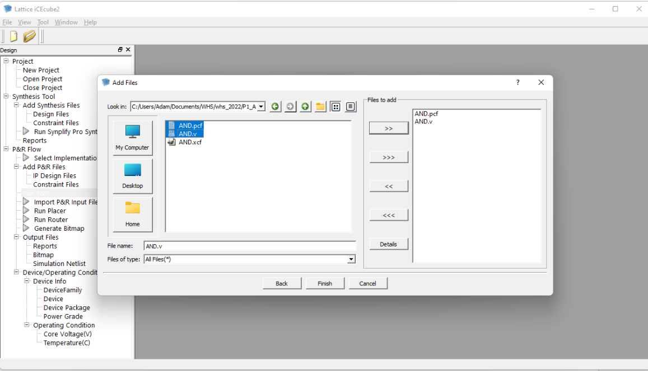
Project 3 Step 2: Create AND project in ICEcube2
Add Files should pop up
Select files in P3_AND:
AND.pcf
AND.v
Click the “>>” icon so they show up in the “Files to Add”
Click Finish

Slide 22
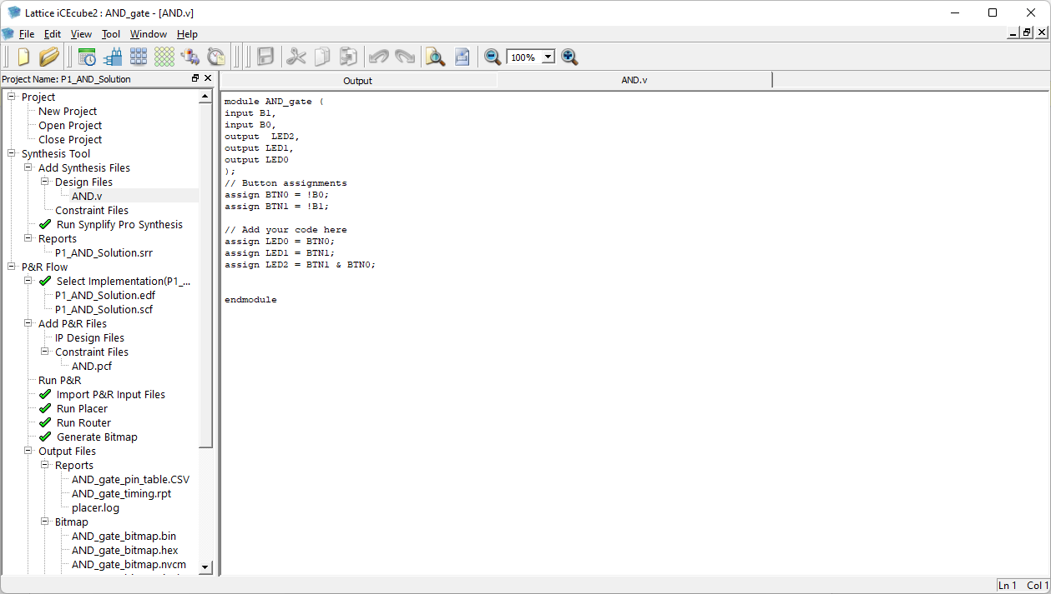
Project 3 Step 4: Create AND gate design in FPGA
Double click AND.v
Add three lines of code
assign LED0 = BTN0;
assign LED1 = BTN1;
assign LED2 = BTN1 & BTN0;

Slide 23
Project 3 Step 5: Run “Synplify” and run “P&R”
Make iCEcube2 SW open
;
Click “run Synplify”
Wait for green check mark
Click “run P&R”
Wait for green check mark

Slide 24
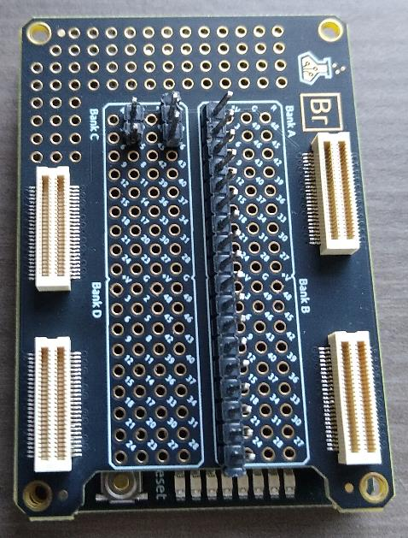
Project 3 Step 6: Place Alchitry Br on Alchitry Cu
Connect Alchitry Br on top of Alchitry Cu
Make sure all four connectors are snug

Slide 25
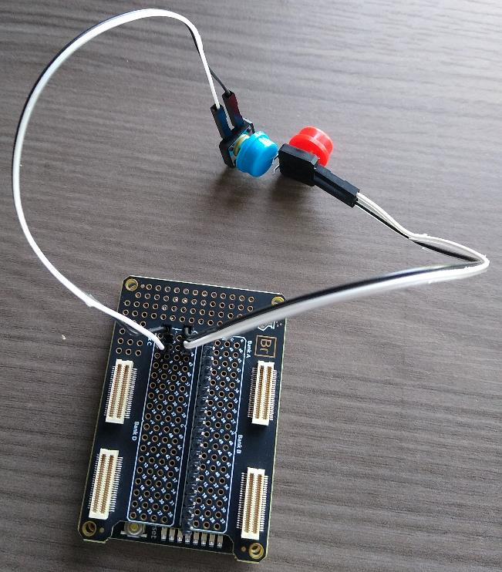
Project 3 Step 7: Connect buttons to Alchitry Br
Connect white and black wire pair to Blue button
Connect white and black wire pair to Red button
Connect one pair to the set of two pins on the Br board
Connect the other pair to the other set of two pins on the Br board
Final assembly should look like the picture on the right

Slide 26
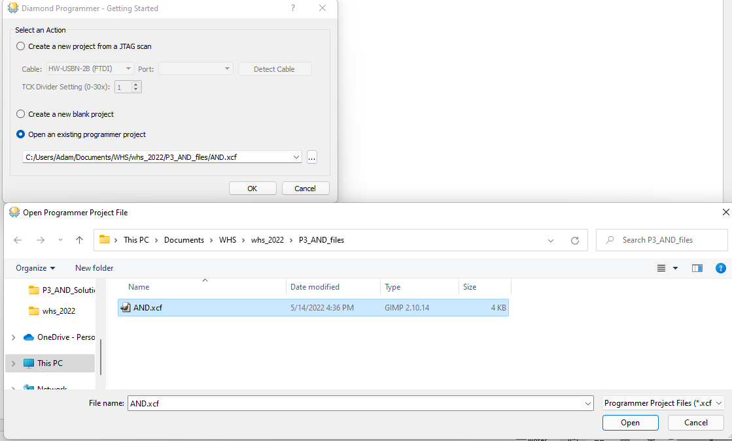
Project 3 Step 8: Launch Diamond Programmer and open AND.xcf
Open Diamond Programmer SW
Select “Open an existing programmer project”
Choose P3_AND_files/AND.xcf
Click “Open”

Slide 27
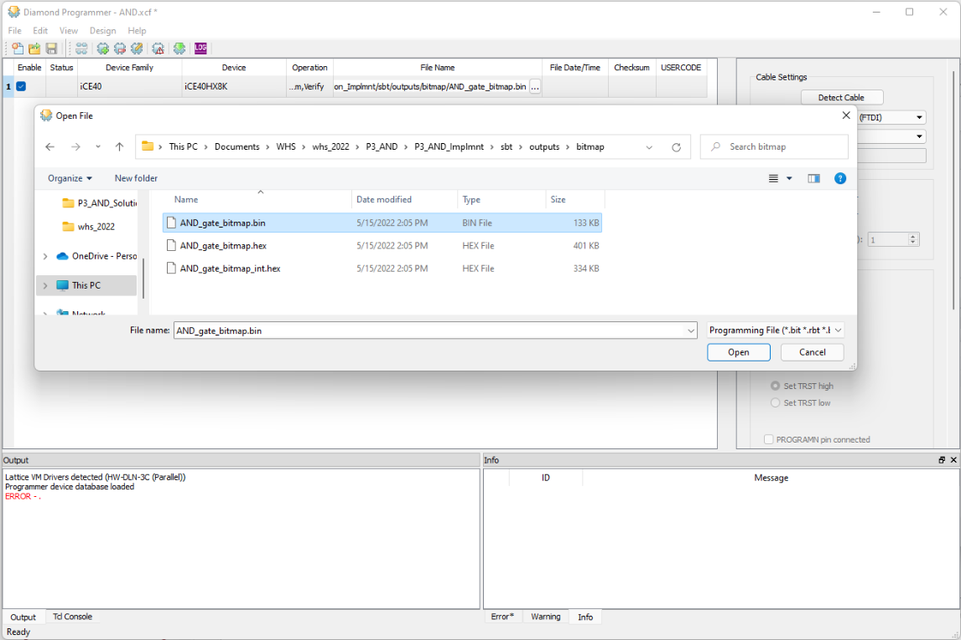
Project 3 Step 9: Select AND .bin file
Make sure Diamond Programmer SW is open
Select File under File Name
Navigate to: P3_AND/P3_AND_Implement/sbt/outputs/bitmap/
Select AND_gate_bitmap.bin
Click Open

Slide 28
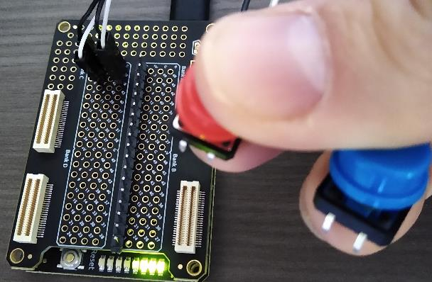
Project 3 Step 10: Program AND into FPGA
Click Program Icon (or Design>Program)
Click buttons and observe AND behavior
Make sure you see blue text with “operation successful” in bottom left
LEDs for AND behavior

Slide 29
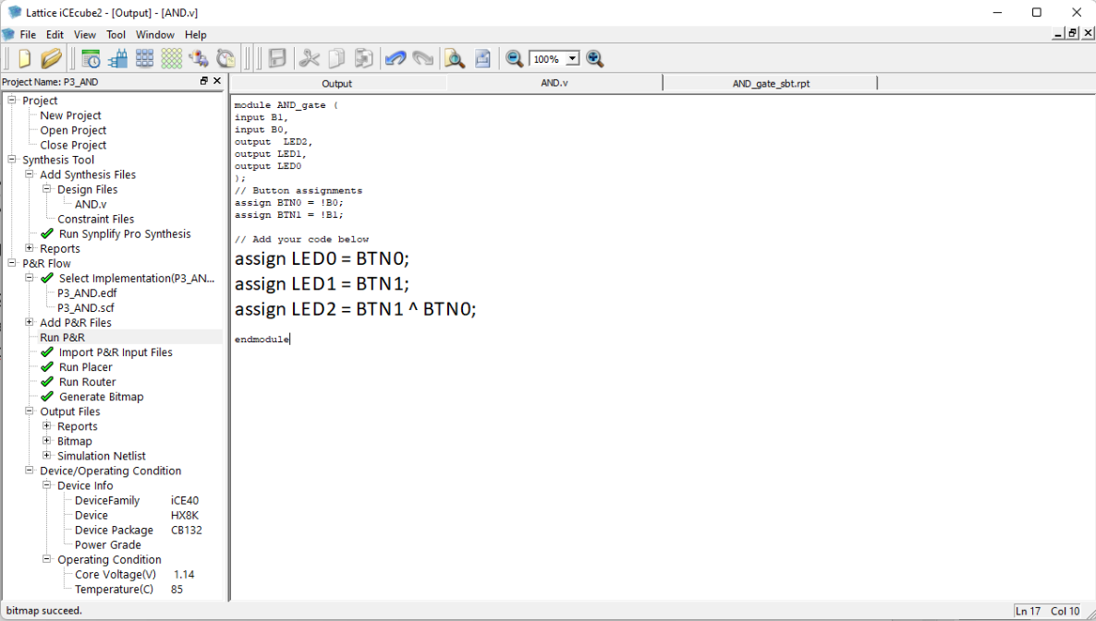
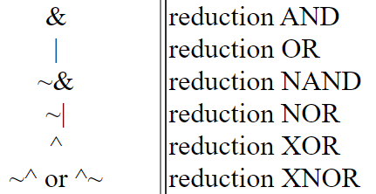
Project 3 Step 11: Change AND to XOR
Change arithmetic operate from AND (&) to XOR (^)
Assign LED2 = BTN1 ^ BTN0;
Click save to save AND.v
Rerun “Run Synplify”
Rerun “Run P&R”
Make sure all check marks green
Repeat step “Program into FPGA” on previous slide
Press the Red and Blue buttons to verify that the FPGA incorporated your change
Try others below as well:
https://class.ece.uw.edu/cadta/verilog/operators.html

Slide 30
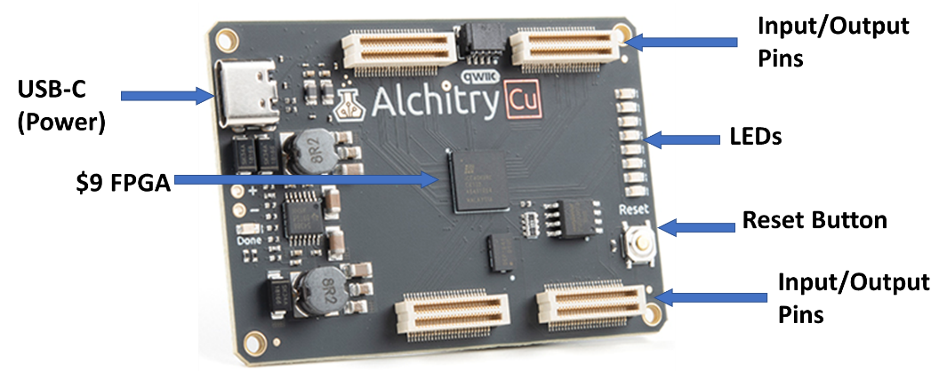
Project 4: Build a video game system!
Turn the Alchitry Cu into a video game system by programming FPGA to:
Run game engine
Create VGA video
Implement a controller
Transmit score to LEDs

Slide 31
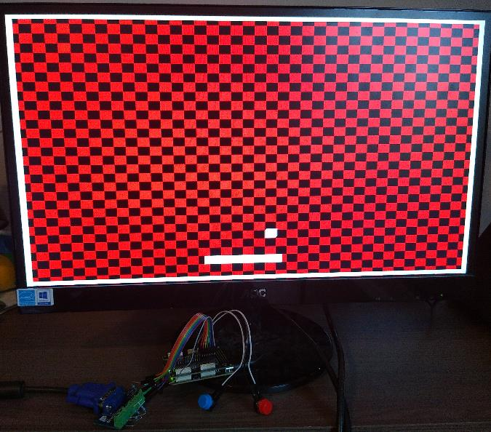
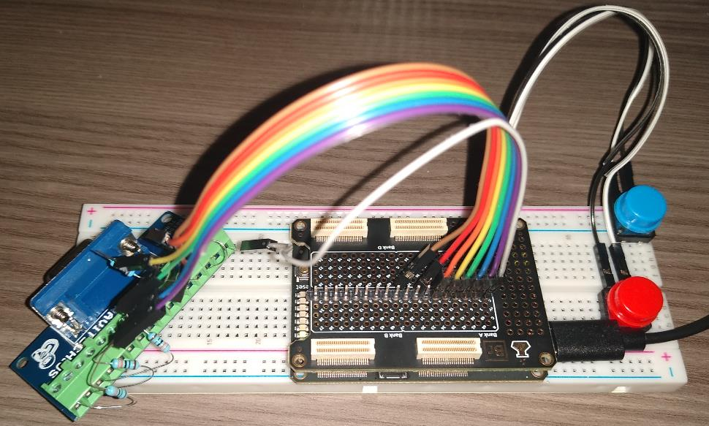
Project 4: What it could look like …
Final base design will look something like this …
The VGA output should look like this …

Slide 32
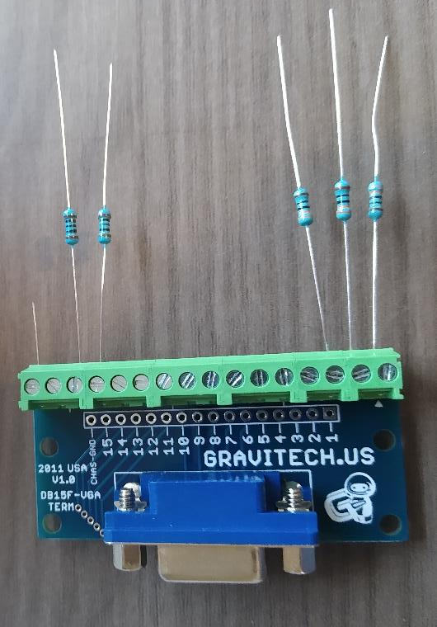
Project 4 Step 1: Connect to VGA module
Make the following connections
VGA pin screw connector | Connection | Name
1 | 330 ohm resistor | R
2 | 330 ohm resistor | G
3 | 330 ohm resistor | B
13 | 1000 ohm resistor | Hsync
14 | 1000 ohm resistor | Vsync
16 (GND) | Wire (cut wire from resistor) | GND
Screw connector pin 16 (GND)
Screw connector pin 1

Slide 33
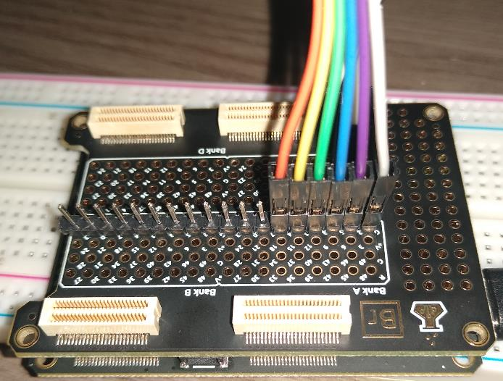
Project 4 Step 2: Connect ribbon cable to Alchitry Br
Make the following connections
Alchitry Br Pin # | Ribbon Connector Color
1 | Grey
2 | Purple
3 | Blue
4 | Green
5 | Yellow
6 | Orange

Slide 34
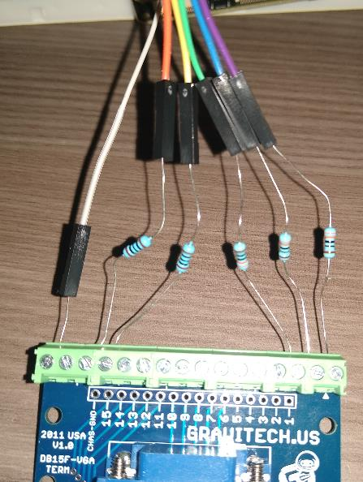
Project 4 Step 3: Connect ribbon cable to resistors and wires on VGA board
Make the following connections
VGA pin screw connector | Connection | Ribbon Connector Color | Name
1 | 330 ohm resistor | Purple | R
2 | 330 ohm resistor | Blue | G
3 | 330 ohm resistor | Green | B
13 | 1000 ohm resistor | Yellow | Hsync
14 | 1000 ohm resistor | Orange | Vsync
16 (GND) | Wire (cut wire from resistor) | Grey | GND

Slide 35

Project 4 Step 4: Create pong project in ICEcube2
Open iCEcube2 SW
File>New Project
Type Project Name = P4_pong
Set Device Family = ICE40
Set Device = HX8K
Set Device Package = CB132
Click Next

Slide 36
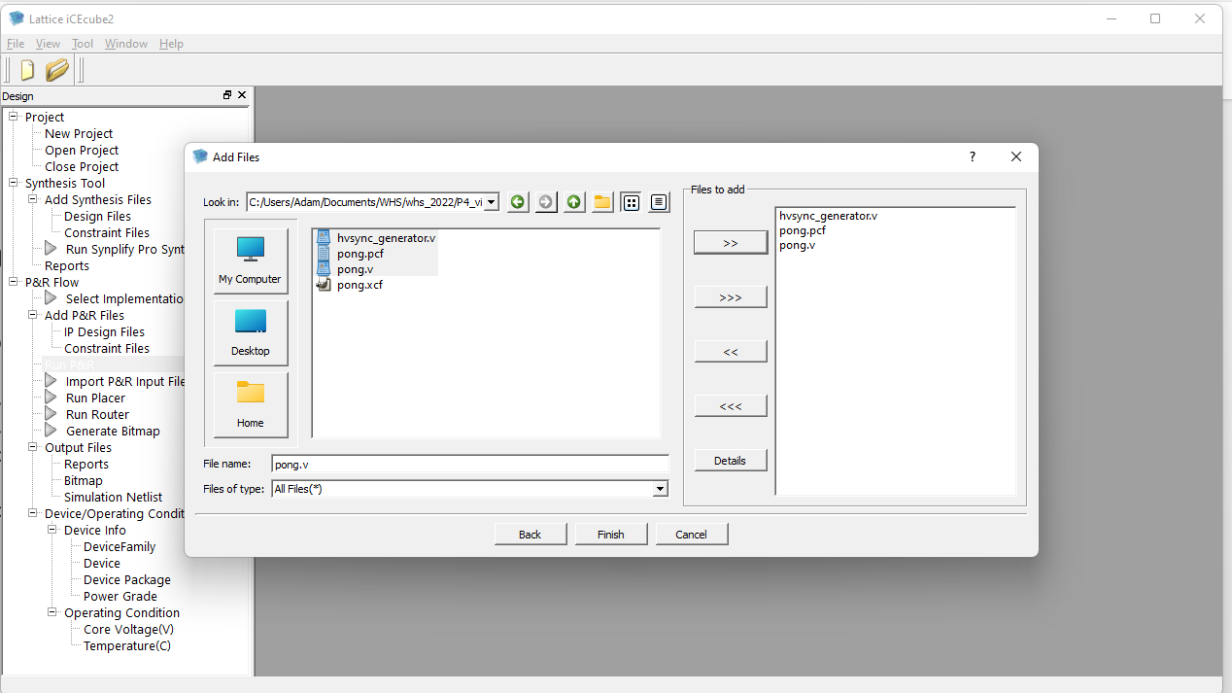
Project 4 Step 5: Create pong project in ICEcube2
Add Files should pop up
Select files in P4_pong:
pong.pcf
pong.v
hysnc_generator.v
Click the “>>” icon so they show up in the “Files to Add”
Click Finish

Slide 37
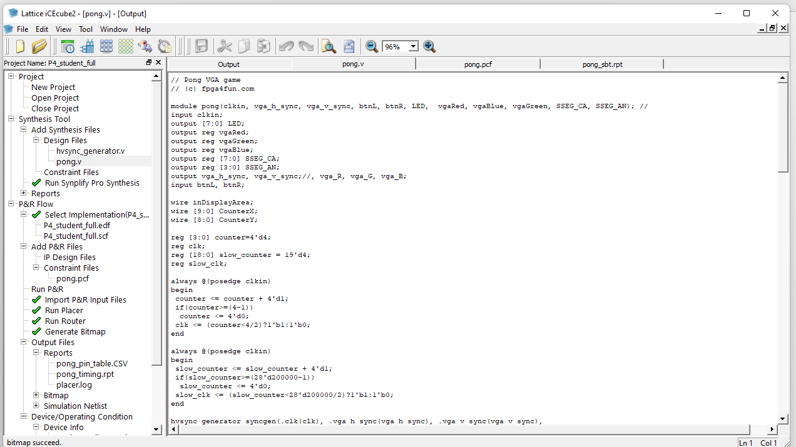
Project 4 Step 5: Run “Synplify” and run “P&R”
Click “run Synplify”
Wait for green check mark
Click “run P&R”
Wait for green check mark

Slide 38
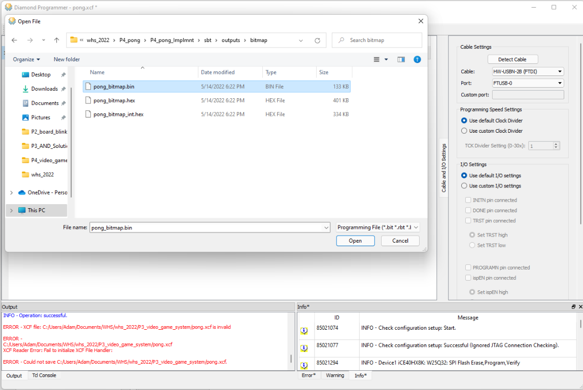
Project 4 Step 6: Load files into IceCube2

Slide 39
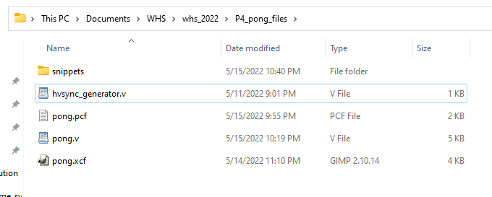
Project 4 Step 7: Make edits to pong.v
Check to see if you see output on VGA monitor
Verify buttons work to move paddle
Go into the snippets directory and use files to make modifications to pong.v to add features to your design
The VGA output should look like this …

Slide 40
Backup

Slide 41
IceCube2 License (Should be done ahead of lesson)
Free license at link below:
https://www.latticesemi.com/Support/Licensing/DiamondAndiCEcube2SoftwareLicensing/iceCube2
“Review your Web Account information below. [ Edit ]Name: John Doe Email: john.doe@gmail.com
Fill in the Software License Request Form and Submit. Finding the Host NIC: For Windows, from an MS-DOS window, use the ipconfig /all command For Linux, from the command prompt, use the ifconfig -a command
After submitting the form successfully, a new license file with instructions on how to install will be emailed to you.”

