Slide 1
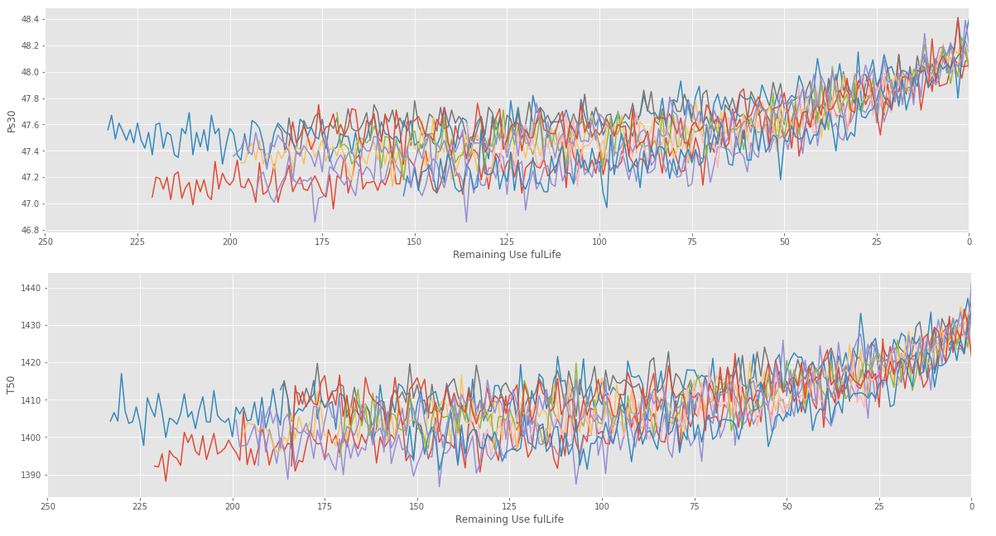
CLASS 10
CLASS 9
CLASS 8
CLASS 7
CLASS 6
CLASS 5
CLASS 4
CLASS 3
CLASS 2
CLASS 1
v

Slide 2
CLASS 5
CLASS 4
CLASS 3
CLASS 2
CLASS 1
v

