Slide 1


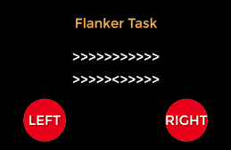
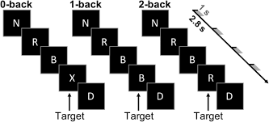
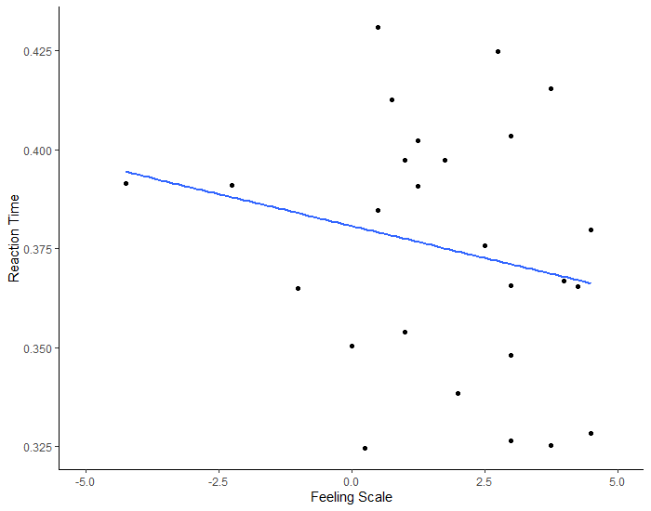
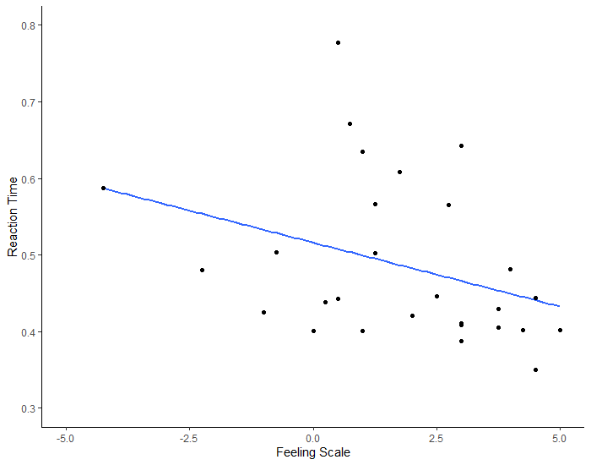
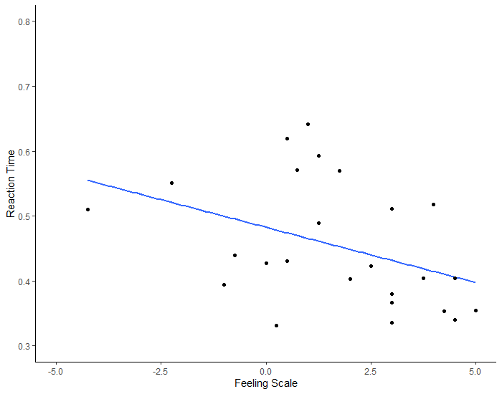
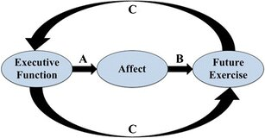
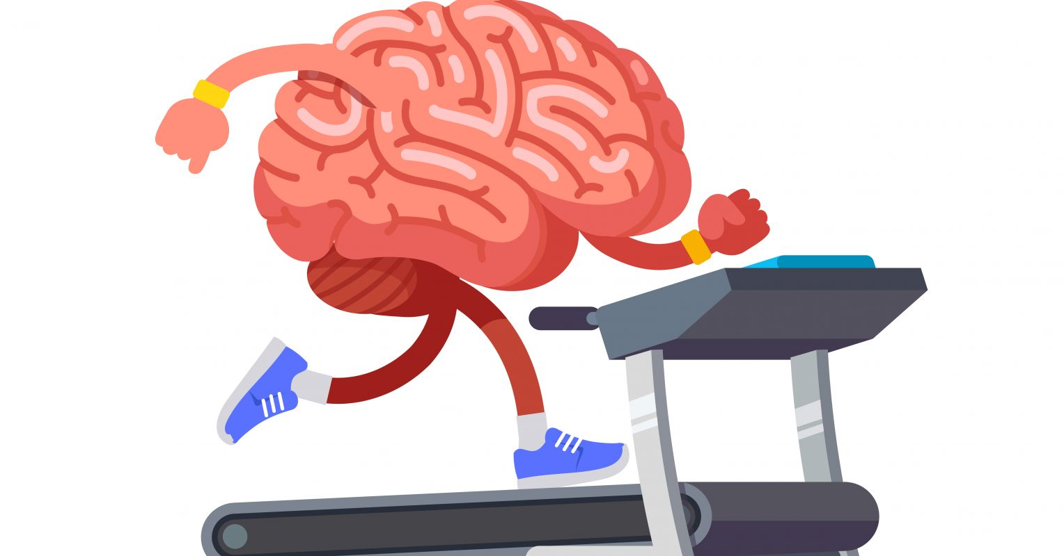
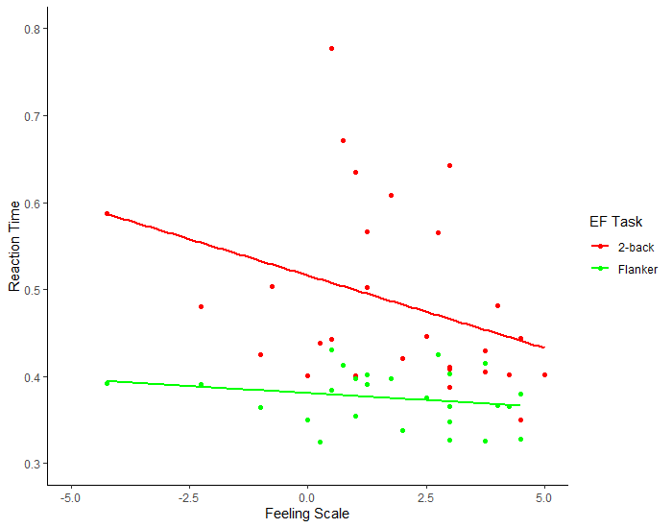
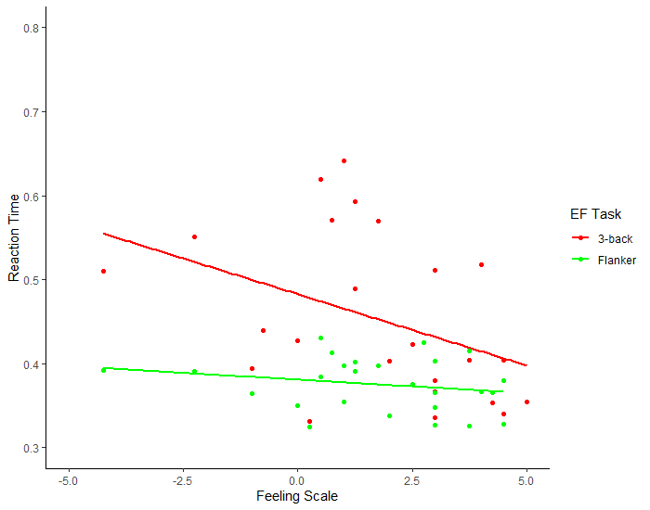
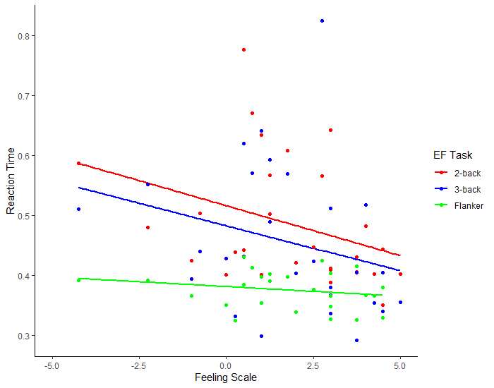


Executive Function Predicts Affective Responses During Exercise
John F. Adamek¹, Jon R. North¹, Erin Markowitz¹, Maddy Szamocki¹, & Steven J. Petruzzello¹, FACSM
¹Department of Kinesiology and Community Health, University of Illinois at Urbana-Champaign;
Abstract
PURPOSE: Examine whether pre-exercise executive function (EF) ability predicts affective responses to an acute bout of running. METHODS: Healthy young adults (N=28, 22.5 ± 3.3 yrs; 75% ♀, BMI= 24.9 ± 4.4 kg·m⁻²) completed the Flanker and N-back tasks (2-back, 3-back), rested 5-min, and completed 31-min of moderate-to-vigorous intensity (HR= 158.6 ± 9.9 b·min⁻¹) treadmill running. During the treadmill session, Feeling Scale (FS), Felt Arousal Scale (FAS) and Ratings of Perceived Exertion (RPE) were recorded every 3-min. FS, FAS, and RPE scores were computed as the average across the 3-minute intervals. Inhibitory control was the average reaction time (RT) for correct responses in the incongruent trials. Working memory (WM) performance was the average RT for correct responses for each level of difficulty (i.e., 2-back, 3-back). Separate multiple regressions were conducted to examine whether WM performance and inhibitory control significantly predicted affective responses (i.e., FS, FAS, RPE) to exercise. Results are reported as standardized coefficients (β). RESULTS: Multiple regressions indicated that 2-back (β= -0.54, t(21)= -2.58, P=0.02) and 3-back (β= -0.59, t(21)= -2.49, P= 0.02) predicted affective valence (FS) to exercise, but not Flanker (P = .10). Neither of the EF measures significantly predicted arousal or RPE (P > 0.05). Follow-up regressions were conducted to examine the strength of the relationship of inhibitory control (i.e., Flanker) and WM (i.e., 2-back, 3-back) on valence. Models included either Flanker and 2-back or Flanker and 3-back. Neither model revealed a significant predictor. However, standardized coefficients for 2-back and 3-back were large (β_{s}= -0.41, -0.47) compared to Flanker (β’s = -0.17, -0.11) indicating the lack of significance is likely due to lack of power. CONCLUSION: Participants with faster RT to working memory (WM) tasks prior to exercise reported feeling more positive while engaging in moderate-to-vigorous exercise compared to their counterparts. Findings also suggest that WM performance may have a stronger effect on valence than inhibitory control. This has implications for considering the role of pre-exercise EF directly on influencing affective valence during exercise and habitual physical activity behavior.
Key Findings
Individuals with greater working memory performance reported feeling more positive/less negative during an acute bout of exercise.
Working memory performance had a stronger effect (β_{s}: -0.41, -0.47) compared to inhibition control (β_{s}: -.17, -.11) on affective valence.
Figure 1. Timeline of the Exercise Session
Table 1. Demographics
Pre-Session
Exercise Session
 | N = 28 (M±SD)
Age | 22.50 ± 3.25
Sex (Female) | 75%
BMI | 24.89 ± 4.37
Exercise min·wk⁻¹ | 238.07 ± 149.03
Feeling Scale | 1.75 ± 2.19
Flanker RT (msec) | 375.21 ± 31.68
2-Back RT (msec) | 486.98 ± 104.97
3-Back RT (msec) | 456.28 ± 122.67
10-min
10-min
5-min
5-min
Pre
3m
6m
9m
12m
15m
18m
21m
5-min
Flanker
N-Back
Rest
Warm
up
FS
FAS
RPE
FS
FAS
RPE
Cool Down
FS
FAS
RPE
FS
FAS
RPE
FS
FAS
RPE
FS
FAS
RPE
FS
FAS
RPE
FS
FAS
RPE
Introduction
The Cognitive Affective Model (see below) states that EF influences exercise-induced affective responses (valence, arousal) which then influences future exercise behavior.
Path A (New): EF pays an influential role in fostering exercise-induced affect
Path B (known): Individual affective responses to exercise influence future exercise behavior
Path C: (known): A cyclical, bi-directional relationship exists between EF and exercise. EF influences exercise behavior and exercise influences EF
However, this association has not been extensively examined yet.
Table 2. Separate Multiple Regressions Predicting Affective Valence
Tasks | β | SE | Adj. R²
Flanker | -0.408 | 0.239 | 0.022
2-back | -0.543* | 0.211 | 0.170
3-back | -0.589* | 0.237 | 0.156
r = -0.08
r = -0.35
r = -0.27
Figure 2. Flanker RT on Exercise-Induced Affective Valence
Figure 3. 2-Back RT Exercise-Induced Affective Valence
Figure 4. 3-back RT Exercise-Induced Affective Valence
Results
Multiple regressions indicated that RTs for 2-back (β= -0.54, t(21)= -2.58, P= 0.02) and 3-back (β= -0.59, t(21)= -2.49, P= 0.02) predicted affective valence (FS) to exercise, but not Flanker (P = .10). Neither of the EF measures significantly predicted affective arousal or RPE (P > 0.05). Follow-up regressions were conducted to examine the strength of the relationship of inhibitory control (i.e., Flanker) and WM (i.e., 2-back, 3-back) on affective valence. Models included either Flanker and 2-back or Flanker and 3-back. Neither model revealed a significant predictor. However, standardized coefficients for 2-back and 3-back were large (β_{s}= -0.41, -0.47) compared to Flanker (β_{s} = -0.17, -0.11) indicating the lack of significance was likely due to lack of power.
Table 3. Follow-up Regressions Predicting Affective Valence
 | β | SE | Adj. R² | F
Model 1 |  |  | 0.060 | 1.253
Flanker | -0.173 | 0.294
2-back | -0.406 | 0.307
Model 2 |  |  | 0.047 | 1.197
Flanker | -0.114 | 0.337
3-back | -0.471 | 0.386
Discussion
Participants with faster RT to working memory (WM) tasks prior to exercise reported feeling more pleasant while engaging in moderate-to-vigorous exercise compared to those with slower RT. Findings also suggest that WM, but not inhibitory control, performance may have a stronger effect on affective valence. This has implications for considering the role of pre-exercise EF directly on influencing affective valence during exercise and habitual physical activity behavior.
Figure 5. Flanker & 2-Back RT on Exercise-Induced Affective Valence
Figure 6. Flanker & 3-Back RT Exercise-Induced Affective Valence
Figure 7. All 3 EF Tasks Exercise-Induced Affective Valence

