Slide 1



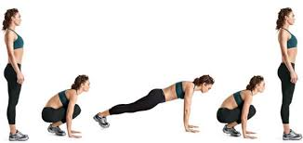
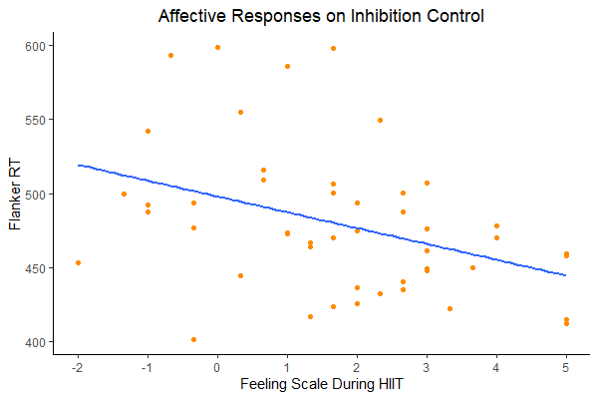
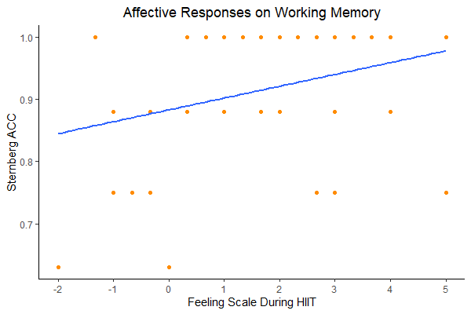
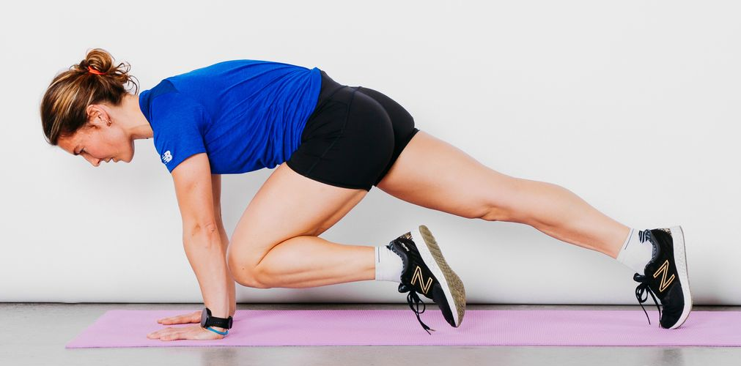
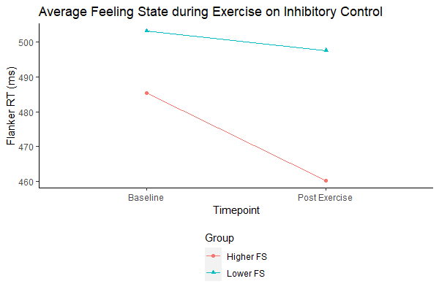
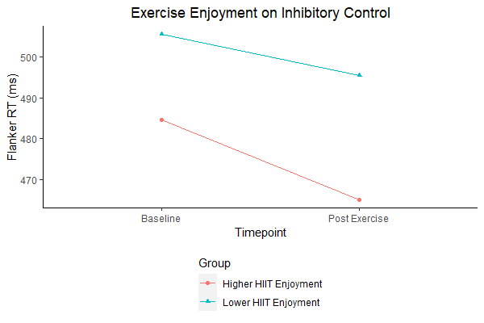


The Effect of Affect During High Intensity Interval Training on Executive Function
John F. Adamek¹, Revati Malani¹, Steven J. Petruzzello¹, FACSM & Neha P. Gothe^{1,2}
¹Department of Kinesiology and Community Health, University of Illinois at Urbana-Champaign;
² Department of Physical Therapy, Movement & Rehabilitation Sciences, Northeastern University, Boston, MA
Abstract
PURPOSE: The purpose of this study was to examine the influence of affective states before, during and after an acute bout of exercise on executive function. METHODS: Young adults (N = 48, M age = 25.5 yrs, 83.3% ♀, BMI = 24.2) completed the Feeling Scale (FS) at various times during a 20-min bout of high intensity interval training (HIIT). Following the bout, they completed the Physical Activity Enjoyment Scale (PACES) and two executive function tasks - Flanker and Sternberg. The HIIT consisted of a 2.5 min warmup, eight rounds (work:recovery = 20s:10s) of high knees, burpees, and mountain climbers, followed by a 2.5 min cool-down. FS was assessed before (FS1) and after (FS2) the warmup, every 5-minutes (FS3, FS4, FS5) during the session, and after the cool-down (FS6). Following the cool-down, participants completed PACES while resting for 5 minutes, and then completed the Flanker and Sternberg tasks. Affective valence was measured as the average FS score during the session (FS_{AVG}) and following the cool-down (FS_{END}). Executive function was determined by reaction time (RT, ms) and accuracy (%) on the tasks. Groups of higher and lower FS_{AVG} and PACES were determined based on a median split to assess feeling states during and following HIIT. RESULTS: Bivariate correlations were small but significant (P< 0.05) for Sternberg accuracy-FS_{AVG} (r= 0.31) and Sternberg accuracy-FS_{END} (r= 0.32). A moderately negative correlation was found between Flanker RT and PACES (r= -0.46), FS_{AVG} (r= -0.38) and FS_{END} (r= -0.58). Group differences in Flanker RT were observed between higher/lower FS_{AVG} (M= 460.10 vs M= 497.68, P< 0.05, d= 0.81) and between higher/lower PACES (M= 465.04 vs M= 495.57, P< 0.05, d= 0.43). CONCLUSION: The pattern of findings suggests that young adults who felt more positive/less negative during, and had greater enjoyment following, an acute bout of HIIT showed better executive functioning. The results suggest that examining affective responses during and after exercise are important factors in the acute exercise-cognition relationship. Future studies should more carefully explore this mediating role of affect on cognition across various exercise modalities.
Key Findings
Individuals who felt more positive/less negative while participating in HIIT performed better on executive function tasks.
Those who reported greater enjoyment following HIIT performed better on executive function tasks. _______________________________________________________________________________________________________________
Figure 1. Timeline of the Exercise Session
Table 2. Correlation Matrix of Affect and Executive Function
2.5min
5min
5min
5min
2.5min
Variable | 1 | 2 | 3 | 4 | 5 | 6 | 7 | 8 | 9 | 10 | 11
1. Flanker RT | - | - | - | - | - | - | - | - | - | - | -
2. Flanker AC | 0.29* | - | - | - | - | - | - | - | - | - | -
3. Sternberg RT | 0.51*** | 0.22 | - | - | - | - | - | - | - | - | -
4. Sternberg AC | -0.15 | -0.11 | 0.02 | - | - | - | - | - | - | - | -
5. FS1 | -0.17 | 0.07 | 0.04 | 0.23 | - | - | - | - | - | - | -
6. FS2 | -0.14 | -0.09 | 0.00 | 0.30* | 0.82*** | - | - | - | - | - | -
7. FS3 | -0.29* | -0.24 | -0.26 | 0.31* | 0.39** | 0.64*** | - | - | - | - | -
8. FS4 | -0.41** | -0.27 | -0.13 | 0.28 | 0.26 | 0.38** | 0.82*** | - | - | - | -
9. FS5 | -0.36* | -0.17 | -0.01 | 0.29* | 0.27 | 0.34* | 0.72*** | 0.90*** | - | - | -
10. FS6 (FS_{END}) | -0.58*** | -0.22 | -0.14 | 0.32* | 0.29* | 0.36* | 0.66*** | 0.79*** | 0.82*** | - | -
11. FS_{AVG} | -0.38*** | -0.24 | -0.13 | 0.31* | 0.32* | 0.47*** | 0.89*** | 0.98*** | 0.94*** | 0.81*** | -
12. PACES | -0.46*** | -0.25 | -0.22 | 0.18 | 0.15 | 0.23 | 0.36* | 0.50*** | 0.48*** | 0.52*** | 0.48***
Warmup
R1: Tabata
R2: Tabata
R3: Tabata
Cool-down
FS1
FS2
FS3
FS4
FS5
FS6
FS_{AVG}
FS_{END}
Table 1. Description of the HIIT Tabata Session
Order | Exercise | Duration
1 | High Knees | 0:30
2 | Burpees | 1:00
3 | Mountain Climbers | 1:30
4 | High Knees | 2:00
5 | Burpees | 2:30
6 | Mountain Climbers | 3:00
7 | High Knees | 3:30
8 | Burpees | 4:00
- | Rest (1 minute) | 5:00
Note. Each exercise is performed for 20s followed by a 10s rest.
*P< 0.05; ** P< 0.01; *** P< 0.001
Introduction
Affective responses to acute exercise have been shown to influence habitual exercise behavior. Exercise has also been shown to impact cognitive performance, particularly executive function. However, little is known about the impact of affective responses (i.e., valence) before and during acute exercise on cognitive performance, thus the purpose of this study.
Figure 2. Feeling Scale (FS) during exercise on Flanker Task
Figure 3. Feeling Scale (FS) during exercise on Sternberg Task
Purpose
The purpose of this study was to examine the influence of affective states before, during and after an acute bout of exercise on cognitive performance, more specifically on executive function.
r = -0.38*
r = 0.31*
Methods
Young healthy adults (N= 48, Mage= 25.5±7.98 yrs, 83.3% ♀, BMI= 24.19±4.83 kg·m⁻²) completed the Feeling Scale (FS) during 20-min of high intensity interval training (HIIT; see Fig 1, Table 1). Following HIIT, participants completed the Physical Activity Enjoyment Scale (PACES) and two executive function tasks – the Eriksen Flanker, which assesses ability to inhibit a response by focusing on task-relevant stiumli, and the Sternberg, which assesses working memory. Data are reported as Reaction Times (RT) and response accuracy (ACC, expressed as %).
Table 1. Affect and Executive Function Before, During, and After HIIT
Affective Responses (during)
FS1 | 3.69 ± 1.32
FS2 | 3.50 ± 1.19
FS3 | 2.60 ± 1.55
FS4 | 1.33 ± 2.07
FS5 | 1.23 ± 2.03
FS6 (FS_{END}) | 2.06 ± 1.90
FS_{AVG} | 1.72 ± 1.77
Enjoyment (PACES; post) | 83.52 ± 16.5
Executive Function Baseline
Flanker RT | 494.66 ± 63.71
Flanker Accuracy (ACC, %) | 0.95 ± 0.05
Sternberg RT | 1097.28 ± 257.52ª
Sternberg ACC | 0.92 ± 0.12
Post-Exercise
Flanker RT | 479.67 ± 49.51
Flanker ACC | 0.94 ± 0.05
Sternberg RT | 913.12 ± 215.98ª
Sternberg ACC | 0.92 ± 0.11
ªIndicates significant difference
Results
Means (SDs) for the affective and cognitive variables are presented in Table 1. Bivariate correlations were low but significant (P< 0.05; Table 2) for Sternberg ACC-FS_{AVG} (r= 0.31) and Sternberg ACC-FS_{END} (r= 0.32). A moderate negative correlation was found between Flanker RT and PACES (r= - 0.46), FS_{AVG} (r= -0.38) and FS_{END} (r= -0.58; Table 2). Group differences in Flanker RT were observed between higher/lower FS_{AVG} (M= 460.10 vs M= 497.68, P< 0.05, d= 0.81; Fig 4) and between higher/lower PACES (M= 465.04 vs M= 495.57, P< 0.05, d= 0.43; Fig 5).
Figure 4. High vs Low FS_{AVG} on Inhibitory Control
Figure 5. Post Exercise Enjoyment on Inhibitory Control
Discussion
The pattern of findings suggests that young adults who felt more positively during, and had higher enjoyment following, an acute bout of HIIT showed better executive functioning, both in terms of faster and more accurate responding. The results suggest that examining affective responses during and after exercise are important factors in the acute exercise-cognition relationship. Future studies should more carefully explore this potential mediating role of affect on cognition across various exercise modalities.

