Slide 1
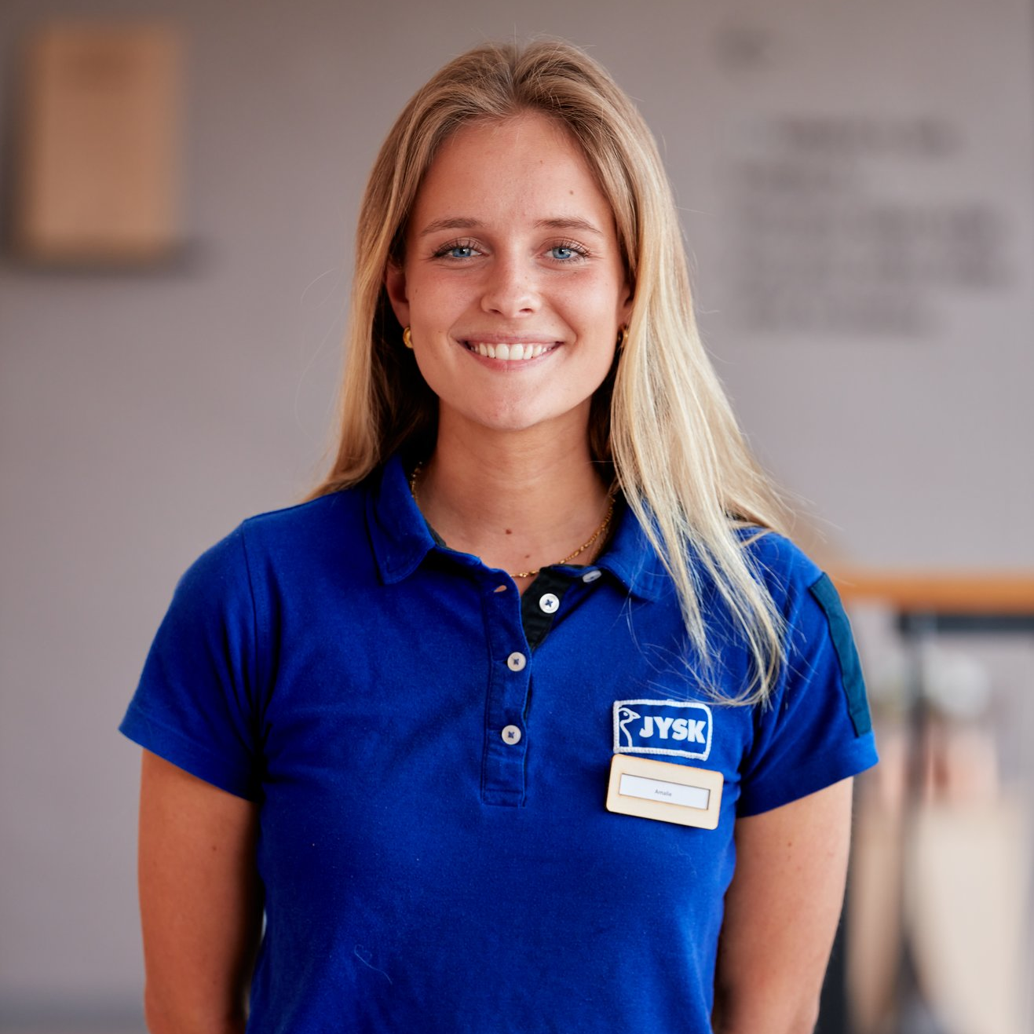



Dear Amalie
We’re proud that you choose to be JYSK
Amalie Meyer
Store Manager Viby
#ProudToBeJYSK

Slide 2
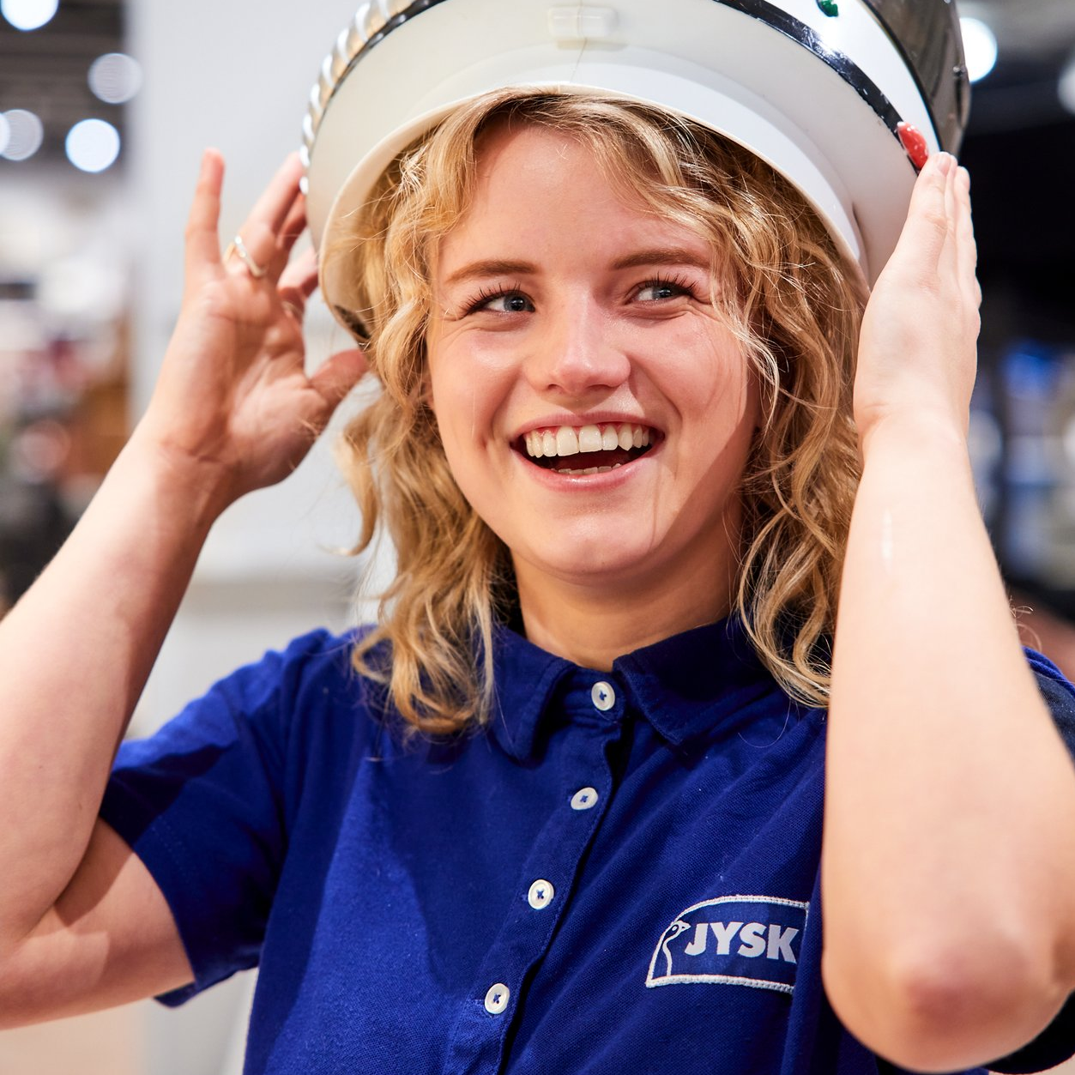
Dear Camilla
We’re proud that you choose to be JYSK
Camilla Meyer
Store Manager Viby
#ProudToBeJYSK

Slide 3
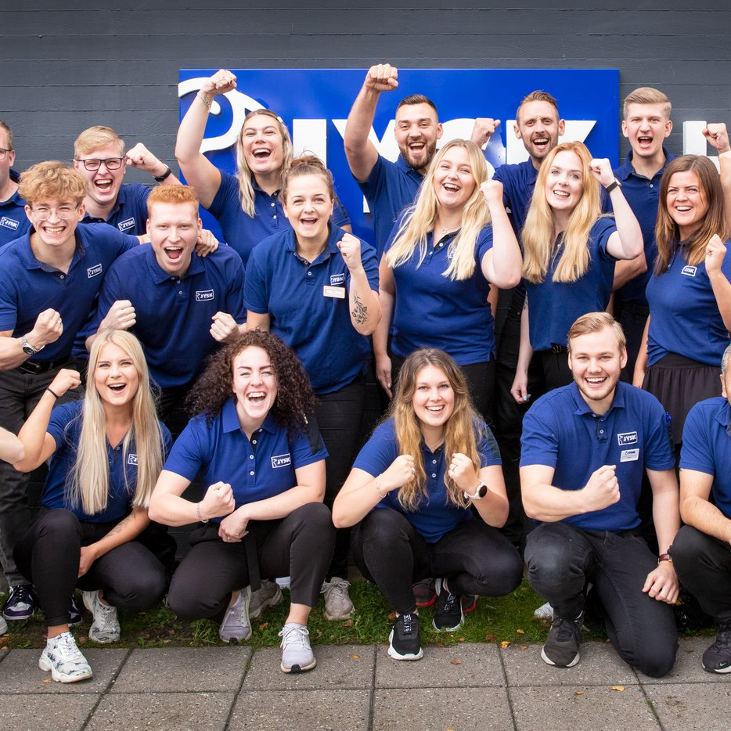
Dear Team Viby
We’re proud that you choose to be JYSK
Store Team Viby
#ProudToBeJYSK

Slide 4
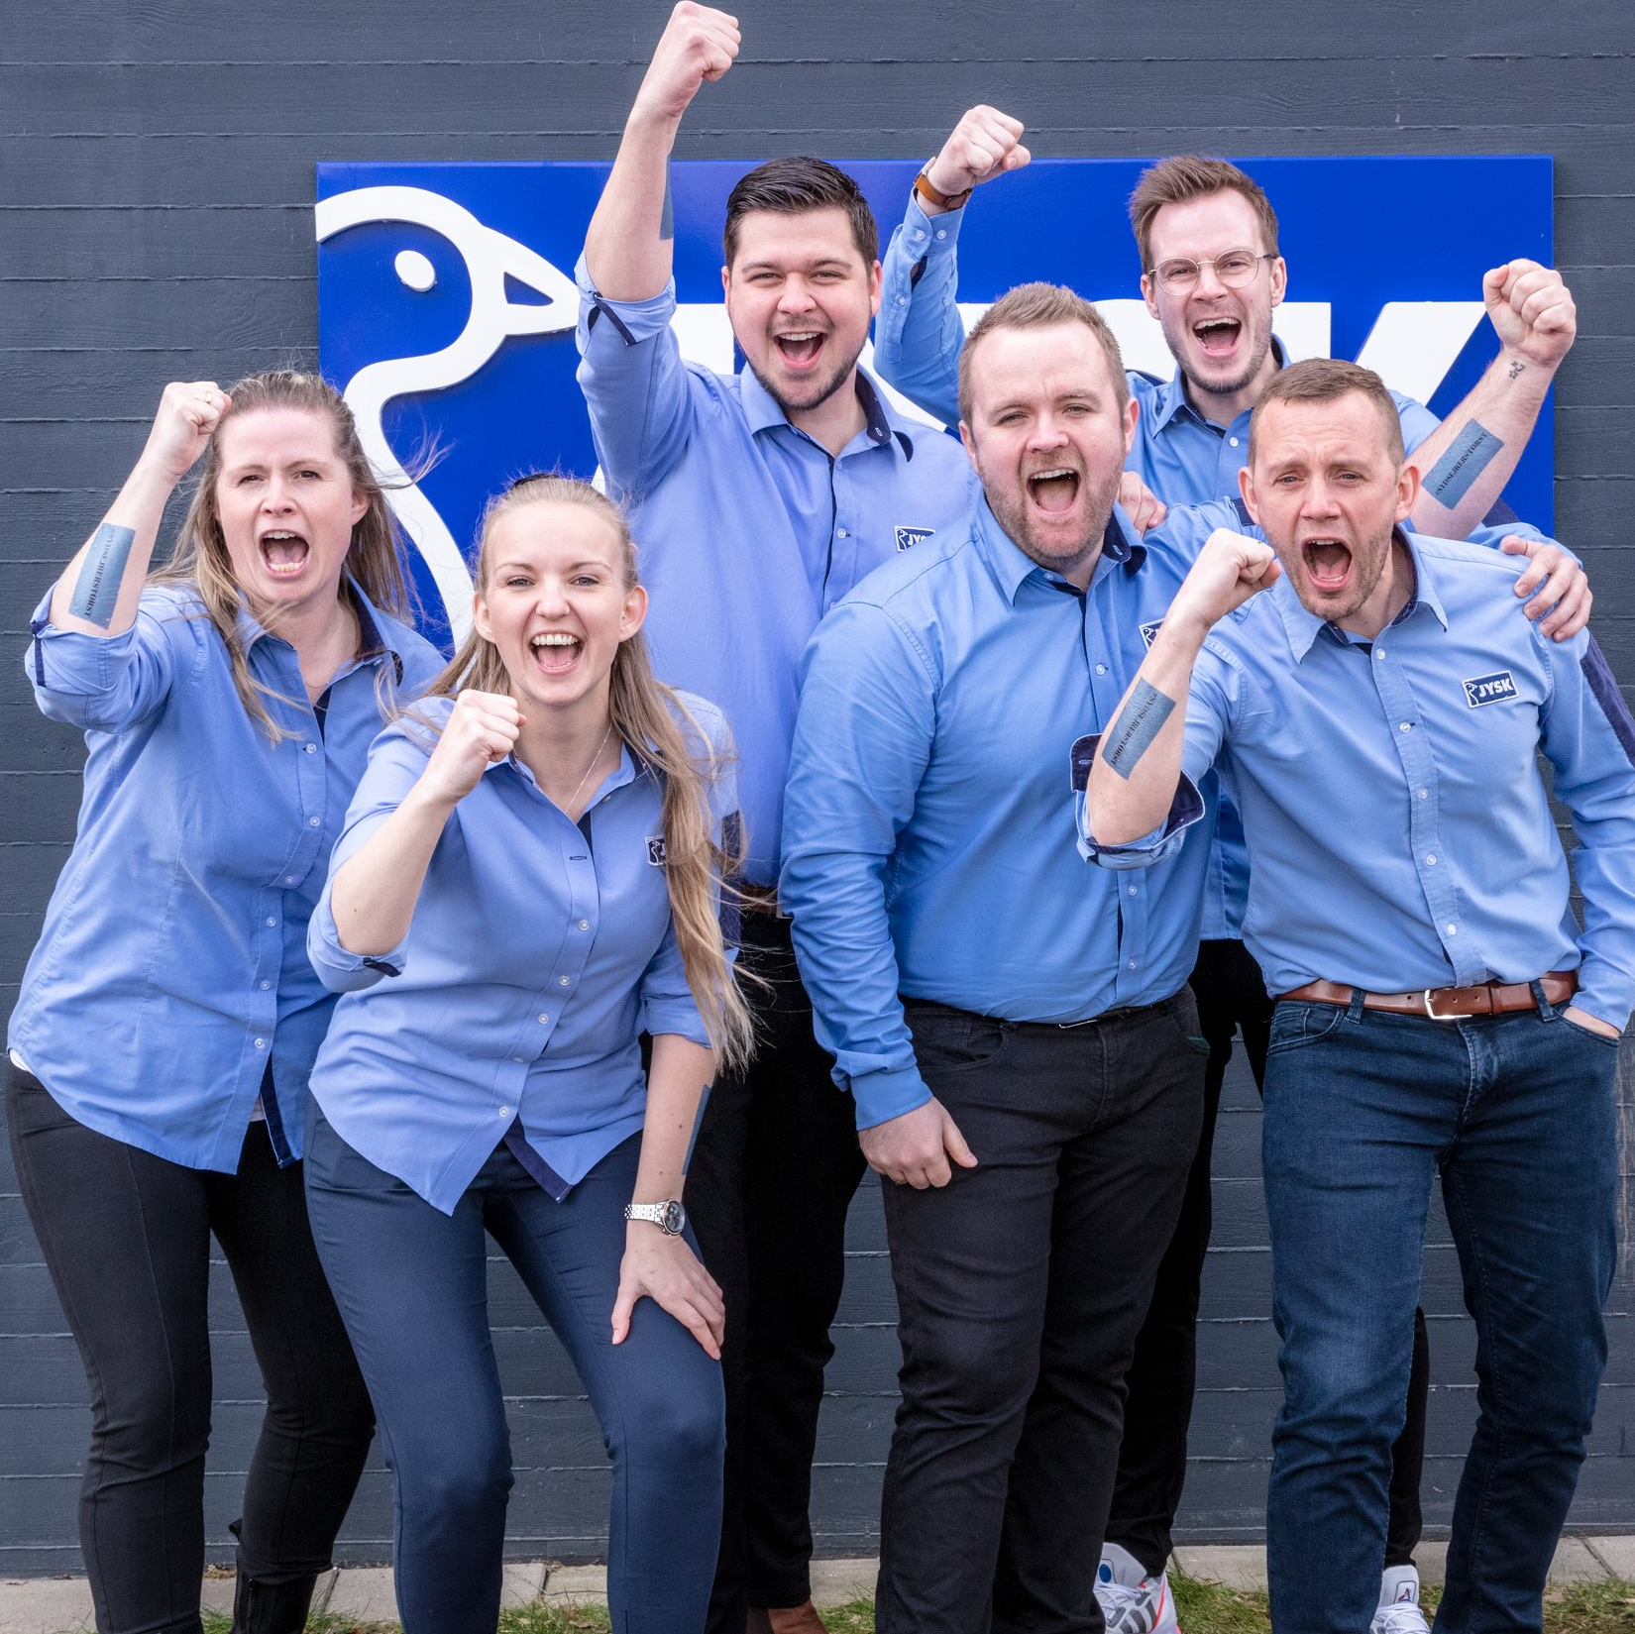
Dear District North
We’re proud that you choose to be JYSK
District North
Denmark
#ProudToBeJYSK

