Slide 1
How to add your own text and photo – A3 poster

Slide 2
Overview
Templates
How to change TEXT
Requirements for your photo
How to change PHOTO
Move photo to another position
Move White / BLUE bar
Make not highlighted position transparent
Save element

Slide 3
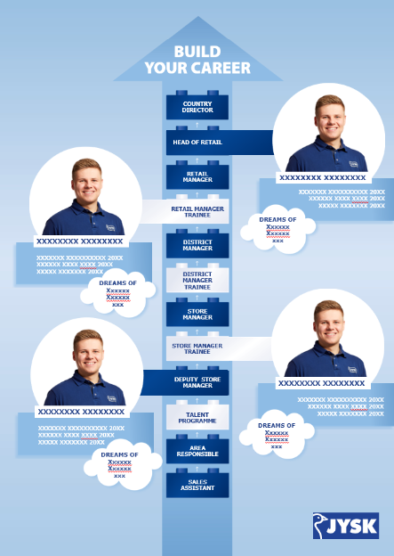
Templates
There is one template →
It is created in PPT
Format A3 for self print.
In the PPT you will find:
Slide 1 template
Slide 2 example on how a poster could look like.

Slide 4
How to change TEXT
All text is editable, so change the text by clicking on the text fields
If you need more space for your local text:
You are allowed to decrease the font size or make the text fields bigger, in the situations where it is possible.
Please be aware the text need to be quite big to ensure readability on mobile view.

Slide 5
Requirements for your photo
Always take a photo with the person in the middle of the frame
Always use a calm background – preferable a white one.
The picture should be sharp and in good quality
Requirements on how the person should appear(Smile, no closed eyes, calm body language) ??

Slide 6
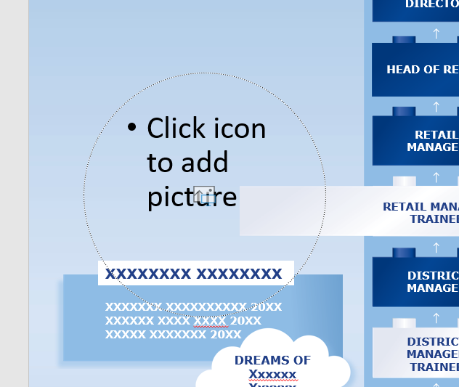
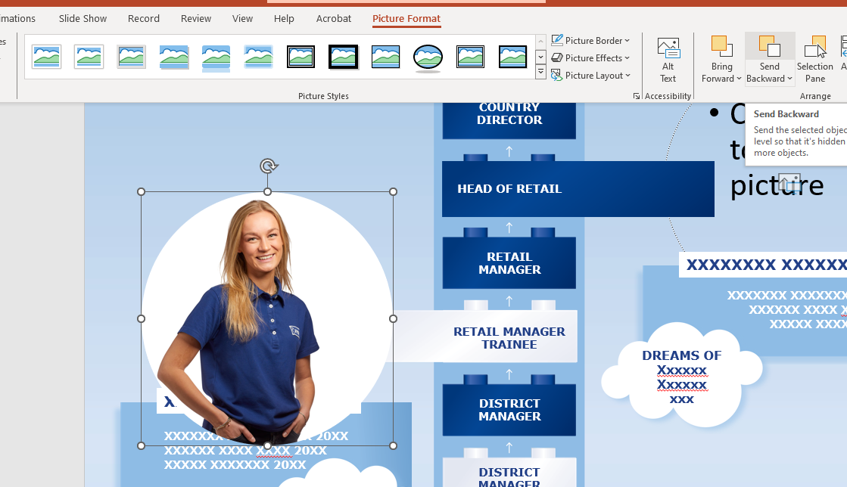
How to change PHOTO
In the PowerPoint there is a Template on slide 3 – use that to create your own poster.
Click on the “picture placeholder” and add your photos
Click on the button “Send backward” until the photo is behind the text, but still in front of the bar from the brick.

Slide 7
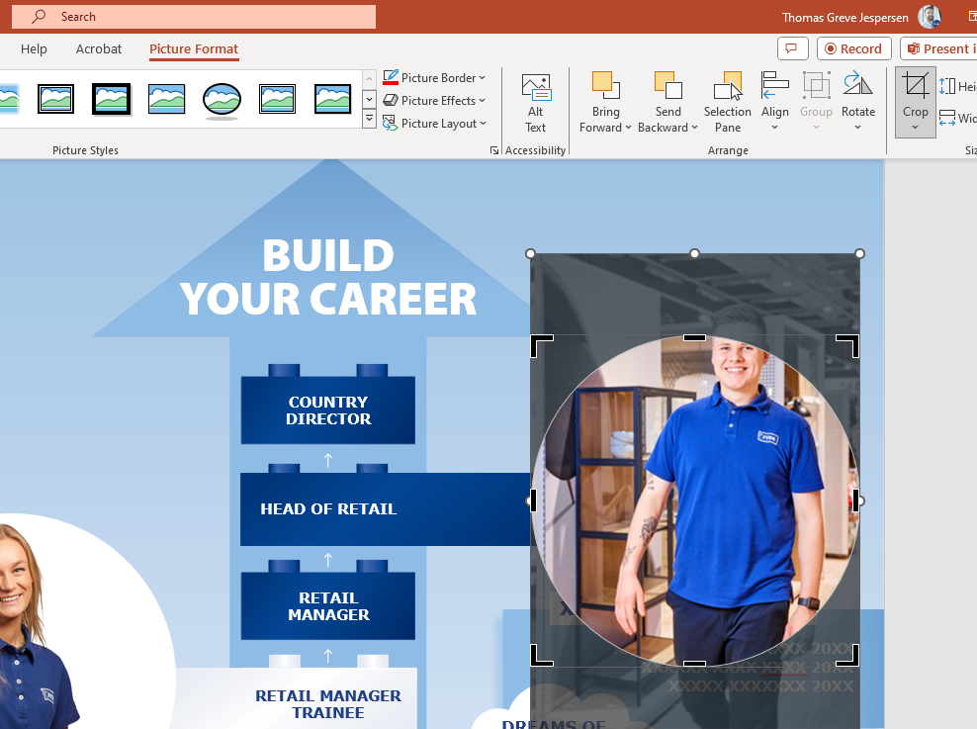
How to change PHOTO
If the photo does not fit, click on the crop button and choose “crop”

Slide 8



How to change PHOTO
Then you will get the opportunity to move the photo in the picture placeholder(step1)
Move the photo so it fits into the picture placeholder(step 2)
When your photo is placed like you want, click anywhere outside of the photo (step 3)
Step 1
Step 2
Step 3

Slide 9
Move photo to another position
We have only placed some random placeholders, so if you want to move the photo and text to another position, just move it after you have placed the photo.

Slide 10

Move White / BLUE bar
We have created 4 different bars in the template
1 white going to the left
1 white going to the right
1 Blue going to the left
1 Blue going to the right
Use the one fits to the position you want highlight by moving them from the current bricks to the one you want.

Slide 11
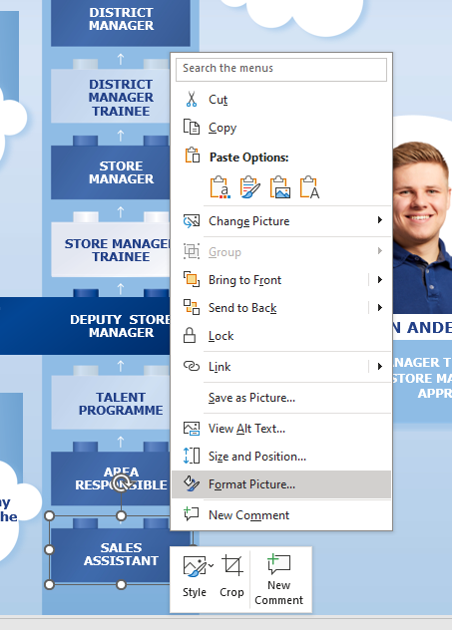
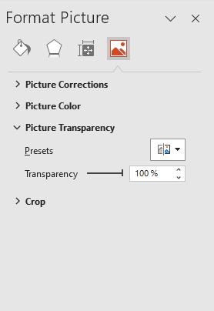
Make not highlighted position transparent
Mark the brick you want to make transparent.
Right click on it
Select “Format picture” (step 1)
Click on the last icon to the far right.(step 2)
Make the transparency 100% (step 2)
Step 1
Step 2

Slide 12
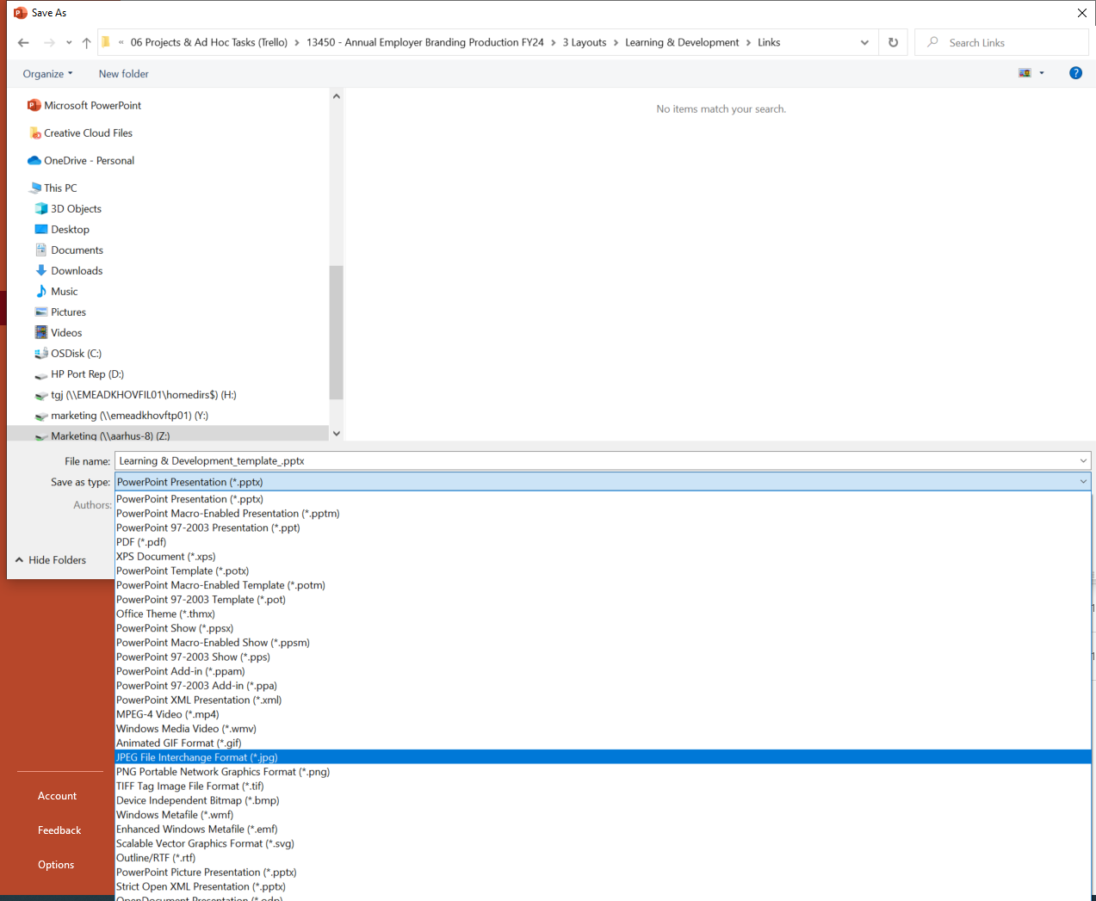
SAVE a PDF
Now the template is ready.
Then save it as a PDF.

