Slide 1
Named entity recognition using topic models
Traveler’s Lab Wesleyan University September 25, 2018

Slide 2
Topic models
A type of “soft” clustering used for content discovery and classification
Topics are collections of words
E.g. weather: snow, rain, wind, hot, cold, humid, thunder
Topic names are picked by an analyst - “beauty is in the eyes of the beholder”
E.g. what’s the difference between weather and climate?

Slide 3
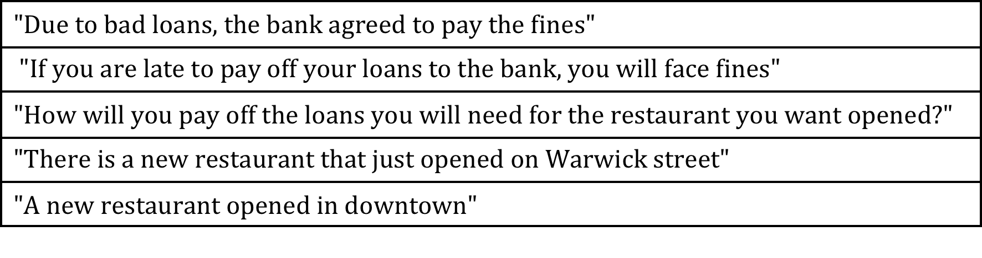
Example
Five documents, two topics – restaurants and loans

Slide 4
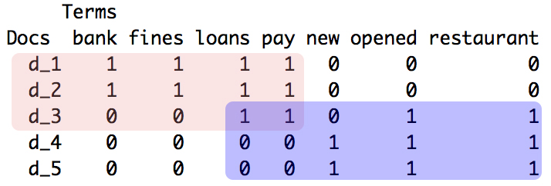
Soft clustering
‘pay’ and ‘loans’ belong to two topics

Slide 5
Soft clustering, ctd.
Regular clustering is ‘hard’ – would assign the word only to one topic
Soft clustering returns a probability of an item belonging to cluster
In topic models, probability of word in topic, or topic in document

Slide 6
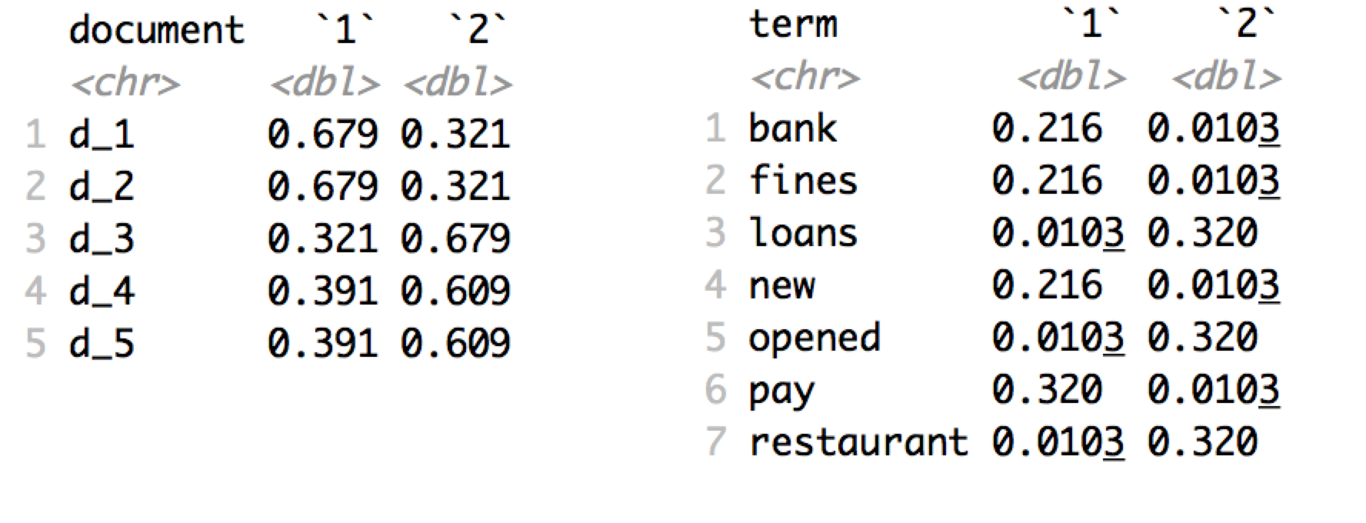
Topic model for 2 topics

Slide 7
Widely used by DH
“Distant reading” in digital humanities
Off-the-shelf solutions: Mallet, JSTOR Text Analyzer
JSTOR Labs https://labs.jstor.org/projects/
JSTOR Topicgraph https://labs.jstor.org/topicgraph/

Slide 8
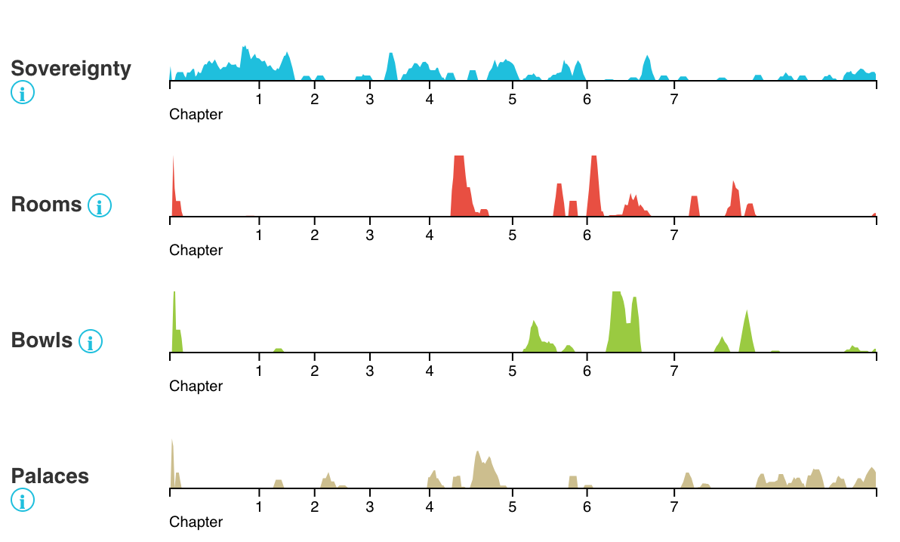
JSTOR Topicgraph
JSTOR topics found in Imperial Matter: Ancient Persia and the Archeology of Empires
“Document” is a chunk of text (500 or 1000 words)
Topic names picked by JSTOR staff

Slide 9
Named entity recognition
Entity – upper-case word within a sentence
Use the word context of an entity
Take n-words from left and right side of entity
E.g. “bishop of ___”, “son of ___”
But consider “went to ___” - ambiguous

Slide 10
Decisions
Finding a pattern for entity
Single or multi-word, are dots allowed? Korykos vs. St. Thomas
Size of the window: 1, 2, or 3 words
Larger window means fewer ‘documents’
Suffix to show the side (left or right)
Reduces term frequencies
How to handle punctuation
Commas limit the size of a context window

Slide 11

Regular expression patterns
Pattern for the entity
Pattern for the entity and the context
Symbols: ? – occurs 0 or 1 time, {2} occurs 2 times, + - occurs 1 or more times

Slide 12
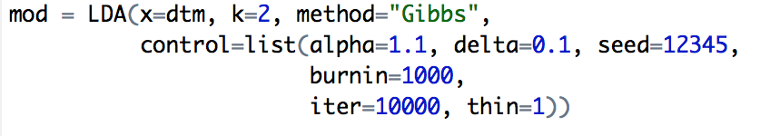
Model fitting
Parameter ‘alpha’ affects the proportions of topics.
alpha > 1 – proportions closer to 50/50
Run time depends on dtm size, number of iterations

Slide 13
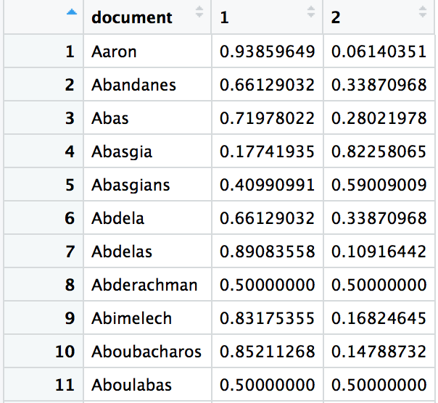
Results
Table with probabilities of topics in documents
Each document – context of one entity
Topic numbering is arbitrary

