Slide 1
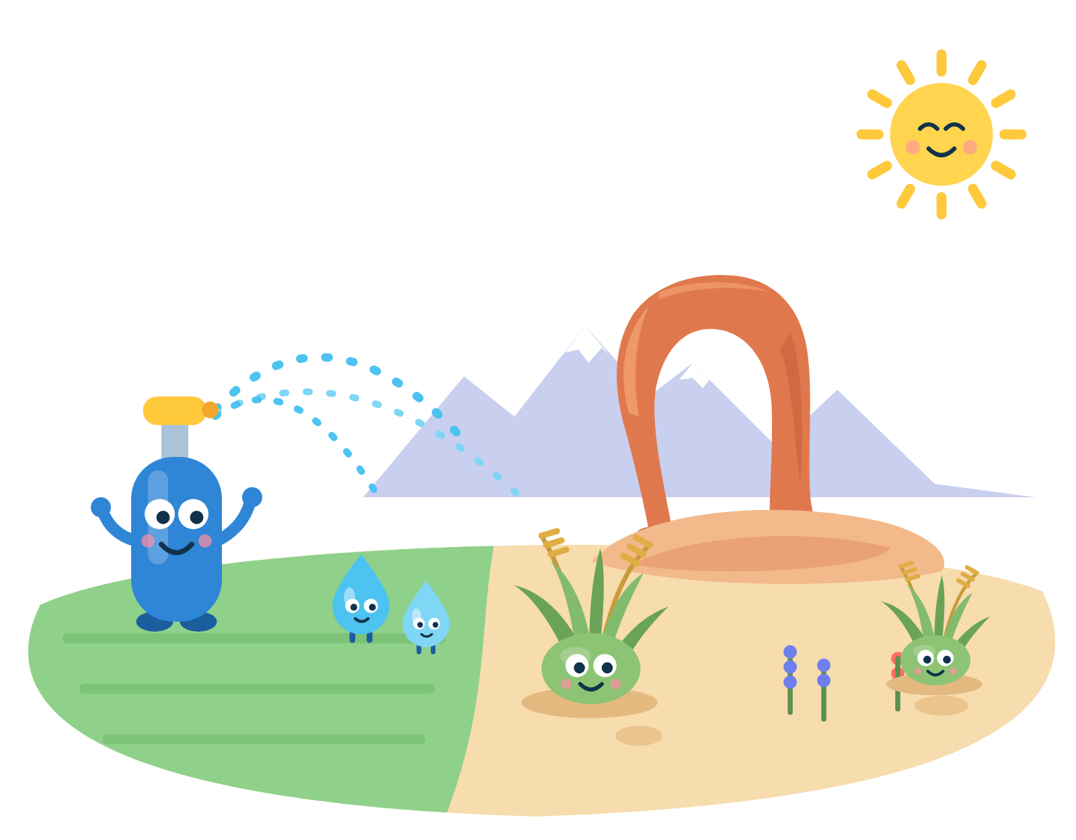

Overwater.ing?
Is your lawn getting more water than it needs?
Every lawn in Utah, measured from the air. What it really needs, sent to the sprinkler controller.
Adam Fortuna · overwater.ing · Nucleus × Startup State
Notes:
[0:00–0:05]
Hi, I'm Adam Fortuna. This is Overwater.ing. Question mark.

Slide 2


HOW I GOT HERE
It started over a pint.
JULY
WHAT I LEARNED
NOVEMBER
Perspectives Over Pints, Fisher Brewing.
Utah pays you to replace your grass.
Our own yard consult is booked.
The Yard Farmer gave the talk.
Utah Water Savers: $1.50–$3 per square foot.
So: how much lawn do I actually have?
Nobody could tell me. Not for my lot, and not for any lot in Utah.
Notes:
[0:05–0:30]
In July I went to Perspectives Over Pints at Fisher Brewing, and The Yard Farmer gave the talk.
That's where I learned about Utah Water Savers: the state will pay you up to three dollars a
square foot to replace your grass. We booked our own yard consult for November. But my first
question was: how much lawn do I have, and what does it really need? Nobody could tell me.

Slide 3
THE PROBLEM
Where Utah's water goes.
All of Utah's water: ~4.7M acre-feet a year
Then mining 6%, industry 3%, fish hatcheries 2%, power 2%, livestock 0.4%
Farms 72%
Cities & towns 15%
Where cities' water goes, counting secondary (untreated) irrigation water
Home yards 42%
Inside homes 28%
Businesses, schools, churches & industry 30%
Home yards: 500,993 acre-feet a year,
enough to raise Great Salt Lake about 10 inches.
All water: USGS Circular 1441, Utah 2015 (withdrawals incl. saline; much of Utah's secondary yard water is counted under irrigation there). Cities: Utah DWR Water Resources Plan 2021 via USU Extension (M&I is 25% of 4.75M AF diverted; >70% residential; 60% of that outdoors). Lake: ~610,000 acres near 4,191 ft (UGS), volume equivalent only; saved water can increase potential flows to the lake.
Notes:
[0:30–0:45]
Here's all of Utah's water. Most goes to farms. About a sixth runs through our cities, and the
biggest share of that is home yards: half a million acre-feet a year. Enough to raise Great Salt
Lake about ten inches.

Slide 4

WHY NOW
The lake needs that water back.
GREAT SALT LAKE
AND IT STAYS WITH THE LAKE
4,190.4 ft
Water saved on yards can flow to the lake.
August 2026. The healthy range starts at 4,198 ft.
Executive Order 2026-03 (May 2026): new data centers may not add to Great Salt Lake's depletion.
So Utah's AI build-out can't take what yards give back.
471,000–1,055,000 more acre-feet a year to get it back.
Sources: Utah News Dispatch / USGS gauge (lake level); Great Salt Lake Strategic Plan (inflow need); Utah Executive Order 2026-03 (May 29, 2026). Saved water can increase potential flows to the lake; it may be reused upstream.
Notes:
[0:45–1:00]
Great Salt Lake is eight feet below healthy. Water we save on yards can flow to the lake. And
since May, new data centers can't add to its depletion, so the AI build-out can't take it.

Slide 5


THE GAP
Utah pays to fix it. It can't see the yards.
$1.50–$3
About half
per square foot of lawn you replace.
of Utahns overwater (BYU, aerial imagery + water bills).
2024: ~3 million sq ft replaced, >$7M paid.
Oct 2022 – Dec 2025: 7.3 million sq ft, 4,700 yards, $16.8M.
But nobody knows, lot by lot, how much lawn there is or how much water it really needs.
Sources: Utah Water Savers rates (checked Oct 27 2026); Utah DWR turf buyback results 2024; state fact sheet "Utah's Big Water Win", Oct 2022–Dec 2025 (Slow the Flow); Sowby et al., BYU 2022.
Notes:
[1:00–1:10]
That rebate program has replaced 7.3 million square feet of grass since 2022. But nobody knows,
lot by lot, how much lawn there is. So I built it.

Slide 6
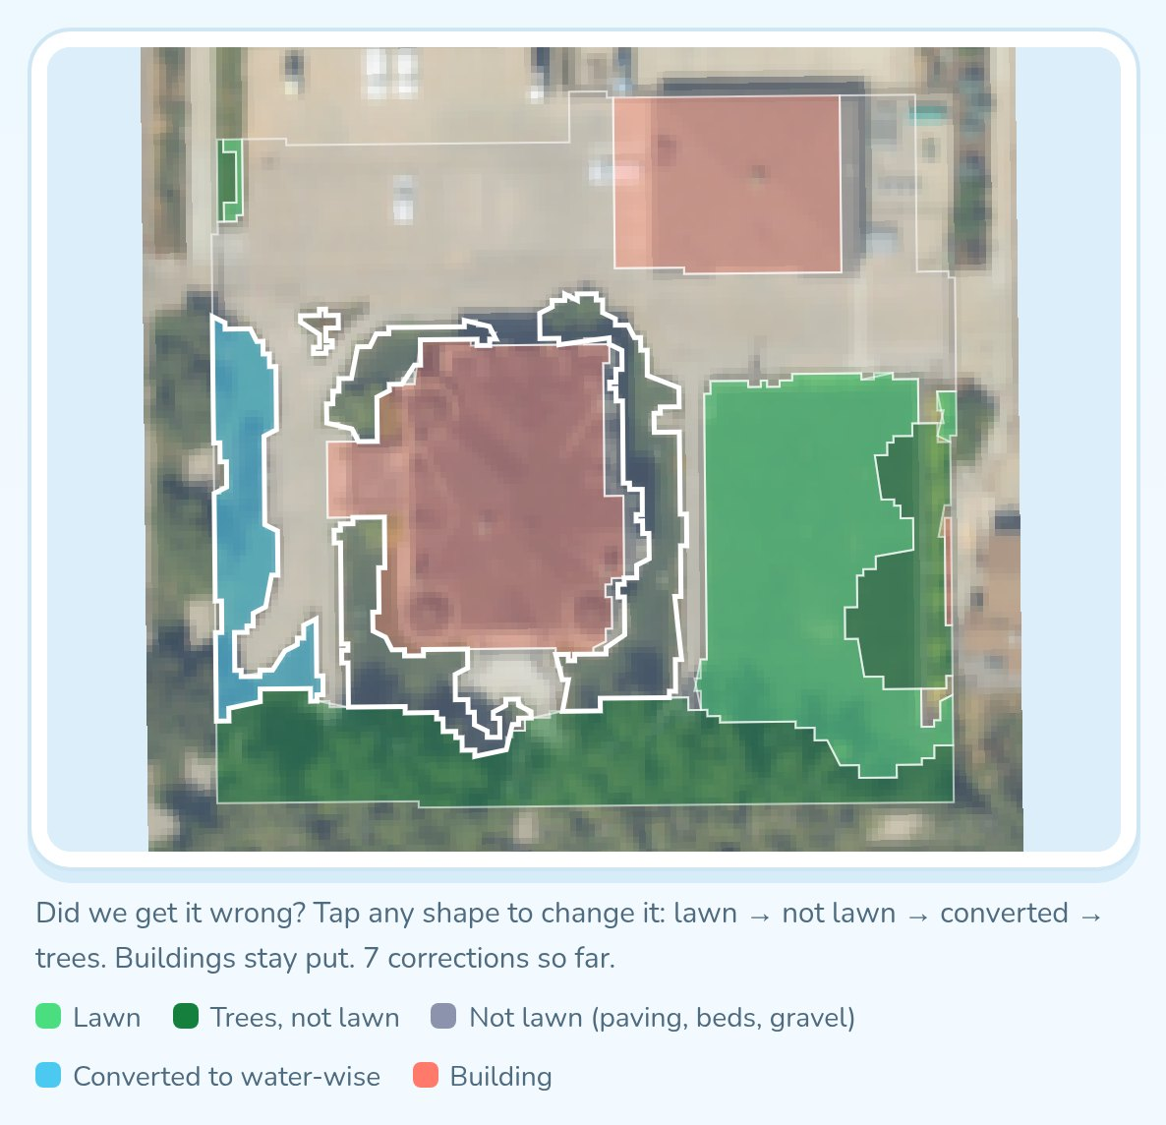
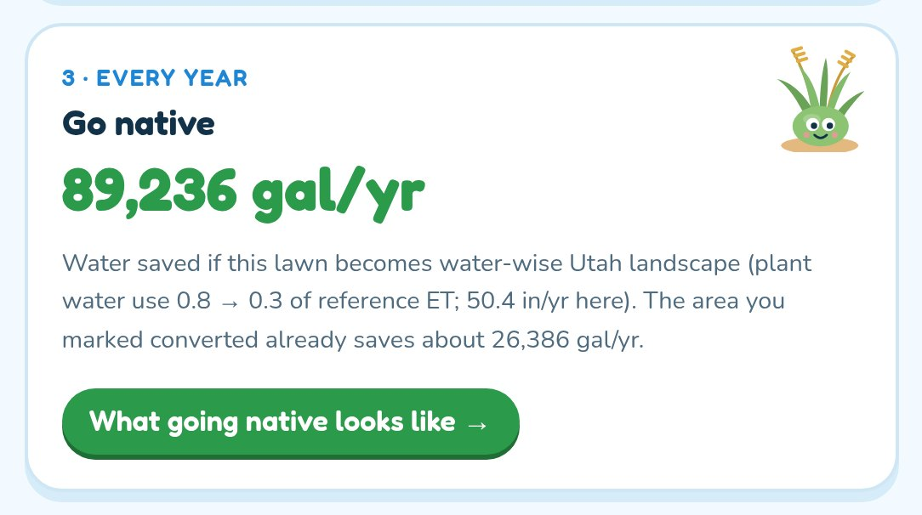
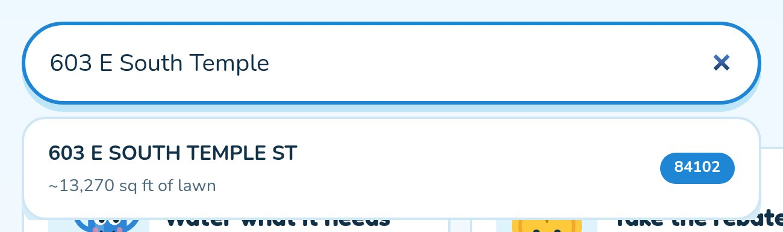

LIVE DEMO · OVERWATER.ING
Type any Utah address.
1 Enter your address
2 Confirm what's grass
3 See what native saves
Any address in all 29 counties.
Tap a shape to fix it. 6,828 sq ft of lawn here.
89,236 gallons a year, and up to $20,484 back.
4 Or lower your water use today
County-level watering schedules that follow the state's weekly guide, as a calendar or sent straight to the controller: OpenSprinkler, Rachio or Home Assistant.
Notes:
[1:10–3:00]
(Switch to the browser. Full click path and fallbacks are in demo.md.)
1:10 Type "603 E South Temple", the Governor's Mansion. Pick it.
1:20 The 2024 aerial photo. Green is lawn, dark green is trees, red is buildings: 6,828 square
feet of lawn. If we got a shape wrong, tap it. That correction trains the model. (Tap one, then
tap it back to green.)
1:40 Go native: about 89,000 gallons a year saved. And Utah pays up to $20,484 here,
from Central Utah Water Conservancy District. It knows the city, the water system and the program.
1:55 What going native looks like: the before and after, the plants, the designers to call.
2:05 Or lower your water use today: pick spray heads and a basic timer. One thing to change, and a
month-by-month schedule for this county.
2:20 Subscribe to it as a calendar, or send it to the controller. This is OpenSprinkler's real
firmware: when the state says skip, it switches itself off. In July: Monday, Wednesday, Friday at
5 a.m., four short cycles a zone.
2:50 (Only if the warm-up worked.) Any address in Utah is measured live, like this one in St. George.

Slide 7
PROGRESS
Live, statewide, and checked against the state.
12,791
29 / 29
r = 0.77
lots precomputed in six Salt Lake City and Sandy neighborhoods: 319 acres of lawn.
Utah counties searchable. Any other address is measured live in the browser.
per-lot agreement with the state's Greenspace model (3,104 lots, median ratio 0.97).
Built on real data: USDA aerial imagery, county parcels, Meta tree heights, gridMET weather, Utah Water Savers rebates, the state's weekly watering guide.
Greenspace comparison: Utah DWRe Greenspace 2024 (NDVI ≥ 0.15) vs. our lawn + tree canopy for ZIP 84102: 189.2 vs 170.2 acres. Data shared by Jack Hinzman, Senior GIS Analyst, DWRe. Method: RESULTS.md, Run 7.
Notes:
[3:00–3:10]
It's live: twelve thousand eight hundred lots precomputed, any address in all 29 counties
measured on demand, and it tracks the state's own Greenspace model lot by lot.

Slide 8
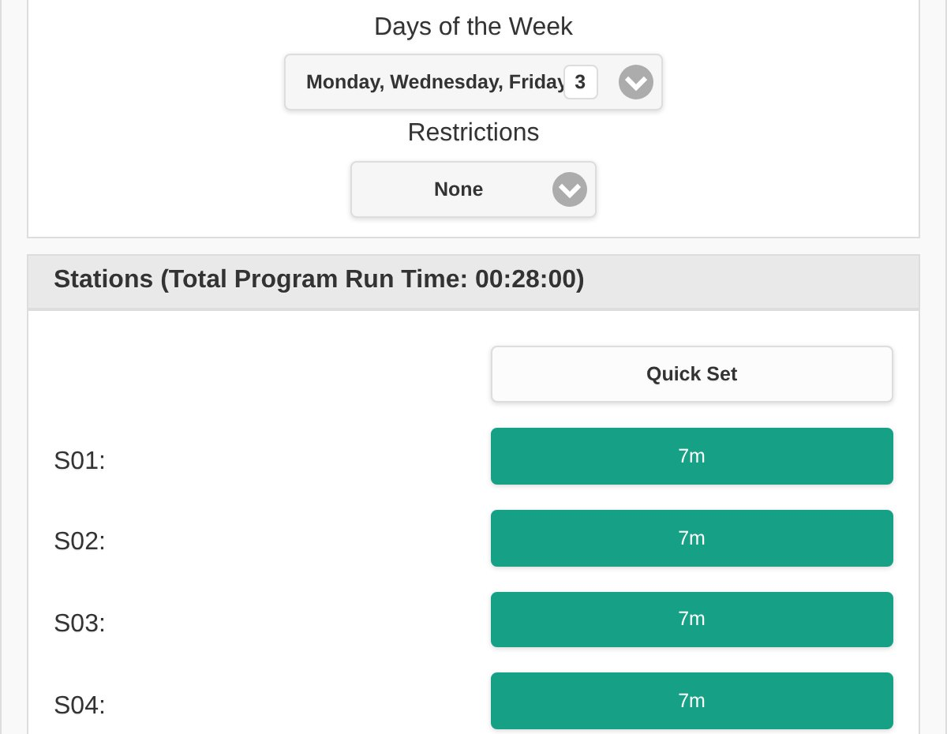
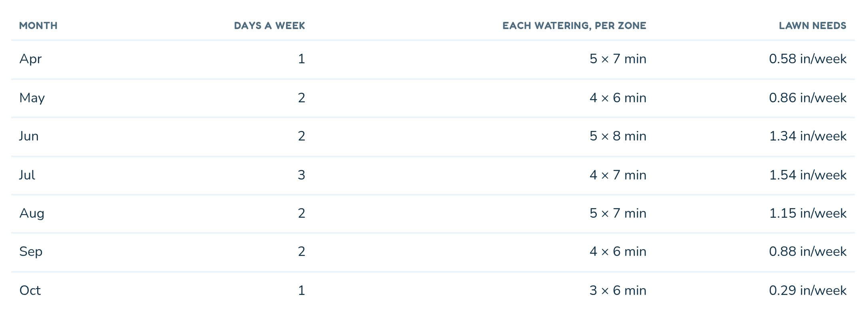
HARD TECH
From an aerial photo to your sprinkler.
1 Find the grass
2 Know what it needs
3 Run the sprinklers
• Aerial photos with infrared, so living plants glow.
• Laser-scanned tree heights and building outlines pull out trees and roofs.
• Each county's weather: how much water grass loses each day.
• Turned into days and minutes, checked against the state's weekly guide.
• A calendar, or the controller itself: off when the state says skip.
• Your corrections train our model. Claude reads bills to check results.
USDA NAIP 2024 (60 cm, 4-band) · NDVI · Meta LiDAR canopy heights · runs in your browser
gridMET reference ET · FAO-56 turf coefficient · Utah Weekly Lawn Watering Guide
Open schedule API · OpenSprinkler, Rachio and Home Assistant connectors · Claude reads bills
Notes:
[3:10–3:45]
How it works, in three steps. Find the grass: aerial photos of the whole state, with infrared so
living plants glow, minus the trees from laser-scanned tree heights, minus the roofs, right in
your browser. Know what it needs: each county's weather tells us how much water grass loses, and
we turn that into days and minutes, checked against the state's weekly guide. Run the
sprinklers: a calendar, or the controller itself, which switches off when the state says skip.

Slide 9



THE PLAN
Three phases. $10K unlocks the second.
PHASE 1 · LIVE NOW
PHASE 2 · WHAT $10K FUNDS
PHASE 3 · WITH THE STATE
Estimate your rebate to go native
Pilot: manage sprinklers remotely
Drone scans tune each sprinkler head
Optimize your watering schedule
Support more sprinkler systems
State drone flights a few times a week map moisture with LiDAR. Each sprinkler waters only the patch that needs it, and skips the rest.
OpenSprinkler integration, plus Rachio and Home Assistant
Moisture sensor integration
Meet Utah's water-wise partners: what's in progress, next steps
slowtheflow.org/partners
Notes:
[3:45–4:15]
Phase one is live today: your rebate estimate, a watering schedule, and connectors for
OpenSprinkler, Rachio and Home Assistant. Ten
thousand dollars funds phase two: a pilot that manages real sprinklers remotely, more sprinkler
systems, moisture sensors, and sitting down with each of Utah's water-wise partners to see what's
already in progress. Phase three is with the state: drone scans a few times a week, so each
sprinkler head waters only the patch that needs it.

Slide 10

PATH TO REALITY
Two customers: the state and the homeowner.
Cities, districts & the state
Homeowners
NOW
Every lot's lawn and need. Rebate outreach goes where the savings are.
Your lawn, your rebate, and a schedule that changes itself.
PHASE 2
Schedules that follow the state guide across a district. Savings measured on meters.
Sprinklers managed for you. Moisture sensors skip the wet days.
PHASE 3
Drone scans spot overwatering from the air, lot by lot.
Each sprinkler head waters only the patch that needs it.
Districts already named on the site: Central Utah, Jordan Valley, Weber Basin, Washington County, and the statewide Utah Water Savers program.
Notes:
[4:15–4:40]
Two customers. Cities, districts and the state already pay for rebate outreach; we show them
every lot's lawn and need, so that money goes where the savings are. With drone scans, they
could spot overwatering from the air, before a bill ever shows it. Homeowners get their lawn,
their rebate, and a schedule that runs itself, down to each sprinkler head.

Slide 11


THE ASK
Type your address at overwater.ing
$10K for phase 2: a pilot that runs real sprinklers.
Intros to Utah's water-wise partners, a district conservation team, and drone training academies for LiDAR scans.
overwater.ing
Notes:
[4:40–5:00]
So here's the ask: ten thousand dollars for phase two, a pilot that runs real sprinklers. And
introductions: to Utah's water-wise partners, to a district's conservation team, and to drone
training academies that could fly LiDAR scans with us. And right now, take out your phone and
type your address at overwater.ing. Thank you.

Slide 12
Backup: the demo, step by step
If the Wi-Fi fails, click through these instead. Same order as the live demo.
Notes:
[backup]
Only if the live demo fails. Each following slide matches one demo step in demo.md.

Slide 13
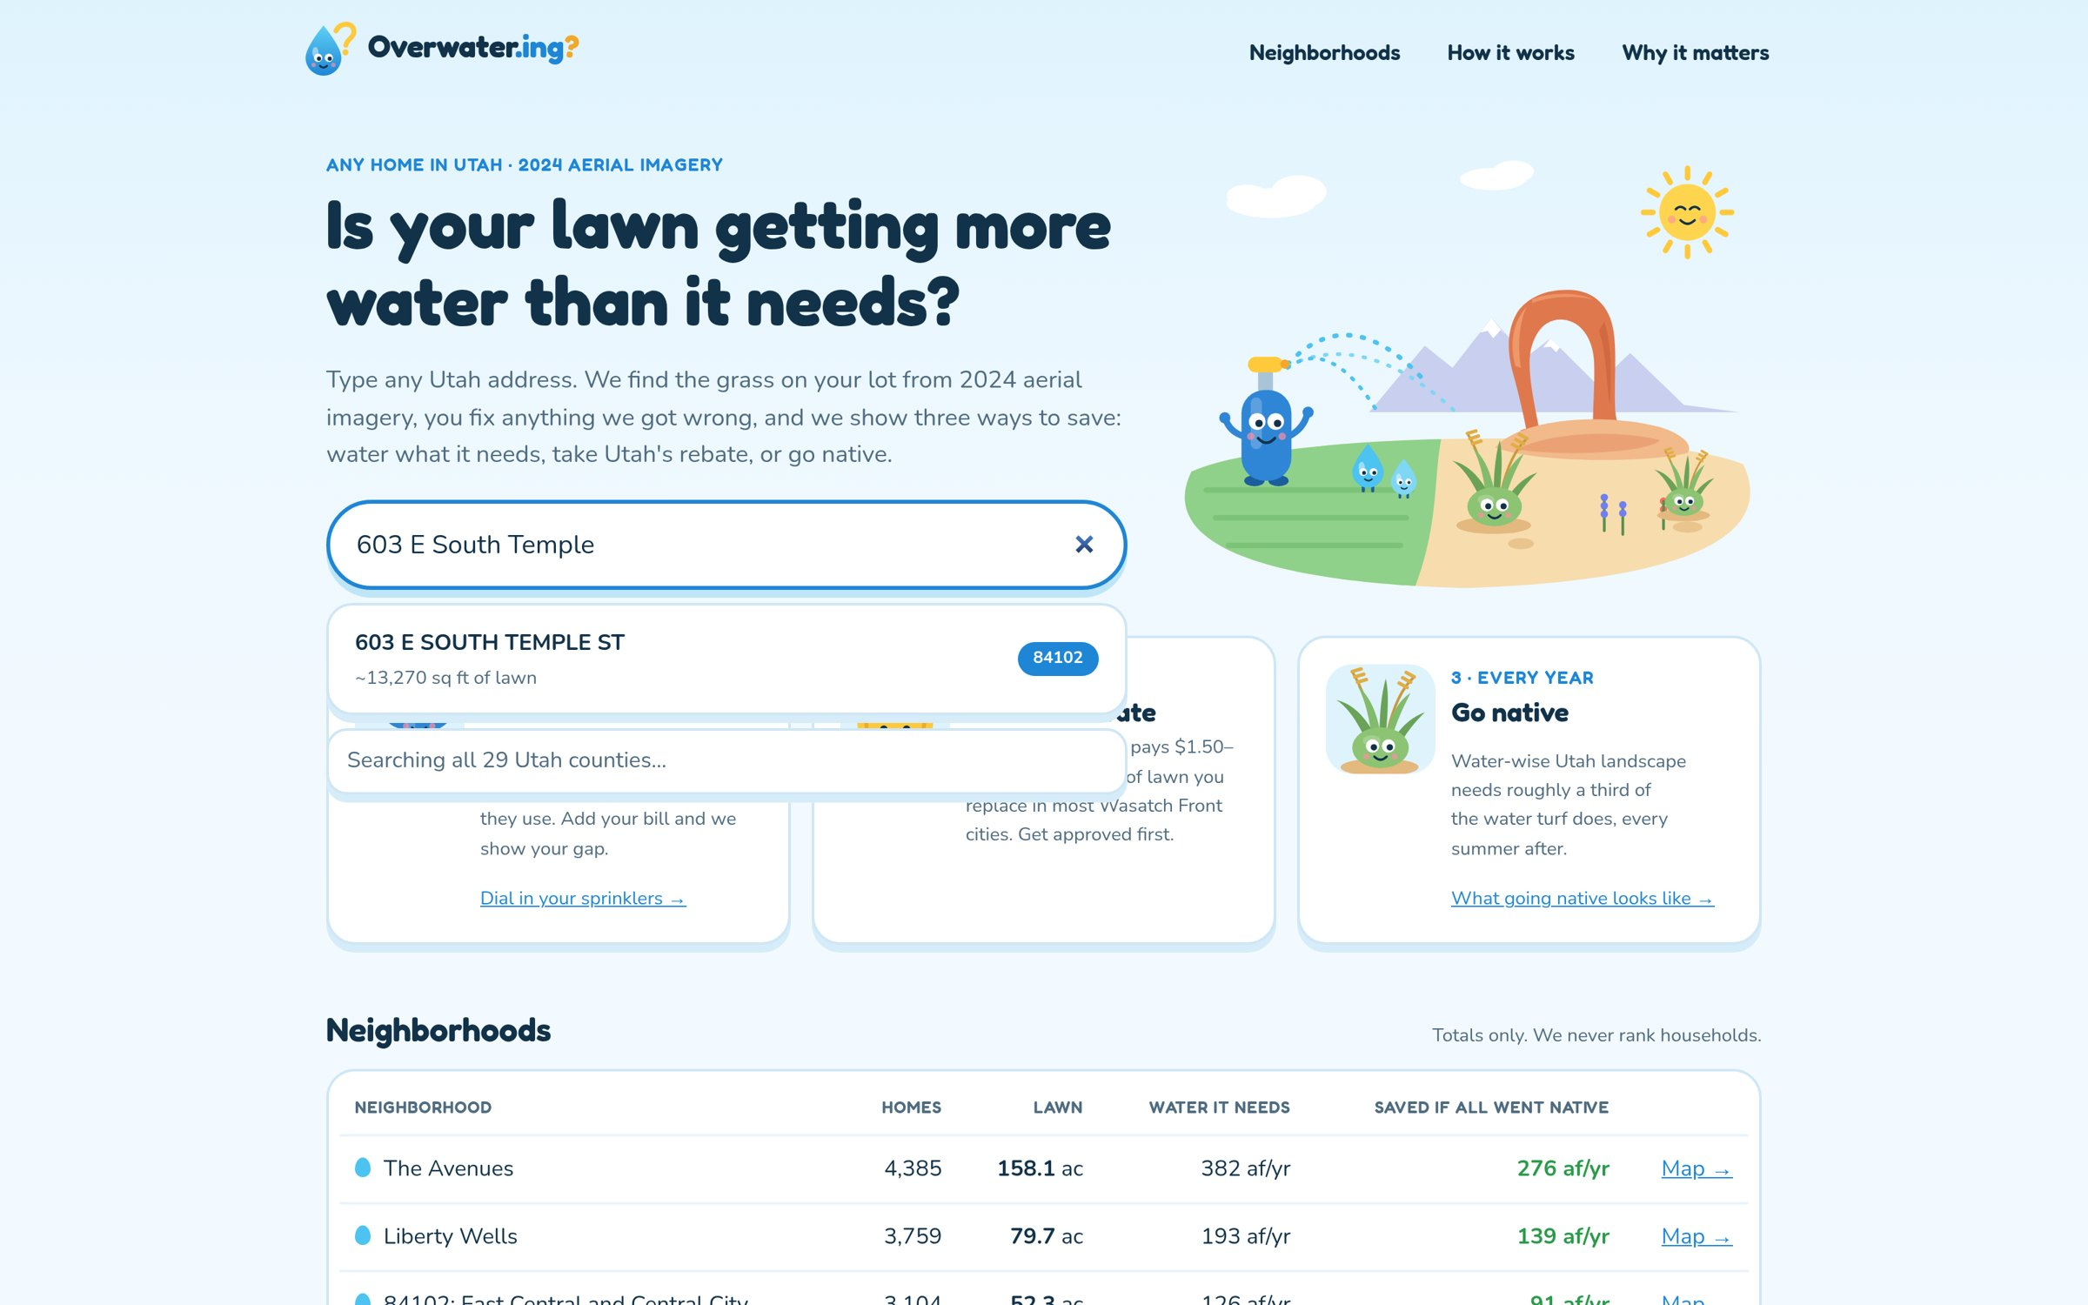
1 · Enter any Utah address
Search covers parcels in all 29 counties.
Notes:
[demo 1:10]
Type 603 E South Temple and pick the first result.

Slide 14
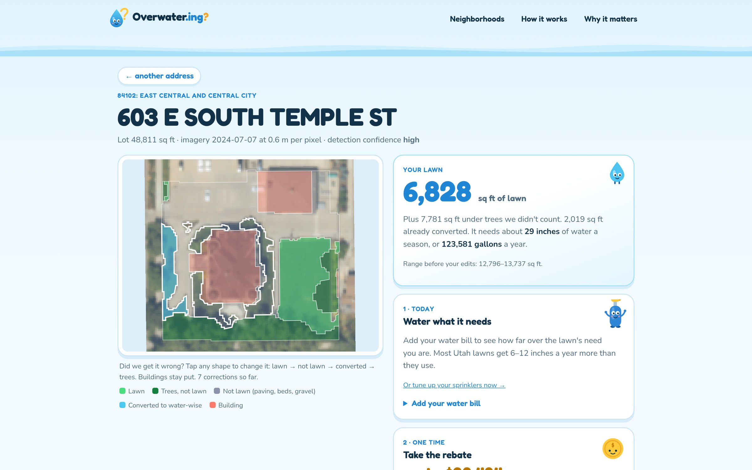
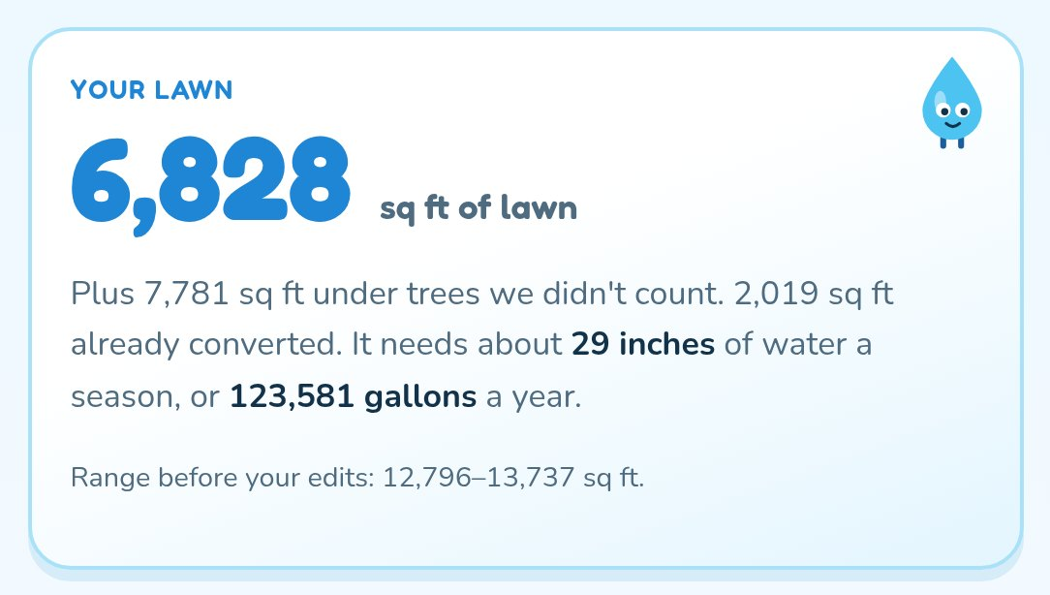
2 · Confirm what's grass
2024 USDA imagery at 0.6 m. Green = lawn, dark green = trees, red = buildings. Tap a shape to fix it. 6,828 sq ft of lawn here.
Notes:
[demo 1:20]
6,828 sq ft of lawn on the Governor's Mansion lot, about 29 inches and 124,000 gallons a year.

Slide 15
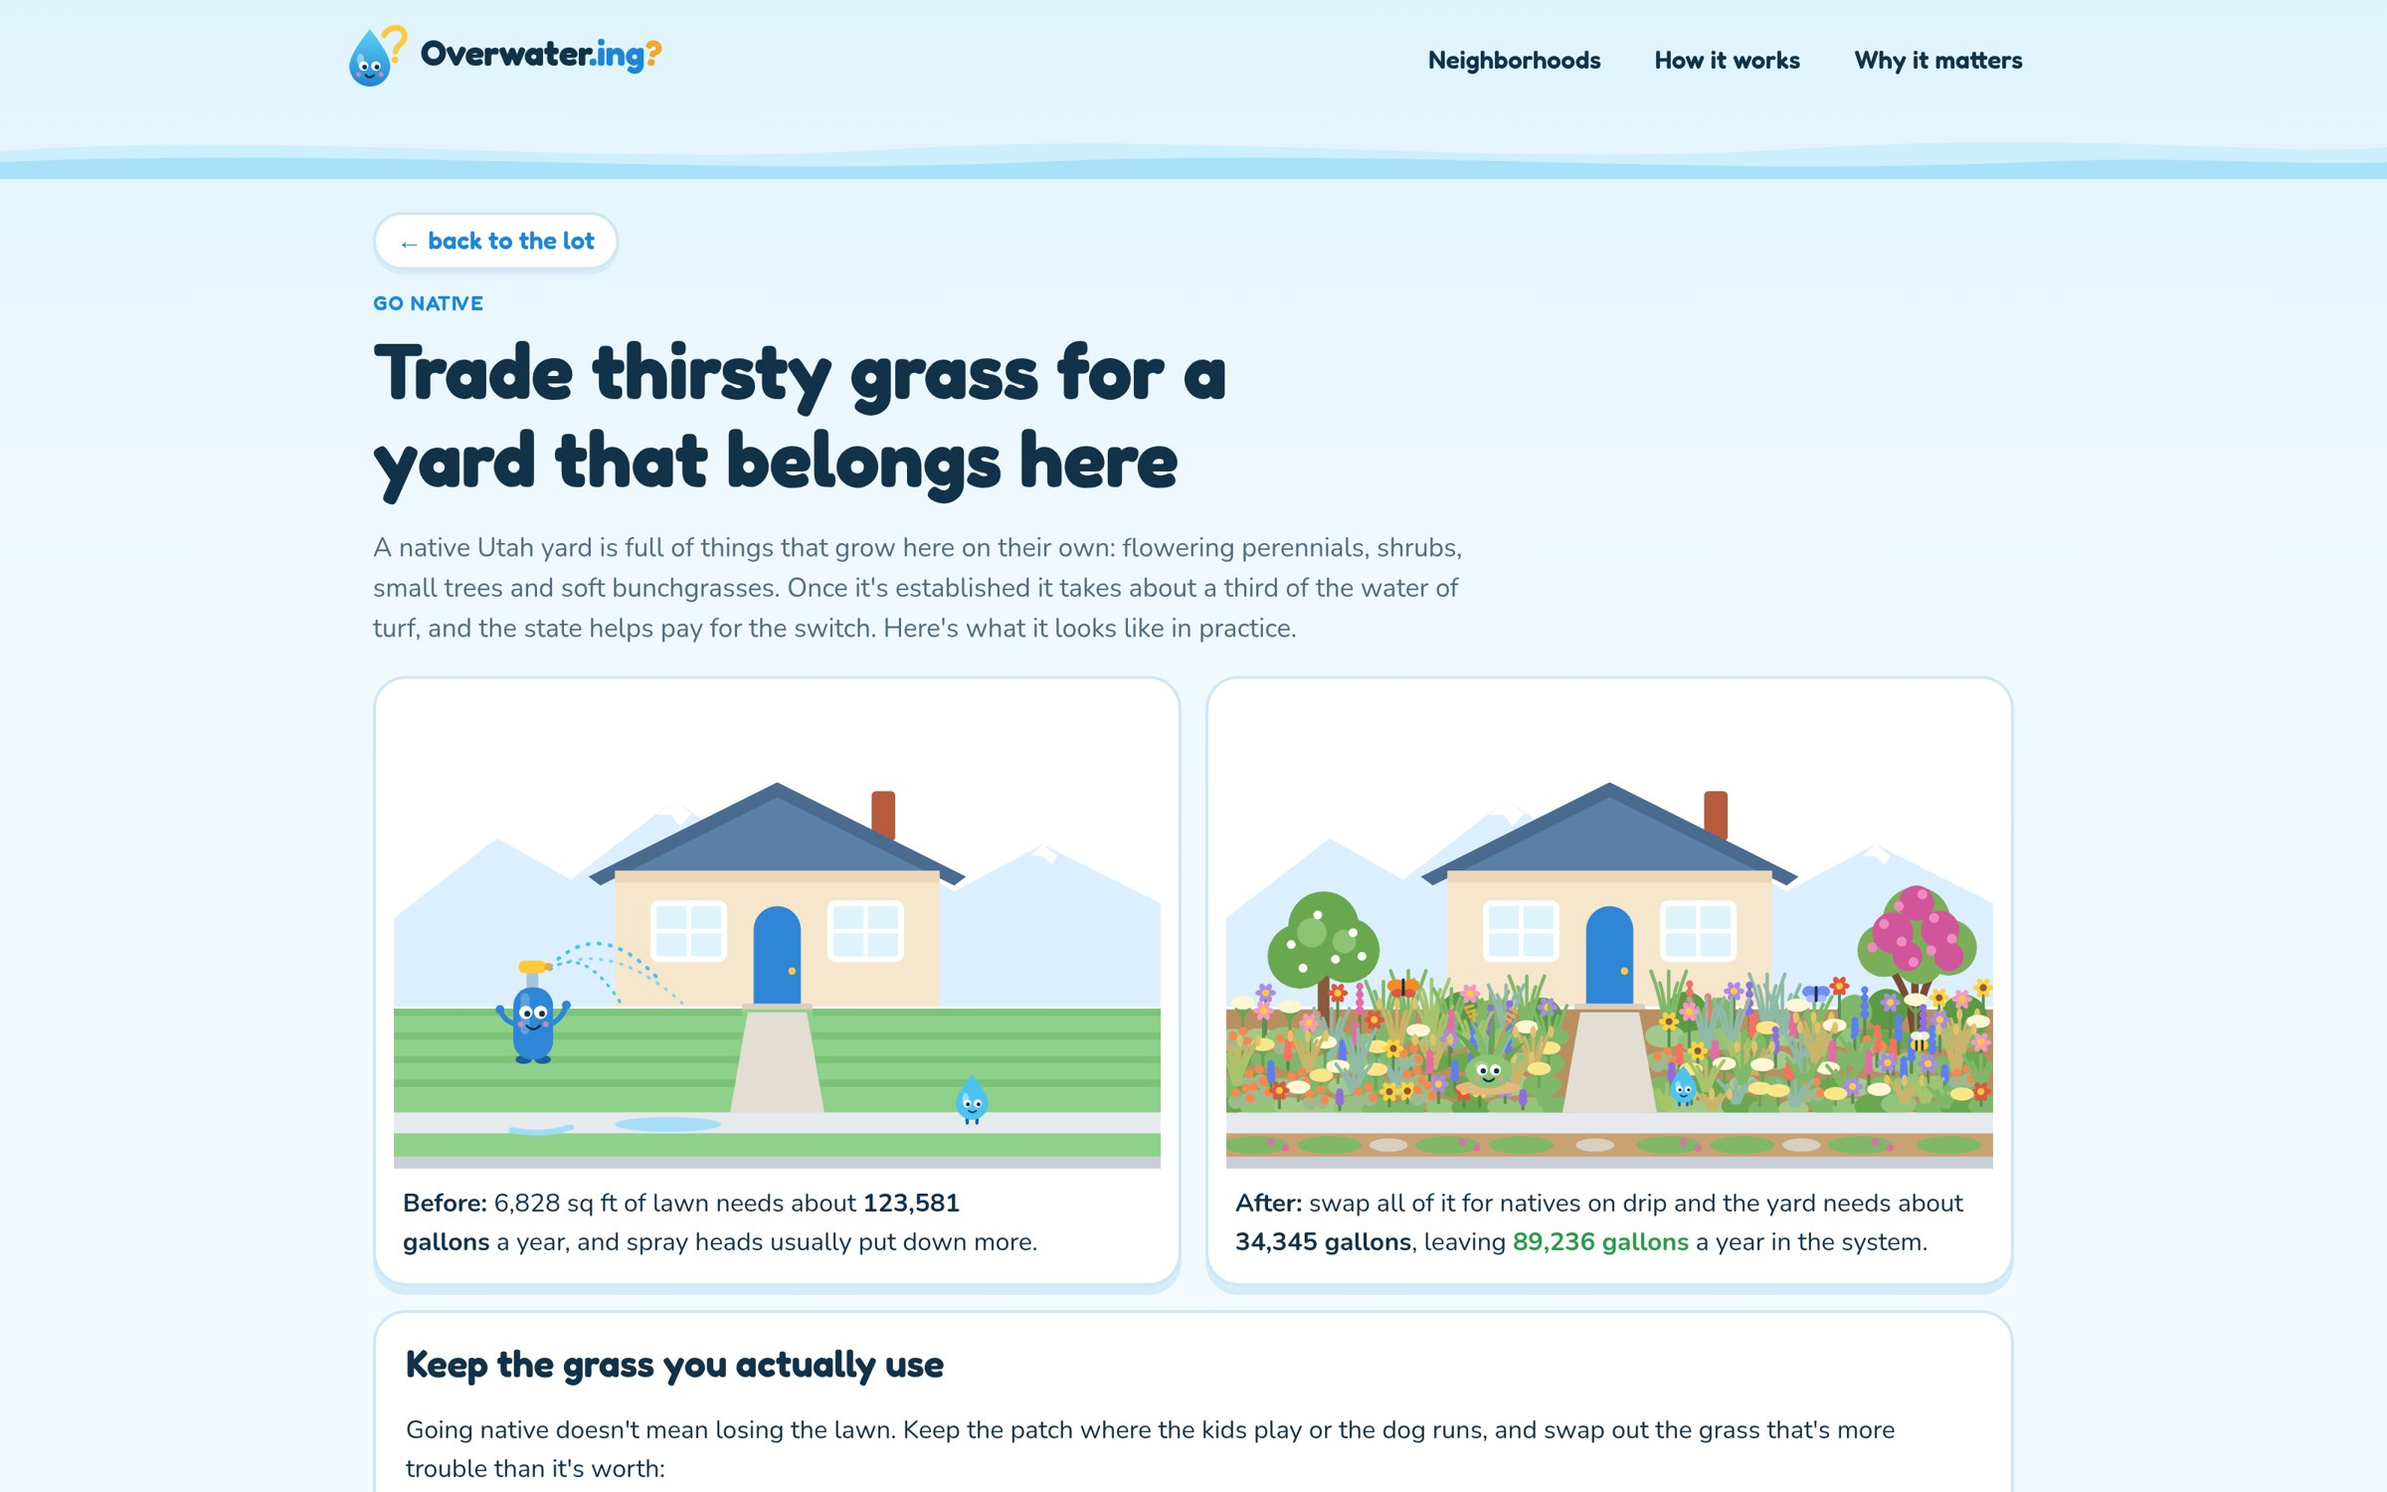
3 · What going native saves
About 89,236 gallons a year for this lot, then the plants and the designers to call.
Notes:
[demo 1:55]
The before and after for this lot.

Slide 16
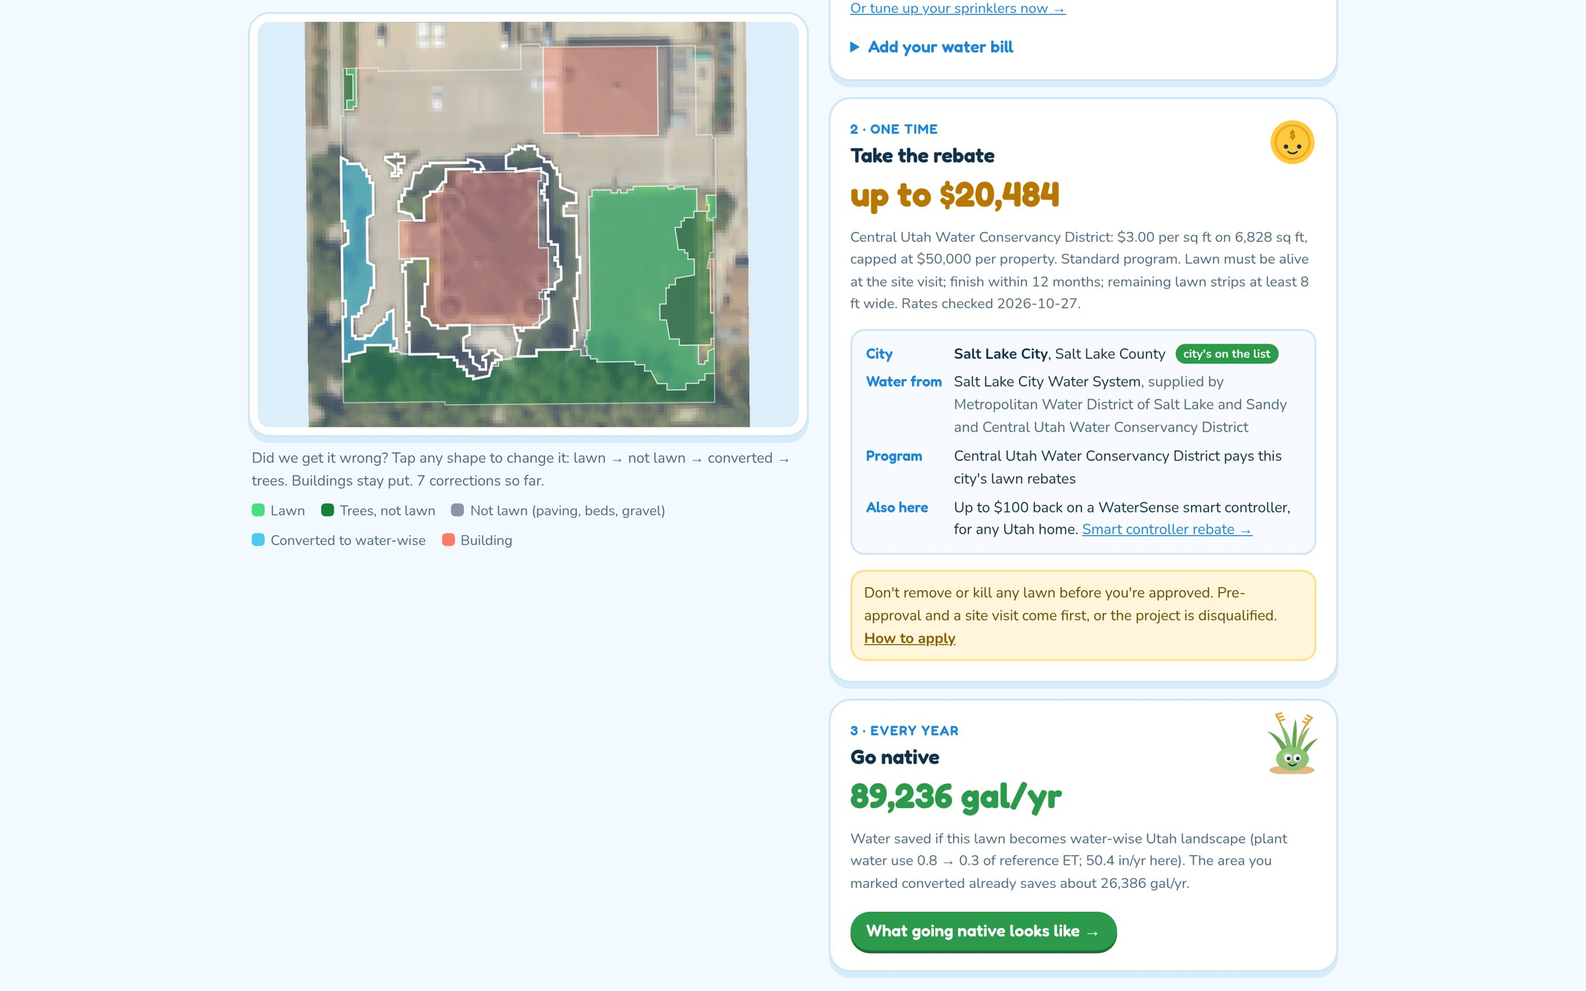
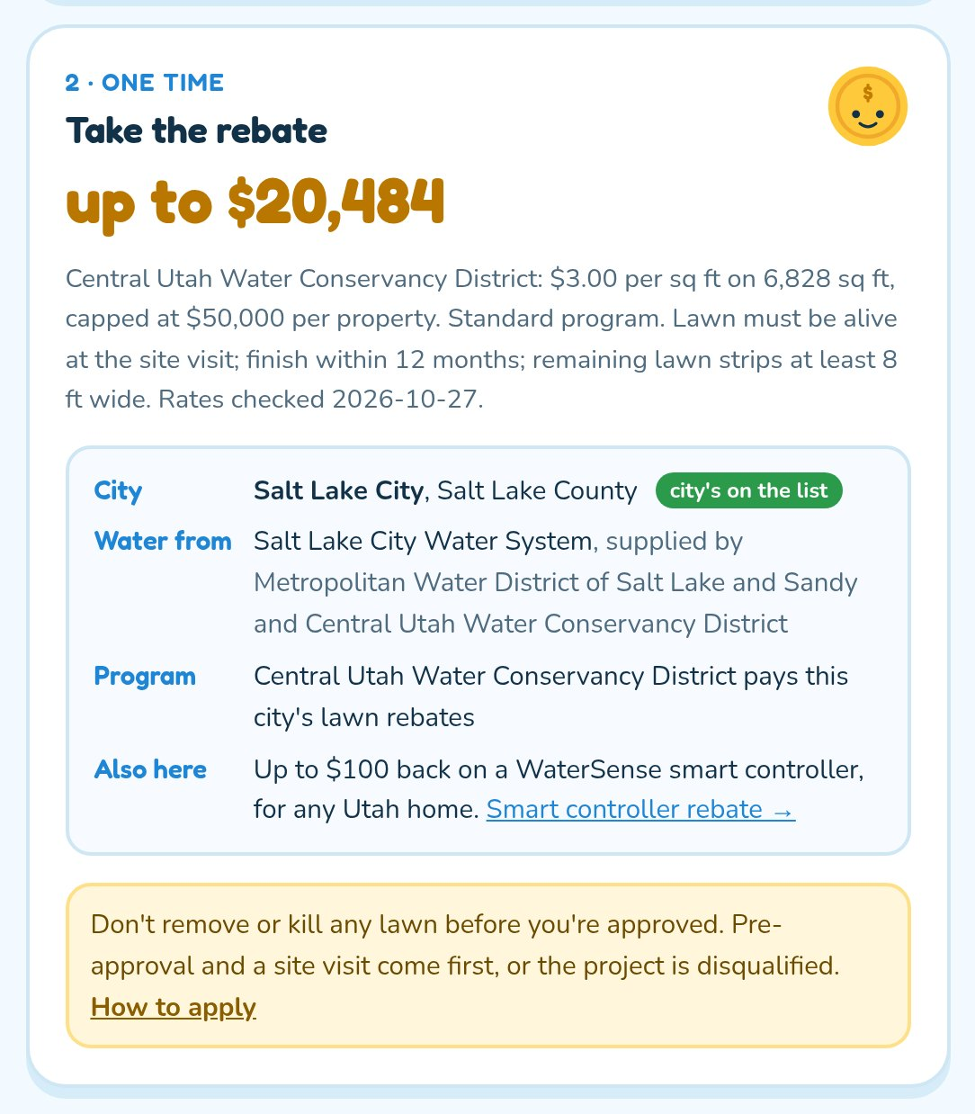
3 · The rebate, and who's in charge here
Up to $20,484 from Central Utah Water Conservancy District. City, water provider and program for this exact lot.
Notes:
[demo 1:40]
The city, the water system and the program for this lot, plus the $100 smart controller rebate.

Slide 17
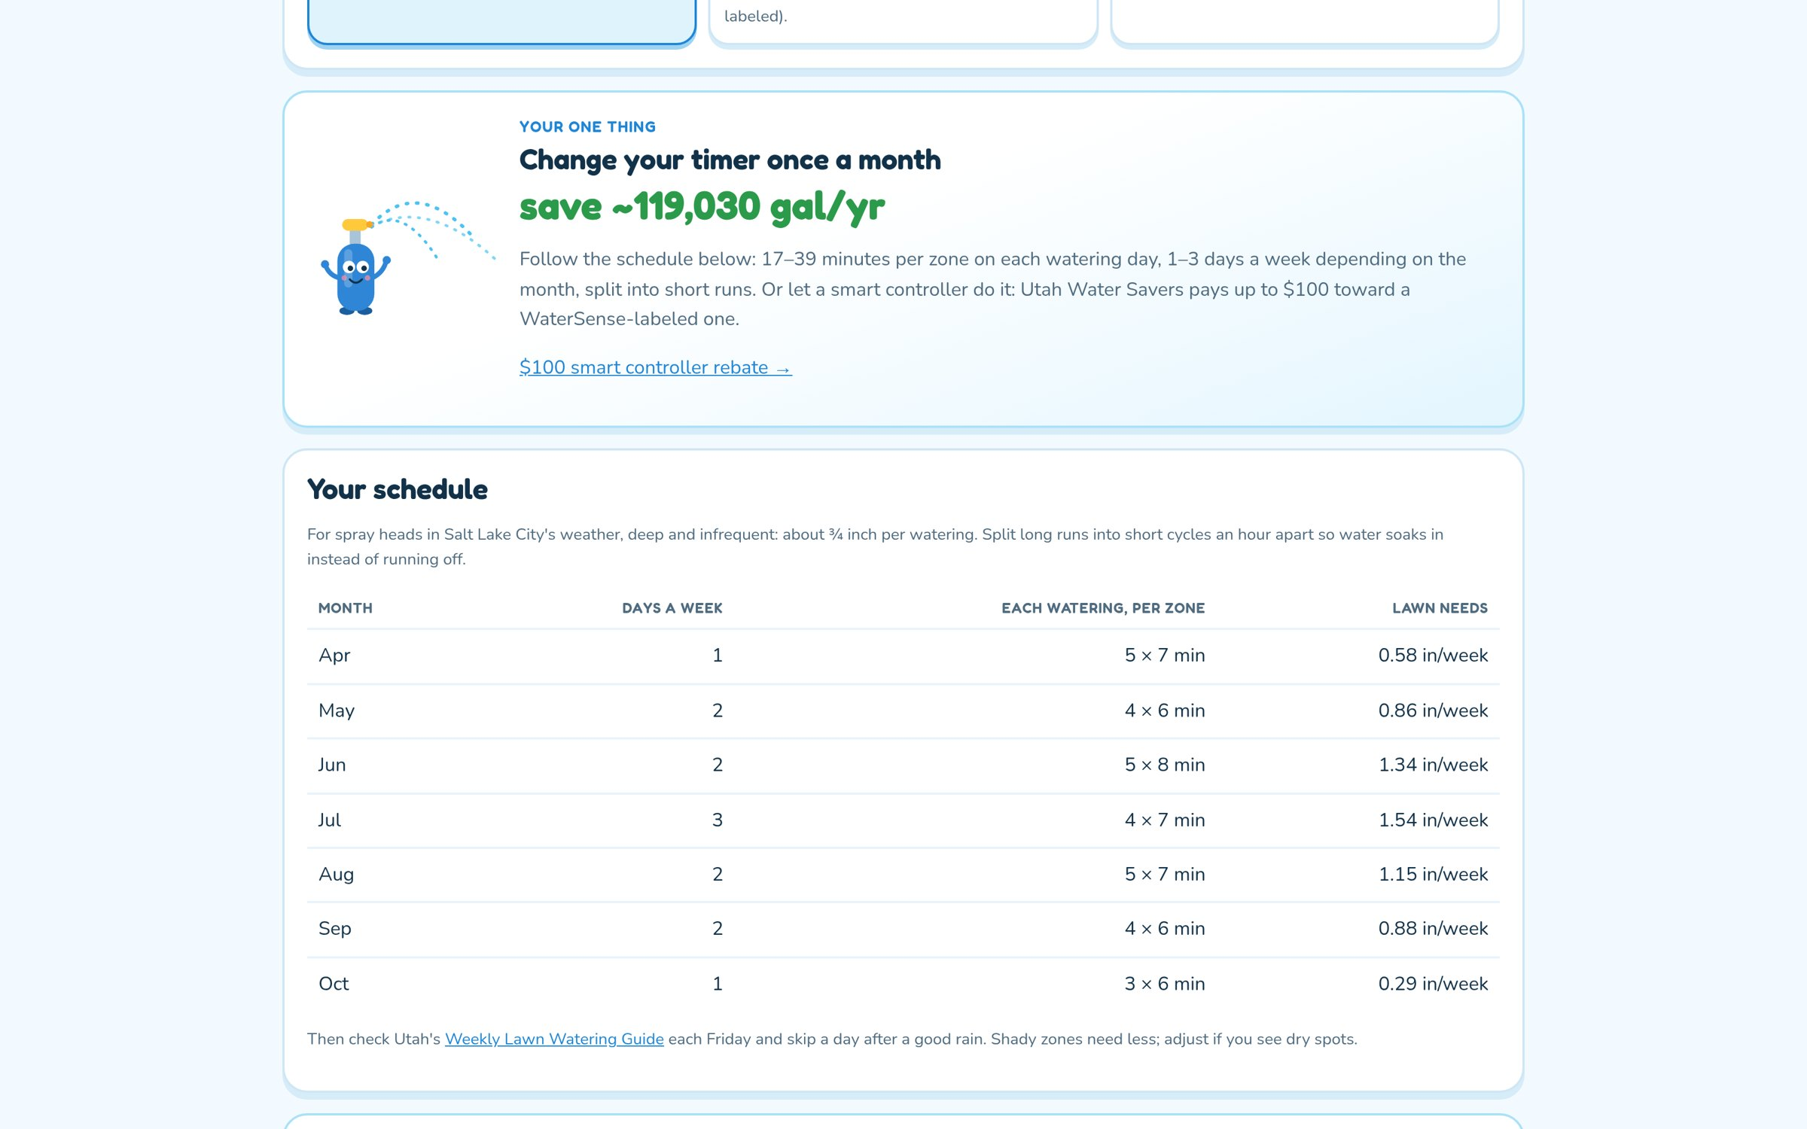
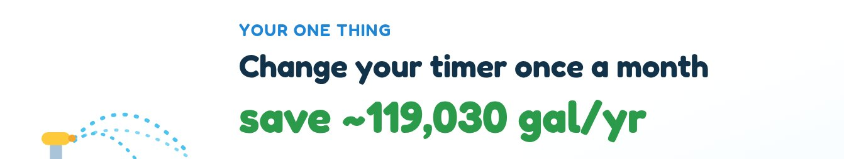
4 · Lower your water use today
Spray heads and a basic timer, in this county's weather: one thing to change.
Notes:
[demo 2:05]
The single change with the most gallons saved, then the month-by-month schedule.

Slide 18
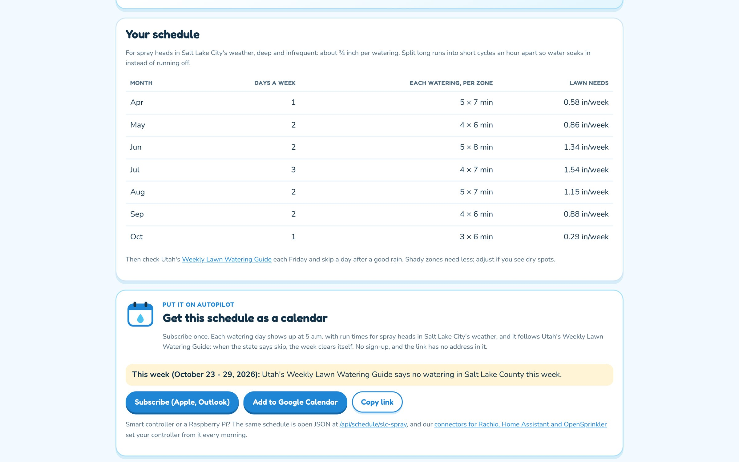
4 · The schedule
Days a week and cycle-and-soak minutes per zone, from local weather.
Notes:
[demo 2:10]
Deep and infrequent, split into short cycles so it soaks in.

Slide 19
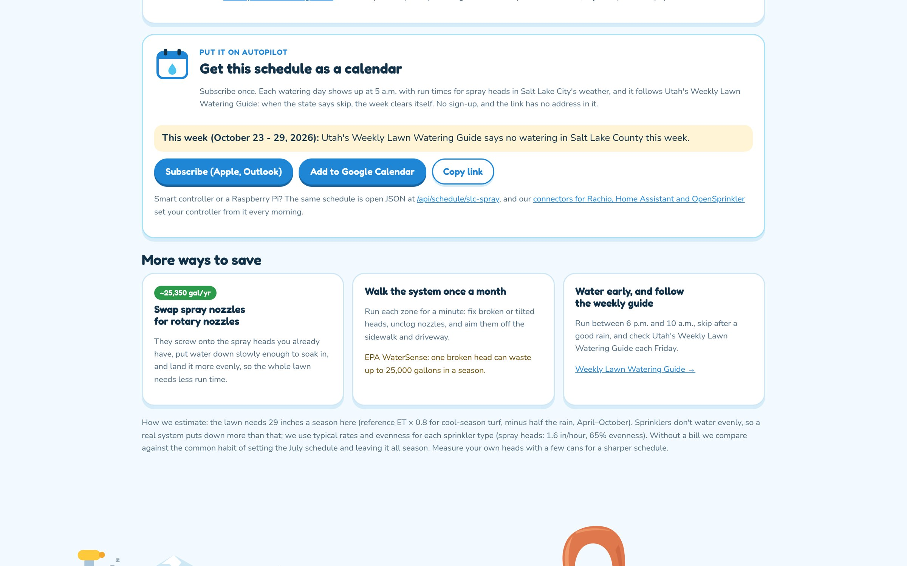
4 · Subscribe to the watering calendar
It follows Utah's Weekly Lawn Watering Guide; skip weeks clear themselves.
Notes:
[demo 2:20]
Subscribe once; each watering day shows up at 5 a.m. with run times.

Slide 20
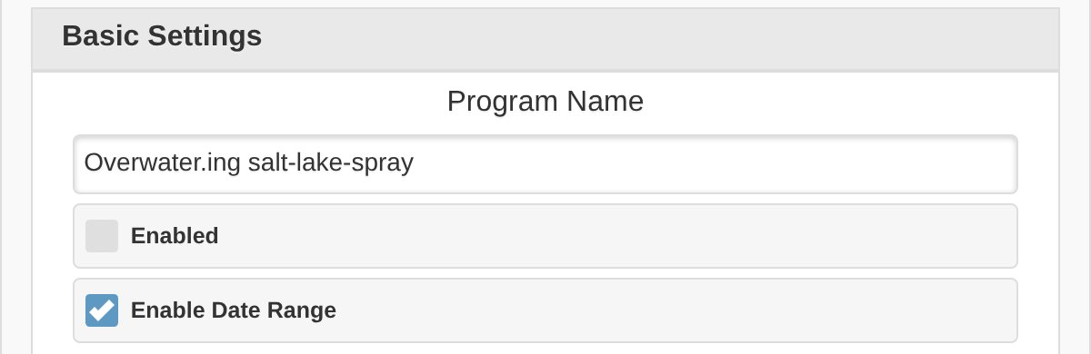
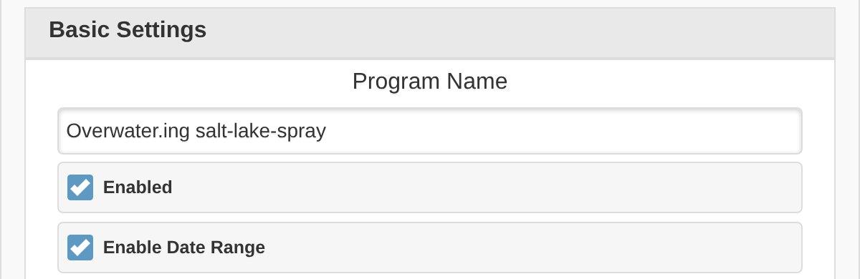
4 · The controller follows the schedule
When the state says skip: off
A July week: on
Utah's Weekly Lawn Watering Guide said no watering in Salt Lake County, so the connector switched the program off. Other programs are untouched.
Mon, Wed, Fri at 5:00 AM. 4 × 7 min per zone, an hour apart, so it soaks in.
OpenSprinkler's own firmware, in demo mode, set by overwater.ing/connect. One program, rewritten each morning.
Notes:
[demo 2:25]
OpenSprinkler firmware in demo mode, set by our connector. When the guide says no watering, the program is switched
off. Preview a July week and it's Monday, Wednesday, Friday at 5 a.m., four 7-minute cycles per zone.

Slide 21
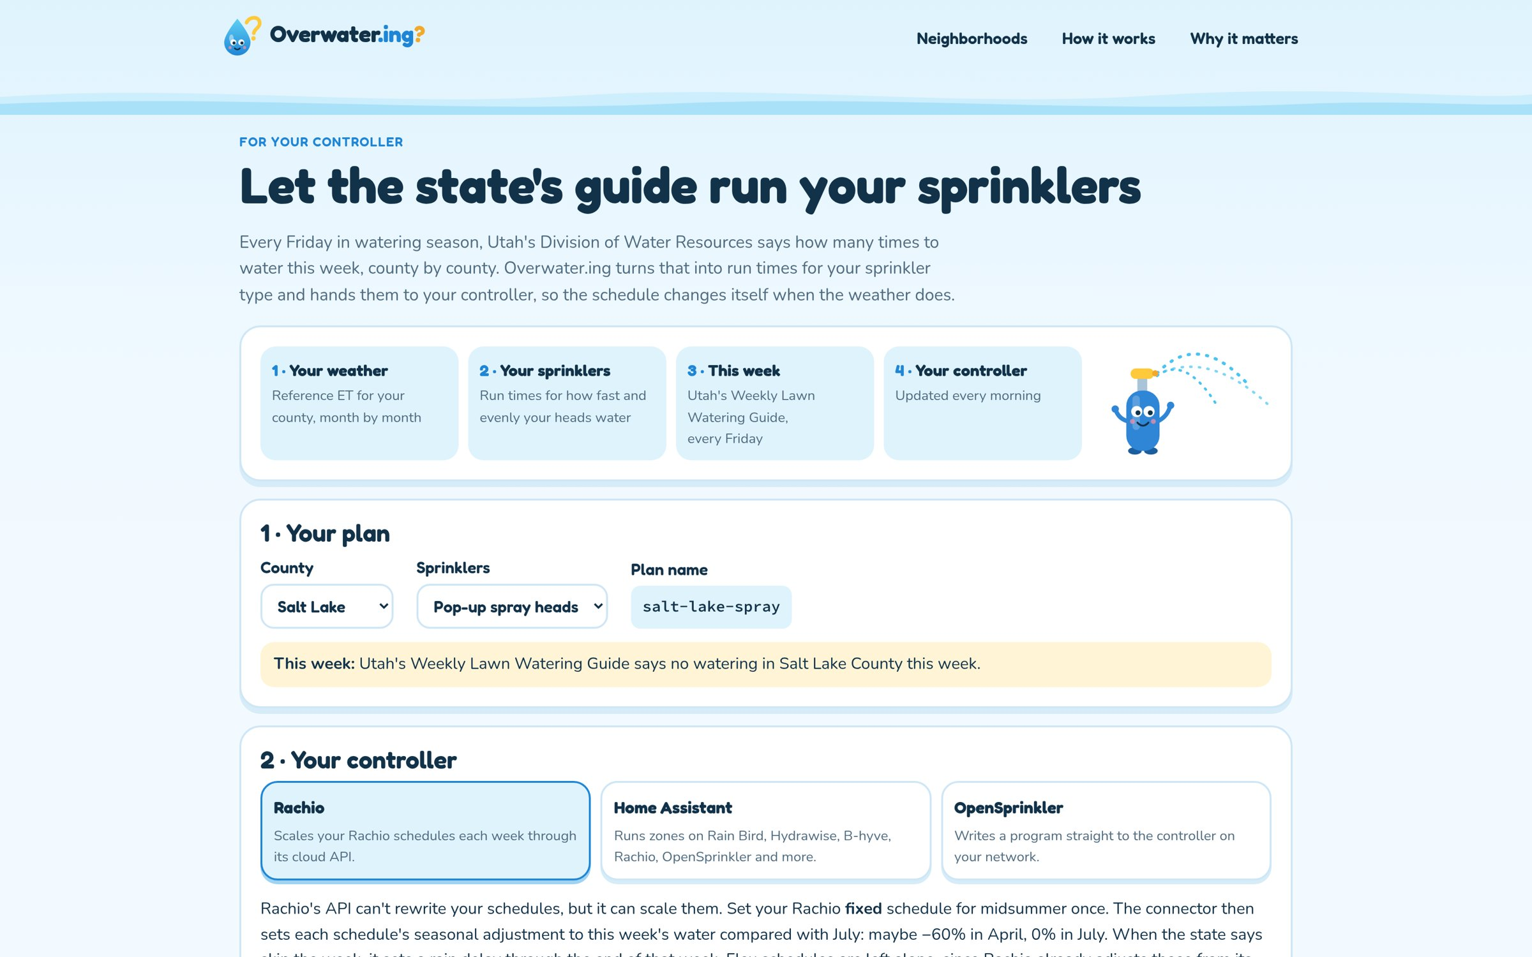
4 · Any controller: /connect
Pick a county and sprinkler type, then OpenSprinkler, Rachio or Home Assistant. The same schedule is open JSON.
Notes:
[demo 2:30]
Rachio and Home Assistant cover most smart controllers sold in Utah; OpenSprinkler is the open-hardware path.

Slide 22
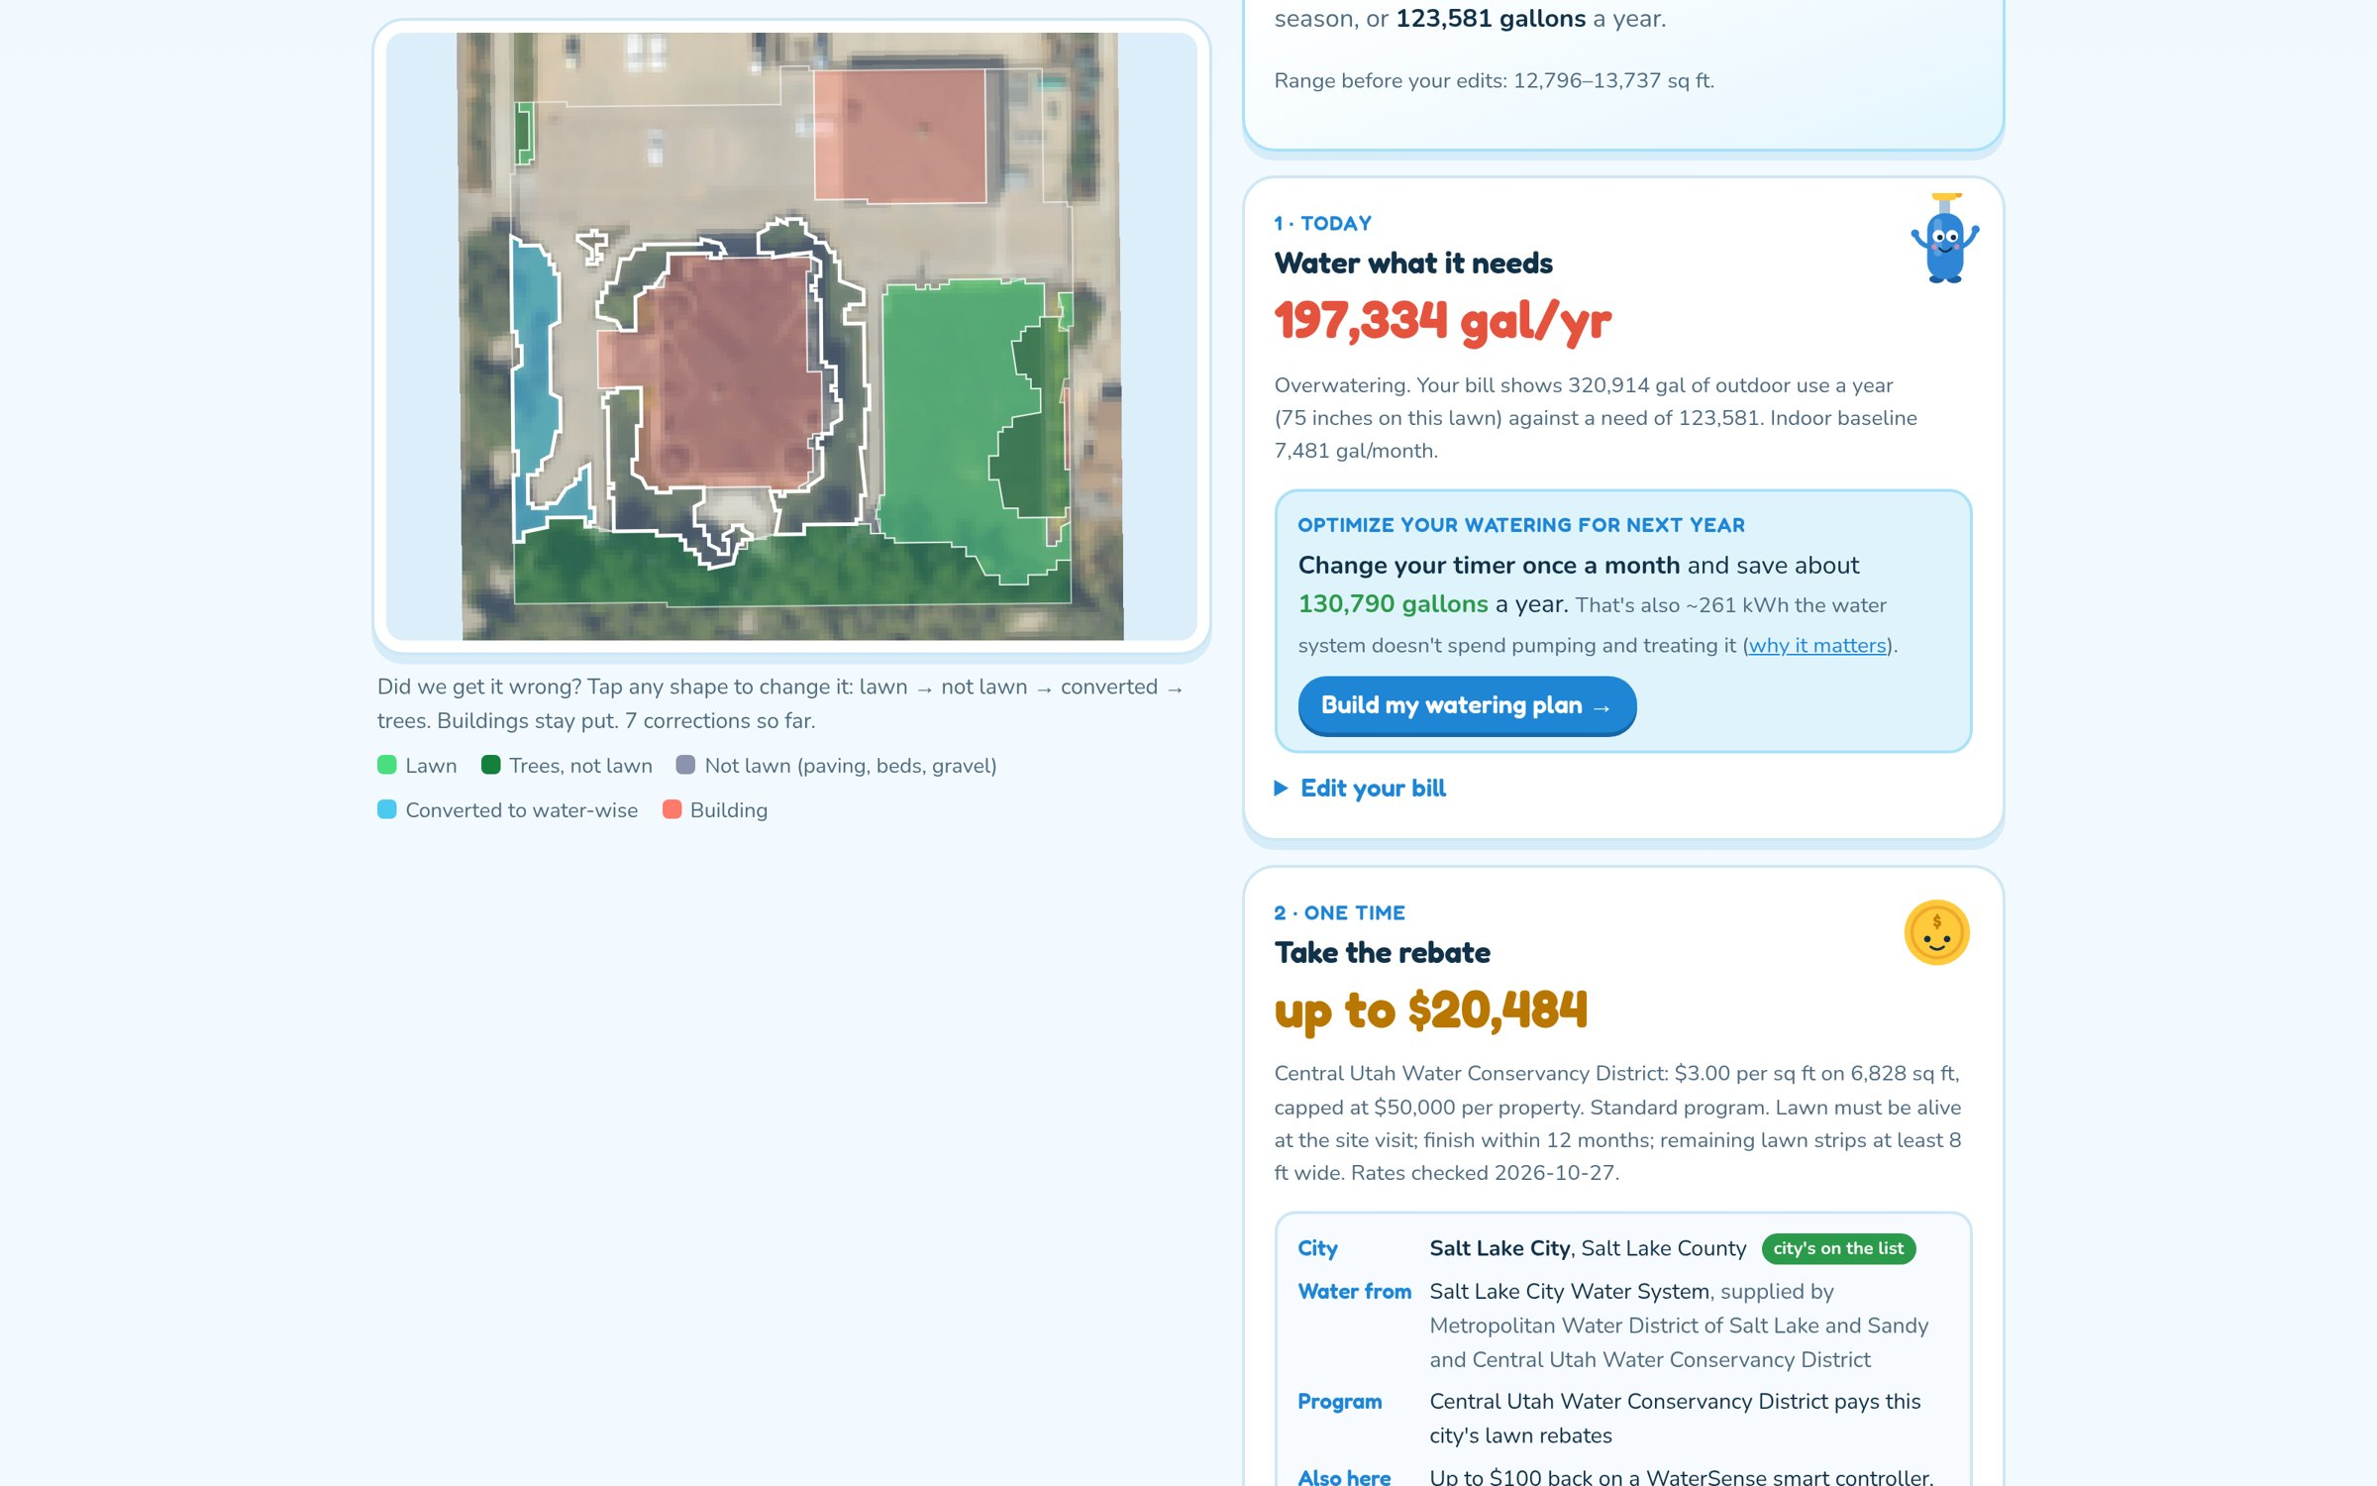
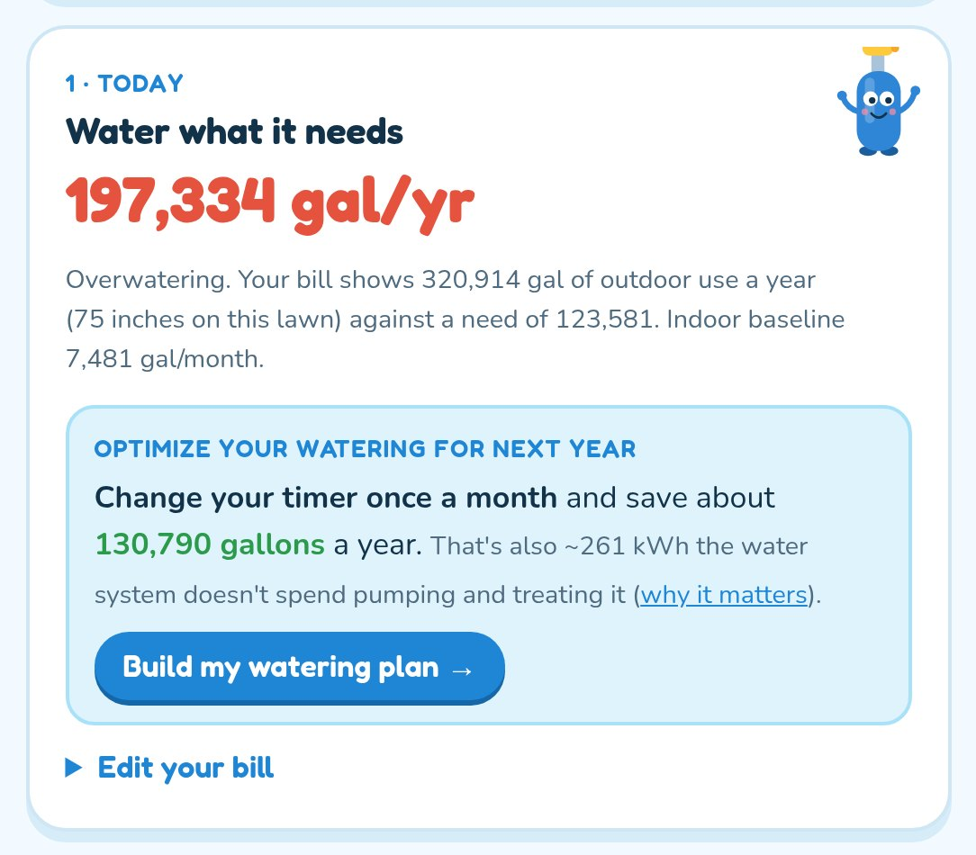
Optional · Claude reads the bill: 197,334 gallons over
320,914 gallons a year outdoors against the 123,581 this lawn needs, read from a photo of the bill.
Notes:
[optional]
Upload the sample bill. Claude reads twelve months; the page shows the overwatering gap.

Slide 23
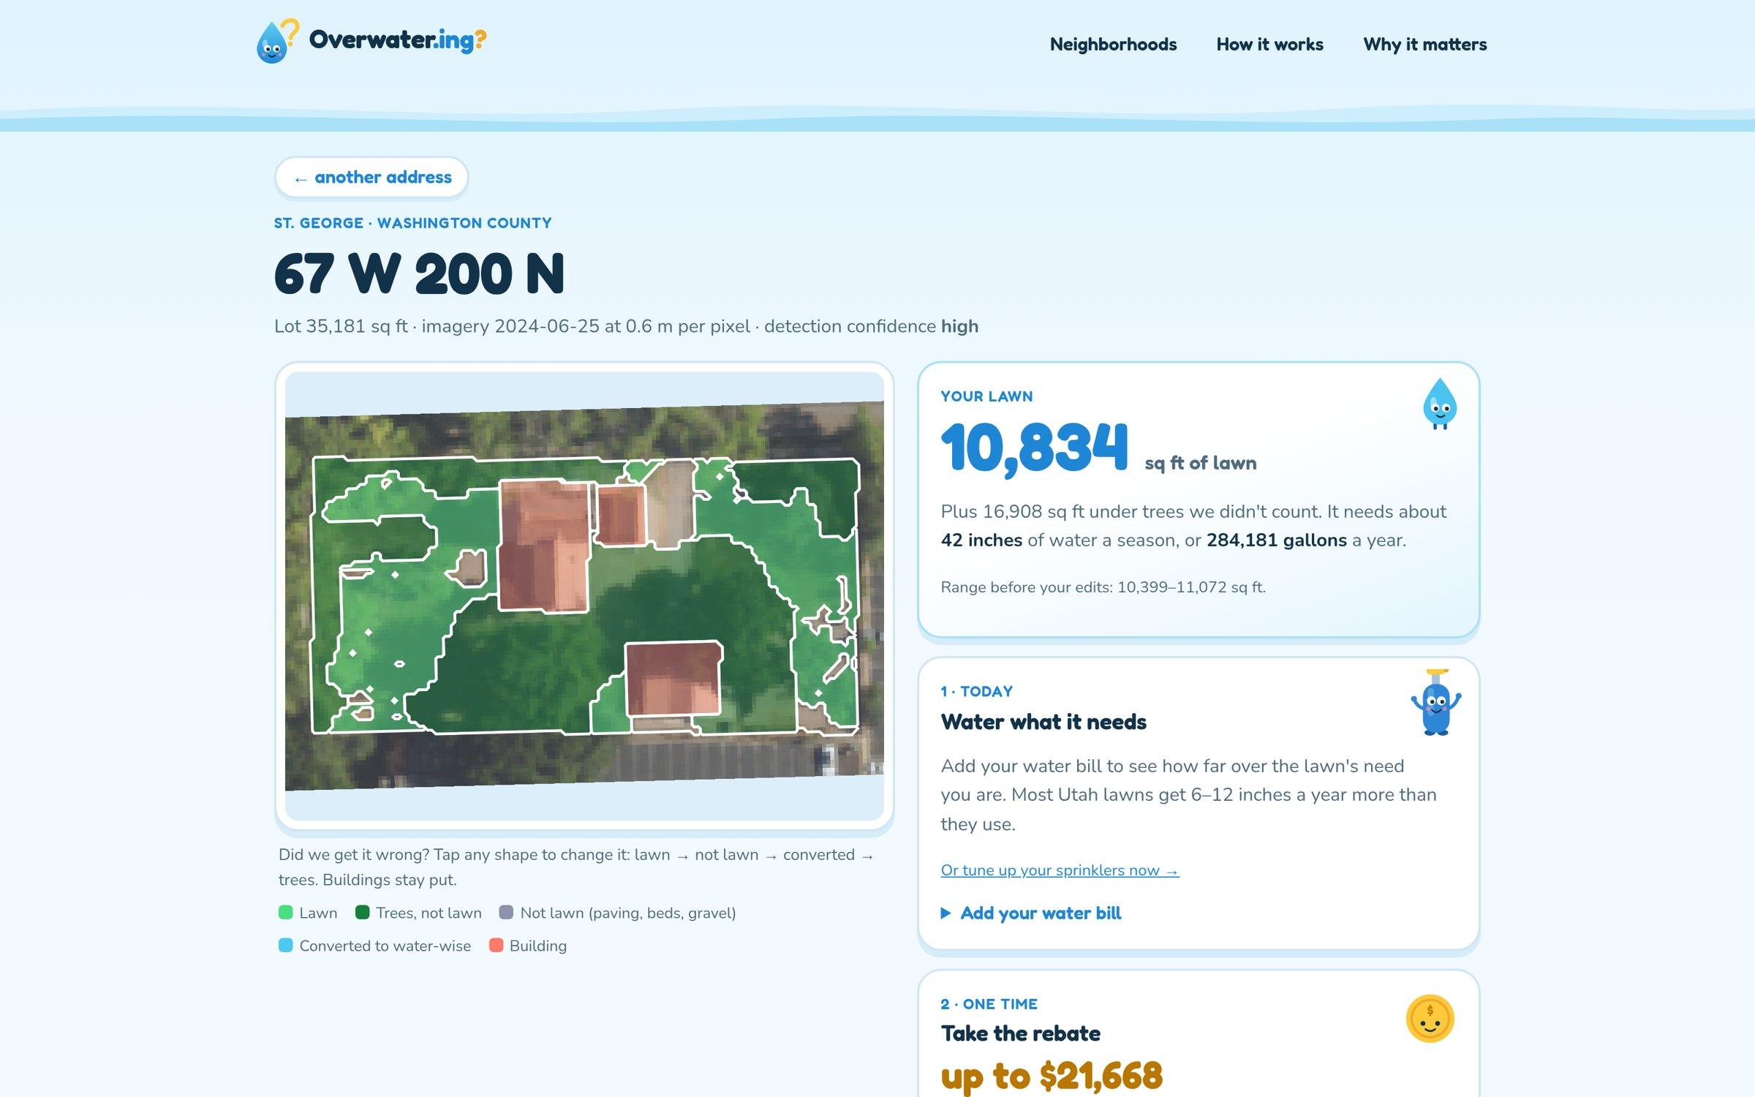
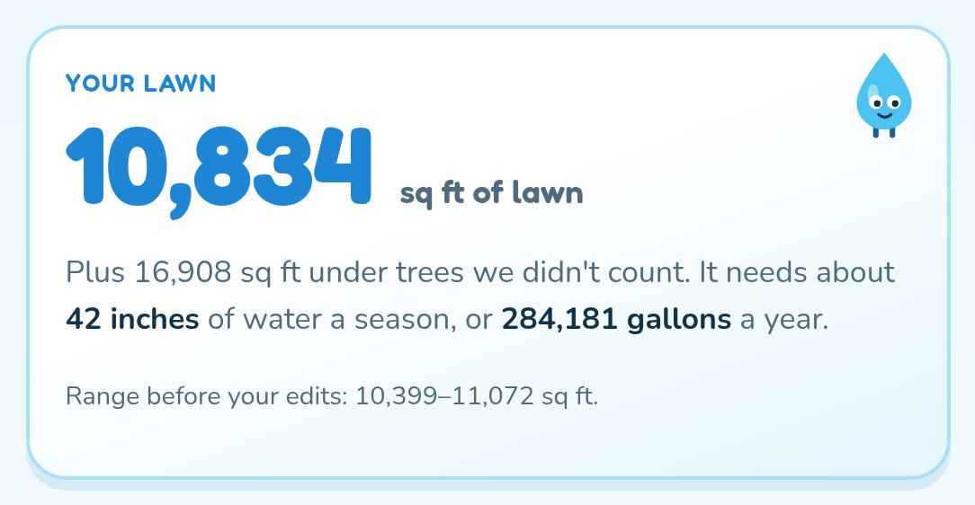
Optional · Any address, measured live
67 W 200 N, St. George: 10,834 sq ft of lawn needing 42 inches a season. Measured in the browser, nothing precomputed.
Notes:
[demo 2:50]
Any Utah address is measured live in the browser in seconds.

Slide 24
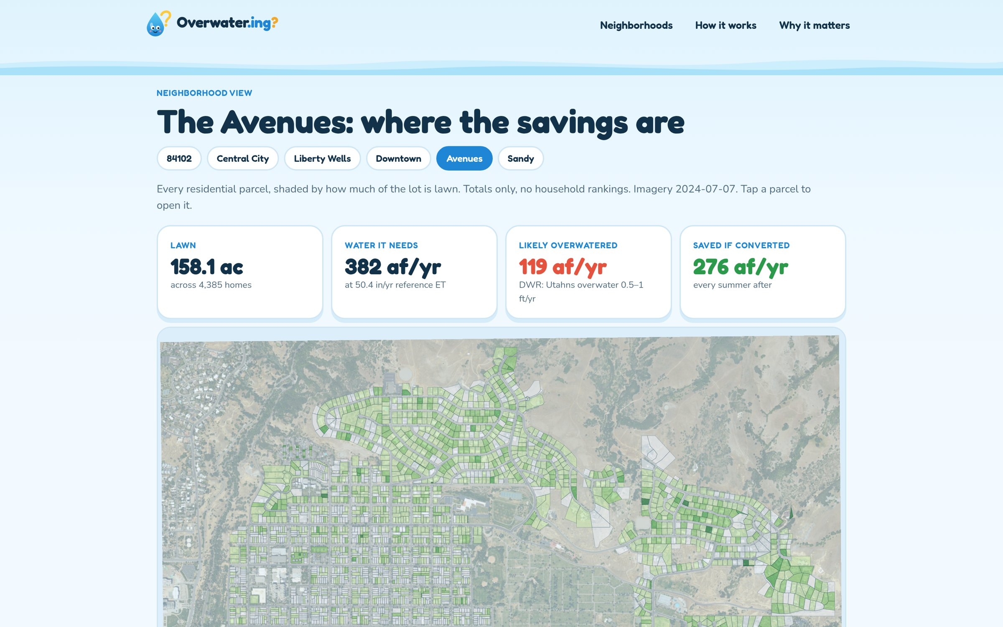
Neighborhood view for districts
Totals only, never household rankings.
Notes:
[backup]
What a district sees: lawn, need, likely overwatering and savings for a whole neighborhood.

Slide 25
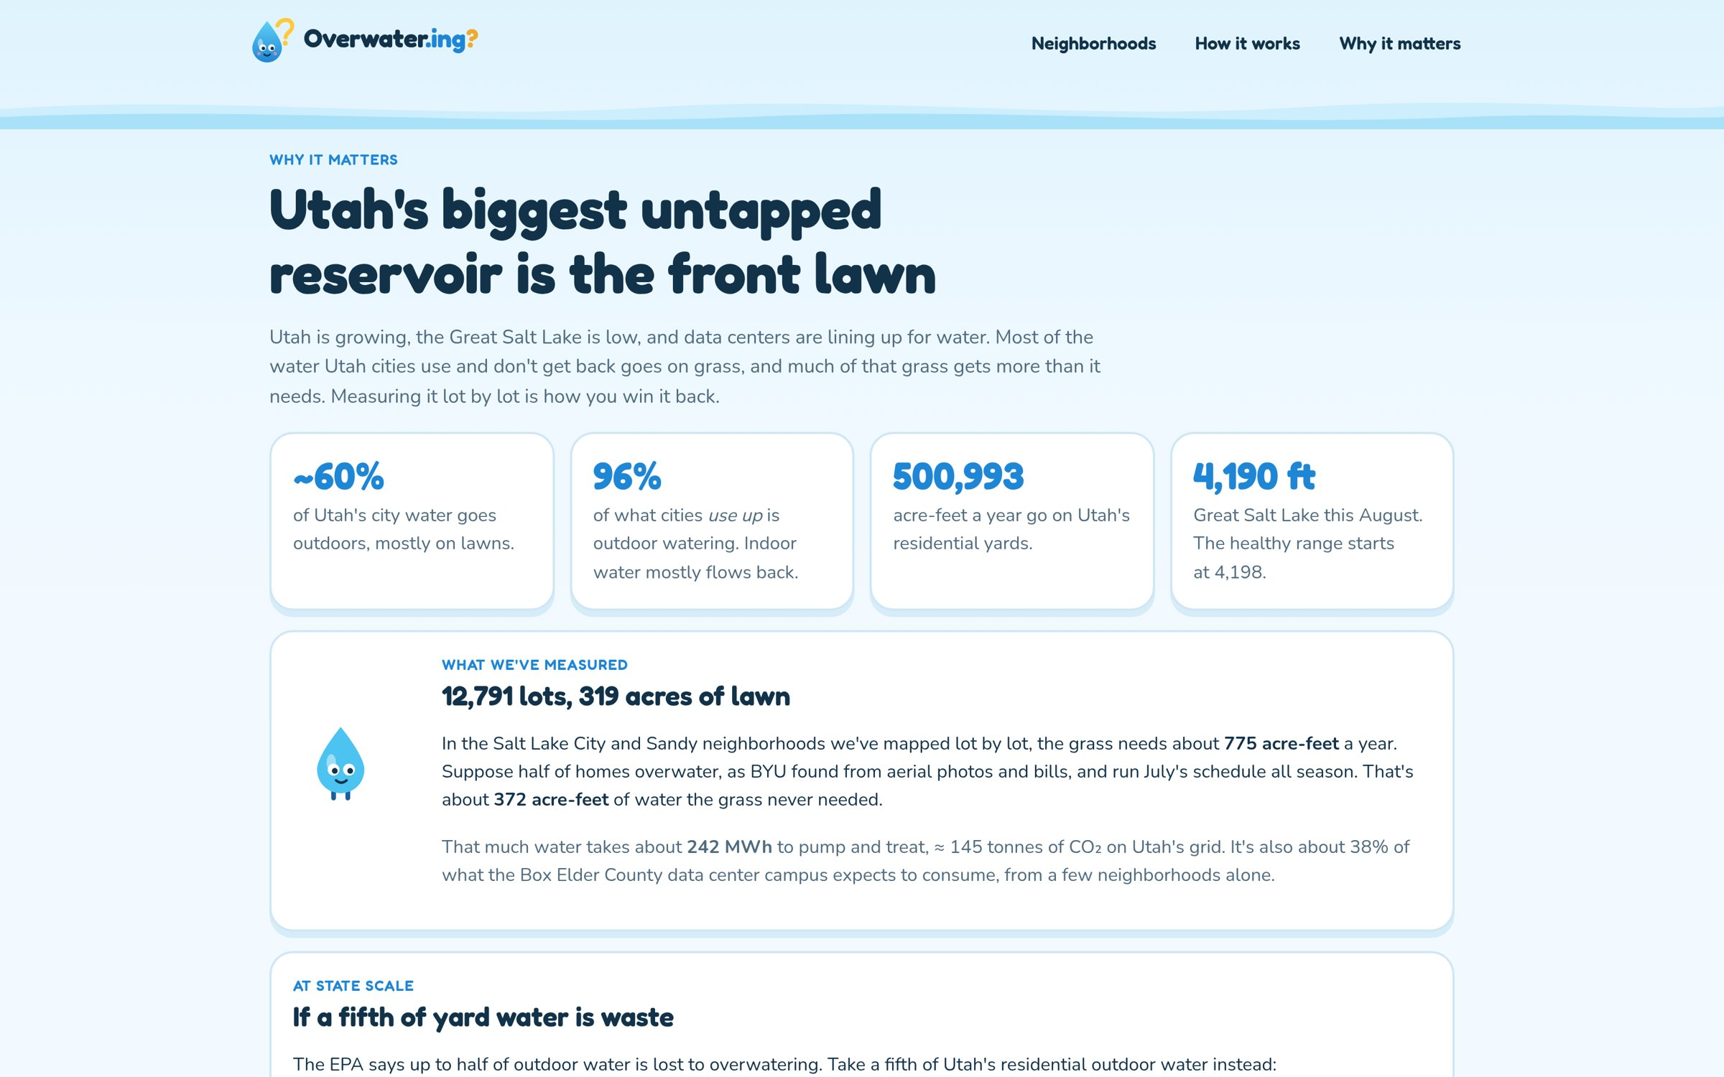
Utah-scale numbers: overwater.ing/impact
Our measured neighborhoods and the state-scale scenario.
Notes:
[backup]
Utah-scale numbers, live on the site.

Slide 26
Sources
• All Utah water by category (2015): USGS Circular 1441, Estimated Use of Water in the United States in 2015, Table 2B
• Cities' water: Utah DWR Water Resources Plan (Dec 2021) via USU Extension, extension.usu.edu/climate/research/water-wise-policies-and-programs-utah: 4.75M AF diverted, M&I 25%, >70% residential, 60% outdoors, 500,993 AF/yr
• Great Salt Lake area ~610,000 acres near 4,191 ft: Utah Geological Survey. Level 4,190.4 ft (Aug 2026), healthy from 4,198 ft: Utah News Dispatch; wre-rapps.utah.gov/GSLApp
• 471,000–1,055,000 AF/yr more inflow: Great Salt Lake Strategic Plan, greatsaltlake.utah.gov
• Data centers may not add GSL depletion: Utah Executive Order 2026-03 (May 29, 2026)
• About half of Utahns overwater: Sowby, BYU 2022 (aerial imagery + bills)
• ~3M sq ft converted in 2024, >$7M paid: Utah DWR. 7.3M sq ft, 4,700 participants, $16.8M (Oct 2022–Dec 2025): "Utah's Big Water Win" fact sheet, Slow the Flow
• Water-wise partners: slowtheflow.org/partners
• Our numbers: 12,791 lots, 319 acres of lawn; Greenspace r = 0.77, median ratio 0.97 (84102, 3,104 lots): RESULTS.md Runs 6–7
Notes:
[reference]
Sources for every number in the deck. Saved water can increase potential flows to the lake; it may be reused upstream.

