Slide 1
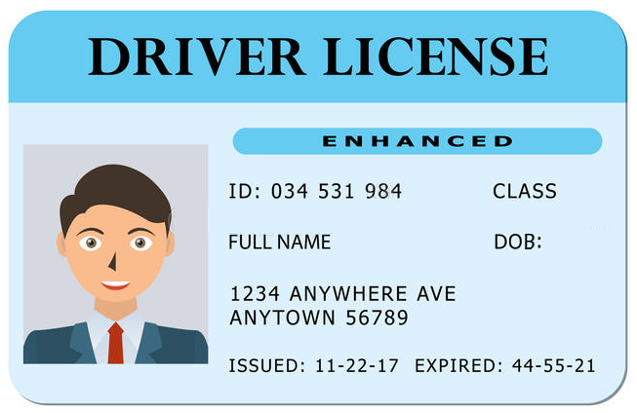
License is valid.
License is Class G.
Ensure age is over 21.
Ensure the driver is over 25 if the “25 and Under” fee was not applied.
License is not expired.
Name Matches Online Purchaser

