Slide 1
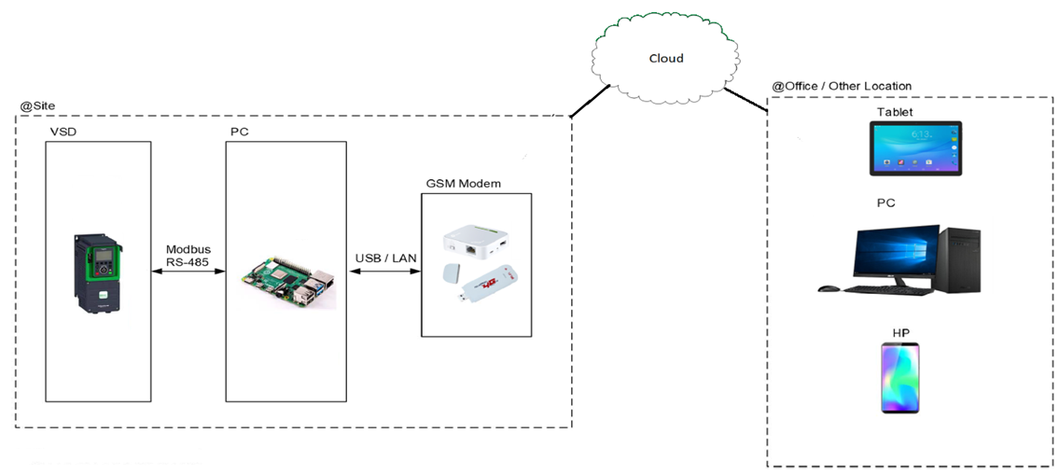
ARSITEKTUR

Slide 2
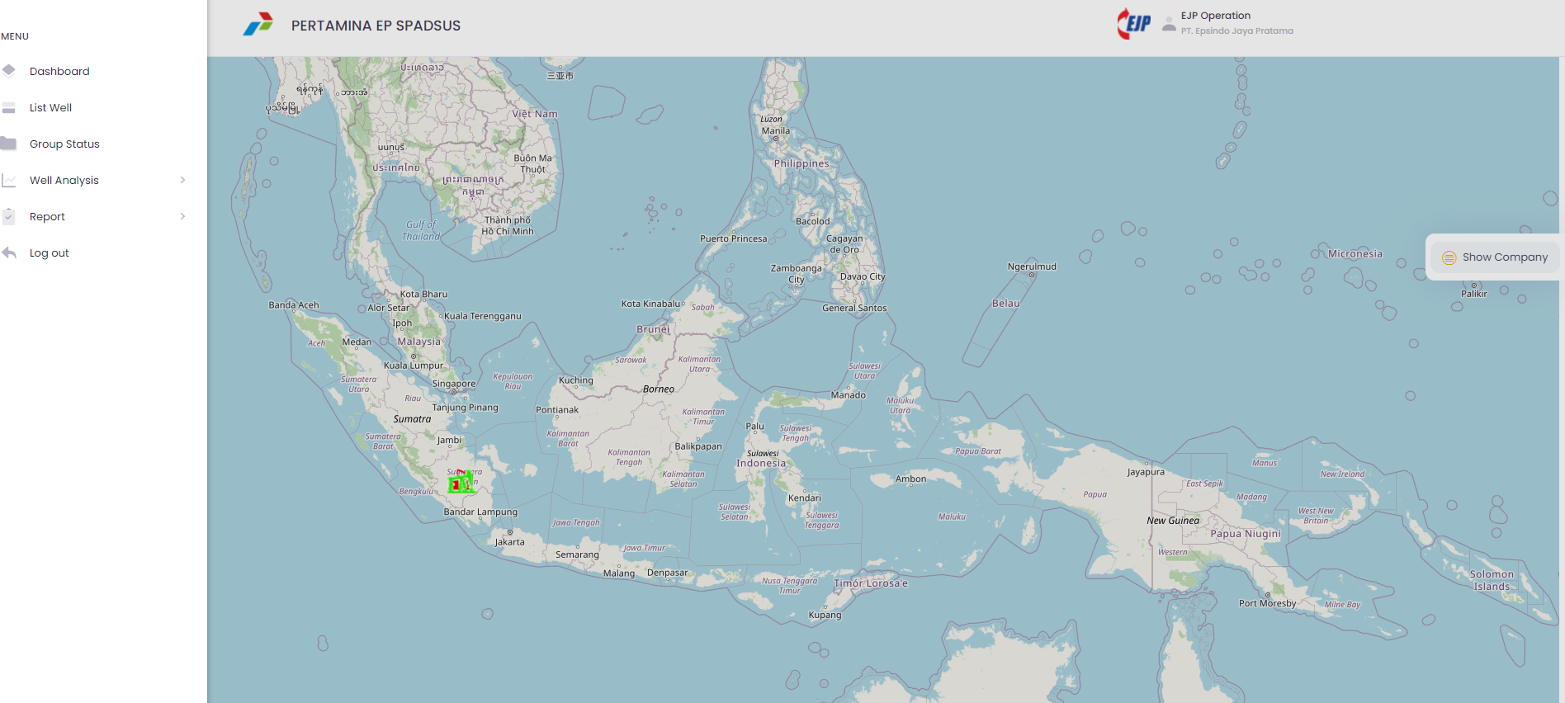
DISPLAY MONITORING

Slide 3
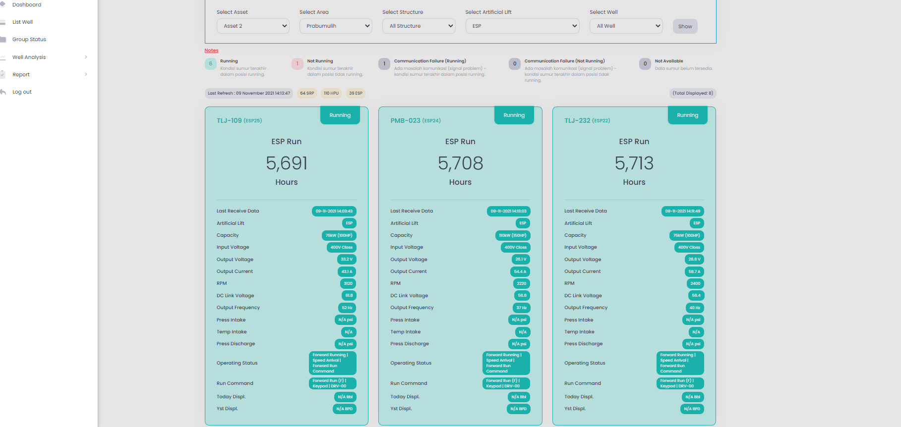
DISPLAY MONITORING

Slide 4
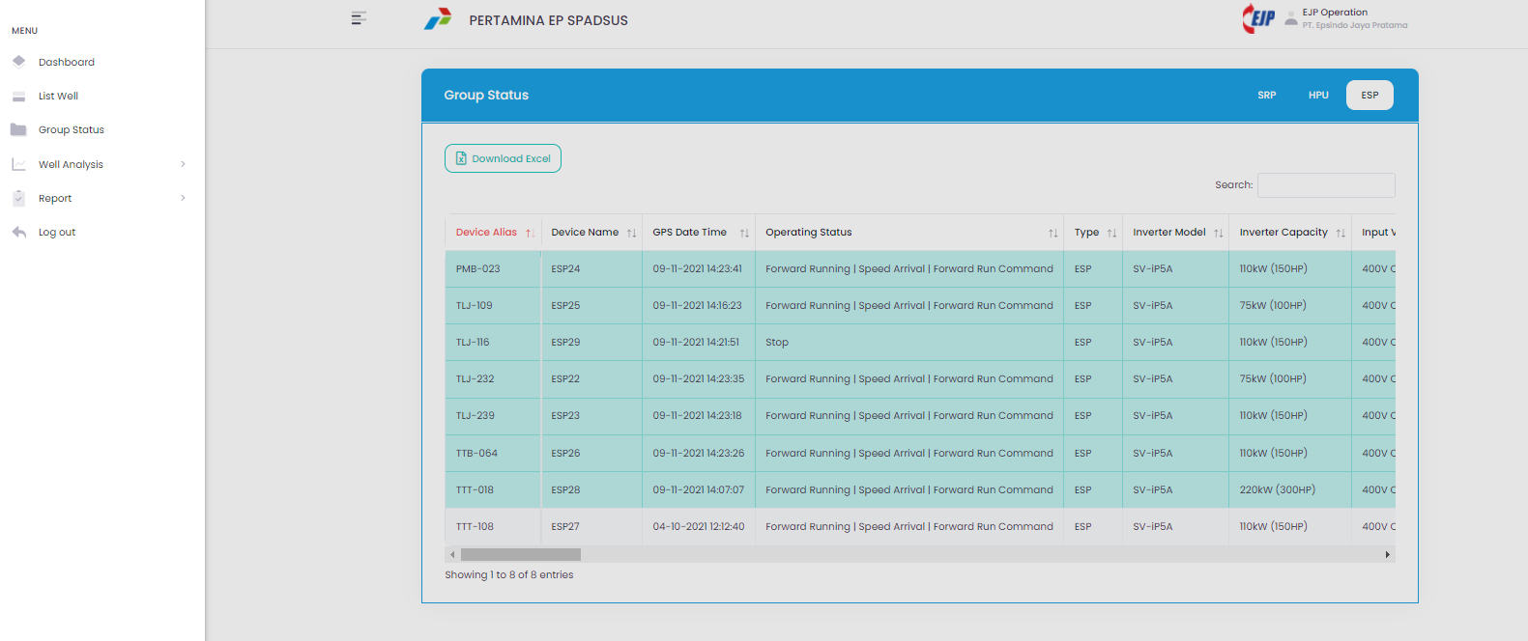
DISPLAY MONITORING

Slide 5
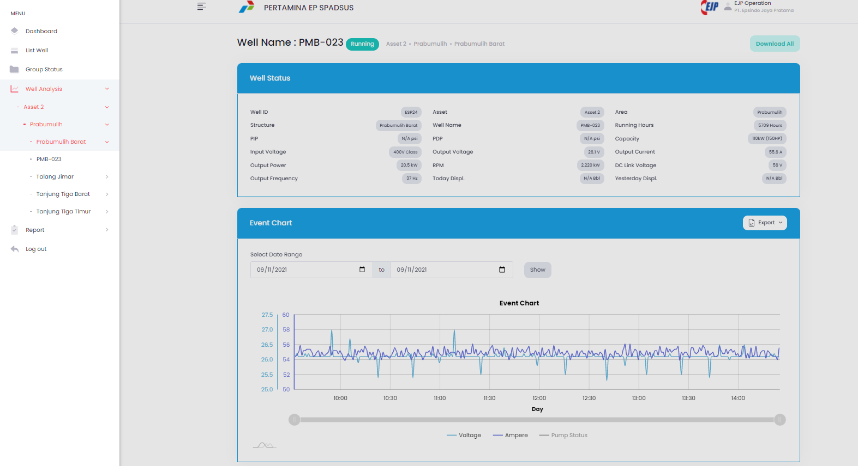
DISPLAY MONITORING

Slide 6
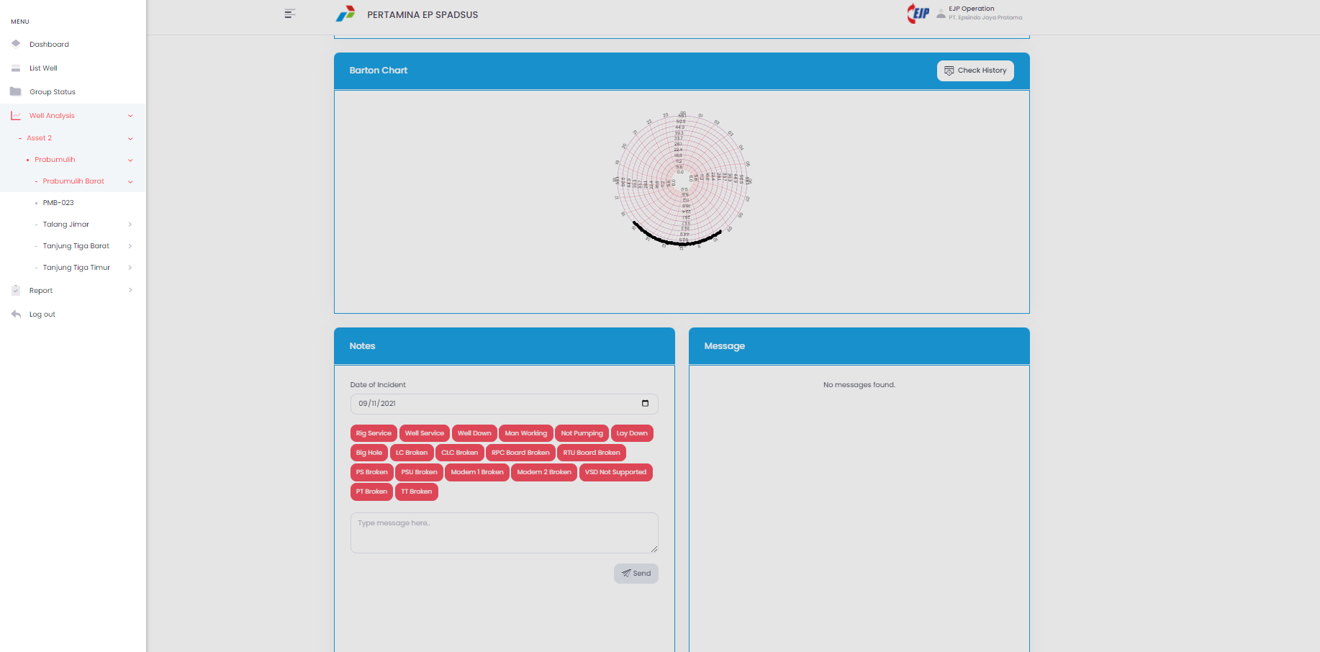
DISPLAY MONITORING

Slide 7
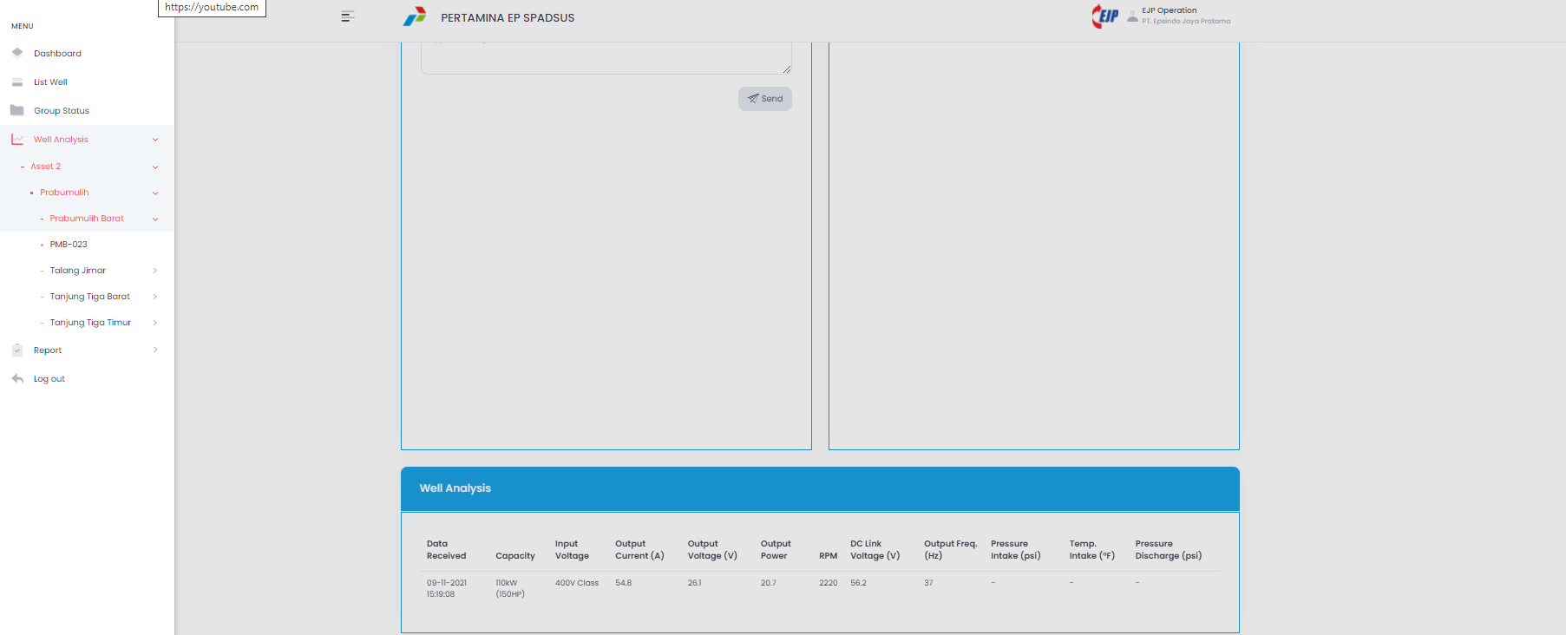
DISPLAY MONITORING

Slide 8
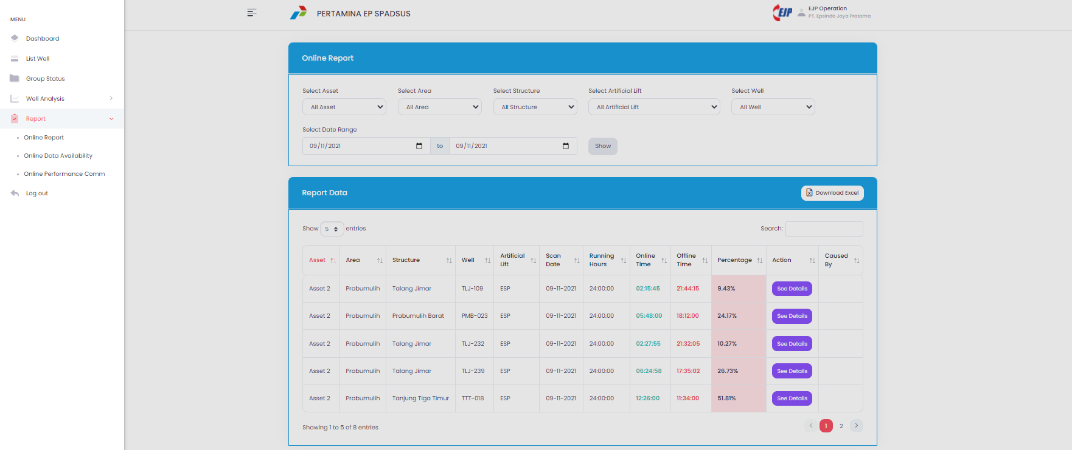
DISPLAY MONITORING

Slide 9
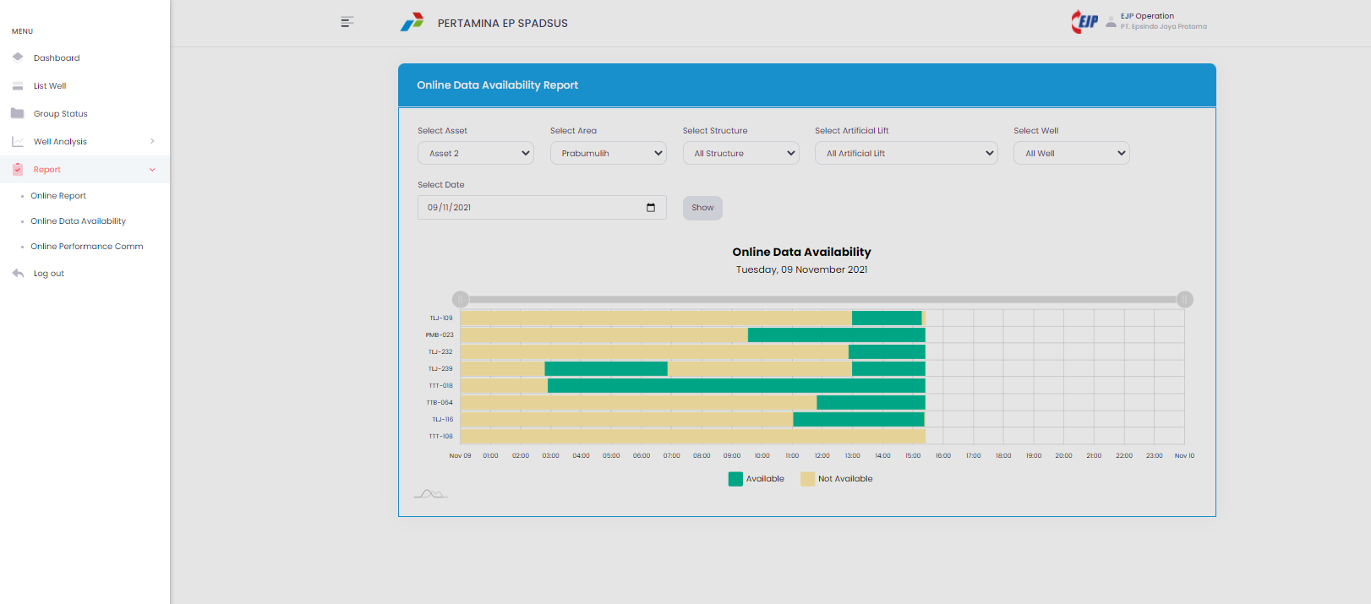
DISPLAY MONITORING

Slide 10
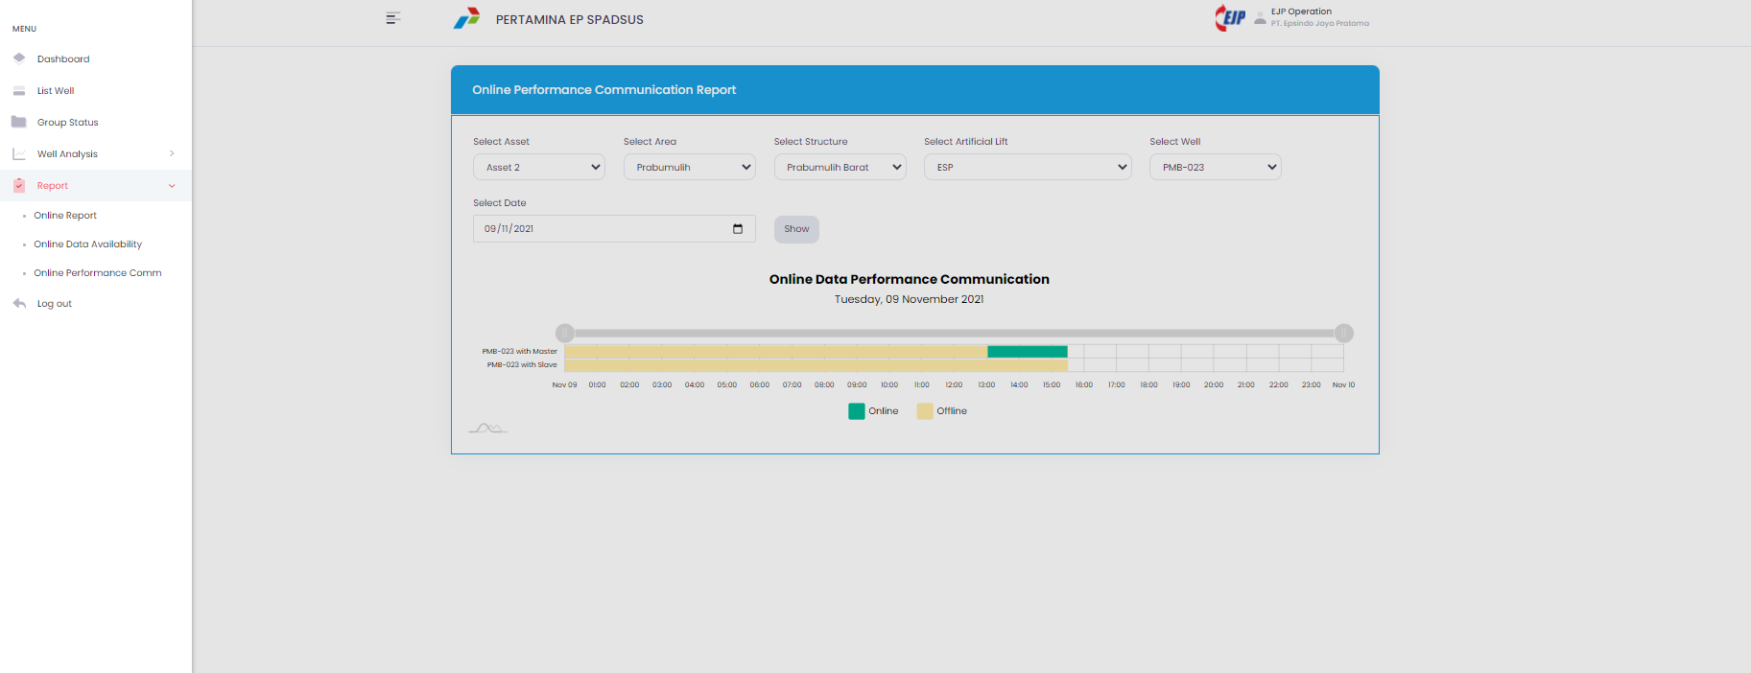
DISPLAY MONITORING

