Slide 1
Simulating Mycorrhizal Networks to Optimise Computer Networks
Adam Garai

Slide 2
Introduction to Mycorrhizal Networks
Beneath forests lies a web of roots and fungi connecting trees and plants to each other. The roots and fungi combine to form a mycorrhiza.
Mycorrhizal fungi form a symbiotic relationship with hosts and exchange nutrients [1] and even information [2] hence being called the “Wood Wide Web”
Despite being nearly 500 million years old the study of these networks is relatively new
Research is being conducted but overall, still not very well understood
Numerous similarities between mycorrhizal networks and computer networks exist, while this point is repeated online, there is a lack of research into the comparison
Notes:
Beneath almost every forest lies a tangled web of roots and fungi that connect trees and plants to each other, fungi attach themselves to the roots of these hosts to form a mycorrhiza. These mycorrhizae then spread throughout the forest and form large interwoven mycorrhizal networks. The fungi forms a symbiotic relationship with hosts, where it receives sugars from photosynthesis produced by the plants while providing the plants with hard to get nutrients from the soil such as phosphorus and nitrogen. A form of communication is even facilitated, where by information is spread throughout a forest for things such as warning other trees about incoming predator attacks. This allows for increased growth and chance of survival for both organisms.
These organisms are very old but were only discovered in 1885, and since research on them has been conducted
Conflicting research
No shortage of blog posts on the internet, relating trees to nodes in a computer network forming links based on mycorrhizal travel between the forest, since we know information can be passed across the networks many people say they are natures wood wide web.

Slide 3
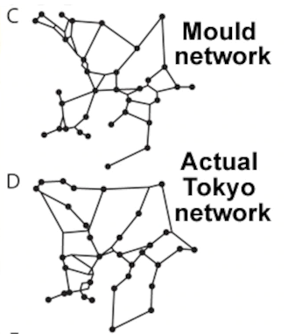
Motivations
A research team placed oat flakes around a slime mould, modelling cities around Tokyo
The slime was able to mimic the efficient Tokyo railway system very closely.
Slime and fungi can efficiently construct physical networks, but could they also help computer networks?
The project aim is to simulate mycorrhizal networks by using existing research in the area, and comparing them to computer networks
One of the first of its kind to try and bridge these two specific fields.
Notes:
A research team in Tokyo placed a slime mould on a a growth medium, surrounded by oat flakes in the shape of the Tokyo railway system which is known for its efficiency. After only a day the slime was able to model the railway system very similarly with no input. It is clear from nature that these natural networks grow efficiently to support life underground, but could they also help us see if computer networks could learn anything from them? That is the main goal of this project, to create models that simulate how mycorrhizal networks grow and analyse their outputs to find the most efficient inputs, and investigate whether they are similar, different or if computer networks could implement any optimization techniques.
This is also the first project that tries to explore this question and help bridge these two fields, hopefully producing a clearer understanding of these networks, while producing a usable model and starting a discussion on just how similar nature can be to man made computer networks.

Slide 4
Methodology
Decide programming language to use and learn it
(Term 1 Week 3-5)
Implement various models while continuing research with literature reviews
(Term 1 week 6-10)
Decide which models to use and finalize them.
(Term 2 week 1-4)
Begin initial research into the topic
(Term 1 Week 1-2)
Use models to investigate potential relationships with computer networks.
(Term 2 week 5- week 10)
Agile methodology for simulation development
(Continuous)
Notes:
This is my high level overview for my methodology chosen. It has been reworked since the project specification due to gaining a clearer understanding of the project. The timetable was rewritten twice due to delays in finding suitable models to create.
The agile development Methodology with two week sprints was chosen any time development was needed. This is due to the constant changing and evolution of my code. As I researched these networks more and more, my understanding grows and hence new models or changes to existing ones can be implemented, resulting in a short sprint time. GitHub is also used to proved version control, and to allow me to share my code between my home PC and my laptop

Slide 5
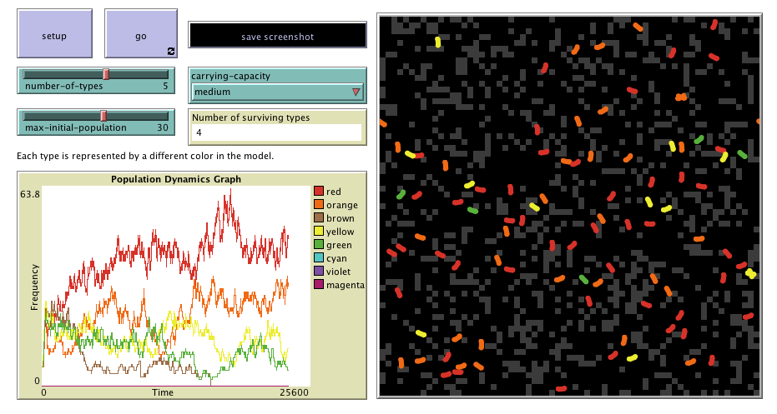
Background Research
NetLogo and Agent-Based-Modelling
One of the most famous and popular ABM languages
Allows creating simulations and “playing” with them, adjusting parameters either in the agent or the environment
Allows gathering of data from simulations to compare efficiency of models
Notes:
Agent based modelling is a powerful tool allowing us to simulate something that happens in real life, and analyse real world tangible stats. It allows us to make changes in both the environment and the agents to see how they affect the world and how it affects them. One of the most famous tools to do this is called NetLogo. NetLogo has numerous advantages such as being free and open source and allowing you to export models to the web for hosting.
Turtles and Patches,
it is however quite a odd programming language so time was taken to learn it by building models that aren’t exactly accurate. Another big advantage is that there are many data parsing tools available for it.

Slide 6
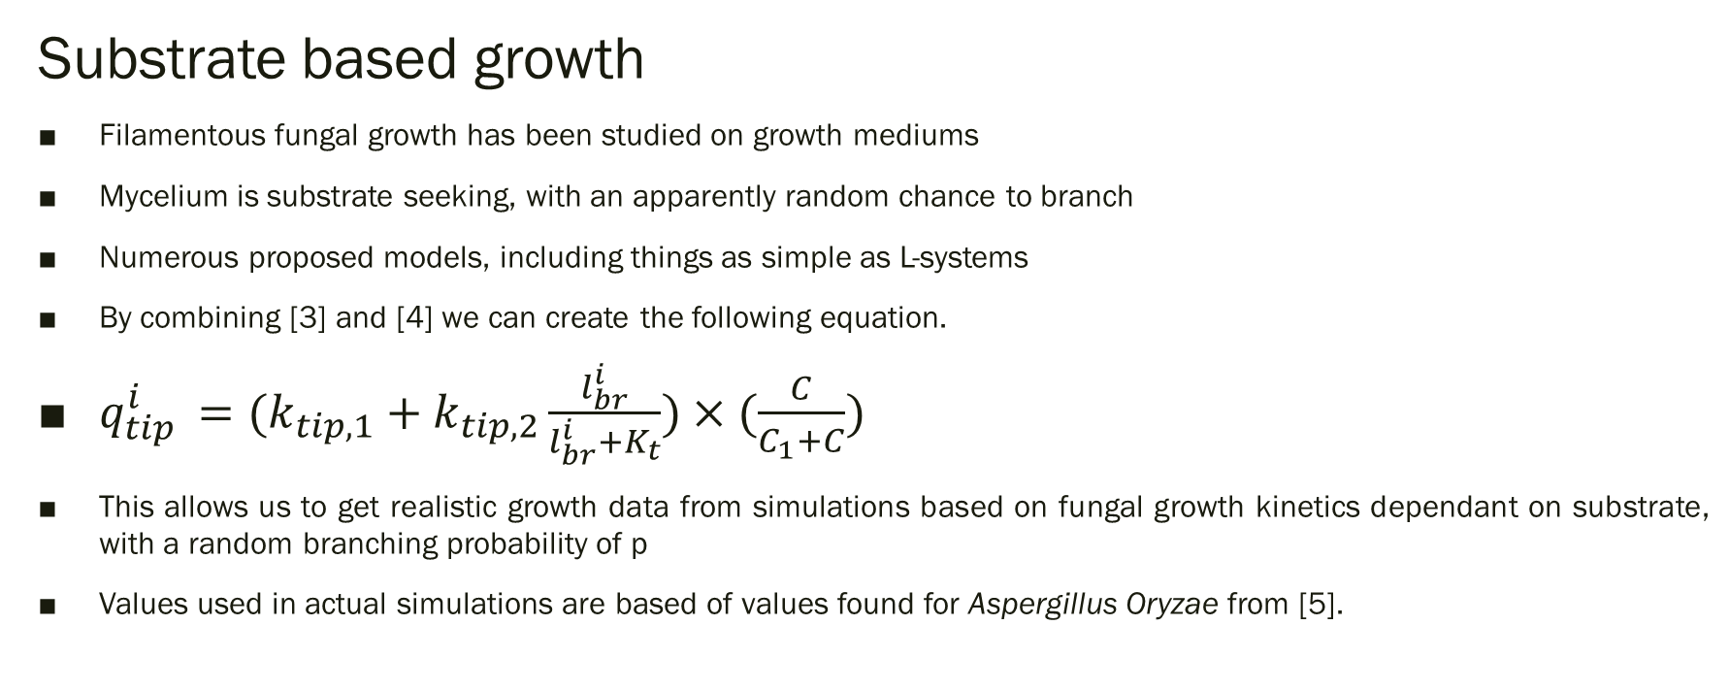
Background Research
Substrate based growth
Filamentous fungal growth has been studied on growth mediums
Mycelium is substrate seeking, with an apparently random chance to branch
Numerous proposed models, including things as simple as L-systems
By combining [3] and [4] we can create the following equation.
$q_{tip }^{i}=(k_{tip,1}+k_{tip,2}\frac{l_{br}^{i}}{l_{br}^{i}+K_{t}})×(\frac{C}{C_{1}+C})$
This allows us to get realistic growth data from simulations based on fungal growth kinetics dependant on substrate, with a random branching probability of p
Values used in actual simulations are based of values found for Aspergillus Oryzae from [5].
Notes:
There is available research on how these networks grow on a growth medium. Unfortunately there is lacking research on how the arise in a real forest as these forests can be hundreds of years old making it very hard to research how the growth comes about. Using literature review I have decided to base my models on the most consistent and mathematical based rules. The first distinction is that mycelium is substrate seeking. Secondly from Lejeune and Baron and Monod, we can combine the studied fungal growth kinetics and substrate based growth on equations presented.
Qtip-I tip extension rate. Ktip1 initial extension rate, ktip2 difference between maximum extensionrate and ktip1, lbri length of branch, and kt is time it takes to reach half of the maximum extension rate, C is total substrate available and C1 is the concentration of nutrient at which the rate is half the maximum.

Slide 7
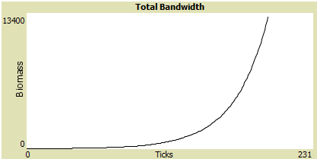
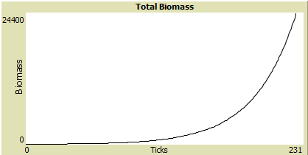
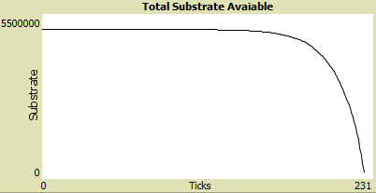
Torrenting Case Study
Comparing the growth of a single spore on a growth medium to the “growth” of a torrent on a peer-to-peer torrenting site
Proposed theory
Available bandwidth to user as an inverse function of substrate available as time goes on
Hyphal tip branching event comparable to a new seeder or leecher
Basic mycelium and torrenting Model
Assumptions
Conclusions
Interesting case study and shows some similarities between the networks but a very basic model that we cannot infer too much out of
Notes:
To first try and see if I could find a case study showing some mathematical similarity between these MN’s and a computer network I decided to try and model the “growth” of a torrent on a peer to peer adhoc network
My initial thoughts were that available bandwidth would be an exponential function relating to total biomass over time or an inverse of substrate available. The second reason I thought it imight be similar is that when a new leecher or seeder appears this could be thought of as a branching event.
Explain the mycelium simulation
Torrenting assumptions on model -> download speed of a user is limited by the minimum value of either their personal download bandwidth or their share of the cumulative upload bandwidth of everybody else. Average values for UK download and upload speeds are used, in research, popular torrents have a ratio of seeders/leecher at around 3 to 1 or 4 to 1, parameters were set to keep this constant.
Nothing can be inferred graphically as torrent model is just lines forming a circle until their download is finished with a percent chance to become a seeder.

Slide 8
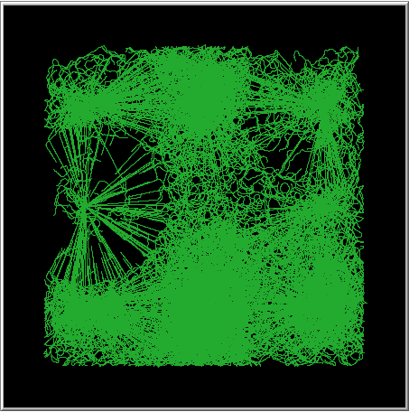
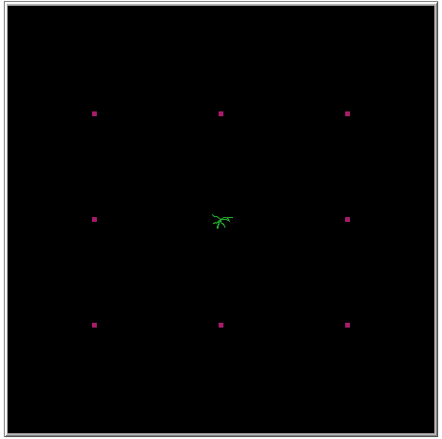
Design of full model
Growth of mycorrhizae originating from a single spore on a growth medium, with a global substrate for the medium, and individual local substrate “patches”
Substrate based growth kinetics used, with substrate seeking behaviour
If there is no local or global substrate available or a set “tick” limit is reached, the simulation will stop
Optimisation problem – How efficiently can the mycorrhizae construct a network trying to optimise substrate gained while minimising both biomass and the amount of substrate not gained
Allows us to tweak parameters in both the agent and environment to observe changes.
Notes:
Talk about the full model, explain internal death timer used in most abm simulations, we use a tick counter and global substrate, which growth speed is dependant on. Substrate seeking behaviour
Provides us a model of growth of mycorrhizae on a growth medium, with “nodes” as local substrate. Allows us to get real world tangible stats of the efficiency of the model based on differing environments and input parameters.
Talk about environment setup, talk about seeking range and angle.

Slide 9
Agent Decision Making
Tick limit reached?
Yes
No
Global/local substrate available?
No
Simulation Stop
Yes
Local Substrate Detected?
Random Branching chance during cycle
No
Yes
Branch (Hatch new agent)
Wiggle random direction and move forward
Face and move forward until arrival
Eat substrate and move forward
Notes:
Two conditions for the simulation to end, talk about the flow chart, branching can happen at any point during the cycle.
Patch updating also exists for global and local substrate.

Slide 10
Usage of model
Simulations can be run multiple times with parameters tweaked to find optimum parameters
Different environments can be used to see how the environment affects the agent and vice-versa.
Minimising biomass and maximising substrate gained relates to Tokyo experiment by minimising rails and maximising people reached (population density). Can also be thought as miles per gallons, producing an optimisation problem.
We want to additionally minimise the amount of substrate not eaten.
We can calculate substrate gained divided by biomass as a ratio, then divided by substrate not eaten + 1, as a “success” would be if substrate not eaten would equal 0.
Notes:
This model provides us an optimisation problem, and an insight into how fungi might optimise themselves in differing environments. Two efficiency counters are used. First one can be thought of as miles per gallon, which is substrate gained divided by the total biomass. This relates to the Tokyo experiment, as we also want to factor in how much substrate was left, for example if the simulation stops before all local substrate is eaten.
Success
The model can also be analysed visually to see the paths taken by the mycellium

Slide 11
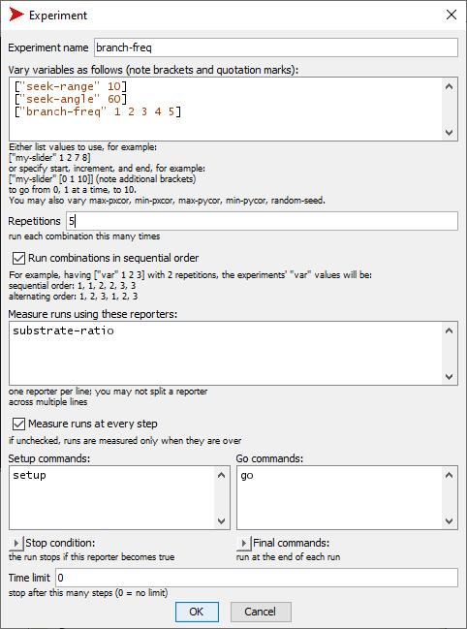
Gathering Results
Results can be gathered quite easily using Netlogo’s behaviour space extension or RNetLogo
We can vary variables in the environment and plot the output of a variable we want to measure in a csv file
Multiple repetitions of the same parameter can be used to gather an average over runs
Notes:
There are multiple ways to collect and analyse data using the model. Netlogo provides a built in behaviourspace extension allowing multiple simultaneous runs in parallel, and export of data into a CSV file.

Slide 12
Sample Results
These results show the effect of different branching value on ER = SR / local substrate leftover +1 where, SR = Substrate gained / biomass
The CSV files are imported into excel for simple graphing purposes
Full data analysis, comparison of case studies and discussion about results and implications will be discussed in the final report
Possible to find optimal parameters, suggesting this could be how mycorrhizae branch for efficiency.
These results are interesting as they show how for the MN branching is efficient but not too much
Notes:
Full data analysis and conclusions will be talked about in detail in the report, however I would like to just show some sample results. On an environment with eight Nodes and the spore spawning in the middle, I used behaviour space to run multiple runs with different branching values, each run repeated 5 times to find an average for the efficiency ratio. These results in particular are important as they can explain why mycelium branch, to find other plants and to maximise distance covered in a forest, but suggests that if they want to be very efficient they must limit their branching based on their substrate available to them. Data analysis such as this helps expand the current research field.

Slide 13
Comparisons to Computer Networks
As it is an optimisation problem, we can see how changes to parameters lead to a more optimum network design and can test if this can be applied to computer networks, while serving as a scalability guide
Challenges
Physical networks are fundamentally very different to computer networks due to being location based
When constructing computer networks “tips” have unlimited “seek range
Any comparison to computer networks will have to have a “substrate” equivalent
Two proposed ideas
Blockchain network of data routing a ledger
Cloud computing
Notes:
When trying to compare my model to computer networks there are a few fundamental challenges that make this difficult. First of all physical networks are very different to most computer networks as most computer networks are not location based. Secondly when the mycelium move around the environment they have a limited seek range. However there are two ideas that I can propose. The first is a blockchain network of data routing an update for a ledger, explain how when a transaction is made it is added to the ledger and each node on the environment must receive and confirm the update. If you model a map of the world and gather the amount of blockchain computing power each country uses, my model can provide a visualisation of the route taken for a ledger to be updated in a peer to peer ad hoc blockchain network. Branches would represent a ledger coming into an adhoc node and being passed around. There is currently no way to visusalise this ledger update , and this might serve as an interesting application for the model. The second idea is cloud computing with centralised server locations containing a share of computing power on the network, the model could show how if the environment is setup correct, the path of data taken to be transferred across servers. Where clusters visually appear in the simulation, could be argued to be a good place to hover a satellite over as that means a lot of data is being transferred over that physical location.

Slide 14
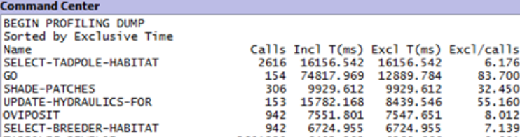
Optimization
In larger environments with more substrate available, agent count reaches thousands resulting in a significant slowdown
Although the slowdown is unavoidable at very high agent counts, optimization techniques were used to speed up my naïve implementation
Optimizations techniques
Use of NetLogo’s profiler extension to identify slow subroutines
Use of RNetLogo to send input values to NetLogo
Notes:
As branching can be quite frequent at certain values, optimization is much needed in my project. When total substrate levels are very high, especially if the environment is large, thousands of agents can be created, all calculating what they should do next. Eventual slowdown is unavoidable, however there are a few techniques to try to minimize it.
First of all as few variables as possible are calculated in an agent context, meaning when operations are being performed on turtles or patches, they will update necessary local values but try to access or create other values as little as possible. The values such as the total biomass are then calculated in an observer context greatly reducing the number of calls. Agent filterting statements are key to any ABM simulation, but must be minimized or if repeated stored global for continuous memory access.
The code is in a constant state of being rewritten by using tools such as NetLogos profiler extension to identify problem subroutines.
RNetLogo is an extension for R that allows the user to run many simultaneous parallel runs efficiently, by sending NetLogo a set of input values to analyse results. Speedup is achieved as R is a vector oriented language and handles vectors more efficiently than individual values.

Slide 15
Limitations
Memory handling in NetLogo can be very inefficient, therefore it is not feasible to keep track of which turtle has been to which node to draw a graph of “linked” nodes
Computational expensive
Lack of research which could provide further insight into comparisons
How nutrients flow around an already grown network
How the mycelium communicate messages
Notes:
The first limitation of my project is that memory handling in NetLogo can be quite inefficient which can be an issue when trying to keep track of certain parameters such as what nodes a tip has visited. Secondly it can be quite computationally expensive due to the nature of ABM simulations and branching. However this can be counteracted with tools such as RNETLogo. Secondly the field is relatively new and there is not that much research available to build very accurate full model scales, which could be used to infer more about the relationship to computer networks.

Slide 16
Future Work
Implement the simulation in a language such as unity with better memory handling and built-in functions for things such as collision
Implement a 3D model
Build models that reflect mycorrhizal networks without using ABM simulations such as neural networks
Notes:
Future work could entail changing language for better handling of arrays. This could then be used for more data analysis maybe even providing a graph of links in a densely populated forest.
The model could be implemented in 3D, for a more interesting picture of how the tips could grow underground to have more access to nutrients
Different model building techniques could be used other than ABM for example neural networks where the tips can communicate with each other for optimum decision making, to explore how this would affect the simulation.

Slide 17
Unforeseen Problems
Difficulty of finding consistent research of growth of MN’s
Both timetable and scope was revised as the initial research was a lot higher than expected
Computational power needed to run larger simulations was higher than expected
Code was re-written and optimized from scratch
Initial objectives were not clear and too abstract
Objectives were rewritten with a clearer picture in mind, while keeping the core of the project the same
Notes:
Few unforeseen problems
Research
Computational power
Initial objectives

Slide 18
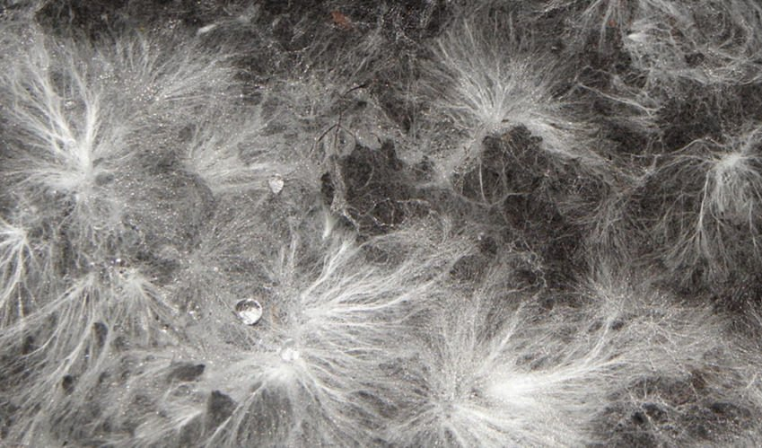
Conclusion
My project serves as a preliminary discussion and investigation about the relationship between MN’s and computer networks
Models are built upon existing research, and provide optimization problems and a scalability guide, with potential uses for constructing computer networks
Could potentially help further research into the study of mycorrhizal networks.
Full data analysis is available with the model helping to further understand how these mycelium may optimize themselves in reality
Notes:
Preliminary discussion
Model built upon existing research, maybe even more potential applications
One of the first to simulate growth and explore how different parameters lead to optimisation, despite their limitations such as seek range, can compare what kind of environment they are best suited too. Simulating them is a potential viable alternative to learning more about them.

