Slide 1
Apache Cassandra in Practice
cass1
dc1
RF 3 · RF 1
A 3-node event-registration lab: replication, partitioning and lightweight transactions
cass3
cass2
Big Data Management and Processing · NoSQL group project · Week 8
Notes:
Good morning. We are Member A, Member B and Member C. Our database is Apache Cassandra 5.0.9. We built one running example, an event-registration system, on a three-node cluster on one laptop, and used it to test the three things the assignment asks for: replication and availability, partition-key placement, and lightweight transactions.

Slide 2
Agenda
1
2
3
4
5B
5C
5D
6
Introduction
Installation & setup
Data model
Basic operations
Replication
Partitioning
Lightweight transactions
Conclusion
One running example throughout: event registrations, 6 events and 120 seats, on a 3-node Cassandra 5.0.9 cluster.
Notes:
The talk follows the six parts of the handout. Part 5 is split into replication, partitioning and transactions. One running example, event registrations, is used throughout.

Slide 3


Where Cassandra comes from
PART 1 · INTRO
2007–08
Built at Facebook for Inbox Search (Lakshman & Malik)
The problem it solves
Store fast-growing, write-heavy data across many commodity servers, with no single point of failure.
Jul 2008
Released as open source
Mar 2009
Accepted into the Apache Incubator
Amazon Dynamo (2007)
Distribution: consistent-hashing ring, replication, gossip, tunable consistency
Feb 2010
Becomes an Apache top-level project
Sep 2024
Cassandra 5.0 released
Google Bigtable (2006)
Data model and storage: column families, memtables, SSTables
Our lab
Version 5.0.9, Apache License 2.0, no paid licence
Sources: Lakshman & Malik (2010); DeCandia et al. (2007); Chang et al. (2006); cassandra.apache.org
Notes:
Cassandra was built at Facebook around 2007 and 2008 by Avinash Lakshman and Prashant Malik for inbox search. It was open-sourced in July 2008, entered the Apache Incubator in 2009 and became a top-level Apache project in February 2010. Its design combines two earlier systems: from Amazon's Dynamo it takes the way data is spread and replicated over a ring of equal nodes; from Google's Bigtable it takes the column-family data model and the memtable/SSTable storage engine. The problem it targets is large, write-heavy data on many cheap machines with no single point of failure.

Slide 4





Core features and fit for our data
PART 1 · INTRO
Why it fits event registrations
Many writes, and the main query is known in advance: “all registrations for event X”.
Masterless ring
Every node is equal. Any node can coordinate a request; no single primary.
Tunable consistency
Each request chooses how many replicas must answer: ONE, QUORUM, ALL.
Strength
Stays readable and writable with a node down (our experiment 5B).
Limitation
Tables must be designed per query; ad-hoc filters are refused (Part 4). Conditional writes cost extra round trips (5D).
Partitioned tables + CQL
SQL-like language; rows grouped by a partition key, sorted by clustering columns.
Replication per keyspace
Replication factor (RF) sets how many copies of each partition exist.
Notes:
Four features matter for our project. There is no primary node: every node is equal and any node can coordinate a request. Consistency is tunable per request. Data lives in partitioned tables and we talk to it with CQL, which looks like SQL. And replication is set per keyspace with a replication factor. It fits event registrations because we write a lot and we know the main query in advance. One strength we will show: the cluster keeps working with a node down. One limitation we will show: you must design tables around queries, and conditional writes are more expensive.

Slide 5

Three nodes, one data centre
PART 2 · SETUP
Docker network cassnet · data centre dc1 · rack1
Image | cassandra:5.0.9 (pinned, digest recorded)
Host | Windows 11, Docker 29.2.1, Compose v5.0.2
Start order | cass1 → cass2 → cass3 via healthchecks
Memory | heap 512M, new gen 128M, limit 1200 MiB
Restart | "no": a stopped node stays stopped
Reset | scripts/reset.sh (down -v deletes data)
cass1
cass2
cass3
seed node
vol: cass1_data
joins after cass1 healthy
vol: cass2_data
joins after cass2 healthy
vol: cass3_data
gossip
CQL only on 127.0.0.1:9042
Host laptop
cqlsh, scripts, evidence
Config: config/docker-compose.yml
Notes:
Our installation route is Docker Compose on Windows 11. Three Cassandra containers share one private Docker network and one data centre called dc1. They start in sequence: cass2 waits until cass1 is healthy, cass3 waits for cass2. Each node has its own data volume. Only cass1 publishes the CQL port, and only on 127.0.0.1, so nothing is exposed to the network. The image tag is pinned to 5.0.9 and we recorded its digest. Because three JVMs share one laptop we lowered the heap to 512 MB and capped each container at 1200 MiB. reset.sh wipes the volumes and re-seeds the data; we mark it clearly because it deletes data.

Slide 6
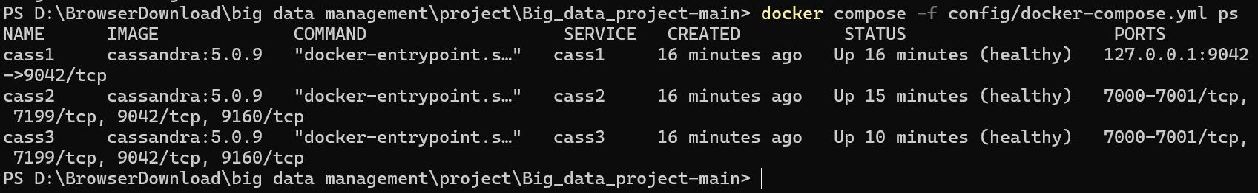
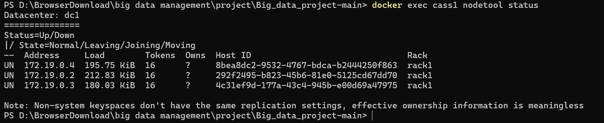
Readiness checks before any experiment
PART 2 · SETUP
docker compose ps: all three containers healthy
3 × UN
all nodes up and normal
1 schema version
shared by all three nodes
nodetool status: three nodes UN (Up / Normal) in Datacenter dc1
Smoke test
write via cass1, read via cass3
Logs clean
no errors on any node
Memory is tight
about 1.1 of 1.17 GiB used per node
Screenshots. Full output: evidence/00_environment/
Notes:
Before every experiment we check the same things. docker compose ps shows all three containers healthy. nodetool status shows three nodes UN, which means up and normal, in data centre dc1. describecluster shows one schema version on all three nodes. A smoke test writes through cass1 and reads the same row through cass3. The logs show no errors. One honest observation: each node uses about 1.1 of its 1.17 GiB limit, so memory is the main constraint on a laptop.

Slide 7
One table per query
PART 3 · DATA MODEL
scripts/00_schema.cql
Query that shaped the design
List all registrations for event X
CREATE TABLE nosql_rf3.registrations (
event_id text, -- partition key
seat_no int, -- clustering col
attendee text,
email text,
registered_at timestamp,
PRIMARY KEY ((event_id), seat_no)
) WITH CLUSTERING ORDER BY (seat_no ASC);
Partition key: event_id
Hashed to a token; the token decides which node stores the partition.
Clustering column: seat_no
Sorts rows inside one partition, so one read returns an event's seats in order.
nosql_rf3.registrations
RF 3 · CRUD, 5B
nosql_rf3.seat_claims
RF 3 · LWT, 5D
nosql_rf1.registrations_good
RF 1 · key event_id, 5C
nosql_rf1.registrations_bad
RF 1 · constant key, 5C
Data: scripts/generate_data.py creates 6 events (E1–E6, 10–30 seats each), 120 rows, deterministic, no external dataset
Notes:
In Cassandra you start from the query, not from the entities. Our main query is: list all registrations for one event. So event_id is the partition key: Cassandra hashes it into a token, and the token decides which node stores that event. seat_no is the clustering column: it keeps the seats of one event sorted inside the partition, so one read returns them in order. We use two keyspaces: nosql_rf3 with three copies for CRUD, availability and transactions, and nosql_rf1 with one copy only for the placement experiment, including a deliberately bad table with a constant partition key. The 120 rows come from our own deterministic generator.

Slide 8
CRUD, verified after every step
PART 4 · BASIC OPS
1
CREATE
2
READ
3
UPDATE
INSERT seat 1, 'Alice'
SELECT * WHERE event_id = 'CRUD-DEMO'
SET email = 'alice.new@…' WHERE seat 1
→ 1 row: seat 1, Alice, alice@example.org
→ 2 rows, automatically sorted by seat_no
→ email changed, name still Alice
4
UPSERT via INSERT
5
UPSERT via UPDATE
6
DELETE
INSERT seat 1, attendee 'Carol' (key exists)
UPDATE seat 3 SET attendee 'Dave' (no row)
DELETE WHERE seat_no = 2
→ No error. attendee → Carol, email kept
→ No error. New row seat 3 created
→ Seats 1 and 3 remain
Every change is followed by a SELECT. Cleanup deletes the demo partition (count 0). Script: scripts/crud.cql · output: evidence/02_crud/crud_output.txt
Notes:
In cqlsh on cass1, first type CONSISTENCY LOCAL_QUORUM. Then run the six steps from scripts/crud.cql and show the SELECT after each one. Create Alice in seat 1. Read the partition: two rows, sorted by seat number because seat_no is the clustering column. Update Alice's e-mail. Steps 4 and 5, in orange, are the important ones: they show upsert. Delete seat 2.

Slide 9


Upsert: writes never check existence
PART 4 · BASIC OPS
cqlsh @ cass1 · CONSISTENCY LOCAL_QUORUM
INSERT overwrites
Only the listed columns change: attendee became Carol, the e-mail written earlier stayed.
-- Step 4: INSERT on an existing key
INSERT ... (event_id, seat_no, attendee)
VALUES ('CRUD-DEMO', 1, 'Carol');
seat_no | attendee | email
---------+----------+----------------------
1 | Carol | alice.new@example.org
-- Step 5: UPDATE on a missing key
UPDATE ... SET attendee = 'Dave'
WHERE event_id = 'CRUD-DEMO' AND seat_no = 3;
seat_no | attendee | email
---------+----------+----------------------
1 | Carol | alice.new@example.org
2 | Bob | bob@example.org
3 | Dave | null
UPDATE creates
Seat 3 did not exist; the UPDATE created it. Unset columns are null.
Why it matters
Two people booking the same seat would silently overwrite each other. Part 5D fixes this with IF NOT EXISTS.
Notes:
This is the most important difference from a relational database. In MySQL, inserting an existing primary key gives an error. In Cassandra, INSERT and UPDATE are both upserts: neither checks whether the row exists. In step 4 the insert on seat 1 replaced only the attendee column; the e-mail we wrote before is still there. In step 5 the update on seat 3, which did not exist, simply created the row. That is fast, but if two customers book the same seat, the second write wins silently. Keep that in mind for Part 5D.

Slide 10
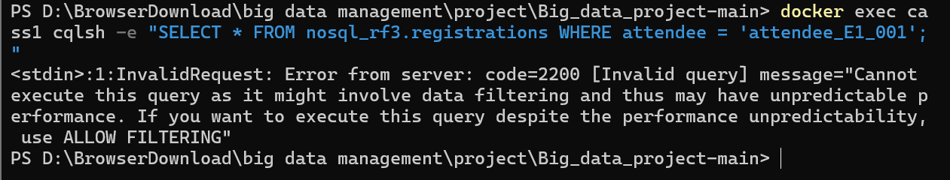
Beyond CRUD, and a refused query
PART 4 · BASIC OPS
useful queries inside one partition
Query on a non-key column (screenshot)
-- range on the clustering column
SELECT seat_no, attendee FROM registrations
WHERE event_id = 'E1'
AND seat_no >= 5 AND seat_no <= 10;
→ seats 5, 6, 7, 8, 9, 10
-- reverse order, last 5 seats
... WHERE event_id = 'E1'
ORDER BY seat_no DESC LIMIT 5;
→ seats 30, 29, 28, 27, 26
-- size of one event
SELECT count(*) ... WHERE event_id = 'E1';
→ 30
Why it is refused
attendee is not part of the primary key, so Cassandra would have to scan every partition on every node.
Query-first design
A new question needs a new table, for example one keyed by attendee. ALLOW FILTERING works but scans everything.
Notes:
Beyond single-row lookups, the clustering column gives us useful queries inside one partition: a range of seats, the last five seats in reverse order, and the number of registrations for an event. The screenshot shows what Cassandra refuses: a query on attendee, which is not part of the key. Cassandra would have to scan every partition on every node, so it refuses unless we add ALLOW FILTERING. The proper fix is another table designed for that query. This is query-first design.

Slide 11

Replication factor vs consistency level
PART 5B · REPLICATION
3 copies
2 replies
3 replies
Replication factor of keyspace nosql_rf3
LOCAL_QUORUM needs a majority of the 3 replicas
ALL needs every replica to answer
Experiment: stop cass3, keep the client connected to cass1
cass1
UN
cass2
UN
cass3
DN
LOCAL_QUORUM read and write
2 replies needed, 2 available: works
ALL read
3 replies needed, 2 available: Unavailable
2 of 3 replicas alive
No primary node: the contacted node (cass1) coordinates the request and asks the replicas.
Notes:
Two numbers are easy to confuse. The replication factor is how many copies exist: three in nosql_rf3, so every node holds a copy here. The consistency level is how many of those copies must answer one request: LOCAL_QUORUM needs two, ALL needs three. Our experiment stops cass3 and keeps the client on cass1. Two replicas are still alive, so we predict that LOCAL_QUORUM keeps working and ALL fails. There is no primary node; cass1 just coordinates.

Slide 12
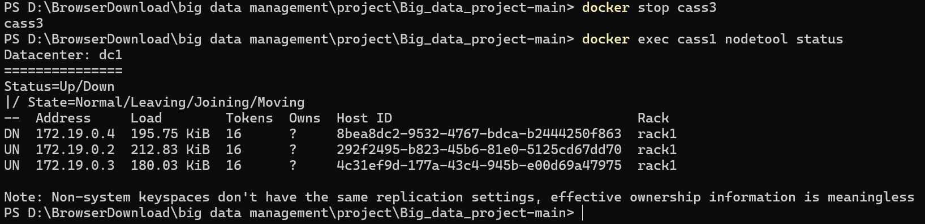
QUORUM works, ALL fails
PART 5B · REPLICATION
B1 seed at ALL, all nodes up
row B-TEST = before_failure, stored on all 3 nodes
Status after docker stop cass3 (screenshot)
B2 docker stop cass3
nodetool shows cass3 DN about 5 s later
B2a LOCAL_QUORUM read
returns before_failure
B2d · cqlsh @ cass1
B2b LOCAL_QUORUM write
during_failure accepted, no error
CONSISTENCY ALL;
SELECT ... WHERE event_id = 'B-TEST' AND seat_no = 1;
Unavailable ... Cannot achieve
consistency level ALL
'required_replicas': 3, 'alive_replicas': 2
B2c LOCAL_QUORUM read back
returns during_failure
B2d ALL read
Unavailable: required 3, alive 2
Script: scripts/b_replication.sh · evidence/03_replication/
Notes:
These are the results from scripts/b_replication.sh. First we seed a row at consistency ALL while everything is healthy, so all three replicas have it. Then we stop cass3; nodetool shows it as DN within about five seconds. With LOCAL_QUORUM we can still read the old value, write a new value during_failure, and read it back. Then we switch to ALL and read the same row: Cassandra refuses with Unavailable, required replicas three, alive replicas two. We use the failed read as evidence, not a failed write, because a failed write may still have reached some replicas.

Slide 13

Recovery after the node returns
PART 5B · REPLICATION
docker start cass3
3 × UN again about 20 s later
 | Expected | Observed
QUORUM read, 1 node down | succeeds | before_failure
QUORUM write + read back | succeeds | during_failure
ALL read, 1 node down | Unavailable | required 3, alive 2
ALL read after restart | new value | during_failure
Hinted handoff
cass1 had stored the missed write and replayed it to cass3
ALL read
returns during_failure from all 3 replicas
Careful interpretation
An ALL read can trigger read repair, so it proves the replicas agree now, not that they were already in sync.
Stopping a container is process failure on one laptop, not the loss of a whole machine.
docker logs cass1 | grep hint
Finished hinted handoff of file
8bea8dc2-...-2.hints to endpoint
/172.19.0.4 (= cass3)
Notes:
When cass3 comes back, all three nodes are UN again after about twenty seconds. The log of cass1 shows hinted handoff: while cass3 was down, cass1 kept a hint for the write it missed and replayed it to cass3's address. An ALL read now returns during_failure from all three replicas. The table compares expected and observed results; all four match. Two cautions: an ALL read can itself repair data, so it shows the replicas agree now; and this is one laptop, so it shows a process failure, not survival of a lost machine.

Slide 14
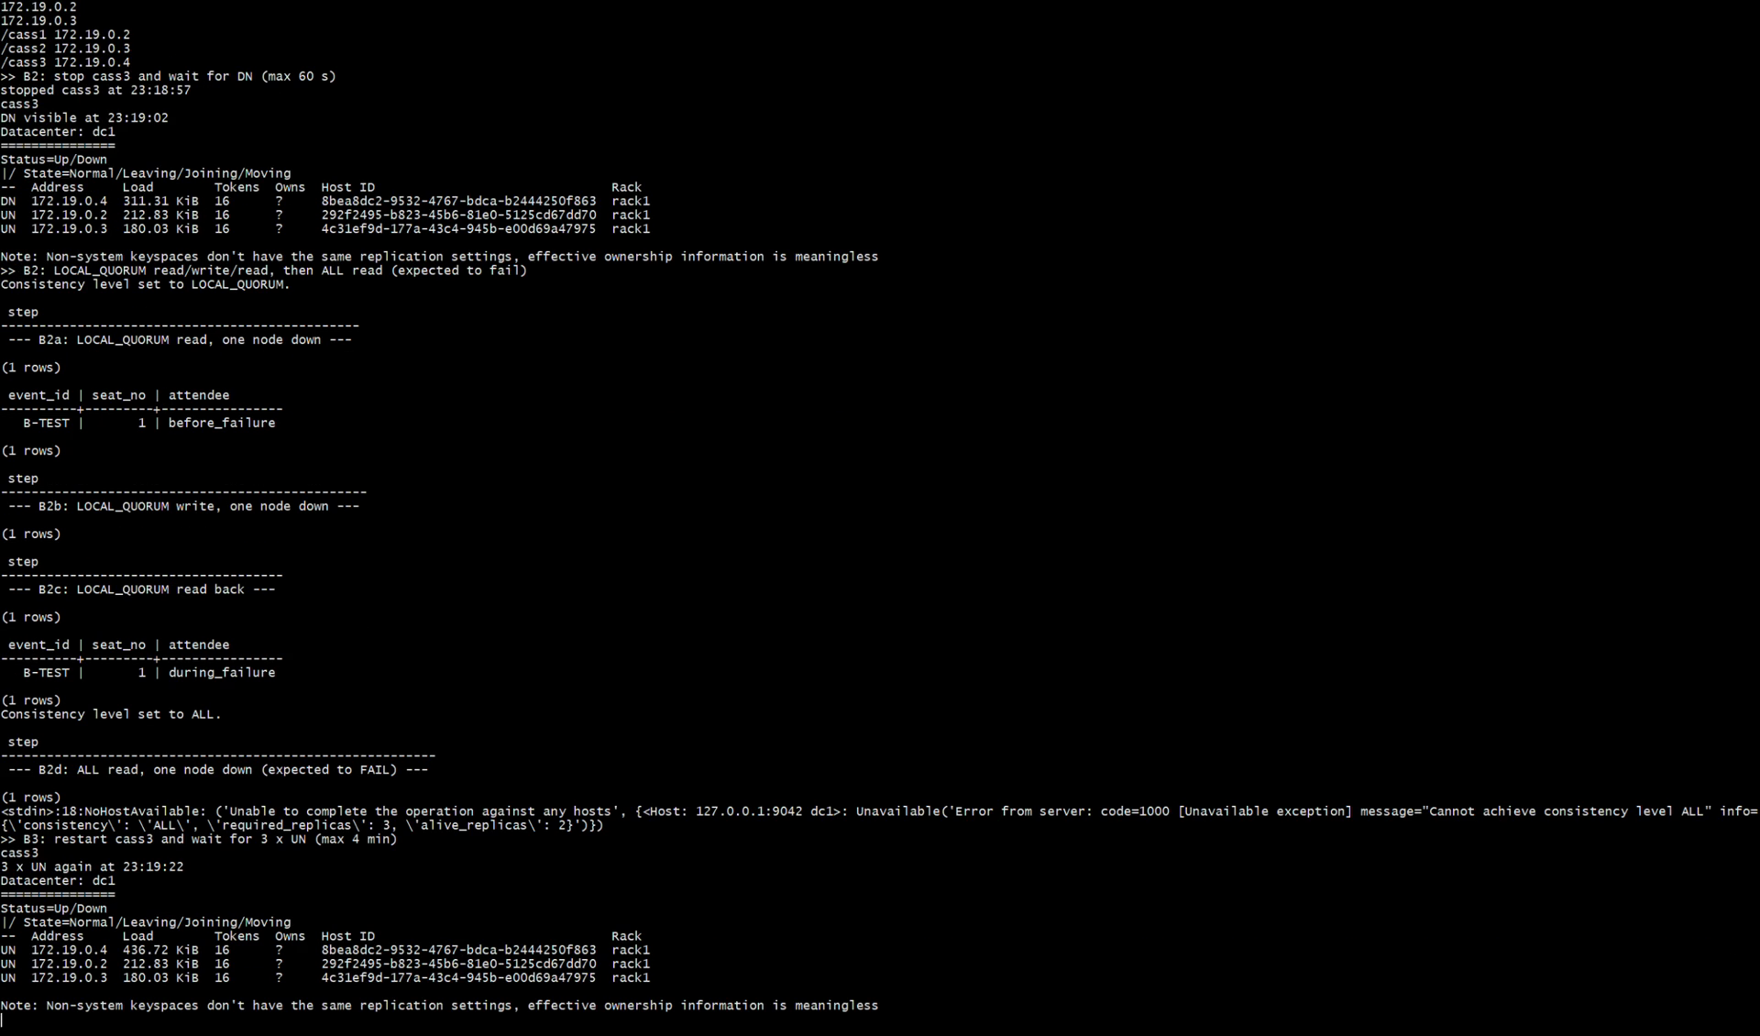
Recording: the full replication run
PART 5B · REPLICATION
Recording of scripts/b_replication.sh (77 s): seed → stop cass3 → QUORUM ✓ / ALL ✗ → restart → hints → ALL ✓
Notes:
This is the unedited recording of scripts/b_replication.sh.

Slide 15
Good vs poor partition key
PART 5C · PARTITIONING
PRIMARY KEY ((event_id), seat_no)
10–30 rows per partition; events can live on different nodes
PRIMARY KEY ((bucket), event_id, seat_no)
bucket = 'all': all 120 rows in one partition
Same intended query, same E1 rows from both tables. Counts verified independently from the seed file (distinct primary keys). RF 1 keyspace.
Notes:
For placement we use the RF 1 keyspace, because with RF 3 on three nodes every node holds every partition and placement is invisible. We loaded the same 120 registrations into two tables. The good table uses event_id as partition key: six partitions of 10 to 30 rows. The poor table puts a constant value, 'all', in the partition key: one partition with all 120 rows. Both tables answer the query for event E1 with the same rows; the difference is where the data lives. We counted distinct primary keys, and cross-checked the numbers from the seed file, so repeated upserts are not counted twice.

Slide 16
Where each partition lives
PART 5C · PARTITIONING
Partition key | Rows | Token | Node
E1 | 30 | -8417341041065285198 | cass1
E2 | 20 | -2554343524930710110 | cass2
E3 | 15 | -7347942446438086986 | cass1
E4 | 25 | 1236003599942733440 | cass2
E5 | 10 | -5474989656694850673 | cass2
E6 | 20 | -5200551344520828814 | cass1
all (bad) | 120 | 5100602505380613394 | cass1
cass1: 3 good + 1 bad partitions
E1, E3, E6 and 'all'
cass2: 3 good partitions
E2, E4, E5
cass3: 0 partitions
none of our keys
What this shows
cass3 owns 35.7% of the token ring yet got none of our 6 keys. More keys spread load, but not perfectly; one popular event is still one hot partition.
From nodetool getendpoints (replica owner, not the coordinator) and SELECT token(event_id)
Notes:
Cassandra hashes each partition key into a token, and the token range decides the node. With RF 1, getendpoints returns exactly one node per key. Our six good keys landed on two nodes: E1, E3 and E6 on cass1; E2, E4 and E5 on cass2. The bad table's single partition 'all' sits on cass1 with all 120 rows, so every request for any event would hit that node: a hotspot. tablestats confirmed the same pattern per node. An interesting result: cass3 owns about 36 percent of the ring but received none of our six keys. With few keys, hashing does not guarantee even load, and a very popular event would still be one hot partition. getendpoints shows where data is stored, not which node coordinated a query.

Slide 17
Two customers, one seat
PART 5D · TRANSACTIONS
the problem (from upsert in Part 4)
 | Ordinary INSERT | INSERT … IF NOT EXISTS
Checks existence | No (upsert) | Yes
Second writer | Overwrites silently | Refused: [applied] = False
Cost | One round of replica writes | Several round trips (Paxos)
Scope | Any rows | One row / one partition
-- ordinary INSERT, no condition
INSERT ... VALUES ('demo-plain', 1, 'Alice');
INSERT ... VALUES ('demo-plain', 1, 'Bob');
event_id | seat_no | owner
------------+---------+------
demo-plain | 1 | Bob
→ no error; Alice's booking silently lost
the fix: a conditional write
INSERT INTO nosql_rf3.seat_claims
(event_id, seat_no, owner)
VALUES (...) IF NOT EXISTS;
Setup: table nosql_rf3.seat_claims (RF 3), PRIMARY KEY (event_id, seat_no), all three nodes UN, a fresh event id for every run
Notes:
Back to the upsert problem from Part 4. With an ordinary insert, Alice books seat 1, then Bob books the same seat; there is no error and the final owner is Bob. Alice's booking is silently lost. A lightweight transaction adds a condition: IF NOT EXISTS. Cassandra checks the condition and applies the write atomically for that one row, using a Paxos-based protocol. That costs several extra round trips, and it only covers one row or partition. We use a separate table, seat_claims, a fresh event id each run, and all three nodes running.

Slide 18
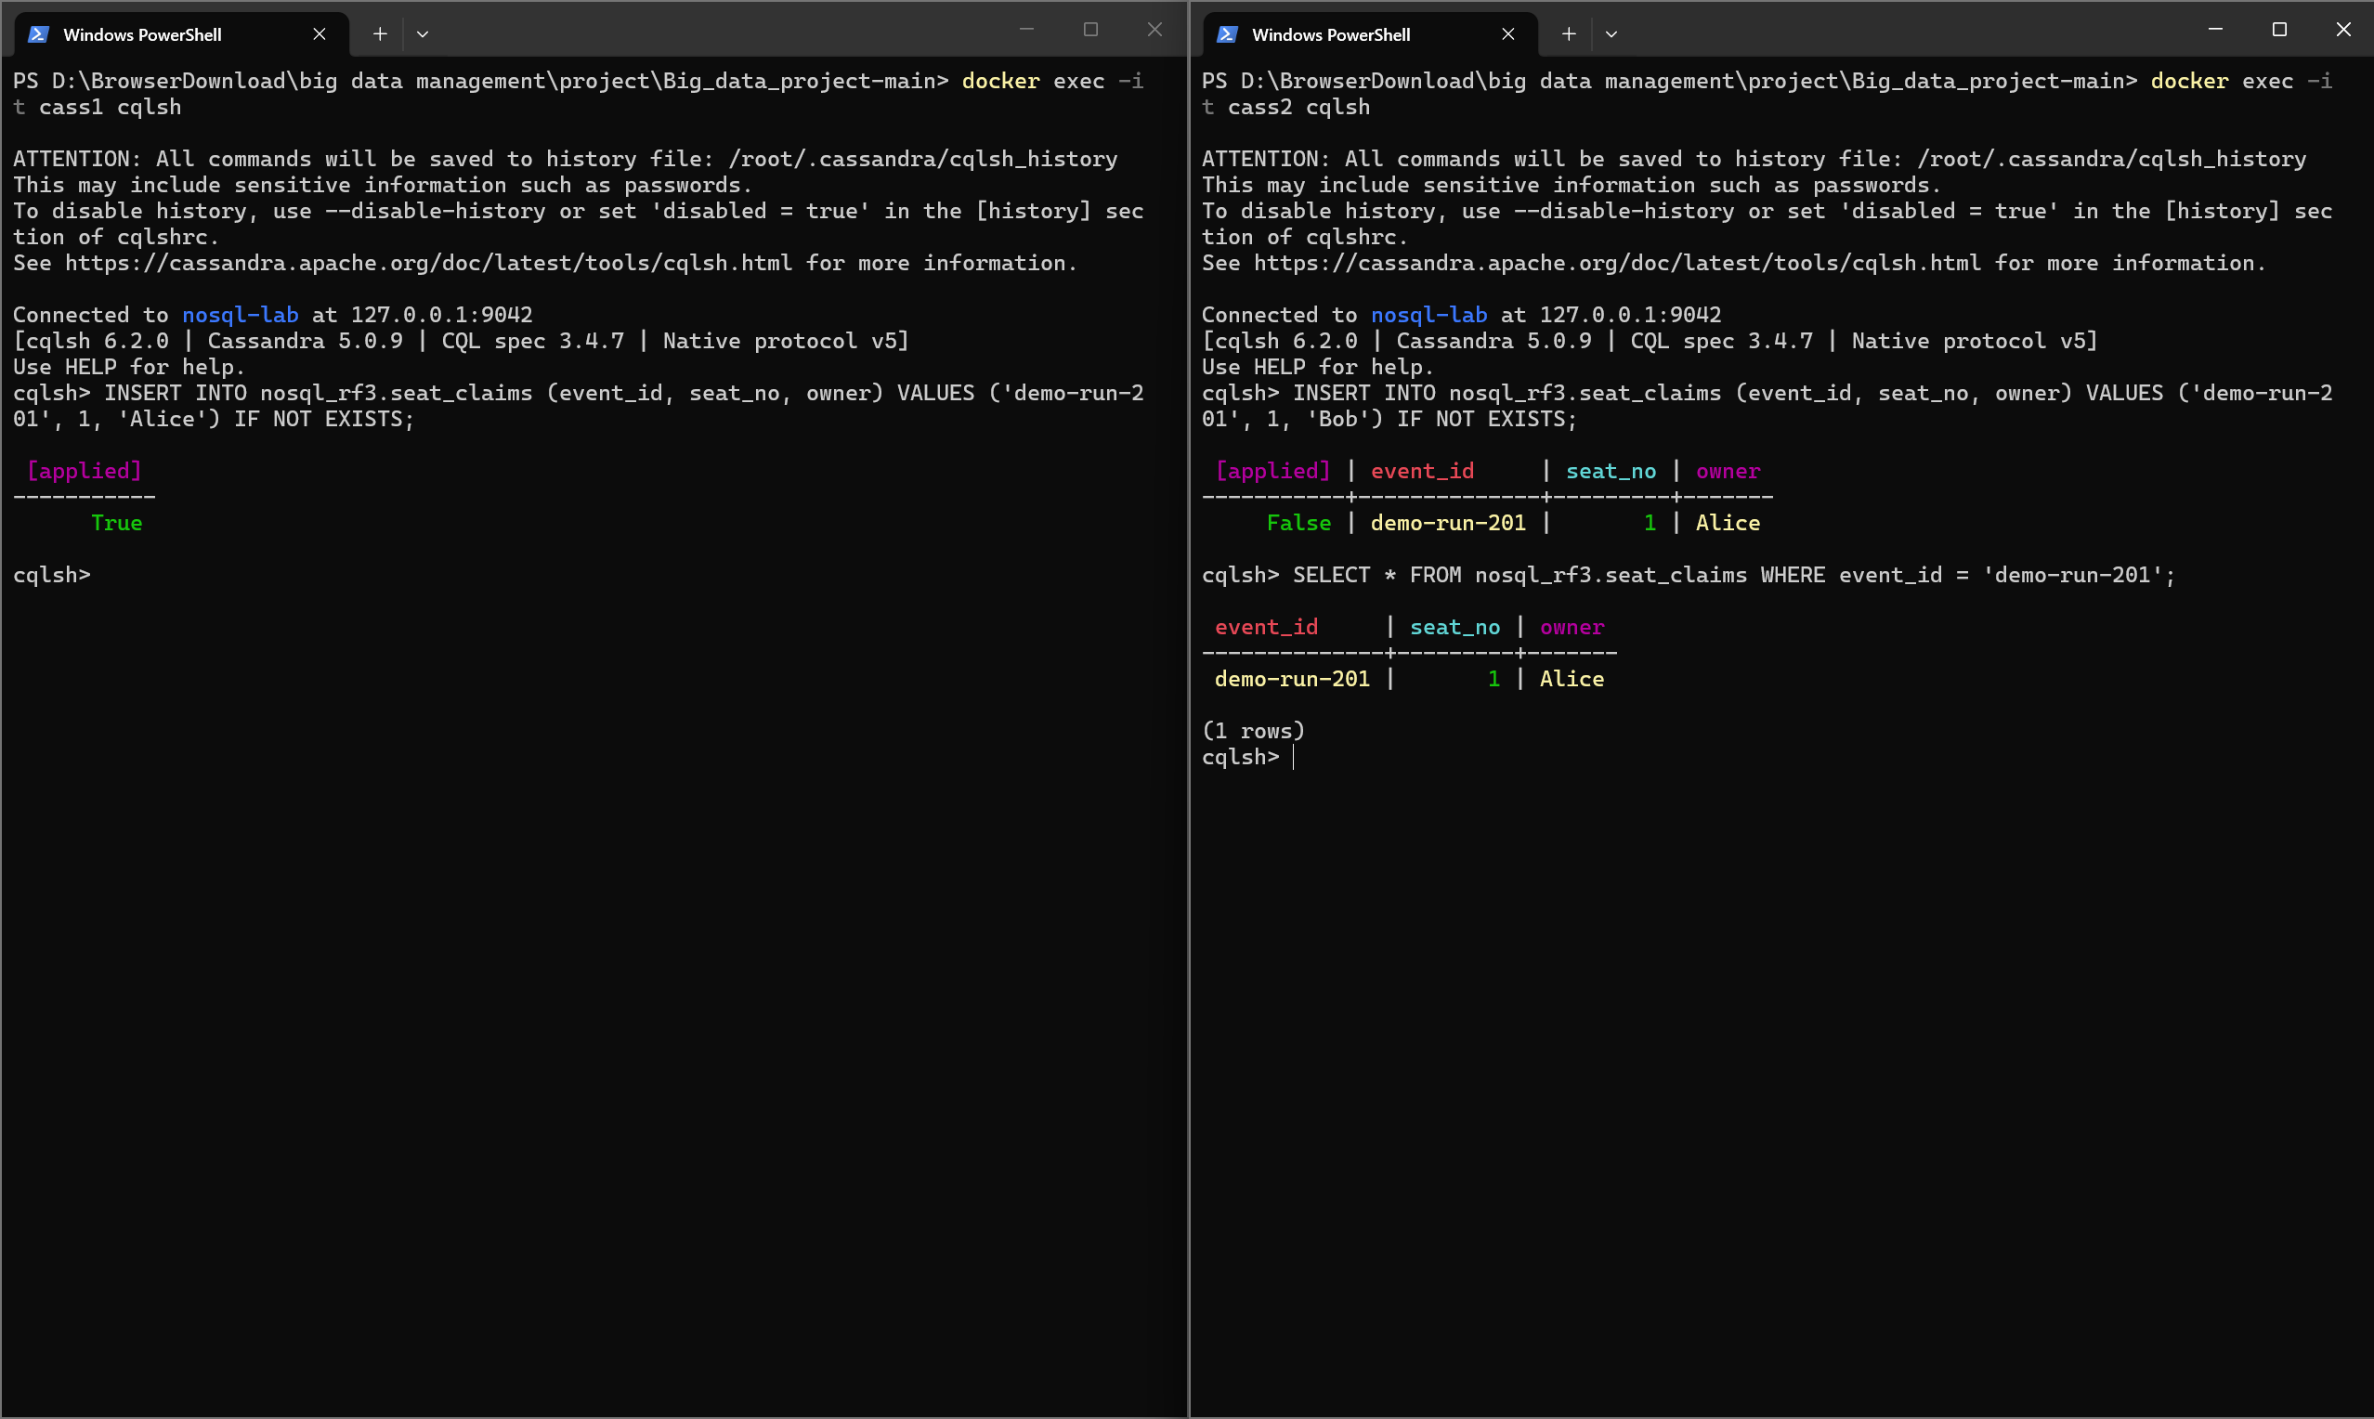
IF NOT EXISTS: first claim wins
PART 5D · TRANSACTIONS
Two independent cqlsh sessions: client A on cass1 (left), client B on cass2 (right)
Client A · cass1
[applied] = True
Client B · cass2
[applied] = False, owner = Alice
Final read · cass3
owner = Alice
Simultaneous run
exactly one True, one False
CONSISTENCY LOCAL_QUORUM
SERIAL CONSISTENCY LOCAL_SERIAL
Notes:
Two terminals, client A connected to cass1 and client B to cass2, so they even use different coordinators. In both, set CONSISTENCY LOCAL_QUORUM and SERIAL CONSISTENCY LOCAL_SERIAL, and show the settings. Client A claims seat 1 for Alice with IF NOT EXISTS: applied is True. Client B claims the same seat for Bob: applied is False, and Cassandra returns the current owner, Alice. A final read through cass3 shows Alice. Our scripted run also started both clients at the same moment: exactly one won. Which client wins can differ between runs, and that is correct. Use a new event id each time, for example demo-run-201.

Slide 19


What a lightweight transaction is not
PART 5D · TRANSACTIONS
Not a SQL transaction
No multi-row BEGIN … COMMIT with rollback. The guarantee covers one conditional change to one row.
Not a BATCH
A logged batch eventually applies all its writes, but gives no isolation across partitions.
Not free
Paxos needs several round trips, so it is slower than a normal write. Use it only where conflicts matter.
Timeout ≠ False
A WriteTimeout means the outcome is unknown. Read the row at SERIAL consistency before retrying.
Two consistency settings, two phases: SERIAL decides whether the condition holds (Paxos); LOCAL_QUORUM commits the write.
Notes:
To be precise about scope: a lightweight transaction is not a general SQL transaction; there is no multi-row commit and rollback here. It is also not a BATCH; a logged batch makes sure all its writes are eventually applied, but gives no isolation across partitions. It costs extra round trips. And a timeout means the result is unknown, not that it failed, so you read the row again at serial consistency. The serial level controls the Paxos phase that checks the condition; the normal level controls the commit.

Slide 20

Conclusion
Use case
Event registration or sensor data: many writes, queries known in advance.
Strength we measured
RF 3 kept reads and writes working at LOCAL_QUORUM with one node down, and the node caught up through hints.
Limitation we measured
Tables are designed per query (ALLOW FILTERING refused); a few keys spread unevenly; LWT costs extra round trips.
What we did not prove: three containers on one laptop show process failure, not survival of a lost machine, and say nothing about production-scale performance. We do not claim Cassandra is better in general.
Notes:
To conclude. A realistic use case is event registration or sensor data: many writes and queries known in advance. The strength we measured: with three copies the cluster kept reading and writing at LOCAL_QUORUM with one node down, and the node caught up through hinted handoff. The limitation we measured: tables must be designed around queries, a handful of keys can spread unevenly, and conditional writes cost extra coordination. What we did not prove: this is one laptop, so it is process failure, not machine failure, and not production performance. Thank you; we are happy to take questions.

Slide 21
Sources and materials
Lakshman, A. & Malik, P. (2010). Cassandra: a decentralized structured storage system. ACM SIGOPS Operating Systems Review, 44(2), 35–40.
DeCandia, G. et al. (2007). Dynamo: Amazon's highly available key-value store. Proc. SOSP 2007.
Chang, F. et al. (2006). Bigtable: a distributed storage system for structured data. Proc. OSDI 2006.
Apache Cassandra 5.0 documentation: Architecture (Dynamo, Guarantees), CQL DDL and DML, Hints, Read repair, cqlsh, nodetool getendpoints. cassandra.apache.org/doc/stable
Apache Cassandra download and licence (Apache License 2.0); Docker image cassandra:5.0.9.
Course handout: NoSQL Group Project, Big Data Management and Processing (NMI_PI130G3).
Project repository
README.md: setup, reset, topology
config/docker-compose.yml
scripts/: schema, generator, CRUD, experiment B, C, D
evidence/: full outputs for every experiment
slides/: this presentation
Data: self-generated by scripts/generate_data.py, no external dataset.
Notes:
Sources for the historical claims and for the behaviour we rely on. All commands and complete outputs are in the repository.

