Slide 1

Big Data Management and Processing: Apache Cassandra
Prepared by:
Ádám Guba (AAEIMO)
Computer Science MSc.
Contributers:
Chen Yuqi,
Sun Tong,
Ádám Guba
Ádám Guba
Big Data Management and Processing: Apache Cassandra
2026.10.30

Slide 2
Presentation Requirements
Introduction to the database ✓
Installation and setup ✓
Database structure and data model ✓
Basic queries and operations ✓
Replication, partitioning/scalability, and transactions ✓
Conclusion ✓
Ádám Guba
Big Data Management and Processing: Apache Cassandra
2026.10.30

Slide 3
Apache Cassandra Project
Use Case: Event Registration & Seat Reservation System
Database Version: Apache Cassandra 5.0.9
Used Technologies:
  Github
  Visual Studio Code
  Docker
Ádám Guba
Big Data Management and Processing: Apache Cassandra
2026.10.30

Slide 4
Introduction to the Database - Background
Developed at Facebook in 2008
Open Source Apache project since 2009
Combines two foundational distributed systems designs:
  Amazon’s Dynamo
  Google’s Bigtable
Ádám Guba
Big Data Management and Processing: Apache Cassandra
2026.10.30

Slide 5
Introduction to the Database – Problem
Original Problem: Powering Facebook’s Inbox Search across petabytes of messages and millions of users
Purpose: To solve a massive infrastructure challenge
Ádám Guba
Big Data Management and Processing: Apache Cassandra
2026.10.30

Slide 6
Introduction to the Database – Core Features
Partitioned wide-column storage
Interface: Cassandra Query Language (CQL)
  Hierarchy: Keyspace -> Table -> Partition (Partition Key) -> Rows ordered by Clustering Column
Ádám Guba
Big Data Management and Processing: Apache Cassandra
2026.10.30

Slide 7
Introduction to the Database - Suitability
Why It Fits Event Registrations:
  Registrations naturally group by event_id (Partition Key) and sort by seat_no (Clustering Column)
Main Strength:
  High write/partition-read scalability and continuous availability
  if one node fails in our RF=3 cluster, reads and writes continue seamlessly.
Main Limitation:
  Query-first design constraint: No JOINs or foreign keys
Ádám Guba
Big Data Management and Processing: Apache Cassandra
2026.10.30

Slide 8
Installation and Setup – Environment and Topology
Os: Windows + Docker Desktop (WSL 2 backend)
Image: cassandra: 5.0.9 (pinned tag + SHA256 digest)
Client: cqlsh 6.2.0 | CQL spec 3.4.7 | Native protocol v5
Licence: Apache License 2.0
Ádám Guba
Big Data Management and Processing: Apache Cassandra
2026.10.30

Slide 9
Installation and Setup – Cluster Topology
Docker network cassnet · data centre dc1 · rack1
Setting | Value
Start order | cass1 → cass2 → cass3 (healthchecks)
Heap | 512M, new gen 128M
Memory limit | 1200 MiB per container
Restart | "no": a stopped node stays stopped
Reset | scripts/reset.sh (down -v deletes data!)
Config | config/docker-compose.yml
cass1
seed node
vol: cass1_data
cass2
joins after cass1
vol: cass2_data
cass3
joins after cass2
vol: cass3_data
nodes talk to each other via gossip
CQL only on 127.0.0.1:9042
Host laptop
cqlsh, scripts, evidence
Ádám Guba
Big Data Management and Processing: Apache Cassandra
2026.10.30
Notes:
Three Cassandra containers share one private Docker network and one data centre called dc1. They start in sequence: cass2 waits until cass1 is healthy, cass3 waits for cass2. Each node has its own data volume. Only cass1 publishes the CQL port, and only on 127.0.0.1, so nothing is exposed to the network. Because three JVMs share one laptop we lowered the heap to 512 MB and capped each container at 1200 MiB. restart is set to no, so a node we stop for an experiment stays stopped. reset.sh wipes the volumes and re-seeds the data; it is marked clearly because it deletes data.

Slide 10
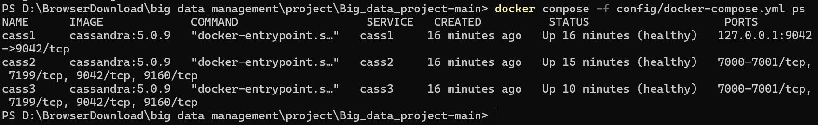
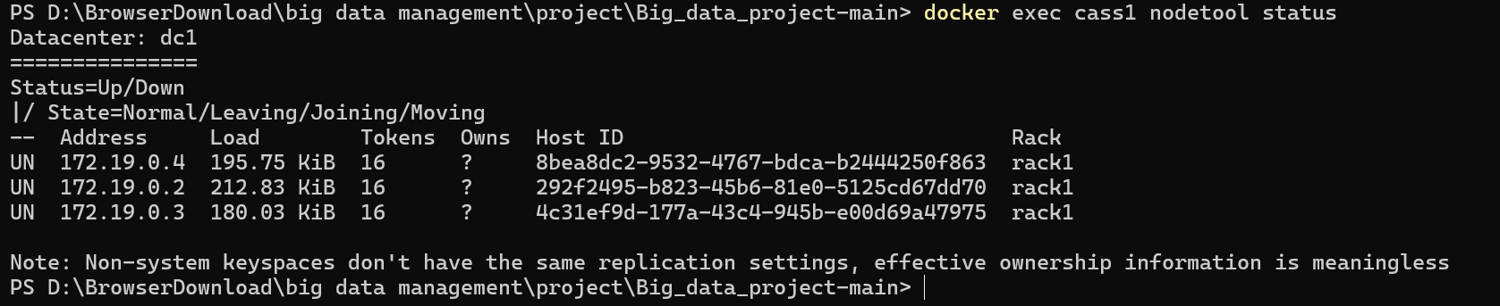
Installation and Setup – Readiness Checks
docker compose ps: all three containers healthy
✓ 3 × UN
  all nodes up and normal
✓ 1 schema version
  shared by all three nodes
✓ Smoke test
  write via cass1, read via cass3
✓ Logs clean
  no errors on any node
! Memory is tight
  about 1.1 of 1.17 GiB per node
nodetool status: three nodes UN (Up / Normal) in dc1
Ádám Guba
Big Data Management and Processing: Apache Cassandra
2026.10.30
Notes:
Before every experiment we check the same things. docker compose ps shows all three containers healthy. nodetool status shows three nodes UN, which means up and normal, in data centre dc1. describecluster shows one schema version on all three nodes. A smoke test writes through cass1 and reads the same row through cass3. The logs show no errors. Each node uses about 1.1 of its 1.17 GiB limit, so memory is the main constraint on a laptop.

Slide 11
Database Structure – Keyspaces and Tables
Keyspace = replication setting
  nosql_rf3: NetworkTopologyStrategy, dc1: 3
  nosql_rf1: NetworkTopologyStrategy, dc1: 1
Data
  scripts/generate_data.py: deterministic, no external dataset
  6 events E1–E6 with 30, 20, 15, 25, 10, 20 seats = 120 rows
Table | Primary key | Used for
nosql_rf3.registrations | ((event_id), seat_no) | CRUD, replication
nosql_rf3.seat_claims | (event_id, seat_no) | transactions
nosql_rf1.registrations_good | ((event_id), seat_no) | partitioning
nosql_rf1.registrations_bad | ((bucket), event_id, seat_no) | partitioning (poor key)
Ádám Guba
Big Data Management and Processing: Apache Cassandra
2026.10.30
Notes:
We use two keyspaces. nosql_rf3 keeps three copies of every partition; we use it for CRUD, the availability experiment and lightweight transactions. nosql_rf1 keeps a single copy and is used only for the placement experiment, because with three copies on three nodes every node holds everything and placement is invisible. Four tables in total. The data comes from our own deterministic generator: six events, 120 registrations, no external dataset.

Slide 12
Database Structure – The registrations Table
Query that shaped the design:
  list all registrations for event X
Partition key: event_id
  hashed to a token; the token decides which node stores the partition
Clustering column: seat_no
  sorts rows inside one partition, so one read returns an event's seats in order
No joins, no foreign keys:
  a different query needs its own table
CREATE TABLE nosql_rf3.registrations (
event_id text, -- partition key
seat_no int, -- clustering column
attendee text,
email text,
registered_at timestamp,
PRIMARY KEY ((event_id), seat_no)
) WITH CLUSTERING ORDER BY (seat_no ASC);
Example row: E1 | 5 | attendee_E1_005 | e1.5@example.org | 2026-11-01 09:05
Ádám Guba
Big Data Management and Processing: Apache Cassandra
2026.10.30
Notes:
In Cassandra you start from the query, not from the entities. Our main query is: list all registrations for one event. So event_id is the partition key: Cassandra hashes it into a token, and the token decides which node stores that event. seat_no is the clustering column: it keeps the seats of one event sorted inside the partition, so one read returns them in order. Clustering columns are optional in general; we use one because our query needs the seats in order.

Slide 13
Basic Queries and Operations – CRUD
Step | Command (event_id = 'CRUD-DEMO') | Result after the SELECT
1 Create | INSERT seat 1, 'Alice', 'alice@example.org' | 1 row: seat 1, Alice
2 Read | SELECT * WHERE event_id = 'CRUD-DEMO' | 2 rows, sorted by seat_no
3 Update | UPDATE SET email = 'alice.new@…' WHERE seat_no = 1 | e-mail changed, name still Alice
4 Upsert (INSERT) | INSERT seat 1, attendee 'Carol' (key exists) | no error: attendee → Carol, e-mail kept
5 Upsert (UPDATE) | UPDATE SET attendee 'Dave' WHERE seat_no = 3 (no row) | no error: new row for seat 3
6 Delete | DELETE WHERE seat_no = 2 | seats 1 and 3 remain
Cleanup | DELETE WHERE event_id = 'CRUD-DEMO' | count = 0
Every change is verified by a SELECT · script: scripts/crud.cql · output: evidence/02_crud/crud_output.txt
Ádám Guba
Big Data Management and Processing: Apache Cassandra
2026.10.30
Notes:
Run in cqlsh on cass1 after CONSISTENCY LOCAL_QUORUM. Every change is followed by a SELECT that shows the new state. Create Alice in seat 1. Read the partition: two rows, sorted by seat number because seat_no is the clustering column. Update Alice's e-mail. Steps 4 and 5 show upsert, explained on the next slide. Delete seat 2. The cleanup deletes the demo partition. Script: scripts/crud.cql, output: evidence/02_crud/crud_output.txt.

Slide 14
Basic Queries and Operations – Upsert
Writes never check existence
INSERT overwrites:
  only the listed columns change; the e-mail stayed
UPDATE creates:
  seat 3 did not exist; unset columns are null
Why it matters:
  two people booking the same seat would silently overwrite each other (solved in Part 5 with IF NOT EXISTS)
-- Step 4: INSERT on an existing key
INSERT ... (event_id, seat_no, attendee)
VALUES ('CRUD-DEMO', 1, 'Carol');
seat_no | attendee | email
1 | Carol | alice.new@example.org
-- Step 5: UPDATE on a missing key
UPDATE ... SET attendee = 'Dave'
WHERE event_id = 'CRUD-DEMO' AND seat_no = 3;
seat_no | attendee | email
1 | Carol | alice.new@example.org
2 | Bob | bob@example.org
3 | Dave | null
Ádám Guba
Big Data Management and Processing: Apache Cassandra
2026.10.30
Notes:
This is the most important difference from a relational database. In MySQL, inserting an existing primary key gives an error. In Cassandra, INSERT and UPDATE are both upserts: neither checks whether the row exists. In step 4 the insert on seat 1 replaced only the attendee column; the e-mail written before is still there. In step 5 the update on seat 3, which did not exist, created the row. That is fast, but if two customers book the same seat, the second write wins silently. Part 5 fixes this with IF NOT EXISTS.

Slide 15
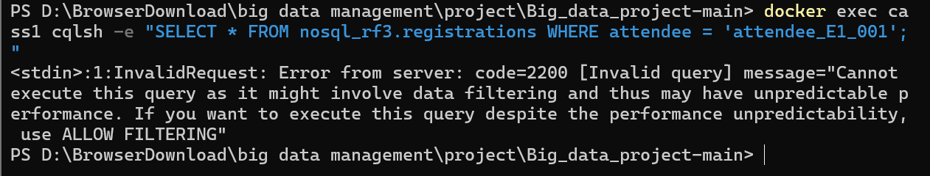
Basic Queries and Operations – Beyond CRUD
Query on a non-key column (attendee):
-- range on the clustering column
SELECT seat_no, attendee FROM registrations
WHERE event_id = 'E1'
AND seat_no >= 5 AND seat_no <= 10;
→ seats 5, 6, 7, 8, 9, 10
-- reverse order, last 5 seats
... WHERE event_id = 'E1'
ORDER BY seat_no DESC LIMIT 5;
→ seats 30, 29, 28, 27, 26
-- size of one event
SELECT count(*) ... WHERE event_id = 'E1';
→ 30
Refused: attendee is not in the primary key, so Cassandra would scan every partition
Query-first design: a new question needs a new table, e.g. one keyed by attendee
Ádám Guba
Big Data Management and Processing: Apache Cassandra
2026.10.30
Notes:
Beyond single-row lookups, the clustering column gives useful queries inside one partition: a range of seats, the last five seats in reverse order, and the number of registrations for an event. The screenshot shows what Cassandra refuses: a query on attendee, which is not part of the key. Cassandra would have to scan every partition on every node, so it refuses unless we add ALLOW FILTERING. The proper fix is another table designed for that query: query-first design.

Slide 16
Presentation Requirements
Introduction to the database ✓
Installation and setup ✓
Database structure and data model ✓
Basic queries and operations ✓
Replication, partitioning/scalability, and transactions
  Replication and availability (experiment B)
  Partition-key design and placement (experiment C)
  Lightweight transactions (experiment D)
Conclusion
Chen Yuqi
Big Data Management and Processing: Apache Cassandra
2026.10.30
Notes:
Parts 1 to 4 are done. This part covers the distributed and transactional behaviour: replication, partitioning, lightweight transactions, and the conclusion.

Slide 17
Replication – Replication Factor vs Consistency Level
Replication factor (RF): how many copies exist
  Keyspace nosql_rf3 has RF = 3, so every node holds a copy
Consistency level (CL): how many replicas must answer
  LOCAL_QUORUM = 2 of 3, ALL = 3 of 3
No primary node: the contacted node coordinates the request
Test: stop cass3, keep the client connected to cass1
cass1
UN
cass2
UN
cass3
DN
2 of 3 replicas alive
✓ LOCAL_QUORUM read and write
needs 2 replies, 2 available: works
✗ ALL read
needs 3 replies, 2 available: Unavailable
Chen Yuqi
Big Data Management and Processing: Apache Cassandra
2026.10.30
Notes:
Two numbers are easy to confuse. The replication factor is how many copies exist: three in nosql_rf3, so every node holds a copy. The consistency level is how many of those copies must answer one request: LOCAL_QUORUM needs two, ALL needs three. We stop cass3 and keep the client on cass1. Two replicas are still alive, so we predict that LOCAL_QUORUM keeps working and ALL fails. There is no primary node; cass1 just coordinates.

Slide 18
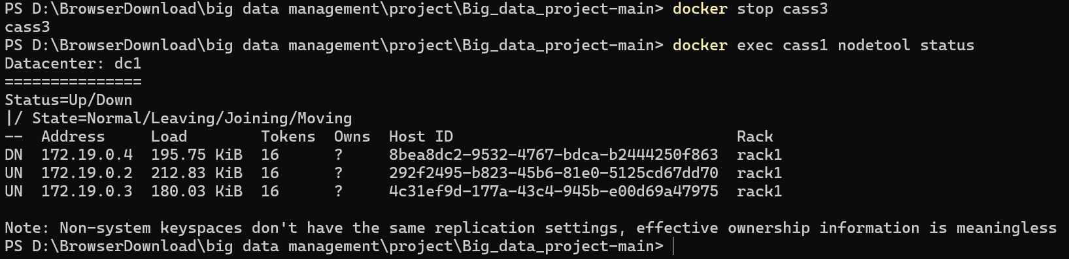
Replication – Experiment: One Node Down
B1 seed B-TEST at ALL: before_failure
B2 docker stop cass3: DN after ~5 s
B2a ✓ QUORUM read: before_failure
B2b ✓ QUORUM write: during_failure
B2c ✓ QUORUM read back: during_failure
B2d ✗ ALL read: Unavailable
  required_replicas 3, alive_replicas 2
nodetool status after docker stop cass3
CONSISTENCY ALL;
SELECT ... WHERE event_id = 'B-TEST';
Unavailable: Cannot achieve
consistency level ALL
required_replicas: 3, alive_replicas: 2
Chen Yuqi
Big Data Management and Processing: Apache Cassandra
2026.10.30
Notes:
Results from scripts/b_replication.sh. First we seed a row at consistency ALL while everything is healthy, so all three replicas have it. Then we stop cass3; nodetool shows it as DN within about five seconds. With LOCAL_QUORUM we can still read the old value, write a new value during_failure, and read it back. Then we switch to ALL and read the same row: Cassandra refuses with Unavailable, required replicas three, alive replicas two. We use the failed read as evidence, not a failed write, because a failed write may still have reached some replicas.

Slide 19
Replication – Recovery After the Node Returns
docker start cass3
  3 × UN again about 20 s later
Hinted handoff
  cass1 stored the missed write and replayed it to cass3 (172.19.0.4)
ALL read
  returns during_failure from all 3 replicas
Careful interpretation
  An ALL read can trigger read repair: it proves the replicas agree now
  One laptop: process failure, not the loss of a machine
Test | Expected | Observed
QUORUM read, 1 node down | succeeds | before_failure
QUORUM write + read back | succeeds | during_failure
ALL read, 1 node down | Unavailable | required 3, alive 2
ALL read after restart | new value | during_failure
docker logs cass1 | grep hint
Finished hinted handoff of file ...hints
to endpoint /172.19.0.4 (= cass3)
Chen Yuqi
Big Data Management and Processing: Apache Cassandra
2026.10.30
Notes:
When cass3 comes back, all three nodes are UN again after about twenty seconds. The log of cass1 shows hinted handoff: while cass3 was down, cass1 kept a hint for the write it missed and replayed it to cass3's address. An ALL read now returns during_failure from all three replicas. All four expected results match. Two cautions: an ALL read can itself repair data, so it shows the replicas agree now; and this is one laptop, so it shows a process failure, not survival of a lost machine.

Slide 20
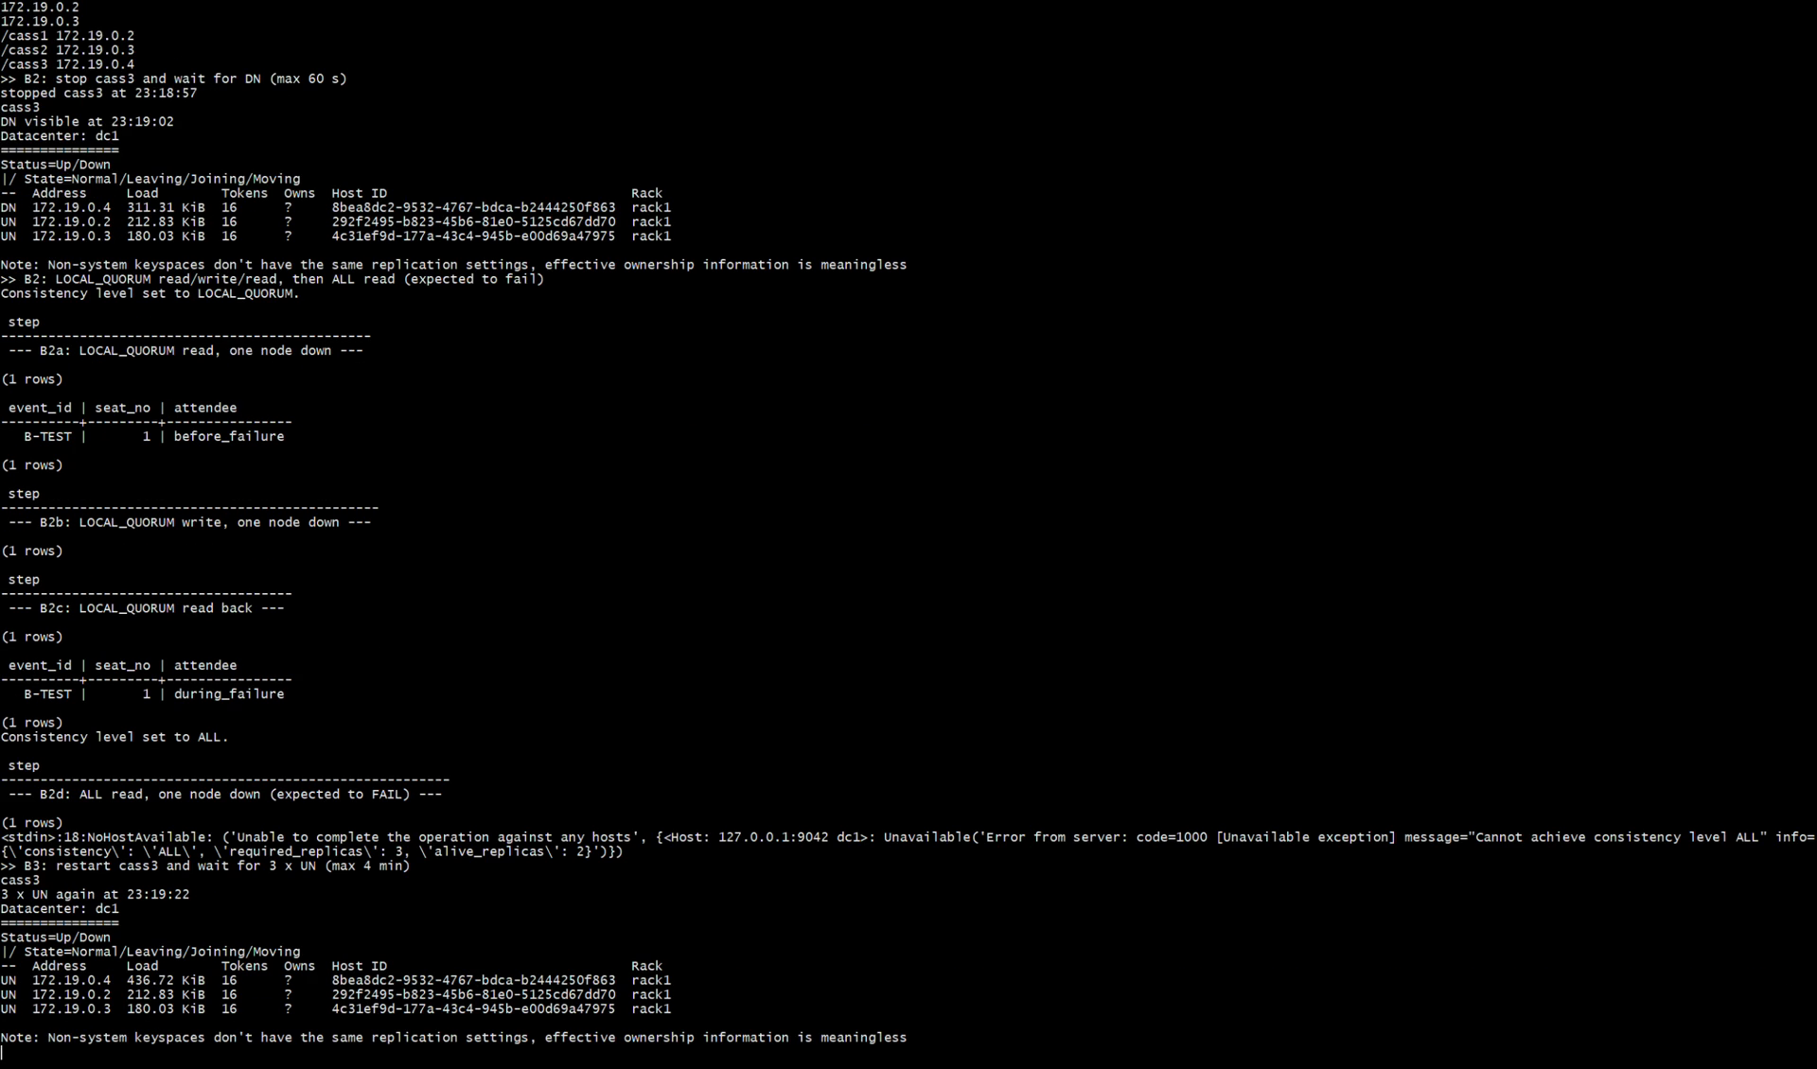
Replication – Recording of the Full Run
Recording of scripts/b_replication.sh (77 s)
Chen Yuqi
Big Data Management and Processing: Apache Cassandra
2026.10.30
Notes:
The unedited recording of scripts/b_replication.sh: seed at ALL, stop cass3, QUORUM succeeds and ALL fails, restart, hints, and the ALL read after recovery.

Slide 21
Partitioning – Good vs Poor Partition Key
PRIMARY KEY ((event_id), seat_no)
  10–30 rows per partition
  events can live on different nodes
PRIMARY KEY ((bucket), event_id, seat_no)
  bucket = 'all': 120 rows in one partition
  every request hits one node
Chen Yuqi
Big Data Management and Processing: Apache Cassandra
2026.10.30
Notes:
For placement we use the RF 1 keyspace, because with RF 3 on three nodes every node holds every partition and placement is invisible. The same 120 registrations went into two tables. The good table uses event_id as partition key: six partitions of 10 to 30 rows. The poor table puts a constant value, 'all', in the partition key: one partition with all 120 rows. Both answer the query for event E1 with the same rows; the difference is where the data lives. We counted distinct primary keys and cross-checked them from the seed file.

Slide 22
Partitioning – Where Each Partition Lives
Partition key | Rows | Token | Node
E1 | 30 | -8417341041065285198 | cass1
E2 | 20 | -2554343524930710110 | cass2
E3 | 15 | -7347942446438086986 | cass1
E4 | 25 | 1236003599942733440 | cass2
E5 | 10 | -5474989656694850673 | cass2
E6 | 20 | -5200551344520828814 | cass1
all (bad table) | 120 | 5100602505380613394 | cass1
cass1: E1, E3, E6 and 'all'
cass2: E2, E4, E5
cass3: none of our keys
  although it owns 35.7% of the token ring
Partition key → token → node
  clustering columns only sort rows inside a partition
More keys spread load, but not perfectly
  a popular event is still one hot partition
From nodetool getendpoints (replica owner, not the coordinator) and SELECT token(event_id)
Chen Yuqi
Big Data Management and Processing: Apache Cassandra
2026.10.30
Notes:
Cassandra hashes each partition key into a token, and the token range decides the node. With RF 1, getendpoints returns exactly one node per key. The six good keys landed on two nodes: E1, E3 and E6 on cass1; E2, E4 and E5 on cass2. The bad table's single partition 'all' sits on cass1 with all 120 rows, so every request for any event would hit that node: a hotspot. cass3 owns about 36 percent of the ring but received none of our six keys. With few keys, hashing does not guarantee even load, and a popular event would still be one hot partition. getendpoints shows where data is stored, not which node coordinated a query.

Slide 23
Transactions – The Double-Booking Problem
Ordinary INSERT (upsert):
 | Ordinary INSERT | INSERT … IF NOT EXISTS
Checks existence | No (upsert) | Yes
Second writer | Overwrites silently | Refused: [applied] = False
Cost | One round of replica writes | Several round trips (Paxos)
Scope | Any rows | One row / one partition
INSERT ... VALUES ('demo-plain', 1, 'Alice');
INSERT ... VALUES ('demo-plain', 1, 'Bob');
event_id | seat_no | owner
demo-plain | 1 | Bob
no error: Alice's booking silently lost
Conditional write (LWT):
INSERT INTO nosql_rf3.seat_claims
(event_id, seat_no, owner)
VALUES (...) IF NOT EXISTS;
Chen Yuqi
Big Data Management and Processing: Apache Cassandra
2026.10.30
Notes:
Back to the upsert problem from Part 4. With an ordinary insert, Alice books seat 1, then Bob books the same seat; there is no error and the final owner is Bob. Alice's booking is silently lost. A lightweight transaction adds a condition, IF NOT EXISTS. Cassandra checks the condition and applies the write atomically for that one row, using a Paxos-based protocol. That costs several extra round trips and only covers one row or partition. We use the table seat_claims, a fresh event id for every run, and all three nodes running.

Slide 24
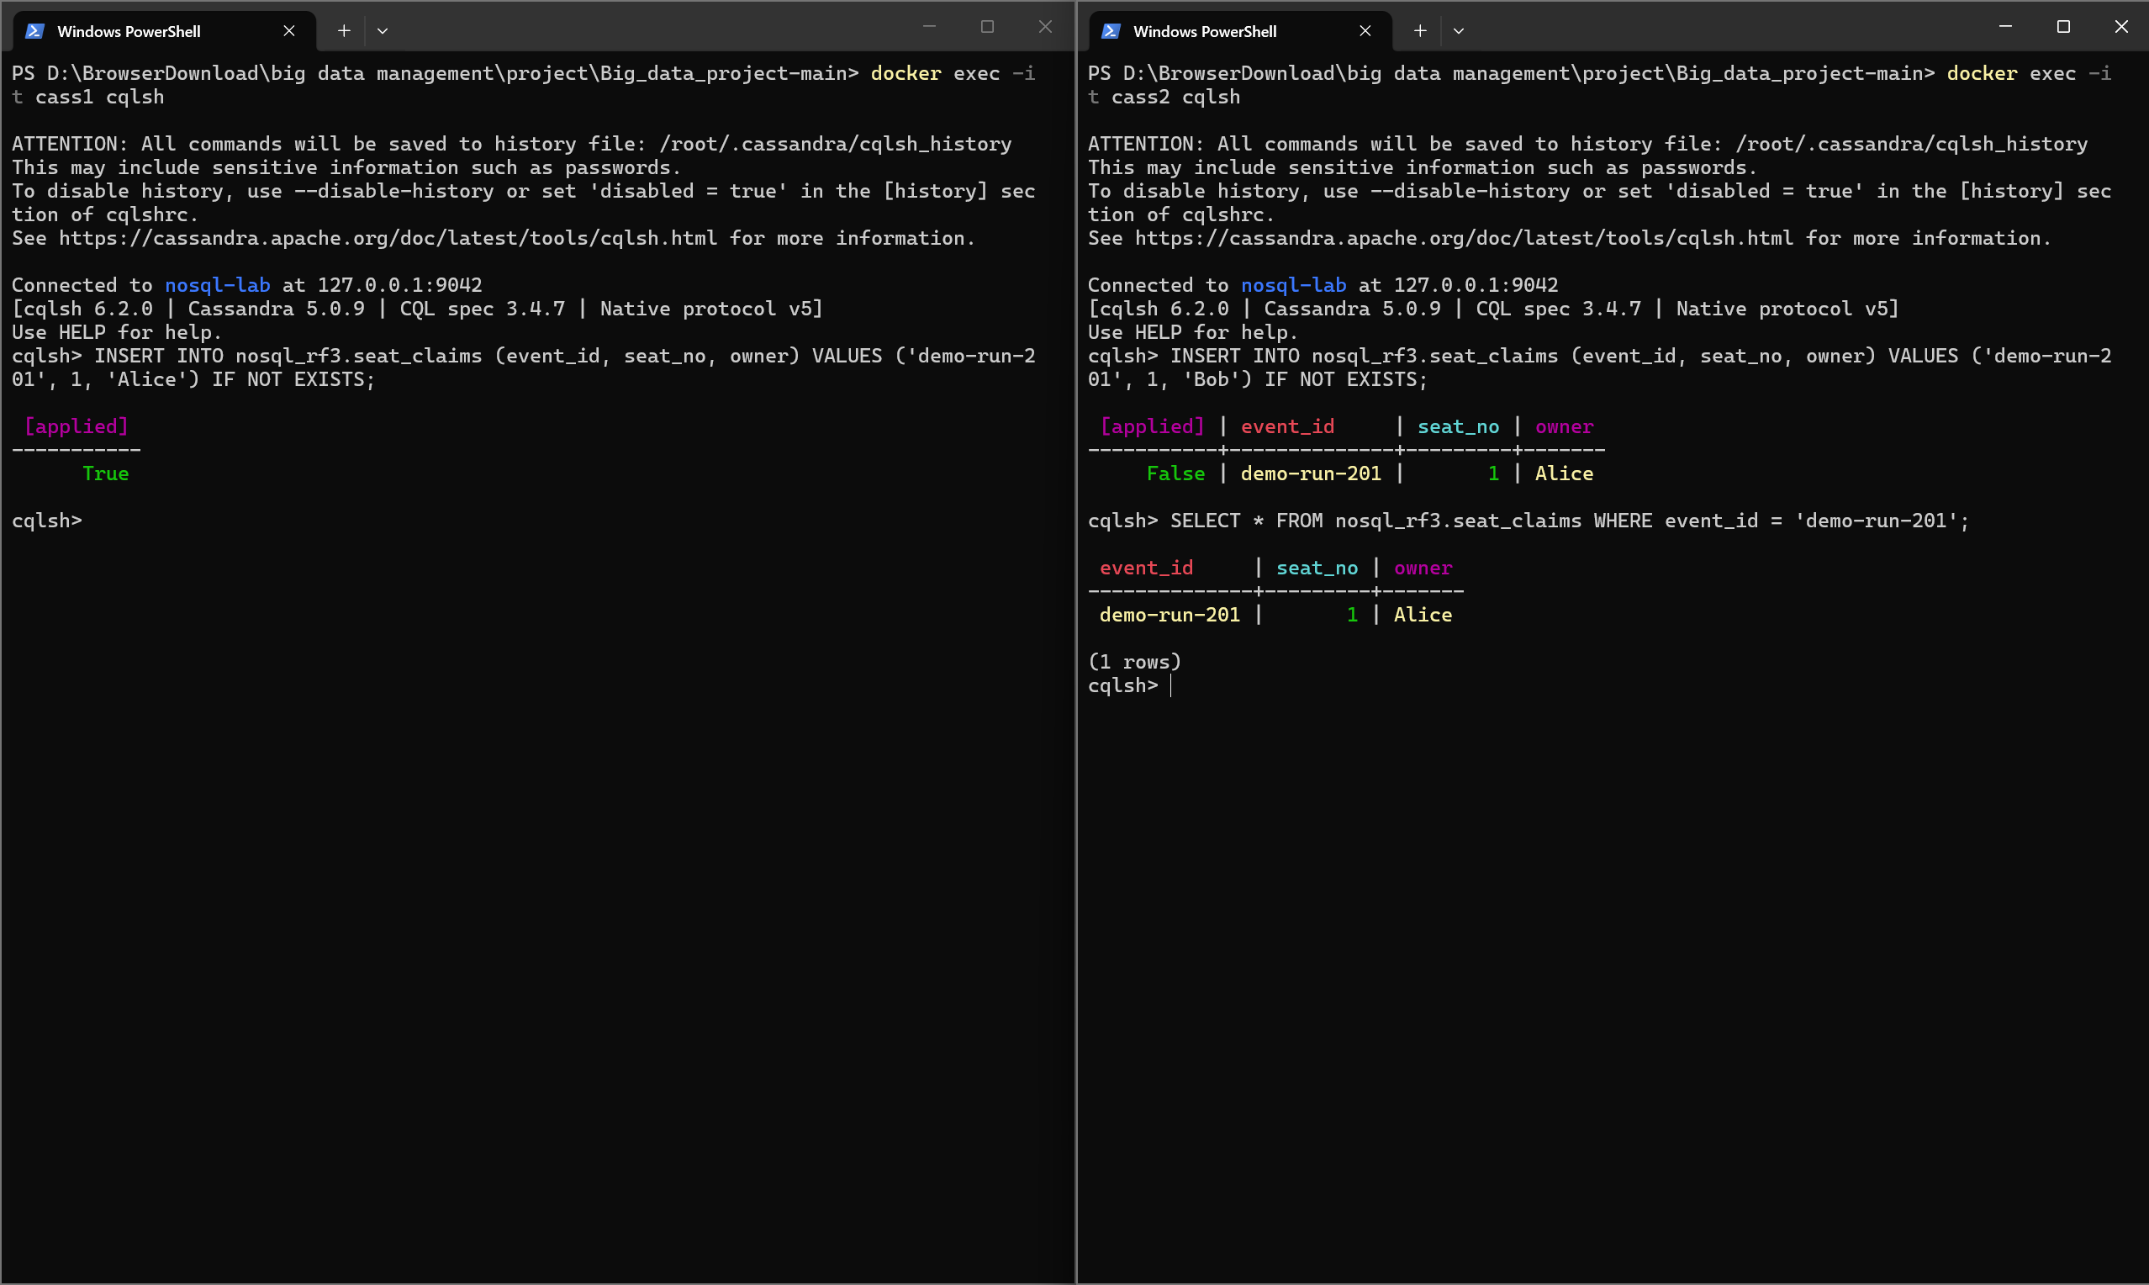
Transactions – IF NOT EXISTS: First Claim Wins
Client A on cass1 (left), client B on cass2 (right)
Client A (cass1)
  Alice: [applied] = True
Client B (cass2)
  Bob: [applied] = False
  Cassandra returns owner = Alice
Final read
  owner = Alice
Simultaneous run
  exactly one True, one False
Settings
  LOCAL_QUORUM + LOCAL_SERIAL
Chen Yuqi
Big Data Management and Processing: Apache Cassandra
2026.10.30
Notes:
Two terminals: client A connected to cass1 and client B to cass2, so they even use different coordinators. Client A claims seat 1 for Alice with IF NOT EXISTS: applied is True. Client B claims the same seat for Bob: applied is False, and Cassandra returns the current owner, Alice. A final read shows Alice. Our scripted run also started both clients at the same moment: exactly one won. Which client wins can differ between runs, and that is correct. The scripted run used CONSISTENCY LOCAL_QUORUM and SERIAL CONSISTENCY LOCAL_SERIAL; use a new event id each time.

Slide 25
Transactions – What a Lightweight Transaction Is Not
Not a SQL transaction:
  no multi-row BEGIN … COMMIT with rollback; the guarantee covers one conditional change to one row
Not a BATCH:
  a logged batch eventually applies all its writes, but gives no isolation across partitions
Not free:
  Paxos needs several round trips, so it is slower than a normal write
Timeout ≠ False:
  a WriteTimeout means the outcome is unknown; read the row at SERIAL consistency before retrying
Two settings, two phases:
  SERIAL decides whether the condition holds (Paxos); LOCAL_QUORUM commits the write
Chen Yuqi
Big Data Management and Processing: Apache Cassandra
2026.10.30
Notes:
A lightweight transaction is not a general SQL transaction; there is no multi-row commit and rollback here. It is also not a BATCH; a logged batch makes sure all its writes are eventually applied, but gives no isolation across partitions. It costs extra round trips. And a timeout means the result is unknown, not that it failed, so you read the row again at serial consistency. The serial level controls the Paxos phase that checks the condition; the normal level controls the commit.

Slide 26
Conclusion
Use Case:
  Event registration or sensor data: many writes, queries known in advance
Strength we measured:
  RF 3 kept reads and writes working at LOCAL_QUORUM with one node down; the node caught up through hints
Limitation we measured:
  Tables are designed per query (ALLOW FILTERING refused); a few keys spread unevenly; LWT costs extra round trips
What we did not prove:
  Three containers on one laptop show process failure, not survival of a lost machine, and nothing about production-scale performance
Chen Yuqi
Big Data Management and Processing: Apache Cassandra
2026.10.30
Notes:
A realistic use case is event registration or sensor data: many writes and queries known in advance. The strength we measured: with three copies the cluster kept reading and writing at LOCAL_QUORUM with one node down, and the node caught up through hinted handoff. The limitation we measured: tables must be designed around queries, a handful of keys can spread unevenly, and conditional writes cost extra coordination. What we did not prove: this is one laptop, so it is process failure, not machine failure, and not production performance. Thank you.

Slide 27
Sources
Lakshman, A. & Malik, P. (2010). Cassandra: a decentralized structured storage system. ACM SIGOPS Operating Systems Review, 44(2), 35–40.
DeCandia, G. et al. (2007). Dynamo: Amazon's highly available key-value store. Proc. SOSP 2007.
Chang, F. et al. (2006). Bigtable: a distributed storage system for structured data. Proc. OSDI 2006.
Apache Cassandra 5.0 documentation: Architecture (Dynamo, Guarantees), CQL DDL and DML, Hints, Read repair, cqlsh, nodetool getendpoints. cassandra.apache.org/doc/stable
Apache Cassandra download and licence (Apache License 2.0); Docker image cassandra:5.0.9.
Course handout: NoSQL Group Project, Big Data Management and Processing (NMI_PI130G3).
Project repository: README, docker-compose, scripts and full evidence for every experiment; data self-generated by scripts/generate_data.py.
Chen Yuqi
Big Data Management and Processing: Apache Cassandra
2026.10.30
Notes:
Sources for the historical claims and the behaviour we rely on. All commands and complete outputs are in the project repository.

