Slide 1
Step 1: PCA on NYC-Q
Ran a PCA on the NYC-Q (n=643) to understand different components of thought that it measures
Ended up with 7 components

Slide 2
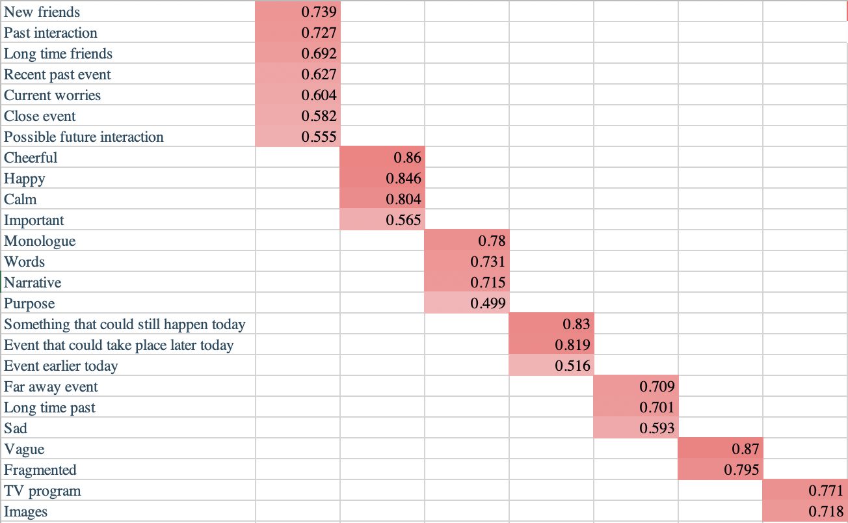

Slide 3
Step 2: t-tests between old and young adults
Ran independent t-tests to understand if the amount to which participants engaged these 7 components differed between old (n=135) and young (n=175) participants
Components 1, 4, and 7 were significantly greater in young adults
Social, episodic thoughts including current concerns
Thoughts about today (earlier and later)
Thoughts in images

Slide 4
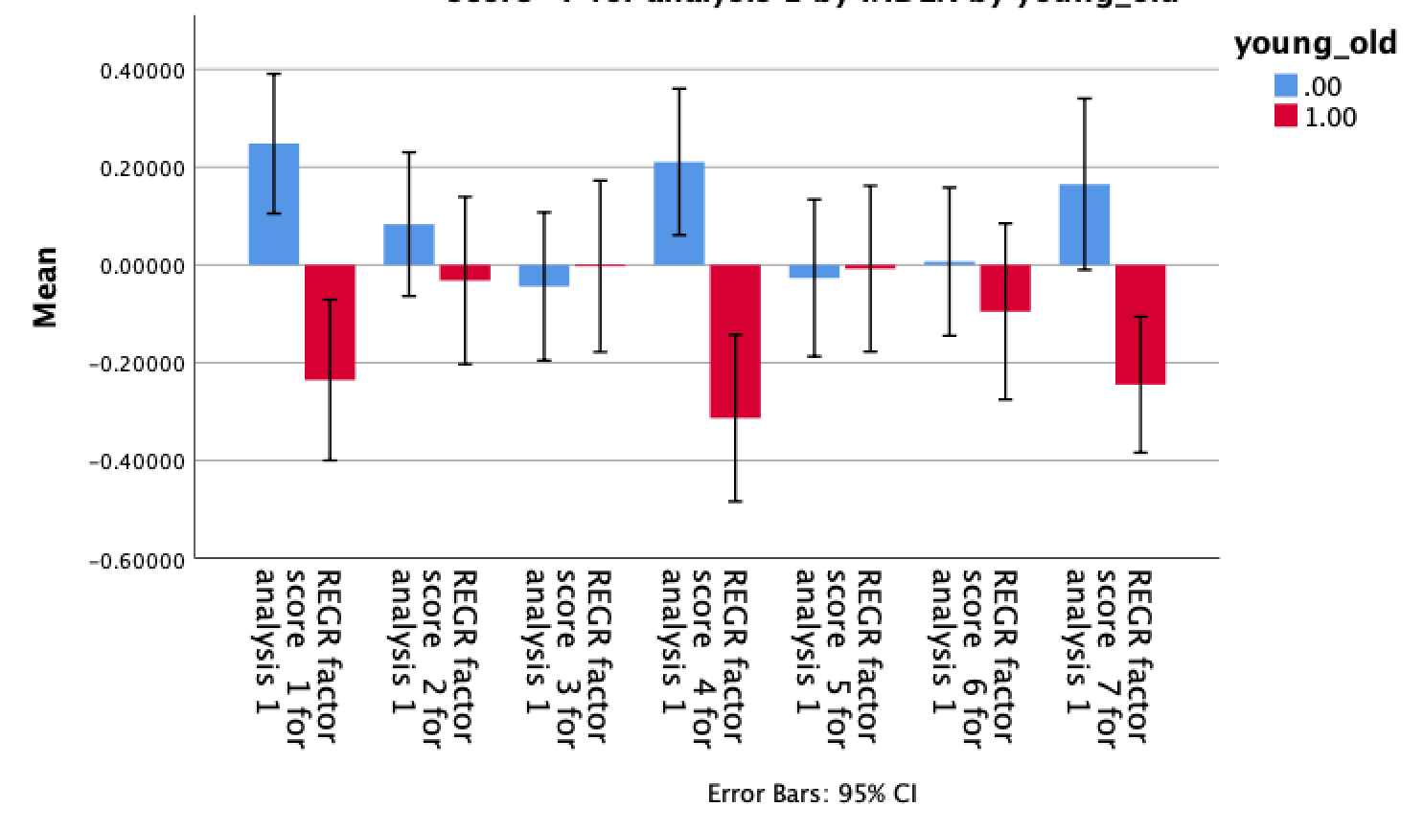
***
***
**

Slide 5
Step 3: PCA on executive functioning battery
Ran PCA on PENN-CPU executive functioning battery (n=742)
Ended up with 3 components

Slide 6
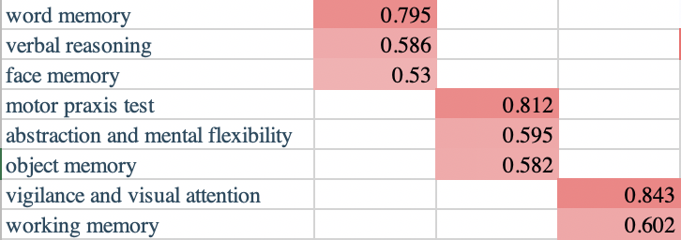

Slide 7
Step 4: t-test between old and young adults
Ran independent t-tests to understand if different aspects of executive functioning differed between old (n=152) and young (n=207) participants
Components 1 greater in old adults
Verbal abilities and face memory
(Not significant if including SES and gender)
Components 2 and 3 greater in young adults
Motor skills, mental flexibility, and object memory
Vigilance and working memory

Slide 8
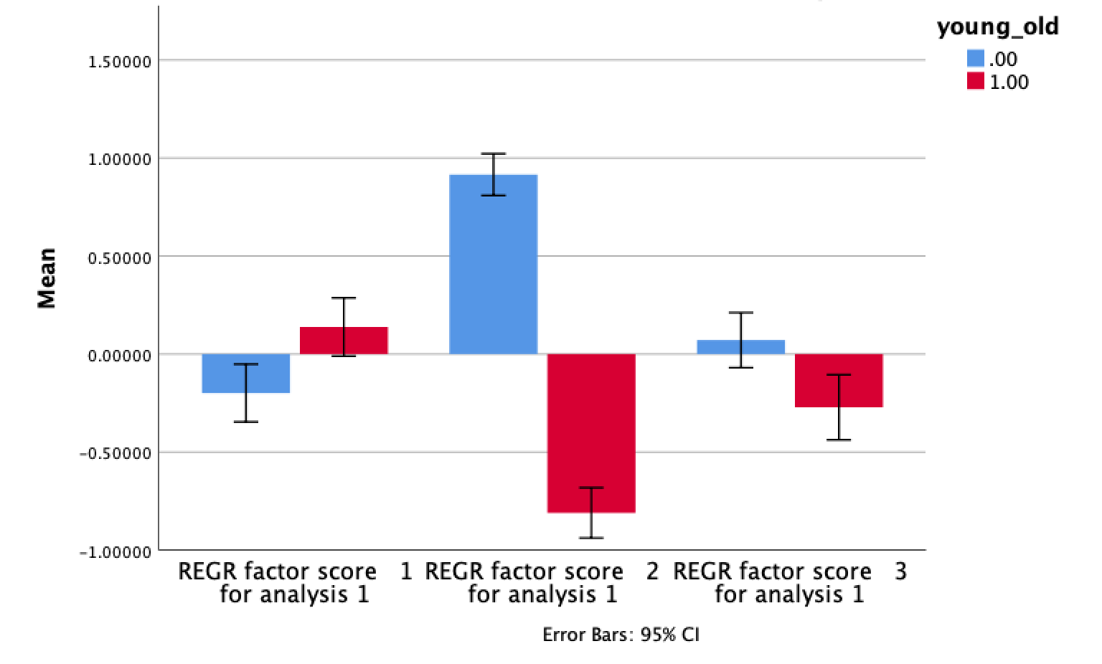
**
***
**

Slide 9
Step 5: multivariate analysis
Assessing the relationship between the 7 components of thought and the 3 measures of EF, as well as interactions with age (n=162 young adults, n=119 old adults)
Significant effect of component 2 of EF (motor skills, mental flexibility, and object memory)
Positive relationship to component 6 (disjointed and fragmented thinking) and component 7 (thinking in images)
Interaction with age for component 6 (driven by younger adults)

Slide 10
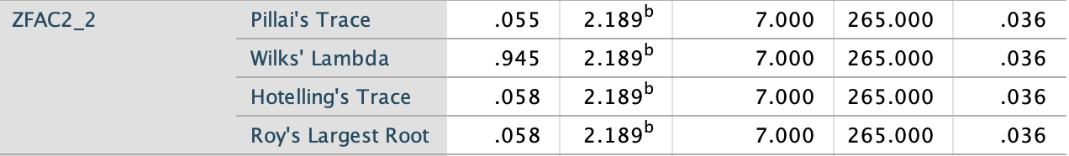
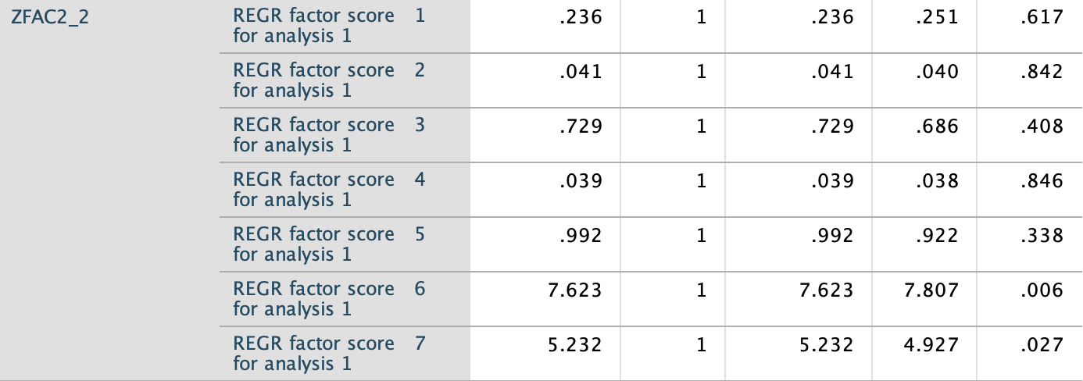

Slide 11
Noticed: age no longer significant
In this model, age no longer related to component 7 (thinking in images)
Potential mediation by EF

Slide 12
