Slide 1
Step 1: PCA on NYC-Q
Ran a PCA on the NYC-Q (n=643) to understand different components of thought that it measures
Ended up with 7 components

Slide 2
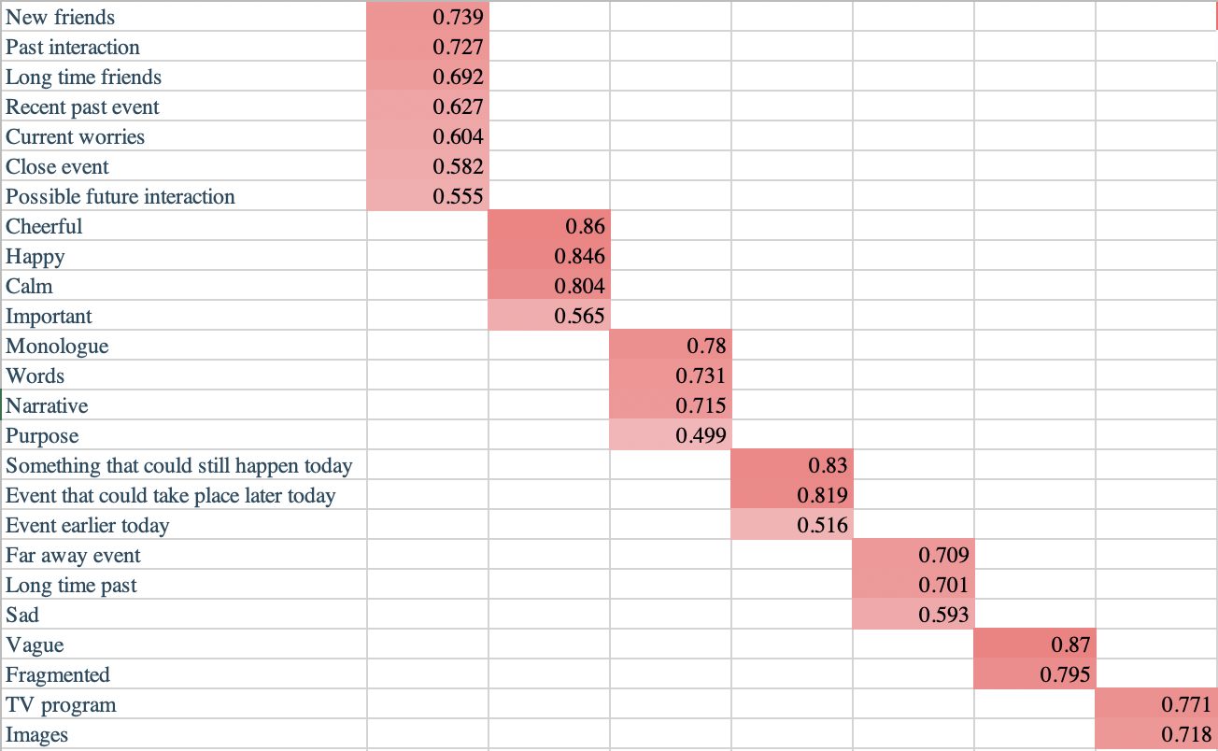

Slide 3
Step 2: t-tests between old and young adults
Ran independent t-tests to understand if the amount to which participants engaged these 7 components differed between old (n=135) and young (n=175) participants
Components 1, 4, and 7 were significantly greater in young adults
Social, episodic thoughts including current concerns
Thoughts about today (earlier and later)
Thoughts in images

Slide 4
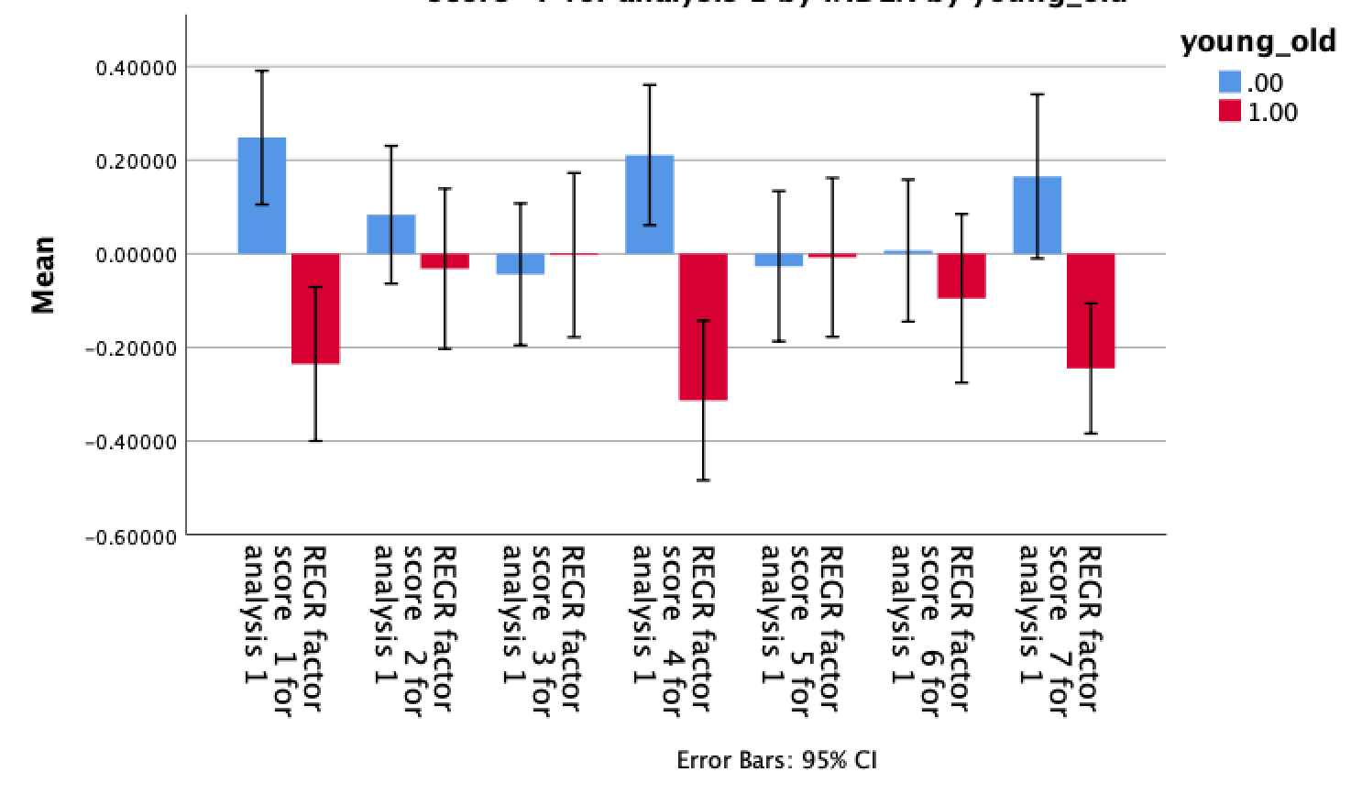
***
***
**

Slide 5
Step 3: created executive function scores
Used a-priori theory to create executive function, episodic memory, and social cognition scores
Created efficiency scores by summing z-scored accuracy and inverse reaction time for correct trials
Summed z-scores across tasks to form composite scores:
EF = conditional exclusion + continuous performance + letter-n-back + logical reasoning test
EM = word memory test + face memory test + visual object learning test
SC = emotion recognition + measured emotion differentiation

Slide 6
Step 4: t-test between old and young adults
Ran independent t-tests to understand if different aspects of executive functioning differed between old (n=112) and young (n=169) participants
All three significantly declined with age

Slide 7
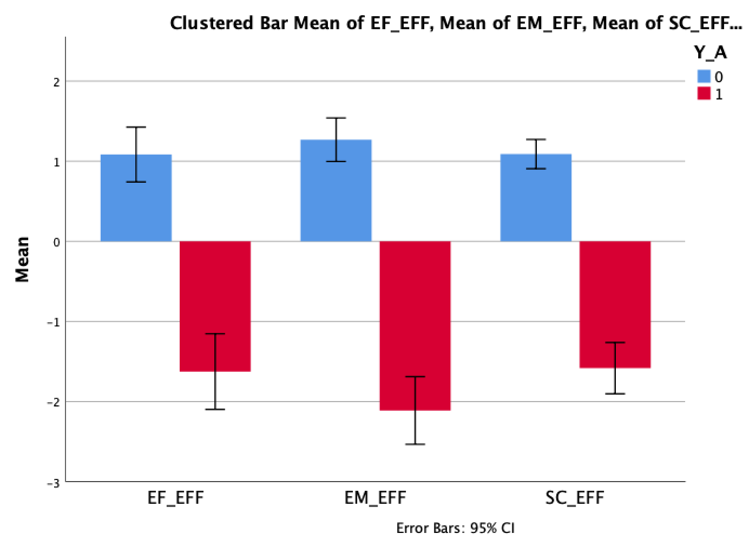
***
***
***

Slide 8
Step 5: multivariate analysis
Assessing the relationship between the 7 components of thought and the 3 measures of cognition (n=167 young adults, n=112 old adults)
Significant relationship between episodic memory and factor 7 (thinking in images)

Slide 9
Noticed: age no longer significant
In this model, age no longer related to component 7 (thinking in images)
Potential mediation by episodic memory

Slide 10
Step 6: formal mediation
Ran a formal mediation using PROCESS macro
Direct effect of age on thinking in images is non-significant
Indirect effect of age on thinking in images (via episodic memory) is significant
Evidence for complete mediation

Slide 11
