Slide 1
Step 1: PCA on NYC-Q
Ran a PCA on the NYC-Q (n=643) to understand different components of thought that it measures
Ended up with 7 components

Slide 2
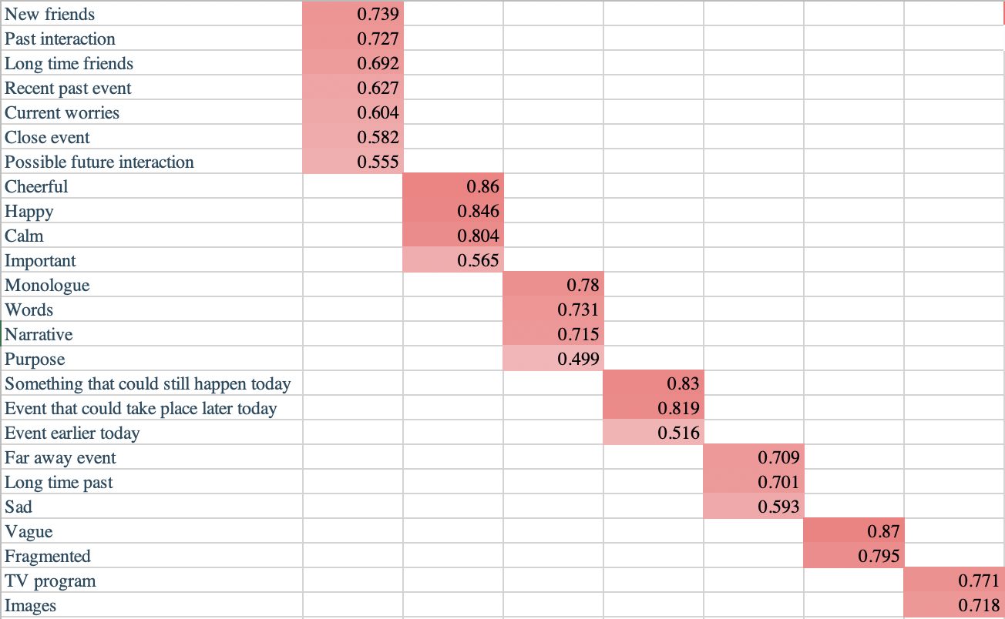

Slide 3
Step 2: t-tests between old and young adults
Ran independent t-tests to understand if the amount to which participants engaged these 7 components differed between old (n=135) and young (n=175) participants
Components 1, 4, and 7 were significantly greater in young adults
Social, episodic thoughts including current concerns
Thoughts about today (earlier and later)
Thoughts in images

Slide 4
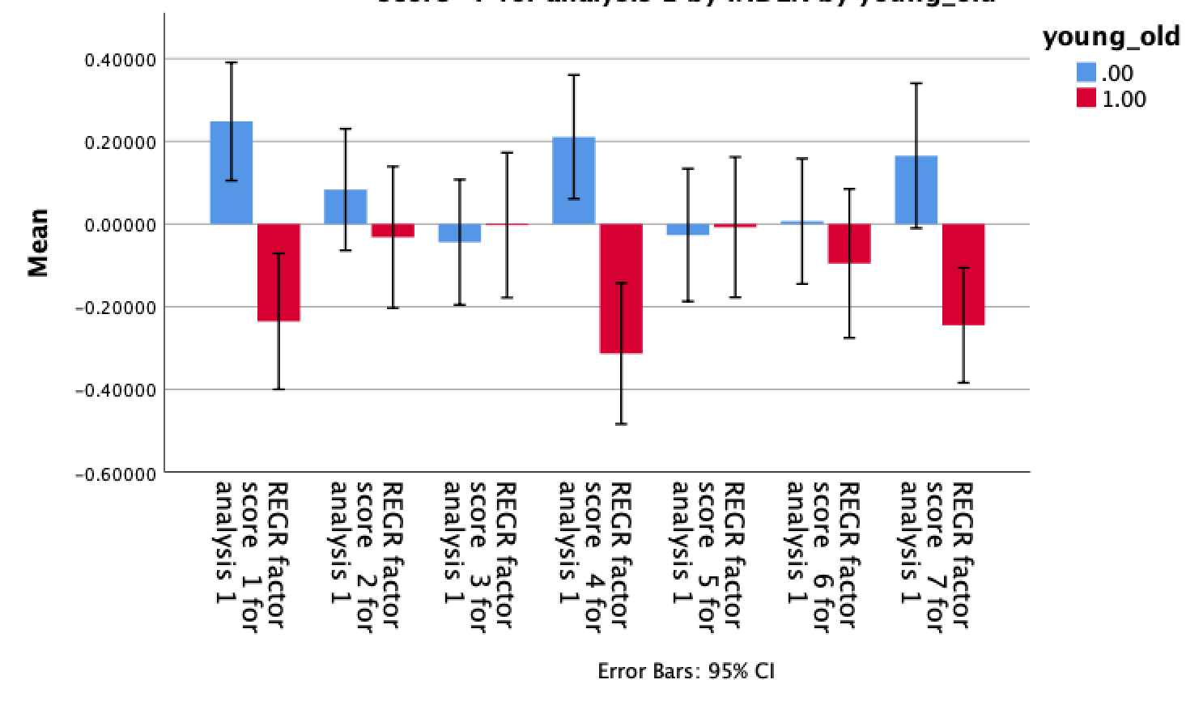
***
***
**

Slide 5
Step 3: PCA on executive functioning battery
Ran PCA on PENN-CPU executive functioning battery (n=742)
Ended up with 3 components

Slide 6
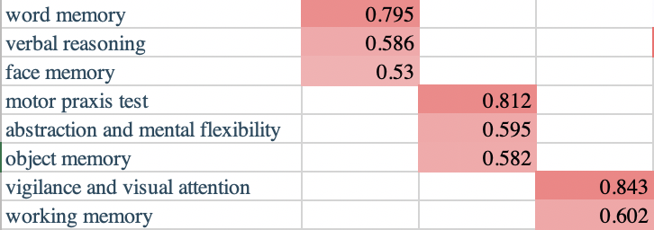

Slide 7
Step 4: t-test between old and young adults
Ran independent t-tests to understand if different aspects of executive functioning differed between old (n=152) and young (n=207) participants
Components 1 greater in old adults
Verbal abilities and face memory
(Not significant if including SES and gender)
Components 2 and 3 greater in young adults
Motor skills, mental flexibility, and object memory
Vigilance and working memory

Slide 8
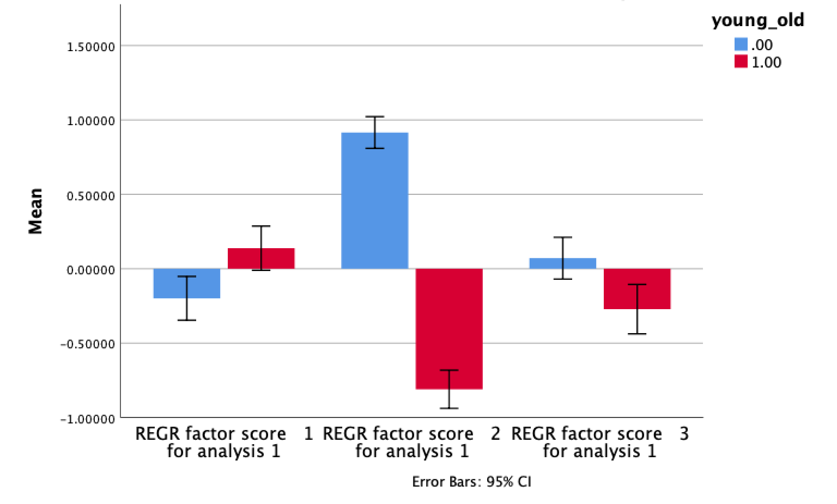
**
***
**

Slide 9
Step 5: multivariate analysis
Assessing the relationship between the 7 components of thought and the 3 measures of EF, as well as interactions with age (n=162 young adults, n=119 old adults)
Significant effect of component 2 of EF (motor skills, mental flexibility, and object memory)
Positive relationship to component 6 (disjointed and fragmented thinking) and component 7 (thinking in images)
Interaction with age for component 6 (driven by younger adults)

Slide 10
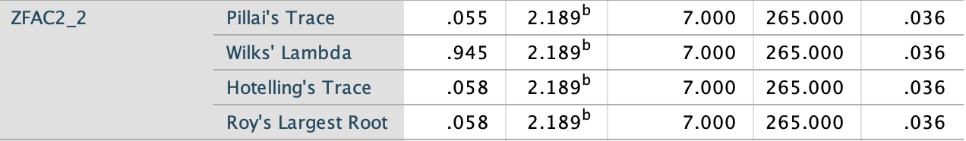
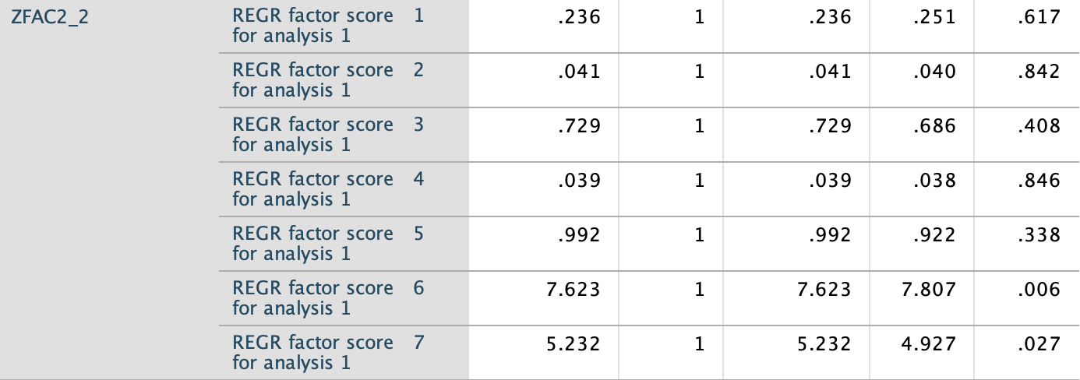

Slide 11
Noticed: age no longer significant
In this model, age no longer related to component 7 (thinking in images)
Potential mediation by EF

Slide 12
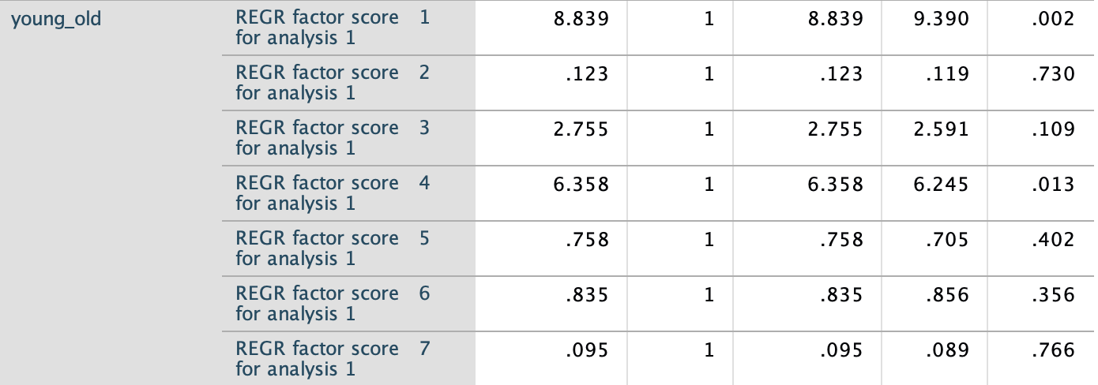

Slide 13
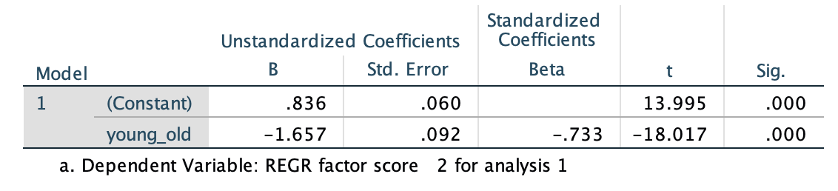
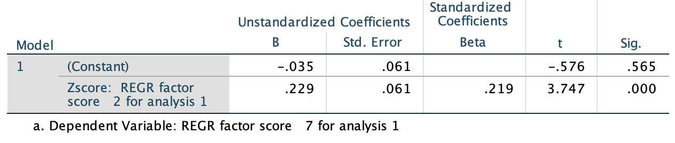
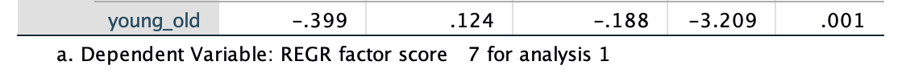
Step 6: mediation checks
Executive functioning (component 2)
Age
Thinking in images (component 7)

Slide 14
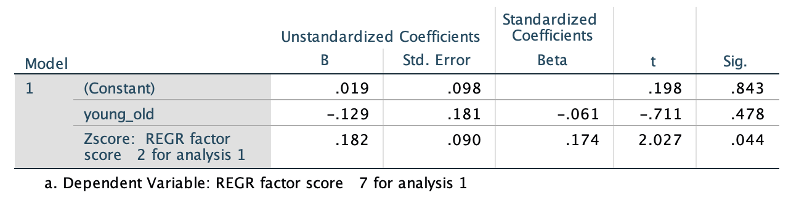
Step 6: mediation checks
Age predicts EF
EF predicts thinking in images
Age predicts thinking in pictures
Age no longer predicts thinking in pictures if EF is included in the model

Slide 15
Step 7: formal mediation
Ran a formal mediation using PROCESS macro
Direct effect of age on thinking in images is non-significant
Indirect effect of age on thinking in images (via EF) is significant
Evidence for complete mediation

Slide 16
