Slide 1
The Data Incubator: Finalist Interview
Adam Gifford, PhD
August 13, 2020

Slide 2
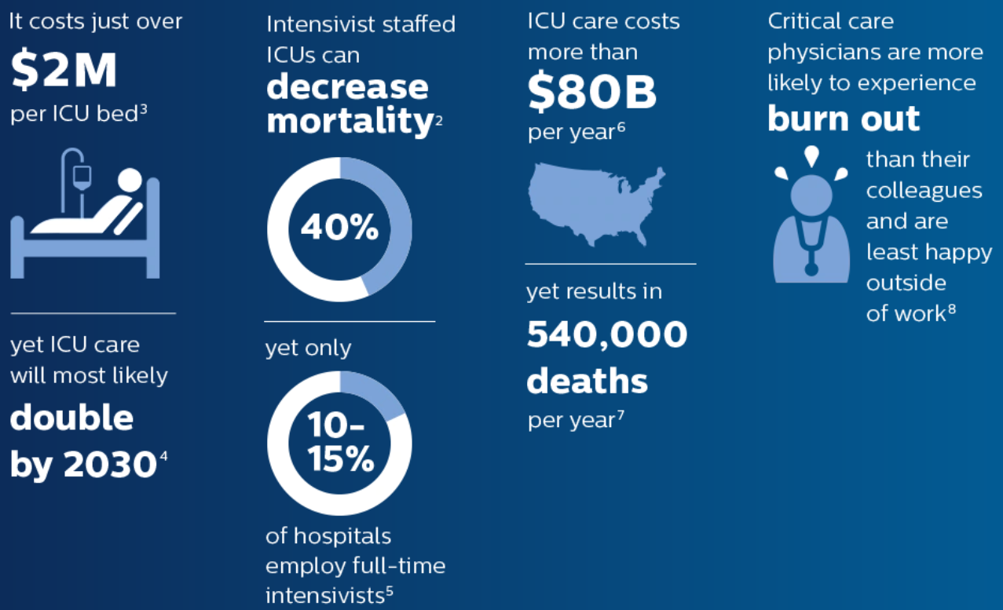
ICUs are expensive, and growing…
PROBLEM
https://www.usa.philips.com/healthcare/resources/landing/whatisteleicu

Slide 3
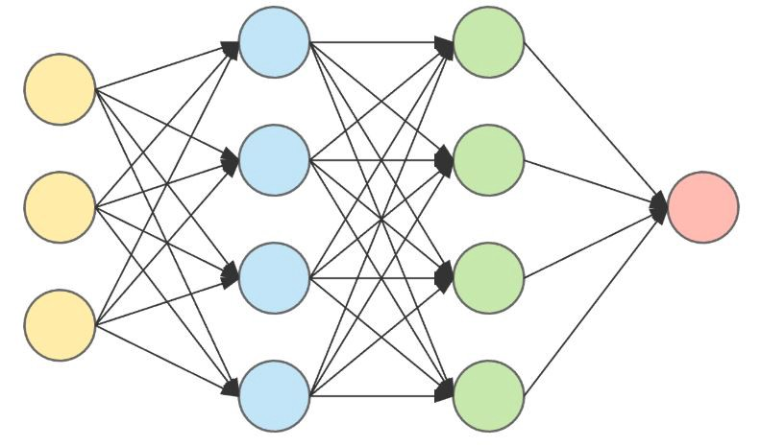
Can we predict which patients may need ICU care?
VALUE PROPOSITION
Demographics
Vitals
ICU risk factor
Clinical Notes
Image modified from: https://www.kdnuggets.com/2019/02/neural-networks-intuition.html

Slide 4
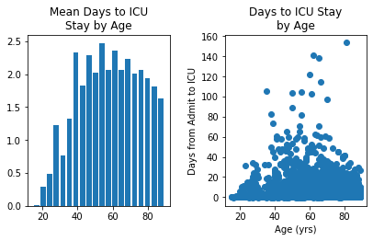
Age is a predictor of days to ICU stay
DATA EXPLORATION
Pearson’s r = 0.036 (p<0.00014)

Slide 5
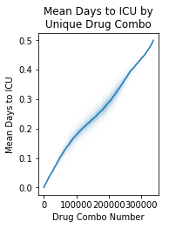
Certain drug types & drug combos co-occur with quick ICU transfers
DATA EXPLORATION
Top drug pairs:
Clobetasol Propionate Top & Dovonex 0.005% cream
Insulin Glargine & Clobetasol Propionate Top
Atorvastatin & Clobetasol Propionate Top
Warfarin 5 MG Oral Tablet & Hydrocortisone 1 % Topical
Skin conditions, blood clots, diabetes, and high blood pressure
Top individual drugs:
Famotidine
Pantoprazole Sodium
Heparin Sodium
Ceftaroline Fosamil
Sodium Chloride
Gastrointestinal distress, antibiotics, and minerals/electrolytes

Slide 6
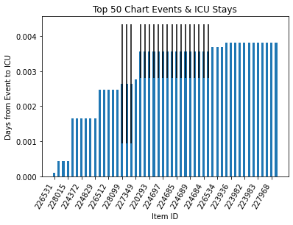
Chart events regarding vital signs most imminently precede ICU stays
DATA EXPLORATION
Top Chart Item ID Labels:
Admission Weight (lbs.)
Sputum (amount, source, color, consistency)
Blood pressure
Respiratory rate, inspiration
Whole blood ion measurements
Assessment of body extremities

Slide 7
Design an application to compute ICU risk factor
FUTURE GOALS
Complete exploratory analyses (~1-1.5 weeks)
Validate/confirm
Analyze clinical notes (NLP)
Settle on model design
Build and test model (~4 weeks)
Neural network
Formulate model into an application (~1-2 weeks)
Heroku

Slide 8
Thank You!
Questions?

